Slide 1
Tab Completion
Mark Vismonte and Timothy Wang
CS 111
Design Problem – Lab 1

Slide 2
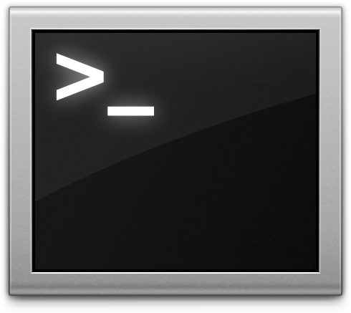
High-Level Specification
Opening the shell creates list of programs specified in $PATH (including “cd”, “exit”)
Uses GNU readline library
When “tab” is pressed, list of programs starting with entered characters is shown
Also works to complete folders and files

Slide 3
The GNU readline library
char *readline(char *prompt);
This is the main function of the library
Prints out the prompt and allows user to use emacs style editing when entering commands
We can easily override existing function pointers so that we can return our own results

Slide 4
Programs in $PATH
Parse the $PATH var
Ex:
/usr/sbin:/usr/bin:/sbin:/bin
Directories are delimited by ‘:’
Use DIR *opendir() and struct dirent *readdir()
Get filename: item->d_name
Add each file name to our data structure

Slide 5
Design Issues
We get all these commands, but how do we store them?
Options:
Dynamic Array
Linked List
Binary Search Tree
We decided to implement a Binary Search Tree
Why?
Save time (big O)
Struct would have one extra pointer over linked list
Arrays would be hard to add and order
<3 Recursion
Finding all matching commands would be straight forward

Slide 6
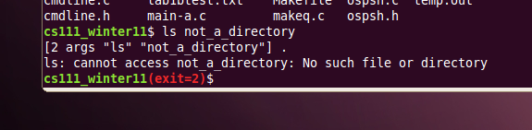
Fun Other Stuff
HISTORY – arrow keys
Color your terminal!
Exit Status

