Slide 1

Exploratory Eye Gaze Analysis (EDA)
^{Name: Maribel Viveros}
^{Department: Cognitive Sciences}

Slide 2
Content
Introduction
Methods
Dataset Overview
Results
Discussion
Observations and Future Directions
Notes:
Pause at intro for brief introduction. Im Maribel Viveros, im a second year phd student in cogs science, Im in interested in how individual differences, manifest themselves in perception. Specifically what to oculomotor behaviors tell us about differences in how we perceive a visual scene, or task, my specific interest are in math problem solvers, but in general across domains . I study differences in eye-movements, and how individual perceive different tasks. For todays presentation, ill be discussing the dataset that used eye-movements to investigate if they can be used to recognize desktop activities students were engaged in, a bit more later.but first what is eye-traking, how it works what it can and can’t do.

Slide 3
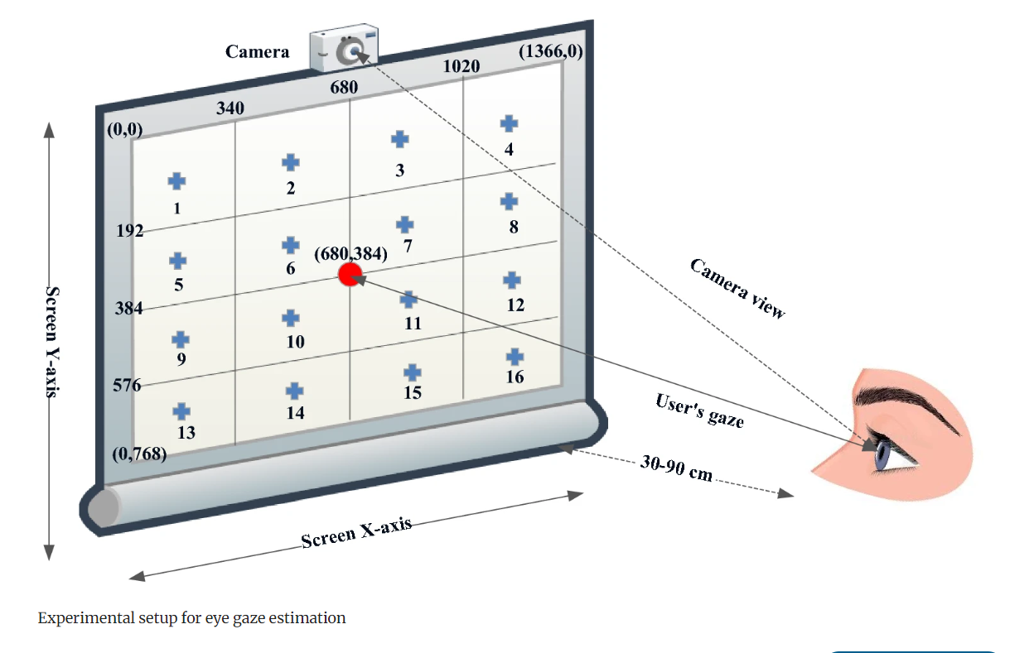
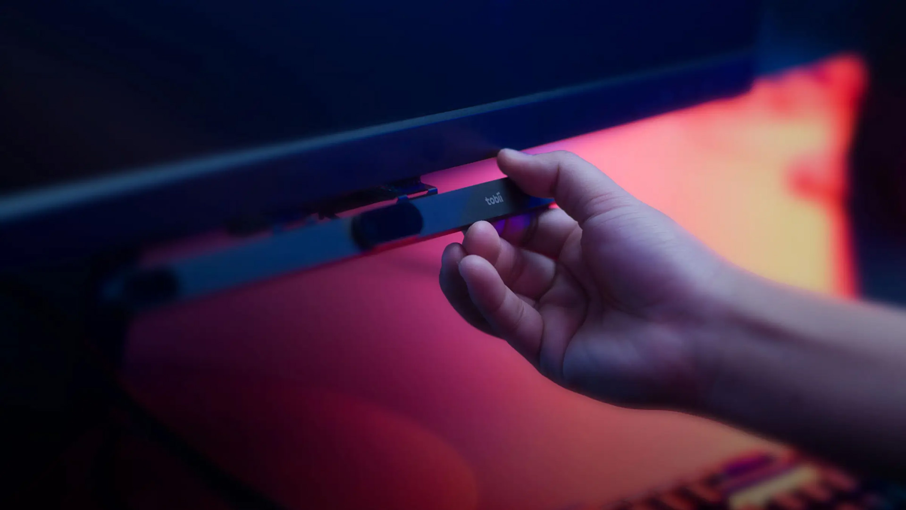
Introduction-Eye-Tracking
What it collects?
X, Y, and Timestamp data.
What it Does?
Sampling rates: 60hz-1000hz
What it Does Not Do?
Modi, N., Singh, J. Real-time camera-based eye gaze tracking using convolutional neural network: a case study on social media website. Virtual Reality 26, 1489–1506 (2022). https://doi.org/10.1007/s10055-022-00642-6
Notes:
What it does? Eye –mind hypothesis people are processing where they are looking at. if we say the eye tracker has a sampling rate of 60 Hz, it means the camera is taking 60 pictures of your eyes every second. Where you look is where your attention is. Where your visual cortex is and how perception occurs, come from different places in the brain, so that you can see where you look, but we don’t know why you look there. And so eye-trackers are useful because It can tell you where people look….just not why people look there,

Slide 4


Introduction-Study
What’s the study?
Dataset
Notes:
Exploration of an existing gaze dataset. What did they do? Their study aimed to identify sedentary activities using eye movements, showcasing the potential of eye tracking for activity recognition. The dataset, comprising 24 participants engaged in eight distinct desktop activities, serves as the foundation for our analysis.

Slide 5
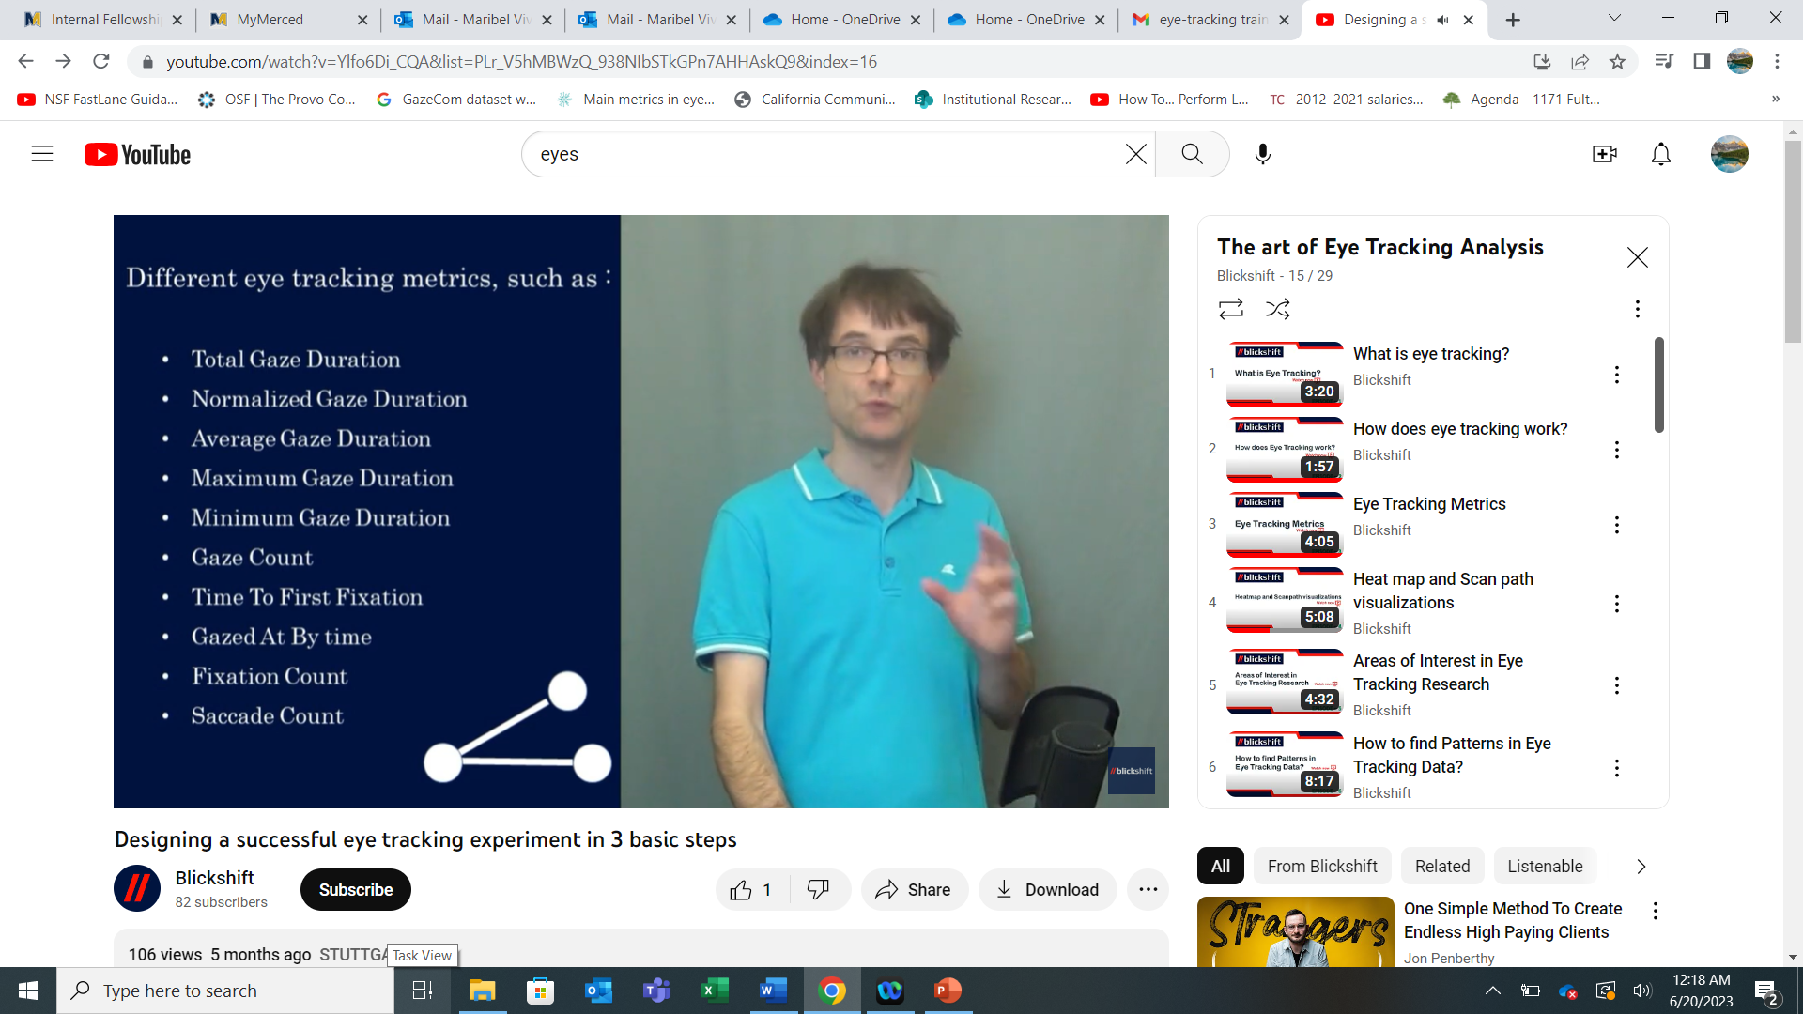
Introduction-Gaze features
What kinds of Eye Measures?
What is Time to First Fixation?
Notes:
First time to fixation tells us what people attend to first. So is that an appropriate measure to distinguish differences?

Slide 6
Methods
Eye data collected from students performing various desktop activities, made available on Kaggle. Dataset provides spatial coordinates, timestamps, and activity identifiers.
192 individual files.
Deduce the nature of a user's activity by examining gaze patterns.
Examine first time to fixation. Which eye-metrics can tell us about the activity?
Notes:
The original objective of introducing "mid-level gaze features" by Srivastava et al. (2018) provides a unique perspective, bridging the gap between low- and high-level gaze features for improved desktop activity classification. Eight distinct desktop activities: Read, Browse, Play, Search, Watch, Write, Debug, and Interpret. . The dataset comprises 24 participants, 3 trials, and 8 activities, with over 1.5 million rows of information. Impressively, our dataset is 100% complete, offering a robust foundation for our analysis. low- and high-level gaze features, known as "mid-level gaze features." These mid-level gaze features don't necessitate a understanding of interface design but are based on intuitive knowledge about the types of eye movements associated with different activities. Intuitively, anyone can deduce the nature of a user's activity by examining gaze patterns

Slide 7
Methods-Research Question
Can we identify which activities require more prolonged or shorter periods of visual engagement? Do all participants stare in relatively the same positions across the activities?
Mean duration of the first time to fixation for each activity unveils patterns in the time participants spend on specific activities. X and Y coordinates tell us if individual participants display patterns of location.
Notes:
he easy solution is to estimate location by plotting the x, or y coordinates since eye-movements are symmetrical, for each participant across the average first fixation time stamp for each activity.Only the row with the minimum timestamp (i.e., the first fixation) is provided below by each activity. The preliminary results show, the first fixation across desktop actiivites is different but most participants look in the same area dependent on the activity. The plot below summarizes data related to participants’ activities, then creates a boxplot, showing the distribution of the first x-coordinate across activities for each participant and the average duration of the first fixation. The plot is faceted by activity for better comparison.

Slide 8
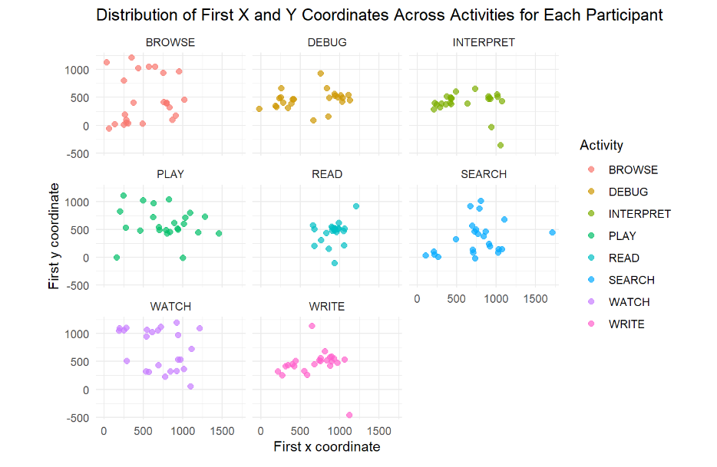
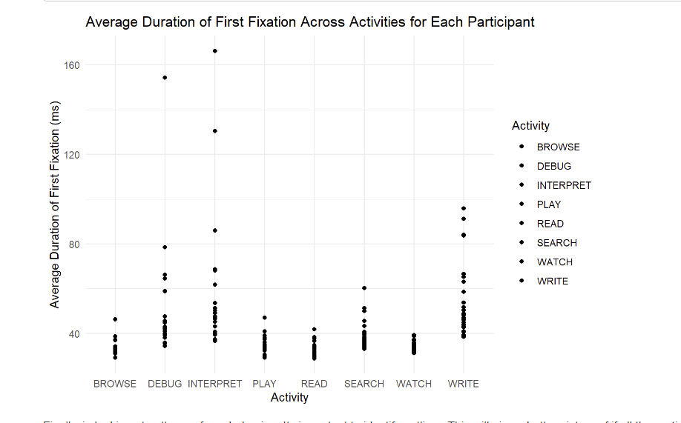
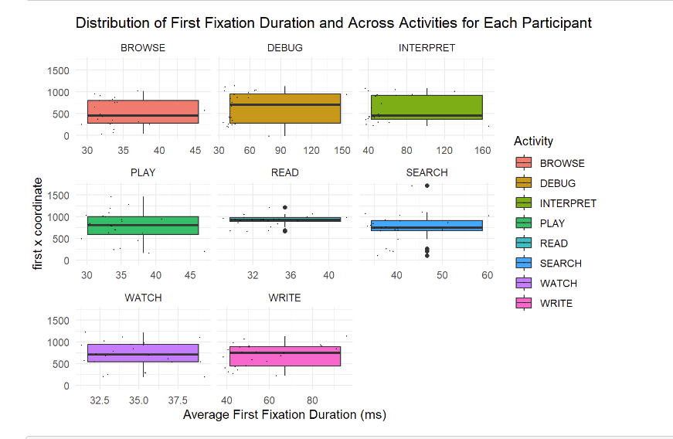
Results
Notes:
The initial plot depicts variability in participants' average time spent observing stimuli during different activities, while subsequent plots delve deeper into first fixation duration across activities and participants.

Slide 9
Discussion
Visual representation illuminates distinct variations in gaze patterns across different activities.
Answers question but also provides valuable insights into participants' cognitive processes and task engagement strategies.
Notes:
Engagement strategies are given by duration of first fixation.

Slide 10
Observations and Future Directions
Individual differences in first fixation locations and durations were observed, hinting at the need for more nuanced investigations in future research. The focus should extend beyond averages, as outliers in our box plot suggest individual variations that warrant deeper exploration.
The findings have implications for future research, emphasizing the importance of understanding individual differences in eye patterns.
Notes:
The use of Exploratory Eye Gaze Analysis sheds light on the intricate relationship between eye movements and desktop activities. Our findings have implications for future research, emphasizing the importance of understanding individual differences in eye patterns.

Slide 11
Citations
Holmqvist, K., Nyström, M., Andersson, R., Dewhurst, R., Halszka, J., & van de Weijer, J. (2011). Eye Tracking : A Comprehensive Guide to Methods and Measures. Oxford University Press. http://ukcatalogue.oup.com/product/9780199697083.do
Modi, N., Singh, J. Real-time camera-based eye gaze tracking using convolutional neural network: a case study on social media website. Virtual Reality 26, 1489–1506 (2022). https://doi.org/10.1007/s10055-022-00642-6
Srivastava, N., Newn, J., & Velloso, E. (2018). Combining Low and Mid-Level Gaze Features for Desktop Activity Recognition. Proceedings of the ACM on Interactive, Mobile, Wearable and Ubiquitous Technologies, 2(4), 189.

