Slide 2
LeCun98
Red Neuronal Convolucional
LeNets

Slide 3
Krizhevsky2012.pdf
Dropout
Slicing with overlap

Slide 4
Lin2014.pdf
NIN
Perceptron Layers instead of fixed filters or kernels and average pooling

Slide 5
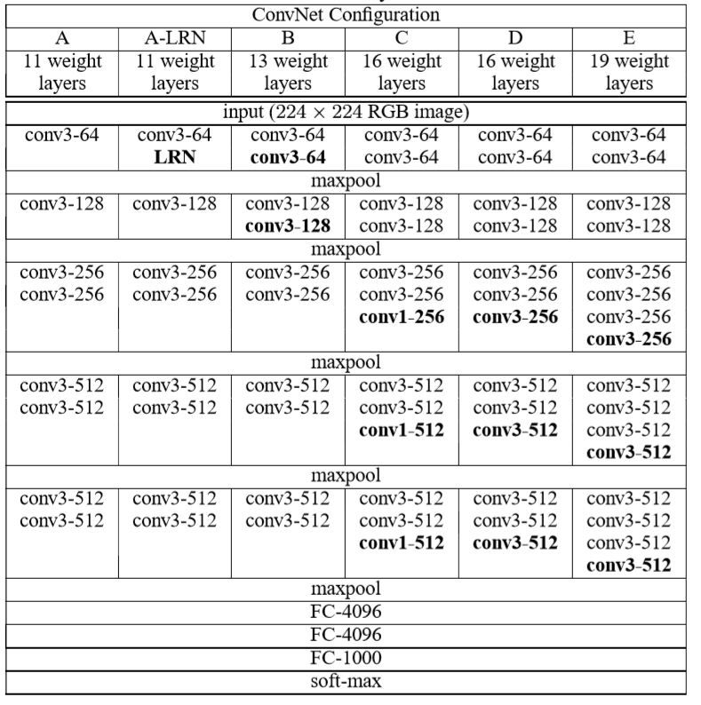
Simonyan2014
Working with Deep and small kernels 3x3

Slide 6
He2015
Residual Lerning creating activation functions that depends on the previous layer and the layer before it, Improves the learning using more layers > 30 Layers

Slide 7
Szagedy2015
GoogLeNet
Inception Network
22 Layers
Kind of Network in Network with convolutions.

Slide 8
Fromm2020
Automated Detection of Conifer Seedlings in Drone Imagery Using Convolutional Neural Networks
Drone flying 5 m above
512x512 image for every tile
100x100 bounding box for seeding
Annotation: Tool LabelImg, 200 bounding boxes(bb) manual, trained object detection model to automatically create another bounding boxes and then fine tunning the bb, result 3940 bb on 9415 tiles.
Object Detection: faster RCNNm R-FCN and SSD
Pre-Trainig with MS-COCO for transfer learning in the lower layers
Data Augmentation:Rotation, flips and cropping
RGB data

Slide 9
Karel2020
Very High Density Point Clouds from UAV Laser Scanning for Automatic Tree Stem Detection and Direct Diameter Measurement
LiDAR data
Circle fitting fit cross sections along the stems: Hough transform, random sample consensus, RANSAC, robust least trimmed squares RLTS

Slide 10
Lin2020
A New Individual Tree Crown Delineation Method for High Resolution Multispectral Imagery
Method of delineation using mathematical morphological method to obtain a morphological gradient also using spectral angle mapper (SAM), identify treetops from 3 scales, sementing gradient image using a marker-controlled watershed.
Segmentation and delineation called SMS

