Slide 1
STAT-528
Covid-19 Data Analysis
Group 3:
Vishnu Kalyan Mylavarapu
Akhil Kusa
Hui-Yee Tan
Vishweshwari Joshi

Slide 2
What is our data?
We have used multiple datasets to gather information(links are available in references) about covid-19. We cleaned and analyzed these datasets and found some interesting insights in them

Slide 3
Key-question we wanted to answer
Q. How is prevalence of malaria impacting Covid-19 results?
Many of the people researching on Hydroxychloroquine have expressed that a previous parasitic viral infection(mainly malaria) can reduce symptoms of Covid-19. A similar research has been proven to work with the deadly SARS virus(which belongs to COVID-19 family) and chloroquine a stronger drug used to treat parasitic viruses.(These drugs also treat symptoms related to other auto-immune diseases).
https://www.ispsw.com/wp-content/uploads/2020/08/711_Lin.pdf
(Reference for the above statements)

Slide 4
Other Questions
Q1 Which state should first get the vaccine to minimize deaths?
Q2 What is the impact of handwash on COVID-19?
Q3 What is the impact of Government stringency on spread of COVID?
Q4 Which countries have higher death rates and why?
Q5 Does population density have an impact on COVID-19?
Q6 What is the impact of smoking on COVID-19 cases?
Q7 What is the impact of diabetes on COVID-19 cases?

Slide 5
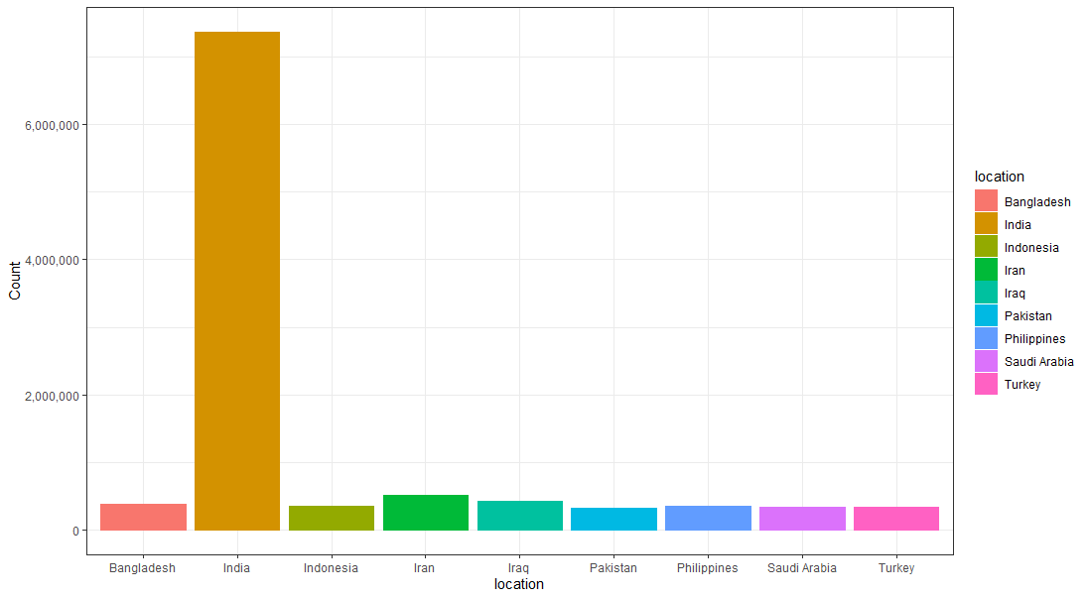
Asia top 9

Slide 6
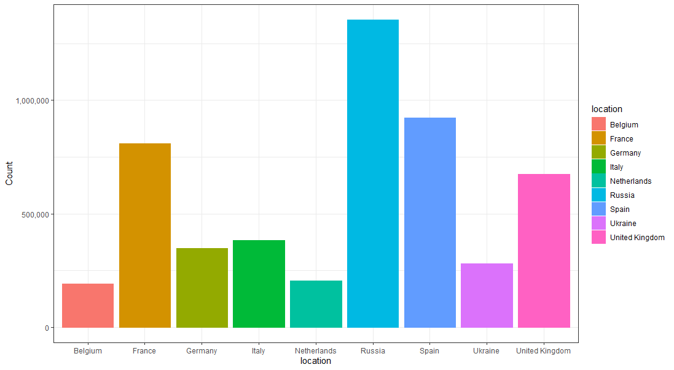
Europe Top 9

Slide 7
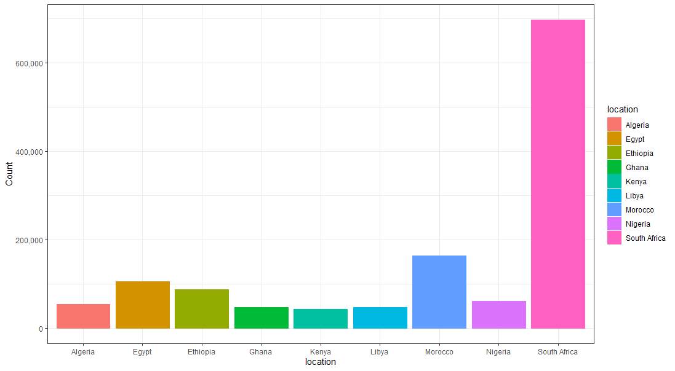
Africa Top 9

Slide 8
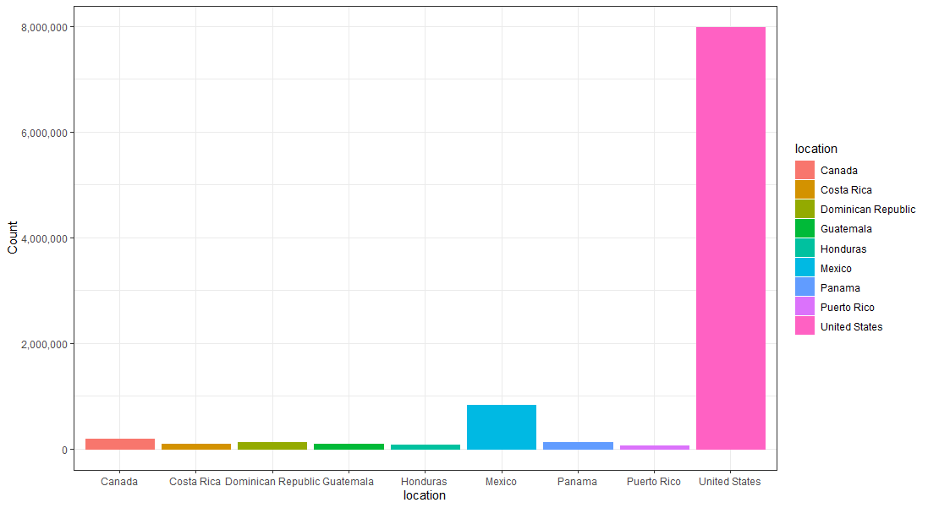
North America Top 9

Slide 9
Which country do you think was worst affected?
USA
India
Italy
UK
Germany

Slide 10
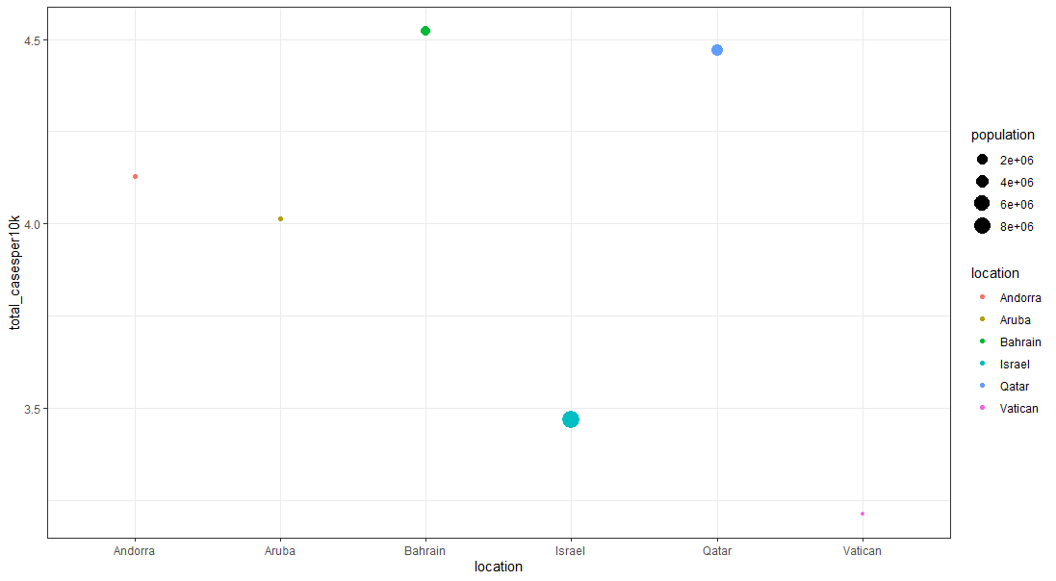
Well… None of them. The top 6 are:

Slide 11
But we know many countries don’t test as well as developed countries do. In order to solve this we created a formula: Comparable=total_cases/(population*total_tests)

Slide 12
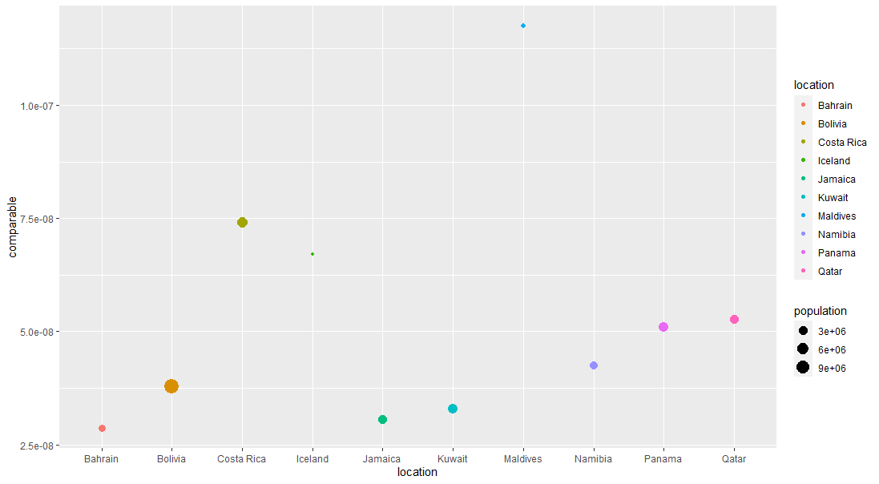
So the top 10 will be…..

Slide 13
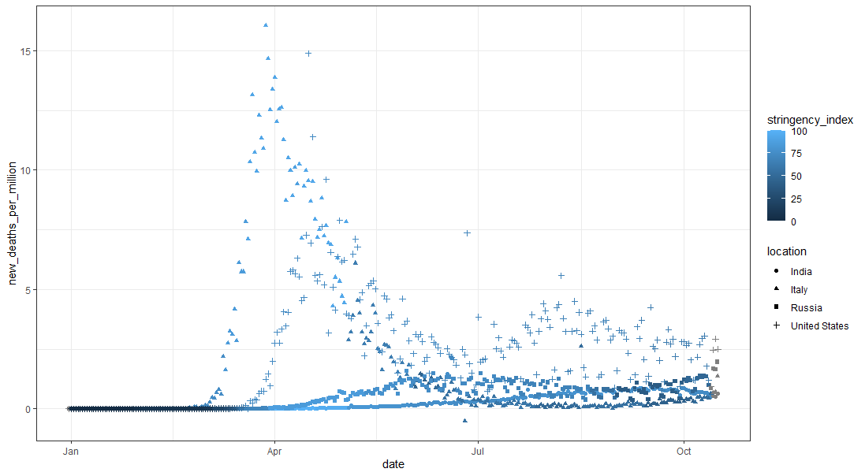
Stringency and it’s impact
We observe that as stringency increases the number of cases will fall in the future

Slide 14
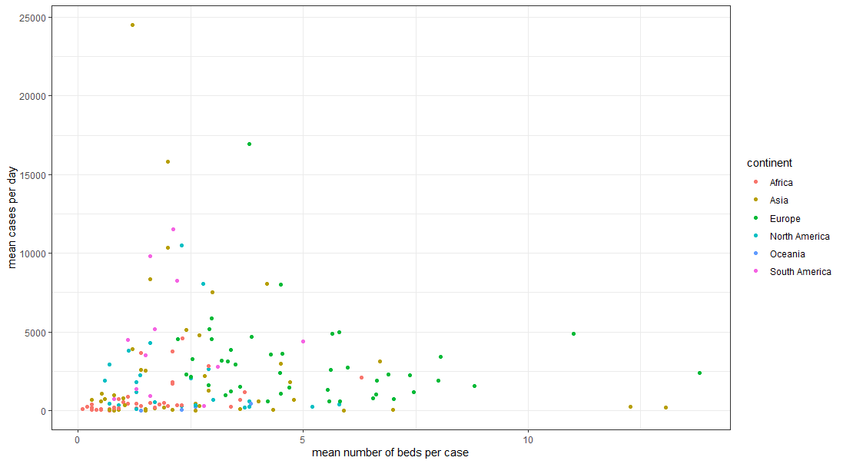
Will number of beds affect cases?
Apparently, they don’t. Observe cases are higher when beds are higher

Slide 15
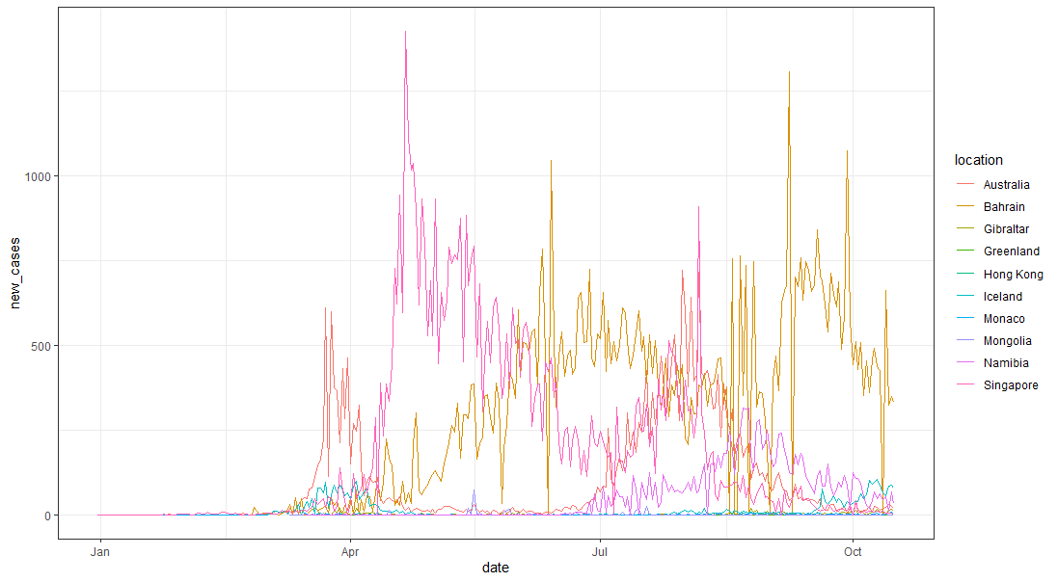
Does population density affect spread?
Simply put yes it does. But when a country is rich, we have a fall in cases rapidly

Slide 16
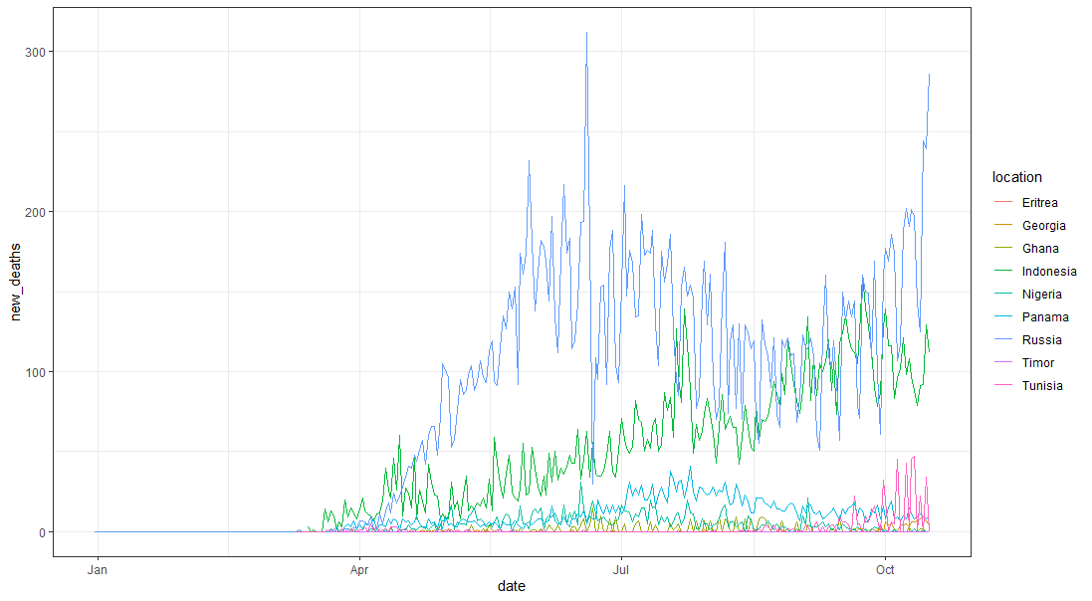
Does smoking impact Covid-19
Yes, we can observe a direct correlation between number of smokers to increase in deaths due to COVID-19.

Slide 17
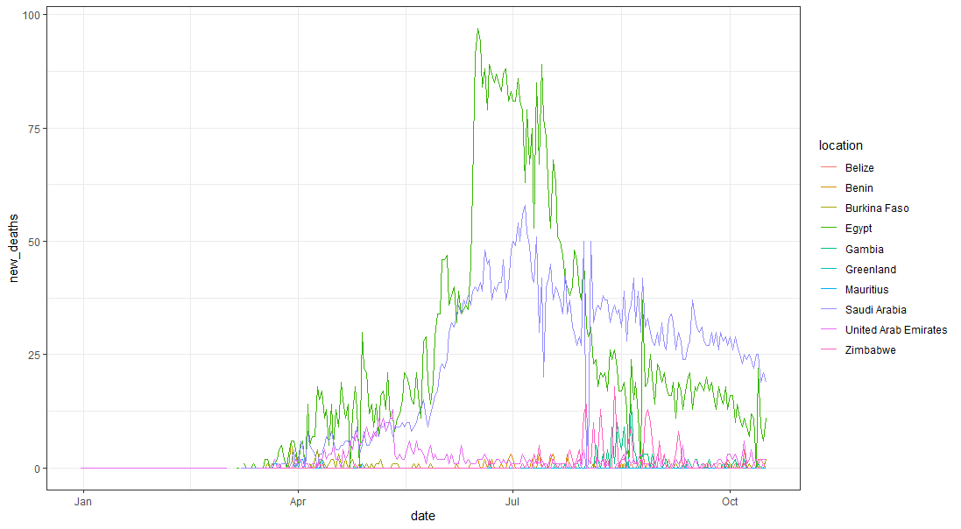
Does diabetes kill COVID patients ?
Yes, diabetes can be as fatal as smoking in case of COVID patients.

Slide 18
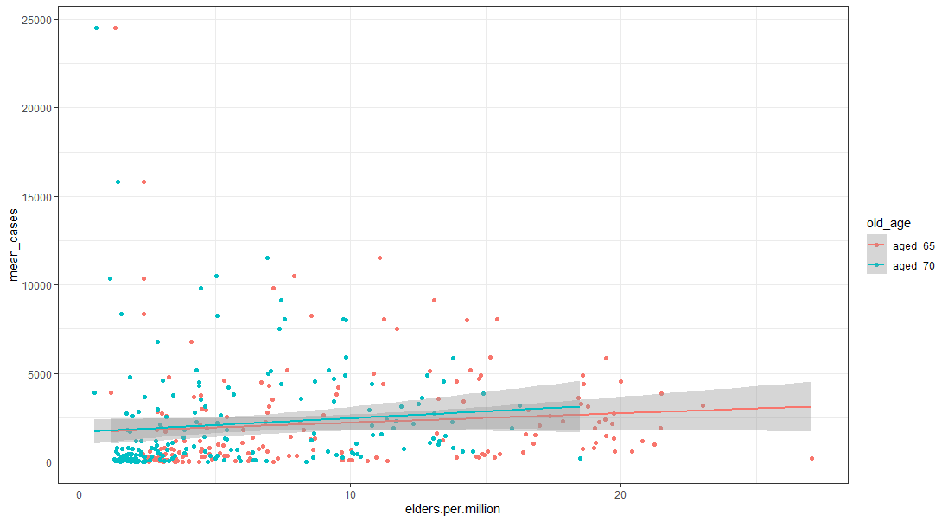
Impact of age on the cases
Though we cannot be certain it is generally believed that older the people are more is the probability of COVID reporting

Slide 19
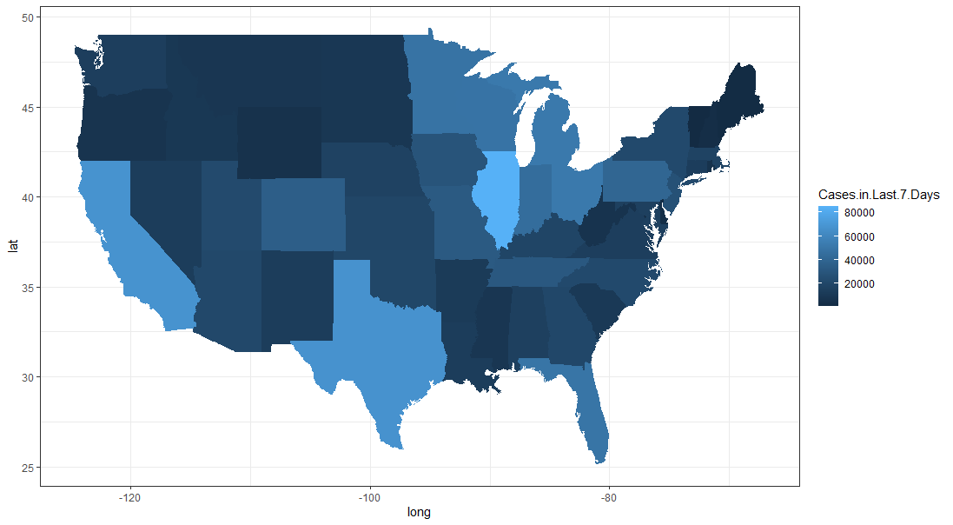
Current state wise cases in USA
Worst 3 are California, Texas and Illinois

Slide 20
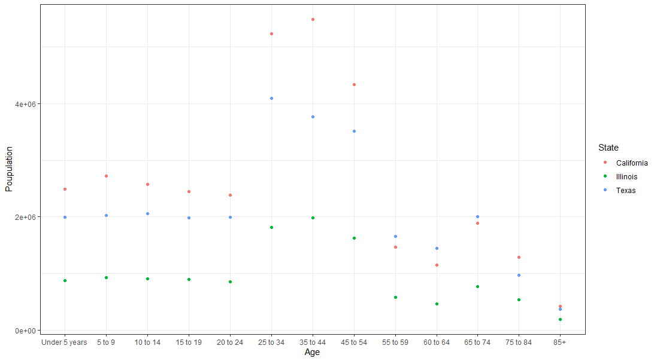
In order to understand which state has to get the maximum vials of vaccine….
We compared the states with maximum virus in terms of age wise population. The order should be:
California
Texas
Illinois

Slide 21
Now finally the important Question
Does malaria prevalence decrease COVID-19 deaths?

Slide 22

Before we understand that we need to know some basics

Slide 23
Countries with highest malaria prevalence: 1. Nigeria 2. Democratic Republic of Congo 3. Uganda 4. Ivory coast 5. Mozambique 6. Niger

Slide 24
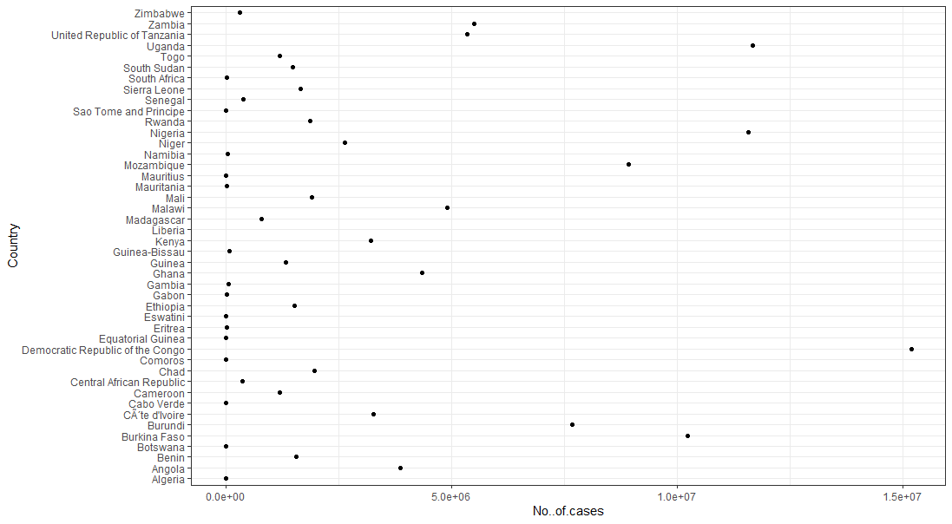
Malaria cases in Africa

Slide 25
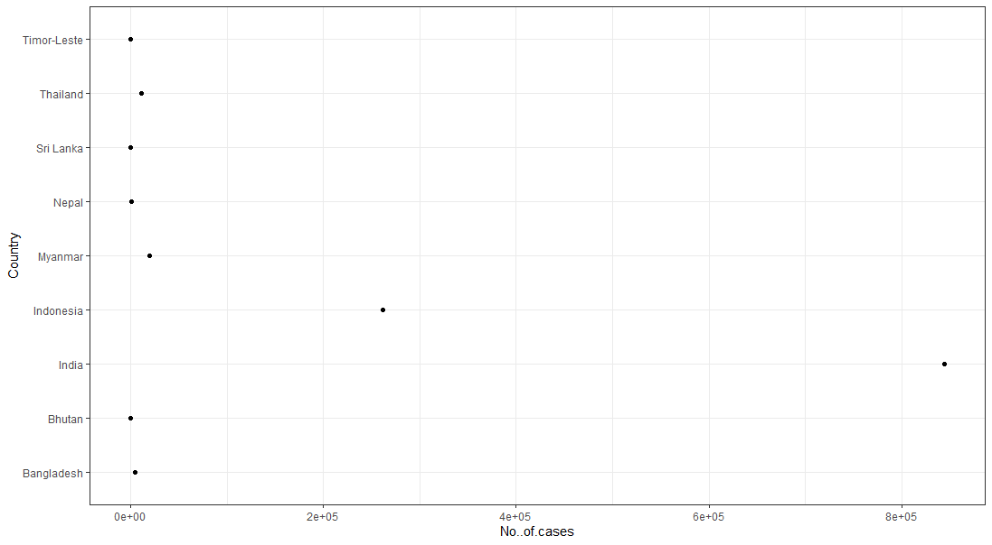
Malaria cases in South east Asia

Slide 26
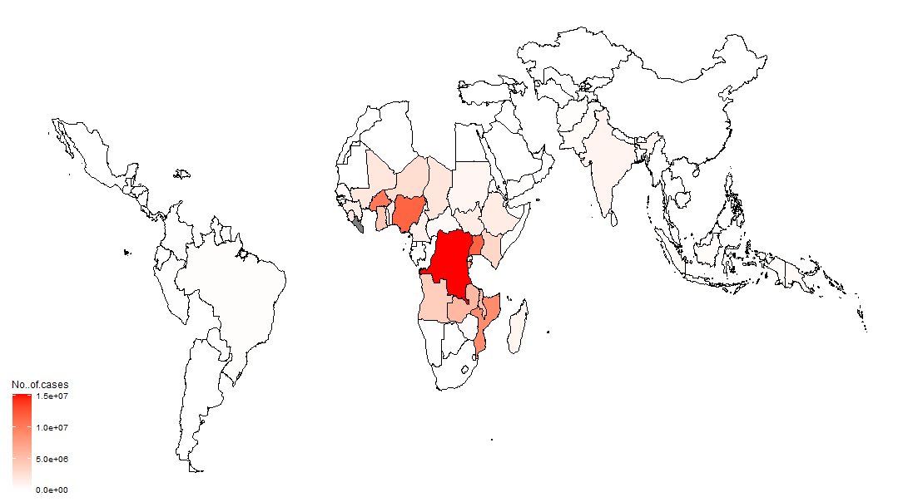
Malaria world map

Slide 27
Countries with lowest malaria prevalence: 1. US 2. Italy 3. United Kingdom 4. Germany 5. France 6. Norway

Slide 28
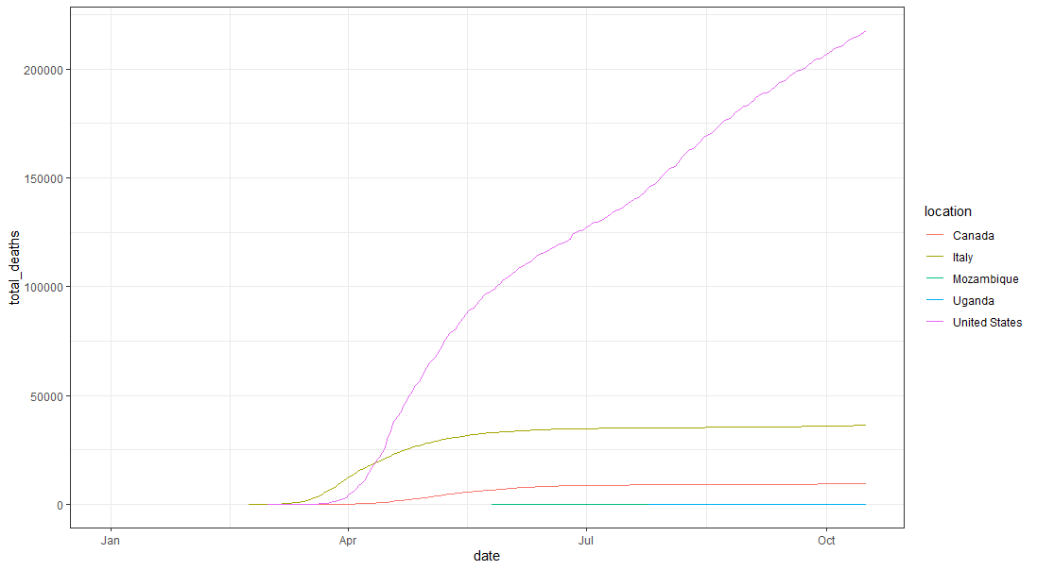
First, we tried plotting a relation between top and bottom countries

Slide 29
But the testing is too low and data from Africa is not reliable at all in terms of numbers, so we came up with a new approach.

Slide 30
We used the data of India’s malaria cases and found two regions with high malaria cases and two with low malaria cases. The states are otherwise comparable in terms of revenue, GDP, population, population density etc.

Slide 31
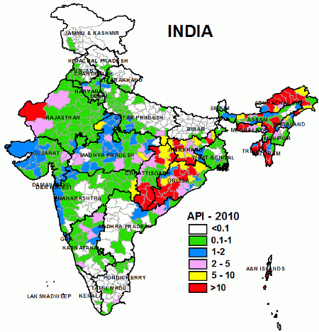
India Malaria cases
High risk areas
Low risk areas

Slide 32
The 4 states are: 1. Andhra Pradesh(low prevalence) 2. Jharkhand(High prevalence)~Andhra Pradesh 3. Odisha(High prevalence) 4. Tamil Nadu(low prevalence)~Odisha

Slide 33
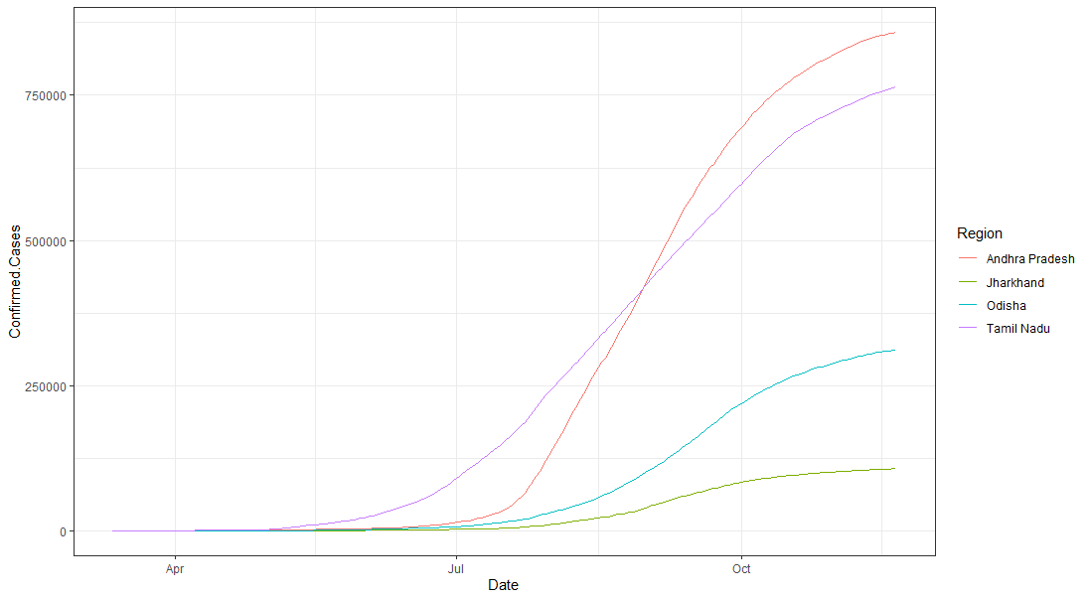
The plot is as follows…
We observe that a high use of HCQ may in fact be decreasing the severity of the COVID-19 virus.

Slide 34
References:
India COVID-19 dataset: https://prsindia.org/covid-19
India malaria dataset: https://www.malariasite.com/malaria-india/
USA dataset for live covid data: https://covid.cdc.gov/covid-data-tracker/#cases_casesper100klast7days
World malaria dataset: https://www.kaggle.com/imdevskp/malaria-dataset
Main dataset for Covid: https://github.com/owid/covid-19-data/blob/master/public/data/owid-covid-data.csv
All the age wise census data for US: https://www.census.gov/quickfacts/

