Slide 1

Cincinnati crime data analysis
MIS 536
Group 3
M. Vishnu Kalyan, Mriga Kher, Abhishek Gurram, Debojyoti Debnath

Slide 2
Agenda
Problem
Midterm Recap
Exploratory Analysis
Final Timeline
Feature Selection
Feature Engineering I
Feature Engineering II
Predictive Analytics
Results
References

Slide 3
Problem Overview
Idea
The core idea of our product is to utilize the PDI crime data to identify trends and patterns in crimes based on zip codes, analyze areas where offenses take place
End Deliverable
Significant insights into the given data the number of crime incidents that will occur in each zip code, given the day of the week, and the time of day, reported areas, location codes
​Will be utilized by 911 officials to make decisions for force dispatching in the reported areas

Slide 4
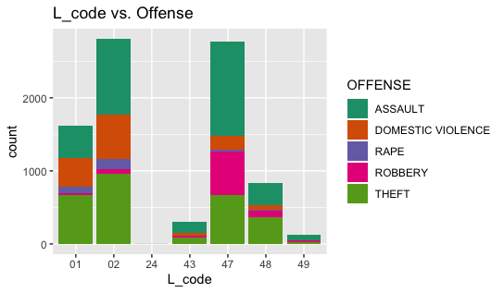
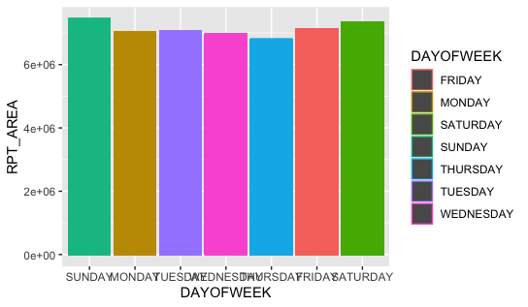
Midterm Recap

Slide 5
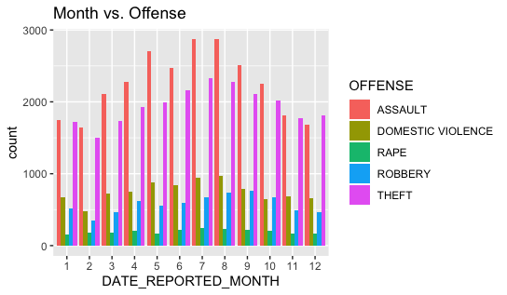
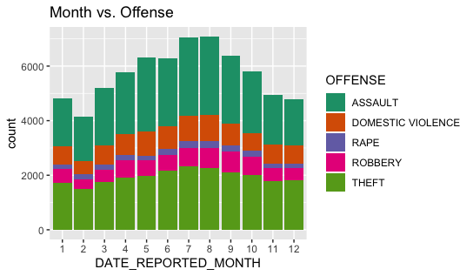
Midterm Recap

Slide 6
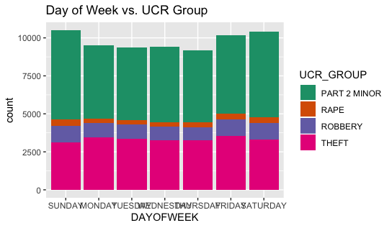
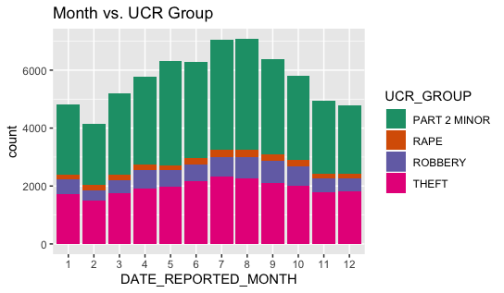
Midterm Recap

Slide 7
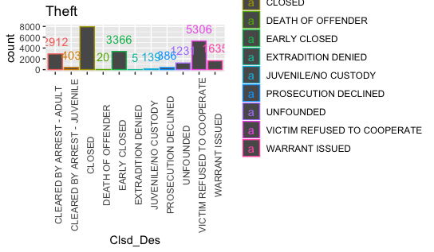
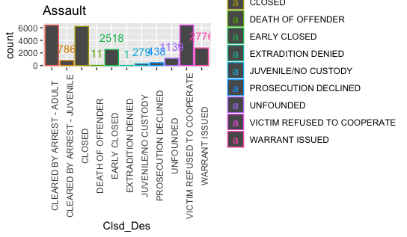
Midterm Recap

Slide 8
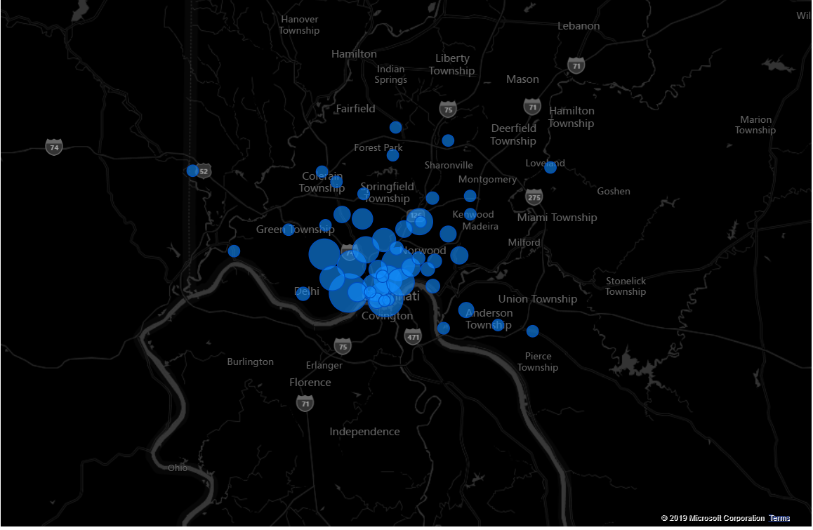
Midterm Recap

Slide 9
Final Timeline
Week 1 - 2
Data acquisition and basic understanding of data
Sample creation
Week 3 - 4
Preprocessing data and basic cleaning of data
Week 4 - 5
Plotting the basic correlation plots and eliminating variables that have a high correlation
Week 6 - 7
Exploratory Analysis
Week 8 - 9
Feature Selection
Feature Engineering
Week 10 - 11
Rendering Code

Slide 10
Updated Feature Selection
Offense
Assault: 26955
Theft: 23349
Aggregated Robbery:15350
Criminal Damage: 14342
Domestic violence: 9012
Lcode
Length: 145021
Reported Areas
427: 2405
416: 2265
310: 2176
308: 1711
271: 1444
223: 1412

Slide 11
Feature Engineering I
For getting the desired model, we have categorized offenses into 2 categories: High Crime, Low Crime
We have used all other attributes to predict whether a high-end dispatch is required for given 911 call

Slide 12
Feature Engineering I
We have used decision trees & logistic regression models to predict the desired output
For the implementation of the models, we created dummy variables from the attributes Lcode, Rpt Area
We have used the date attribute to figure out the months, hour of the day, days of the week and how they impact whether a crime is a high crime or not

Slide 13
Feature Engineering II
After analyzing the data, we built a classification tree & we found the following confusion matrix generated by the model

Slide 14
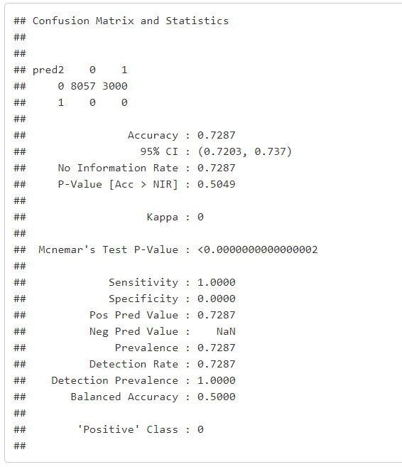
Confusion Matrix

Slide 15
Feature Engineering II
We observed that the data was skewed towards 0 as output
To rectify this error, we oversampled the given dataset and built another classification tree (though there was a decrease in accuracy, we observe a significant increase in the sensitivity of the model

Slide 16
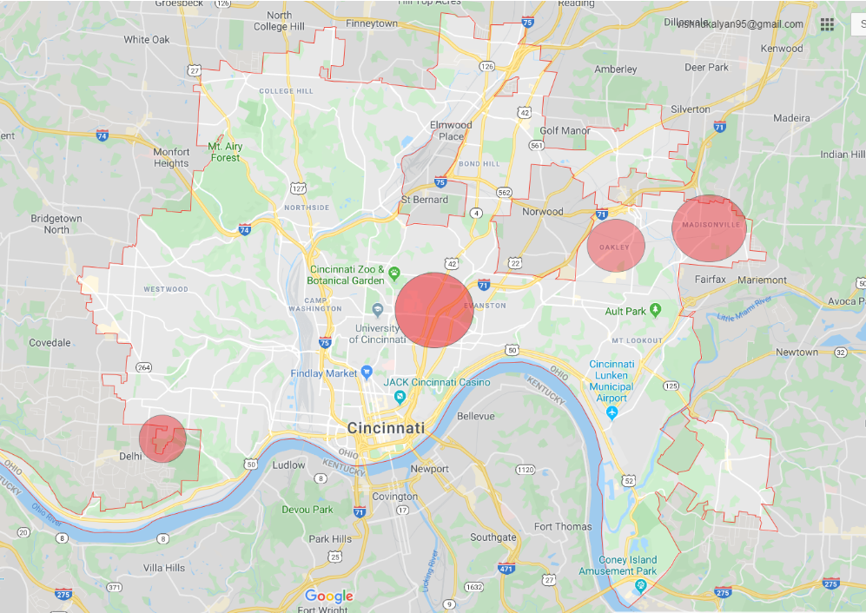
Predictive Analytics

Slide 17
Predictive Analytics
Key focus areas (In sequence):
Multi-family homes
Garage/sheds
Schools
Church
Hospitals
Financial Institutions
Entertainment centers
Departmental stores
Yards
Parking Lots
11. Playground
12. Public transit vehicles

Slide 18
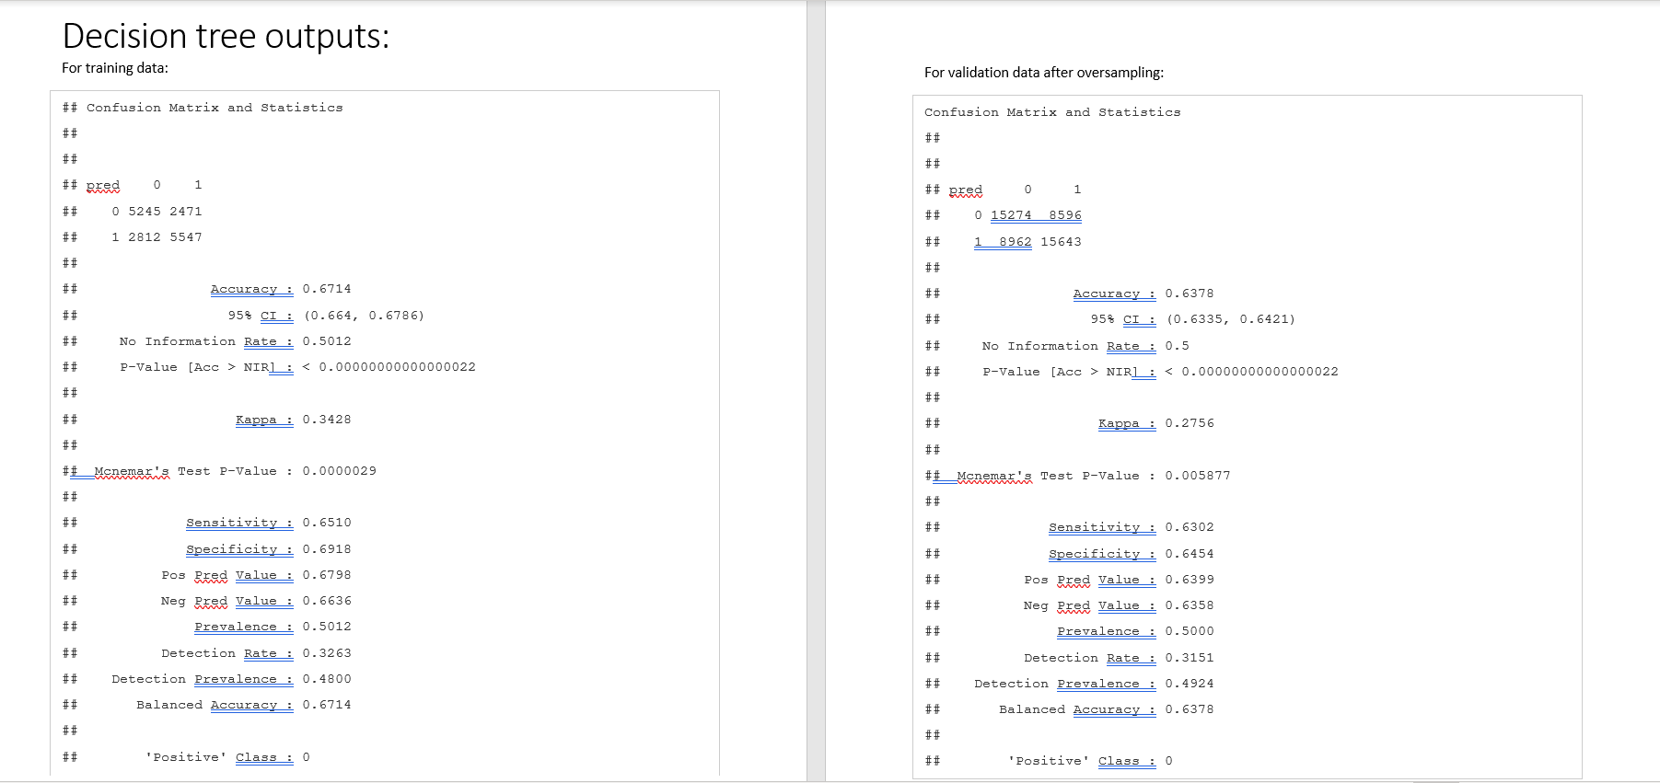

Slide 19
Predictive Analysis
We observed an increase in the number of crimes during the months of:
May
June
August

Slide 20
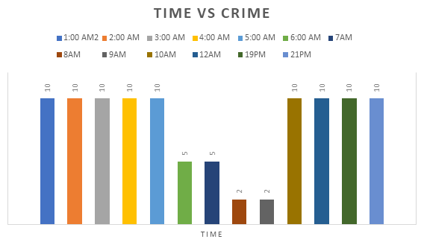

Slide 21
Future Scope
The product would involve interactive dashboards to see general trends and visualizations specific to a region and timeframe
This recommendation engine would be then used by banks and insurance to see if the housing falls under crime-prone area & by police force to deploy preventive measures to reduce future crimes

Slide 22
Source
https://data.cincinnati-oh.gov/Safer-Streets/PDI-Police-Data-Initiative-Crime-Incidents/k59e-2pvf

