Slide 1
News based prediction of Stock price

Slide 2
Abstract
Market prices are not easily predictable as there are multiple factors involved in the variability of a stock.
The main intention of this project is to predict whether a stock price will go up or go down based on daily news about the particular stock.
The data for the predictions is collected from 2 sources:
1. Application Program Interface (API) called NewsAPI
2. Yahoo historic stock data

Slide 3
Introduction
In order to predict the prices I have chosen the following 6 stocks data which are all part of the DOW jones index:
Apple
Coca cola
Microsoft
Nike
Goldman Sachs
Tesla

Slide 4
Literature Review
Similar previous analysis have been done in this field and majority of them combined news about all the stocks for analysis. In this research I have used the data about each stock separately.
Some of the papers I referenced while conducting my research are:
The relation between news events and stock price jump : an analysis based on neural network by W.Walter and Tracy
Predicting Stock Market Behavior using Data Mining Technique and News Sentiment Analysis by Khedr, Ayeman.
Public Sentiment Analysis in Twitter Data for Prediction of A Company’s Stock Price Movements by L.I.Bing

Slide 5
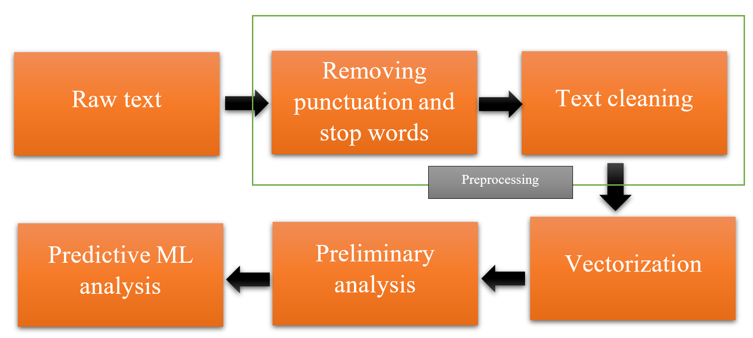
Methodology

Slide 6
Methodology
Data Extraction:
News API was used to extract data from multiple news source.
The Yahoo API was used to get historic data about stocks from Yahoo news
Once the data was collected it was cleaned using python Pandas and stored in CSV files for further analysis.

Slide 7
Data cleaning:
First punctuations were removed along with unnecessary spaces.
As converting sentences to tokens would be easier to analyze I have converted the entire sentences into tokens.
Many words that do not necessarily add value to the NLP hence I removed stop words.
When given the choice between stemming or lemmatization I have used lemmatization. Lemmatization though is more expensive in terms of processing it gives better results. Since the dataset is not too large I converted the words into lemmas.

Slide 8
Sentiment Analysis:
The process of sentiment analysis can be broadly be divided into three sub-processes:
Polarity calculation
Subjectivity calculation
Sentiment Intensity analysis

Slide 9
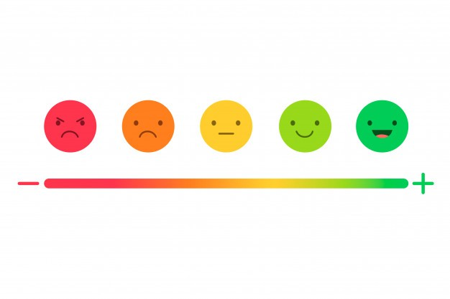
Polarity calculation:
Polarity is the numerical measure of sentiment expressed in the sentence. The values range from -1 to +1. -1 means that the sentence expresses a negative sentiment in general. A value of +1 indicates that the emotion expressed is positive and 0 means the emotion expressed is neutral.

Slide 10
Subjectivity calculation:
Subjectivity is a numerical value that expresses some personal feeling, views or beliefs. Subjectivity comes in many forms like opinions, allegations, desires, beliefs, suspicions and speculation. The numerical value of subjectivity ranges from 0 to 1. 0 being non-subjective approach and 1 being complete subjective approach.
In this project both polarity and subjectivity are measured using TextBlob module in python. The package has built-in calculators for sentiment polarity and sentiment subjectivity for a particular text. Once the calculation is complete two new columns were appended to the dataframe in python to store the values.

Slide 11
Sentiment Intensity Analysis:
Sentiment intensity analysis is a compound measure of the Positive, neutral and negative sentiment that are expressed in a given sentence. The total SIA is always equal to 1 and is very useful measurement for sentiment analysis as it adds a secondary tone to the given sentence thereby reducing the error rate. In this project a prebuilt module called vanderSentiment was imported with a method called SentimentIntensityAnalyzer. This method was used to add 4 new columns to the dataset namely, compound, negative, positive and neutral. The entire process of cleaning data and adding the sentiments was repeated for all the 6 selected stocks and separate datasets were collected.

Slide 12
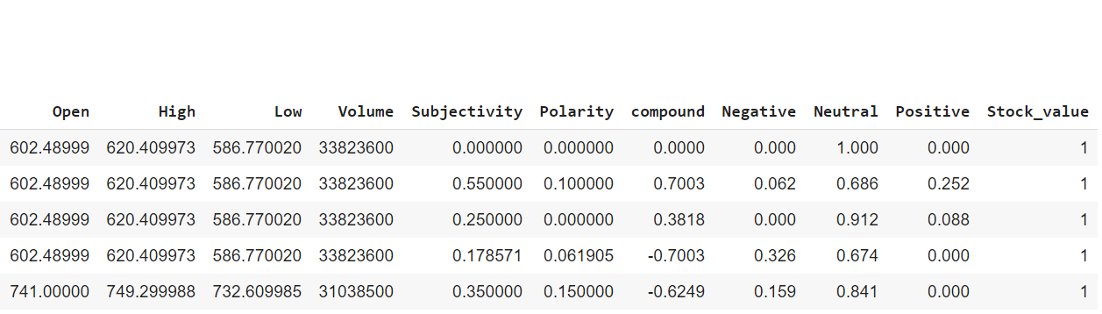
The head of the final dataset

Slide 13
Multiple machine learning models are used to predict the value of the stock.
The final dataset is fed into the last step of the pipeline and the following analysis were performed:
Logistic regression
Linear Discriminant Analysis (LDA)
Decision tree
Random Forests

Slide 14
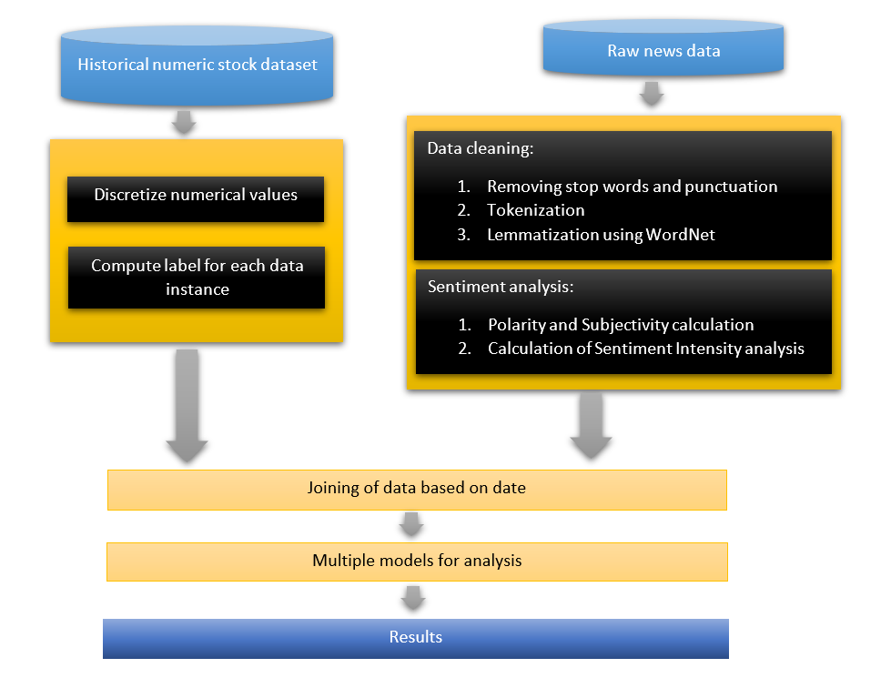

Slide 15
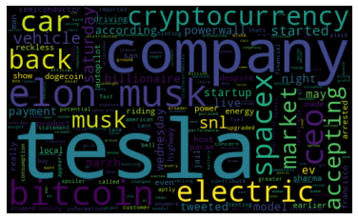
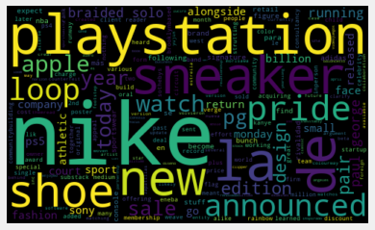
Preliminary analysis:

Slide 16
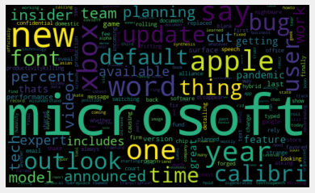
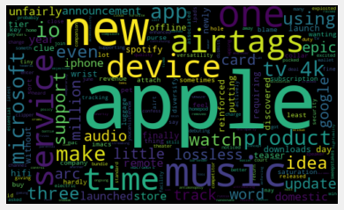

Slide 17
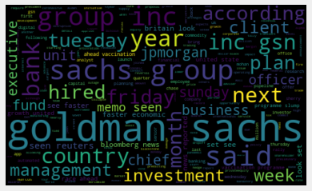
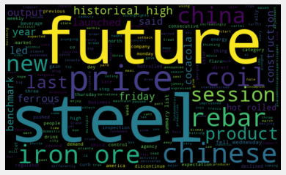

Slide 18
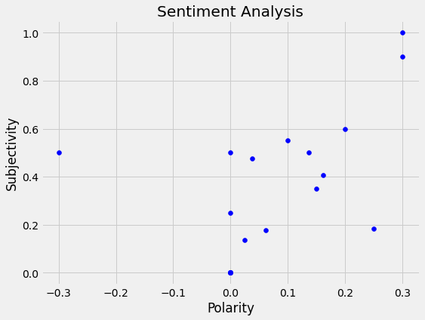
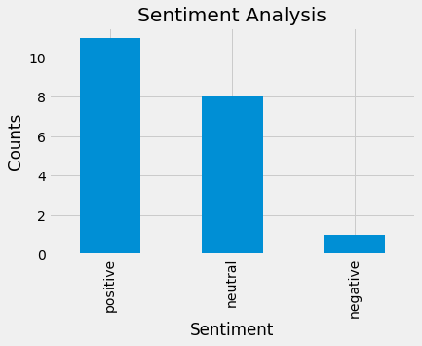
Tesla sentiment analysis

Slide 19
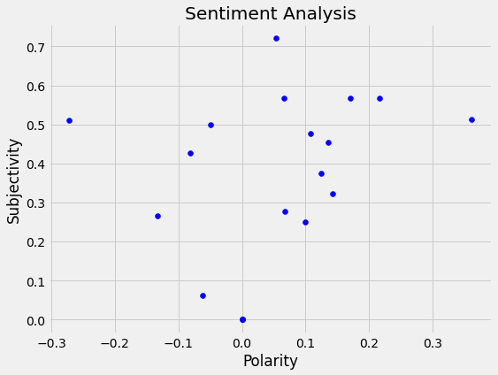
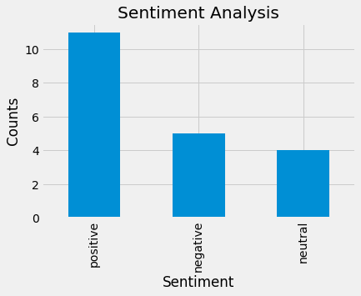
Nike sentiment analysis

Slide 20
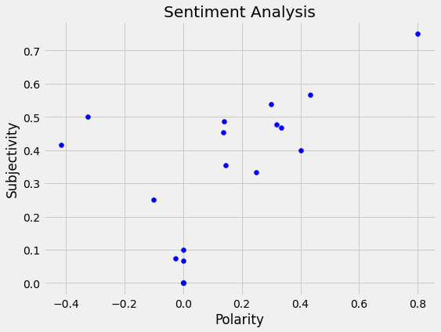
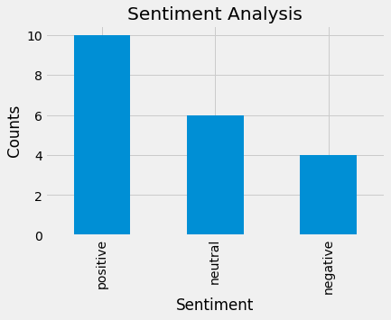
Microsoft sentiment analysis

Slide 21
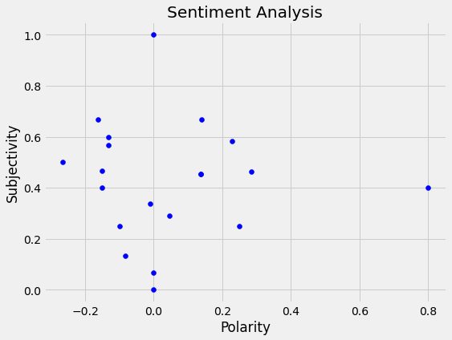
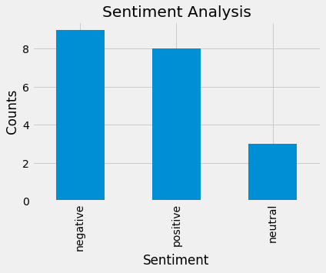
Apple sentiment analysis

Slide 22
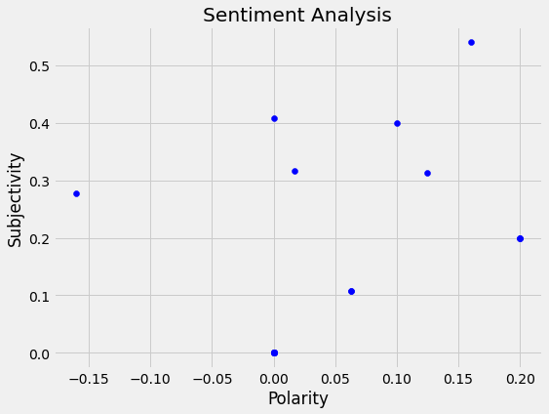
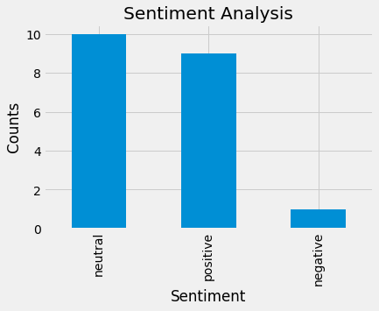
Goldman Sachs sentiment analysis

Slide 23
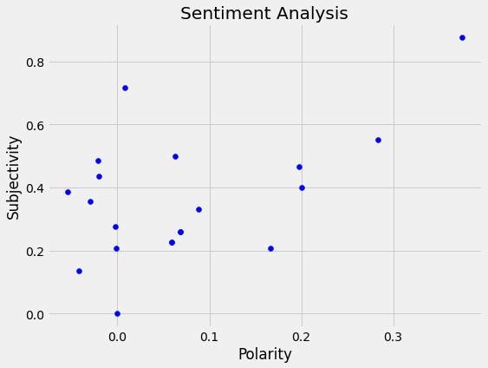
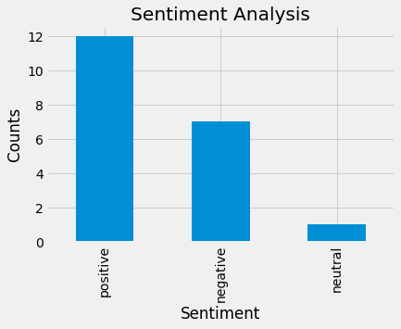
Coca-Cola sentiment analysis

Slide 24
Results

Slide 25
Logistic Regression
Logistic regression predicted that the entire output was 1 as majority of the data points had a 1 as the output. This data is not very useful as predicting 1 irrespective of input would be very inefficient and hence, we need to discard it. The efficiency was just 52%

Slide 26
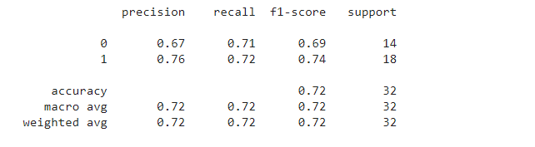
Linear Discriminant Analysis:
With the linear discriminant analysis, we were able to increase the prediction accuracy to 72%. Precision and recall have improved a lot as compared to logistic regression as the error rate in prediction fell. The following is a classification report of LDA:

Slide 27
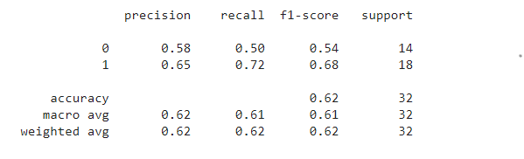
Decision Tree
With decision tree the accuracy fell to 62% and it was mainly due to the distribution of various data points and this could be eliminated if random forests was used. The following is the classification report for decision tree model:

Slide 28
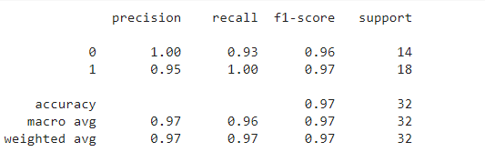
Random Forests
This is the model that gave the maximum efficiency in predicting whether the stock will go up or down. Even reducing the depth to just 2 made the model predict the output with an accuracy of 97%. This is a significant improvement as compared to any previous estimates we had. The following is the classification report of the random forest with a depth of 2:

Slide 29
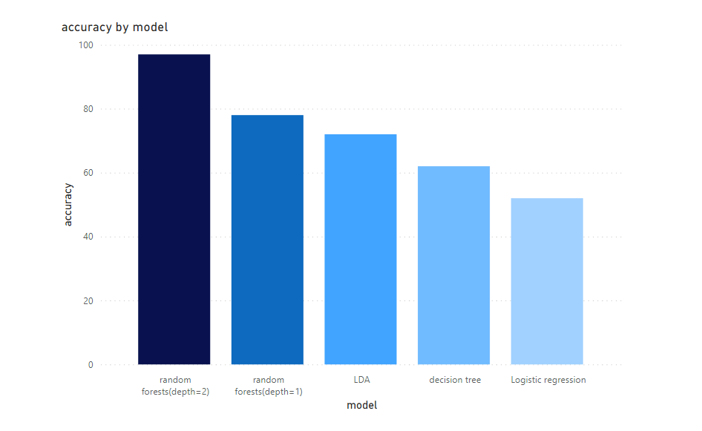
Final Accuracy

Slide 30
Final Accuracy
Model | Accuracy
Logistic Regression | 52%
Linear Discriminant analysis | 72%
Decision tree | 62%
Random forests (depth = 1) | 78%
Random forests (depth = 2) | 97%

Slide 31
Conclusion
In conclusion we can say that there is significant correlation between news articles and published and the closing value of a stock.
Further analysis can be done on this topic by using any of the following steps:
A. Increase the size of data
B. Higher dimensional data
C. Using Deep neural networks.

Slide 32
Questions

