Slide 1
$- sign will explain we are using normal user privileges
Sudo su - : Switch as root user and it goes to root directory
Sudo su Ubuntu : to switch to Ubuntu user
ls : you get permission denied
Sudo ls : will work .
sudo allows a permitted user to execute a command as the superuser
Pwd: present working directory

Slide 2
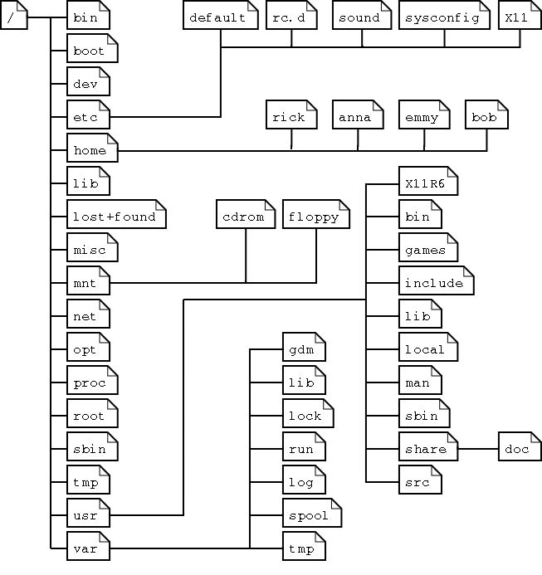

Slide 3
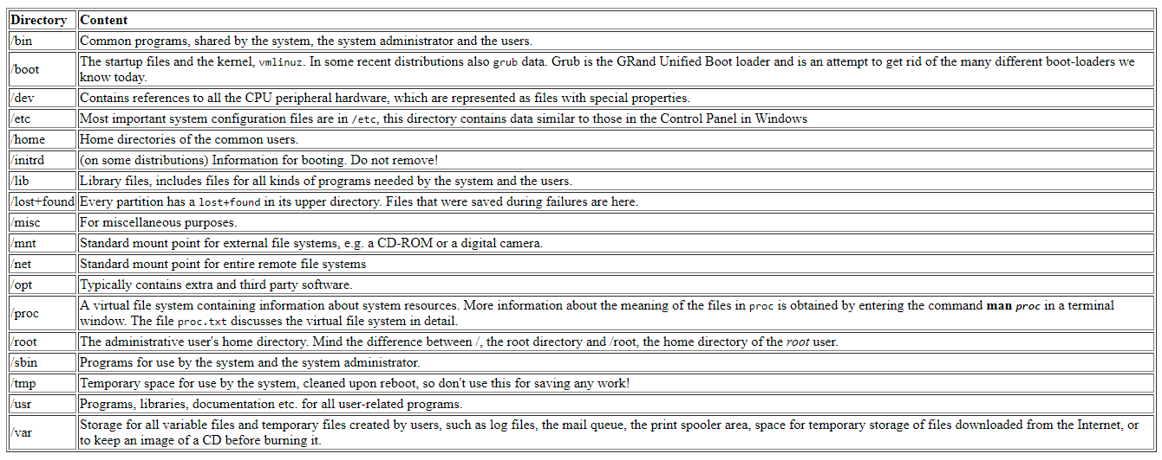

Slide 4
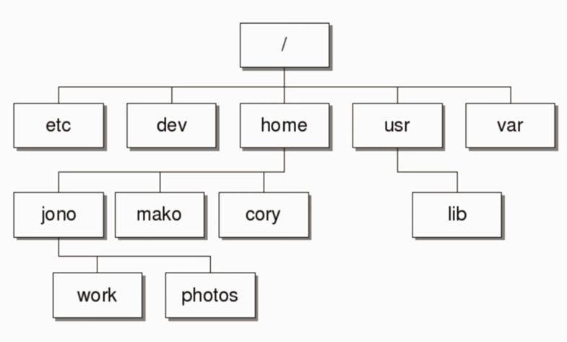

Slide 5

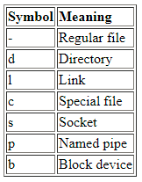
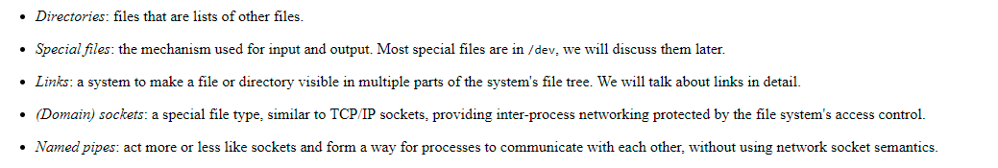
Ls –l : long listing

Slide 6
Ls –a : lists all hidden files
Ls –l lists with permissions
Mkdir: create a directory
Cd : change directory
Absolute path provide from the root of the file system
/home/folder
Rm – r junk : delete folder
CD ~ : go to users directory
date: system time
Cal: shows this month calender
Uptime: current up time. How long your system is up and running
Whoami: which user currently logged in
Users: using which user you connected to this system.
Id: user information
Who: user with public ip
W: more info of the user

Slide 7
Pushd junk : go to that directory
Popd : go back to the directory
Touch file1 : to create file
Touch file2 file3 : to create multiple files
Touch file1 : create new date of existing file
Rm file1 : remove file
Mv file1 file1.txt : move files/change filename
Mv file1.txt /home/test
Cat:
To create file and enter data with multiplelines
Cat > filename enter data then Press ctrl+D
To append content
Cat >> filename
Enter data
Ctrl+D

Slide 8
Cat filename: displays the file content
less filename: displays page by page
More filename: displays file percentage wise
Head: displays first 10 lines of file
Ex: head -20 filename
Tail: display last 10 lines of file
Ex: tail -20 filename
Page: like less command.

Slide 9
Find: is used to find the files or directories path
Synta: find /-options filename
-name : search with file name
-user : searching with user name
-group: files belongs to particular group
Ex: find /-name file1
Diff: show’s the difference between 2 files
Ex: diff file1 file2
File: file command is used to display the type of the file

Slide 10
Grep
Grep stands for global regular expression print
Used to pick the required expression from the file and print the output
Syntax: grep <pattern> filename
Grep - I text filename: ignore case sensitive
Ls - l | grep text you do not required file name over here
Pipe (|)is used to combine 2 different commands
Ls –l | grep ^d : starting with d (^ is charat symbol)

Slide 11
      SED
Sed: stands for stream editor used to search a word in the file and replace it with wod required to be in the output:
Note: Original file content will not be changed
Ex: sed ‘s/oldtext/newtext/’ filename - it applied to only oldtext is separate word
sed ‘s/oldtext/newtext/g’ filename - for all occurances
sed - i ‘s/oldtext/newtext/’ filename – it updates the file as well
sed –n ‘5,10p’ filename : displays only these lines
Sed ’10,20d’ filename: delete these lines while displaying

Slide 12
Rm –r junk :delete folder
Cat junk.txt : to open a file without opening
Echo “cat is great too” : to print data
Echo “put data In file” >junk2.txt
Echo “adding line” >> junk.txt : append the data
Cp junk.txt junk.bak.txt : Copy data
Rm *.txt : remove all text files

Slide 13
Ls-l provides all the list with permissions
In file permissions
First one says it is directory or file
Next 3would be for owner
Next 3 would be for group
Next 3 would be other than user and group
You can take a file and assign to any group

Slide 14
Chmod 760 junk.txt
R- 4
W-2
X-1
To comeout from readonly file use Esc :q!

Slide 15
Man mv : help command
Which mv
Finding files
Grep test junk.txt
Diff command compares 2 files
Echo $USER to get the user
To check the memory – free

Slide 16
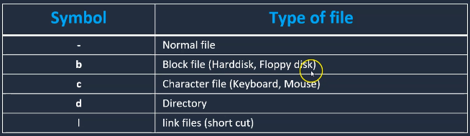
ls –l
Total there will be 8 attributes
-rw-r--r-- 1 ubuntu ubuntu 61 Nov 20 03:09 renamedfile
Chown to change the ownership of a file
Chown prasad:prasad file1
Only the owner of a file can change the file owner

Slide 17
There are 3 types of users
1.Super user: root user
2.System user: Users created by softwares or applications
ftp,ssh,apache
3.Normal user: Normal users are the users created by root user
Id root
Displays user information, like user id, which group user belongs to
All users info stored in /etc/passwd

Slide 18
When ever a user is created in Linux, below things happen
A home directory would be created
unique UID, GID are given to user
An entry in /etc/passwd
Groups are part of /etc/group
to create a user you can use either useradd or adduser
Useradd will add only the user, password we should set by using passwd
Useradd prasad
Passwd
To login to ec2 by using different user
Vi /etc/ssh/sshd_config
Change the property Passwordauthentication as yes
Service sshd reload
Note: MobaXterm is a tabbed ssh tool

Slide 19
To create a new group
sudo groupadd new_group
you can use the usermod command to add a user to a group:
sudo usermod –a –G group_name user_name
The usermod command uses the –append and –group options to append the user to a particular group. Without using –append, the user could be dropped from other groups.

Slide 20
Sudo adduser bob1 : add user
It will ask password and other details.so provide the same
compgen –u : To list all users
cat /etc/passwd
Cd /home: who has directory in home folder
Sudo chown bob filename : change the owner of the file
Sudo passwd bob : change the password
Sudo deluser bob : to delete the user
Group:
To display all groups.
Cat /etc/group
To display members in group
$apt install members
$members groupname
To add users to sudo group
usermod -a -G sudo geek
Delete users from the group
deluser prasad sudo
cut -d : -f 1 /etc/passwd
less /etc/group

Slide 21
tr: used for translation and deletion
File content:
hhelow world
hhow are you. hhhow do you do
To sqeeze
tr -s "h" <sque> file1
To convertt to uppercase
cat file1 | tr "[a-z]" "[A-Z]" >newfilename

Slide 22
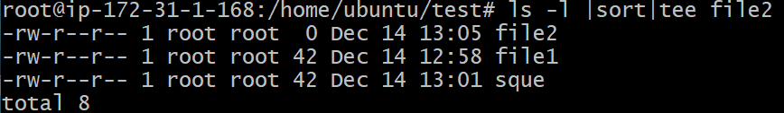
Tee: used to redirect the output to 2 different destinations. Both standard output and one or more files
ls -l |sort|tee file2
Output added to file2 and displayed in standard output

Slide 23
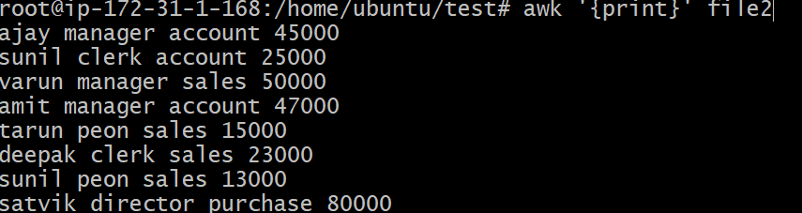
AWK is command for processing and analysing text files mainly used for data files that are organized by lines rows columns like below
ajay manager account 45000
sunil clerk account 25000
varun manager sales 50000
amit manager account 47000
tarun peon sales 15000
deepak clerk sales 23000
sunil peon sales 13000
satvik director purchase 80000
Awk by default prints all the content
awk '{print}' file2

Slide 24
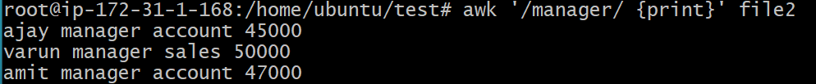
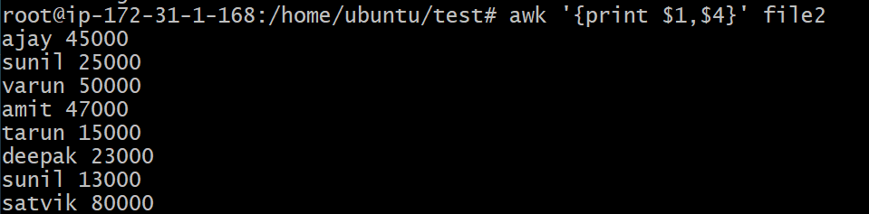
Prints the lines matches with the given pattern
awk '/manager/ {print}' file2
Splitting the line in to fields
awk '{print $1,$4}' file2
awk '{print $1,$4}' file2 | tee file3

Slide 25
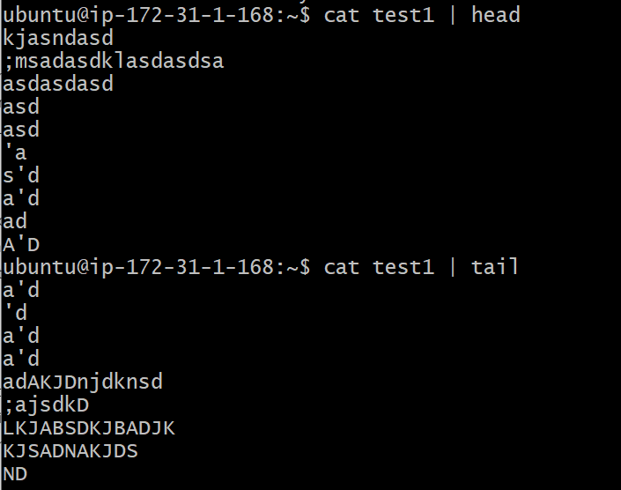
The head command allows you to view the beginning of a file or piped data directly from the terminal
A compliment to the previous command, chances are you will use the tail command much more than the header commands

Slide 26
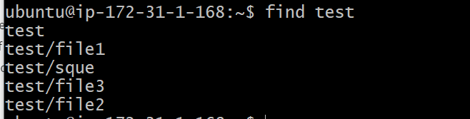
The find command is one of the most used Linux commands to search for files from the terminal
The man command stands for manual and is one of the most useful Linux commands you can get your hands on. This command followed by the name of another command lists the manual or documentation page of that command.
man cat

Slide 27
System management
History
History will be stored in .bash_history file
Free: free command used to check the memory information
free –m: displays in mb
Cat /proc/meminfo: displays memory information
Cat /proc/cpuinfo: displays cpu information

Slide 28
Uname –a : show kernel information
Du: du displays disk usage of current directory
Du –h : human readable
Du –k /var | sort –rn head : most occupied file in given directory
Df: how many file systems are there in this systems

Slide 29
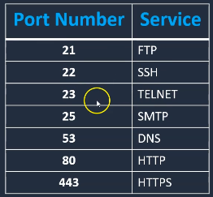
    Networking
Hostname: listing hostname of the server, you can even set the hostname
You can change the host name in /etc/hostname file
Wget : to download the package
Ping: check destination server is reachable or not
Ifconfig : to list the ipaddress of the server(or ip addr)
Curl: access http url
netstat -tunlp : to identify which ports are running
telnet localhost 80 : to check any service with this port is working or not
kill -9 16085: To kill any port use

Slide 30
Services
Service options
status
start
stop
reload : reload the config file
restart
remove
Chkconfig: used to start the service when system starts(at boot time)
Checkconfig <service> on
Chkconfig <service> off
Chkconfig –list : to check the availability of the service
To restart the server we use init 6 or reboot
Systemctl and service both are same

Slide 31
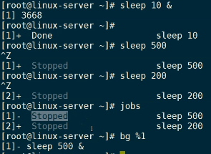
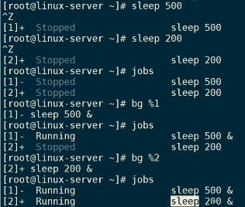
Process management
Ps –ef : to list the process
never kill first process(process id 1)
Kill : kill a process of service
Kill 9: force kill
Fg: run the program in the background
Bg: run the program in the background
Ex: sleep 10 &
Top: display top 20 processes which are consuming more cpu

Slide 32
Compress files
When we use Gzip source file only compressed there won’t be any original file
Gzip: create a compress file
Gunzip: unzip a file
Tar: extract a tar or create a tar( for directories)
Ex: tar –cvf test.tar test
Untar ex: tar=xvf
Install gzip by using apt-get install gzip
ex: gzip filename
You can even use zip (apt install zip)
Ex:
Zip file1.zip file1
Unzip to unzip file
Note: zip and gzip works on files

Slide 33
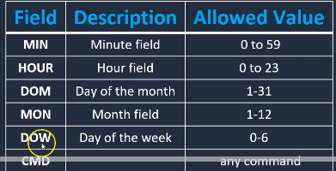
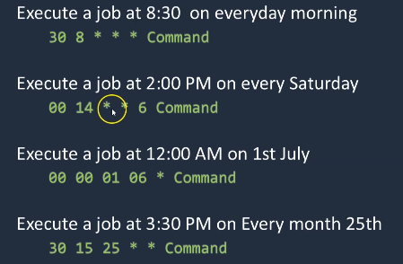

    Crontab
To schedule a job. Crontabs are user specific
Crontab –l : To list all the jobs
Crontab –e
Crontab –e opens an editor keep all the jobs in that page like below
Ex:

Slide 34
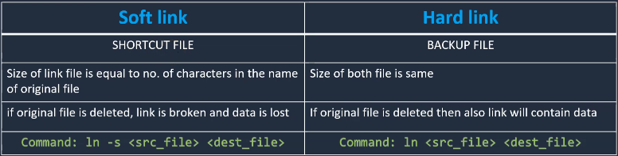
Soft link and hard link
If you wish to use the same file in different locations then use soft link then it occupies less space
To create shortcuts we use soft link(for scripts )
Ex: create a soft link in /usr/local/bin then you can run the script from any where
Copy vs hard link:A hard link allows a user to create two exact files without having to duplicate the data on disk. However unlike creating a copy, if you modify the hard link you are in turn modifying the original file as well as they both reference the same inode

Slide 35
Copy files from one system to another system
Windows to linux
winscp or Mobaxtream
Linux to Linux:
scp
EX: scp filename root@172.34.25.56:/tmp
scp root@172.34.25.56:/tmp /home/ubuntu

Slide 36
What is Shell
A shell script is a computer program designed to be run by the Unix/Linux shell
A command-line interpreter
Execute your commands

Slide 37
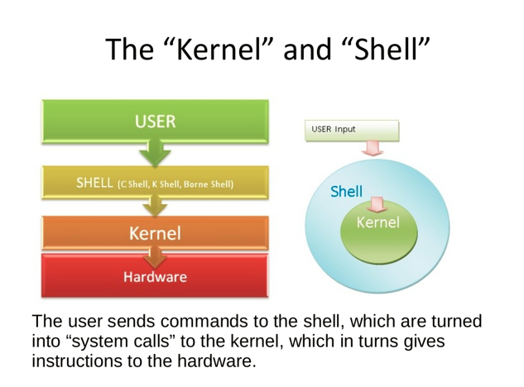
Kernel will talk to hardware we talk to shell

Slide 38
Kernel language:
The Linux kernel is written in the version of the C programming language. together with a number of short sections of code written in the assembly language
Difficult for sys admins write this language.

Slide 39

BASH ( Bourne-Again SHell )
CSH (C SHell)
KSH (Korn SHell) - AT & T Bell Labs
DASH (Debian Almquist shell)
To know which shell Type you are using
  $ echo $SHELL
SH is specification (There is nothing like sh)
We can execute shell by using
Sh filename .filename, ./filename
sh file executes a shell-script file in a new shell process.
. file executes a shell-script file in the current shell process.
./file will execute the file in the current directory
To display all shells
cat /etc/shells

Slide 40
To install c shell
sudo apt-get install csh

Slide 41
which bash: displays where bash present in OS.
/bin/bash
Create a file HelloWorld.sh
touch helloworld.sh
Vi helloworld.sh
Type in file : first line should be where bash present #!
Shebang
#! /bin/bash
#comment
echo "Test shell script"
#: denotes comment

Slide 42
Variables in Shell
Variables declaration is not required.
Assign the data directly to variable without any space. If space is available then it treats as commands
A="prasad"
echo $A
B=67.78
echo $B
INVENTA="Welcome "to" Inventateq"
echo $INVENTA

Slide 43
Read only variables
ROTEST="TEST"
readonly ROTEST
ROTEST="marathahalli“
Will get ROTEST is read only
Read data from console
echo "Enter first name"
read FNAME
echo "Enter Last Name"
read LNAME
echo $FNAME $LNAME

Slide 44

num1=10
num2=20
num3=$((num1 + num2))
echo "$num3"
num4=`expr $num1 + $num2`
echo $num4
num5=$(expr $num1 + $num2)
echo $num5

Slide 45
The following arithmetic operators are supported by Bourne Shell.
Assume variable a holds 10 and variable b holds 20 then
Operator | Description | Example
+ (Addition) | Adds values on either side of the operator | `expr $a + $b` will give 30
- (Subtraction) | Subtracts right hand operand from left hand operand | `expr $a - $b` will give -10
* (Multiplication) | Multiplies values on either side of the operator | `expr $a \* $b` will give 200
/ (Division) | Divides left hand operand by right hand operand | `expr $b / $a` will give 2
% (Modulus) | Divides left hand operand by right hand operand and returns remainder | `expr $b % $a` will give 0
= (Assignment) | Assigns right operand in left operand | a = $b would assign value of b into a

Slide 46
Relational Operators
Operator | Description | Example
-eq | Checks if the value of two operands are equal or not; if yes, then the condition becomes true. | [ $a -eq $b ] is not true.
-ne | Checks if the value of two operands are equal or not; if values are not equal, then the condition becomes true. | [ $a -ne $b ] is true.
-gt | Checks if the value of left operand is greater than the value of right operand; if yes, then the condition becomes true. | [ $a -gt $b ] is not true.
-lt | Checks if the value of left operand is less than the value of right operand; if yes, then the condition becomes true. | [ $a -lt $b ] is true.
-ge | Checks if the value of left operand is greater than or equal to the value of right operand; if yes, then the condition becomes true. | [ $a -ge $b ] is not true.
-le | Checks if the value of left operand is less than or equal to the value of right operand; if yes, then the condition becomes true. | [ $a -le $b ] is true.

Slide 47
echo "Enter A value"
read A
echo "enter B value"
read B
C=`expr $A + $B`
echo "C: $C";
if [ $A -eq $B ];
then
echo "if test"
fi
We can also use arithmetic operators like
num1=10
num2=20
c=$(( num1 + num2 ))
echo $c
num1=10
num2=20
c=$(expr $num1 + $num2 )
echo $c

Slide 48

Assume variable a holds 10 and variable b holds 20
Operator | Description | Example
! | This is logical negation. This inverts a true condition into false and vice versa. | [ ! false ] is true.
-o | This is logical OR. If one of the operands is true, then the condition becomes true. | [ $a -lt 20 -o $b -gt 100 ] is true.
-a | This is logical AND. If both the operands are true, then the condition becomes true otherwise false. | [ $a -lt 20 -a $b -gt 100 ] is false.

Slide 49
      String Operators
Assume variable a holds "abc" and variable b holds "efg" then
Operator | Description | Example
= | Checks if the value of two operands are equal or not; if yes, then the condition becomes true. | [ $a = $b ] is not true.
!= | Checks if the value of two operands are equal or not; if values are not equal then the condition becomes true. | [ $a != $b ] is true.
-z | Checks if the given string operand size is zero; if it is zero length, then it returns true. | [ -z $a ] is not true.
-n | Checks if the given string operand size is non-zero; if it is nonzero length, then it returns true. | [ -n $a ] is not false.
str | Checks if str is not the empty string; if it is empty, then it returns false. | [ $a ] is not false.

Slide 50

num1=20.5
num2=5.2
num3=`expr "$num1 + $num2" | bc`
echo $num3

Slide 51
        Control statements
The if...else statement
The case...esac statement
IF statement
echo "enter a value"
read A
if [ $A -lt 10 ]
then
echo "A value less than 10"
fi

Slide 52
If else
echo "enter a value"
read A
if [ $A -lt 10 ]
then
echo "A value less than 10"
else
echo "A value is greaer than 10"
fi

Slide 53
    If else if
echo "enter a value"
read A
if [ $A -lt 10 ]
then
echo "A value less than 10"
elif [ $A -gt 10 -a $A -lt 40 ]
then
echo "A value is greaer than 10 and less than 40"
else
echo "A is greater than 40"
Fi

Slide 54

MARKS[0]=60
MARKS[1]=80
MARKS[2]=90
MARKS[3]=76
MARKS[5]=56
echo ${MARKS[2]}
echo ${MARKS[*]}
Note:Use bash to execute arrays in ubuntu
NAME=(Test1 Test2 Test3)
echo ${NAME[*]}
You can use either * or @ to get all array values
To read array from user read -a names

Slide 55
To print the indexes of array
Echo “${!Names[@]}
To get length of an array
Echo “${#Names[@]}
To remove element from an array
Unset Names[1]

Slide 56
Loops
While
For
Until
Select
While
#1.Intialization
a=0
while [ $a -lt 10 ]
do
echo "$a "
a=`expr $a + 1`
done
While Loop executes the block of code (enclosed in do...done) when the condition is true and keeps executing that till the condition becomes false. Once the condition becomes false, the while loop is terminated.
Until Loop executes the block of code (enclosed in do...done) when the condition is false and keep executing that till the condition becomes true. Once the condition becomes true, the until loop is terminated.

Slide 57
For loop
NAMES=(prasad reddy Ravi)
for name in "${NAMES[@]}"
do
echo $name
touch $name
echo "testing for loop" > $name
done
read -a NAMES
for name in "${NAMES[@]}"
do
echo $name
done
i=0
for (( i=1; i <= 5; i++ ))
do
echo "Random number $i: $RANDOM"
done
Until
#! /bin/bash
#1.Intialization
a=0
until [ ! $a -lt 10 ]
do
echo "$a "
a=`expr $a + 1`
done

Slide 58
Select
PS3='Please enter your choice: '
options=("Option 1" "Option 2" "Option 3" "Quit")
select opt in "${options[@]}"
do
case $opt in
"Option 1")
echo "you chose choice 1"
;;
"Option 2")
echo "you chose choice 2"
;;
"Option 3")
echo "you chose choice 3"
;;
"Quit")
break
;;
*) echo invalid option;;
esac
done

Slide 59
Create a file and input range from the console and loop the range from 0 and when even number encounters append data to file.
echo "Enter range"
read RANGE
A=0
touch file1
until [ ! $A -lt $RANGE ]
do
echo $A
B=`expr $A % 2`
if [ $B -eq 0 ]
then
echo "$A " >> file1
fi
A=`expr $A + 1`
done

Slide 60
To display all the shells
Cat /etc/shells
Which bash will give where the bash exist
Sh extion is not mandatory. It would be usefull for Editor
Variables
System level variables
$BASH
$BASH_VERSION
$HOME
User level variables
Variable names Should not start with number
read -p 'username:' user
echo "$user"

Slide 61
read -sp ‘password:' pass
echo "$pass“

Slide 62
      File test operations
To check whether file exists or not
echo "Enter file name: \c"
read fname
if [ -e $fname ]
then
echo "$fname file exist"
else
echo "$fname file does not exist"
fi
Options
-f : file exist or regular file or not
-d : check the directory
-c : character special file
-b: block special files(image, video etc)
-s : check whether file is empty or not
-r: check read permission
-w: check write permission
-x : check execute permission

Slide 63
Functions
function print()
{
echo "printing"
}
display()
{
local name=$1
local address=$2
echo "$name resides in $address address"
}
name="sudha"
address="bangalore"
echo "$name resides in $address address"
display $1 $2
echo "$name resides in $address address"
print

Slide 64
#! /bin/bash
function isfileexists()
{
file=$1
if [ -e $file ]
then
echo "$file exists"
return 0
else
return 1
fi
}
if isfileexists $1
then
echo "file exist"
else
echo "file does not exist"
fi

Slide 65
#! /bin/bash
Hello () {
echo "Hello World $1 $2"
return 10
}
Hello Harshith Reddy
# Capture value returnd by last command
ret=$?
echo "Return value is $ret"

Slide 66
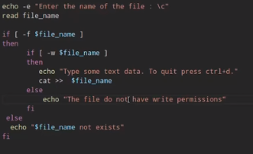

Slide 67
Interview Questions:
How can I find and replace specific words in a text file using command line?
sed -i 's/original/new/g' file.txt
Explanation:
sed = Stream EDitor
-i = in-place (i.e. save back to the original file)
The command string:
s = the substitute command
original = a regular expression describing the word to replace (or just the word itself)
new = the text to replace it with
g = global (i.e. replace all and not just the first occurrence)
file.txt = the file name
https://www.tecmint.com/linux-sed-command-tips-tricks/
grep inplace file1- search the occurance of string
Replace the content
sed -i 's/port 9090/port 8080/' file1
Take backup before replacing the content
sed -ibak 's/port 9090/port 8080/' file1

Slide 68
How can you find out how long the system has been running?
Command “uptime”
How can any user find out all information about a specific user like his default shell, real life name, default directory,when and how long he has been using the sytem?
finger “loginName” …where loginName is the login name of the
user whose information is expected.
https://www.guru99.com/shell-scripting-interview-questions.html

Slide 69
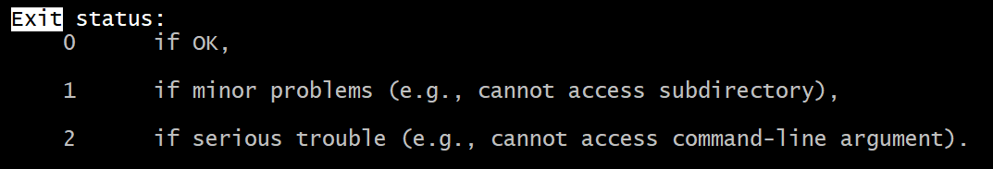
Exit status
Man ls
/exit: search exit
Printenv: to print all environment variables

Slide 70
Check whether user is ubuntu or not
Username=$(id –un)
To get the output of command we use parenthesis()
#! /bin/bash
uid1=1000
if [ $UID -ne $uid1 ]
then
echo "user name is not ubuntu"
exit 1
else
echo "user name is ubuntu"
fi

Slide 71
Empty file in vi
Follow the below steps to empty a file:
Go to command mode in the editor by pressing ESC key on the keyboard.
Press gg. It will take to the first line of the file.
Then press dG. This will delete from the first line to the last line.

Slide 72
Real time examples
Q)Write script to get error logs
A)grep - i error /var/log/messages
Q)Backup directory for today:
A)date +'FORMAT'
### mm/dd/yyyy ###
date +'%m/%d/%Y'
## Time in 12 hr format ###
date +'%r'
## backup dir format ##
backup_dir=$(date +'%m/%d/%Y')
echo "Backup dir for today: /nas04/backups/${backup_dir}“
https://www.cyberciti.biz/faq/unix-linux-getting-current-date-in-bash-ksh-shell-script/

Slide 73
Employee.txt
ajay manager account 45000
sunil clerk account 25000
varun manager sales 50000
amit manager account 47000
tarun peon sales 15000
deepak clerk sales 23000
sunil peon sales 13000
satvik director purchase 80000

Slide 74
Awk is a scripting language used for manipulating data and generating reports.The awk command programming language requires no compiling, and allows the user to use variables, numeric functions, string functions, and logical operators.
AWK Operations:
(a) Scans a file line by line
(b) Splits each input line into fields
(c) Compares input line/fields to pattern
(d) Performs action(s) on matched lines
Print the lines which matches with the given pattern.
$ awk '/manager/ {print}' employee.txt
ajay manager account 45000
varun manager sales 50000
amit manager account 47000

Slide 75
Splitting a Line Into Fields
awk '{print $1,$4}' employee.txt
ajay 45000
sunil 25000
varun 50000
amit 47000
tarun 15000
deepak 23000
sunil 13000
Q)Print the file system in human readable format only for root patrician
a)df –h | grep root

Slide 76
Ping to multiple IPS
IPLIST="path_to_the_Ip_list_file"
for ip in $(cat $IPLIST)
do
ping -c1 $ip &> /dev/null
if [ $? -eq 0 ]
then
echo $ip ping passed
else
echo $ip ping failed
fi
done

Slide 77
Schedule a shell script and send output to email
In the crontab –e enter below code
34 20 * * * /absolute path of file | mail -s “check status” weguidetechnologies@gmail.com”
Create a file with old timestamp
Touch –d “Thu, 1 March 2019 12:30:00” filename
Find files which are older than 90 days
Find /home/ubuntu –mtime +90 –exec ls –l {} \;
Delete old files which are older than 90 days
Find /home/ubuntu –mtime +90 –exec rm {} \;

Slide 78
Find whether file is created today or not
find backup.tar.gz -mtime -1 -type f -print &> /dev/null
To get the file count
ls -l Prasad* | wc -l
Check if any users directory exist in home and not in password
for DIR in *
do
CHK=$(grep -c "/home/$DIR" /etc/passwd)
if [ $CHK -ge 1 ]
then
echo "$DIR is assigned to a user"
else
echo "$DIR is NOT assigned to a user"
fi
done
Here –c stands for count

Slide 79
List of Users Logged in Today
#!/bin/bash
today=`date | awk '{print $1,$2,$3}'`
#last | grep $today | awk '{print $1}'
last | grep "$today“
last: show a listing of last logged in users
tail -f logfile
-f: This option is mainly used by system administration to monitor the growth of the log files written by many Unix program as they are running. This option shows the last ten lines of a file and will update when new lines are added

Slide 80
egrep
egrep is used to grep multiple strigs at a ttime
nohop
nohop is used to run the script in background and get the prompt back
Disable users
Usermod –L username
lastlog | tail -n+2 | grep 'test' | awk '{print $1}' |
xargs -I{} usermod -L {}

Slide 81
Killing the process by using grep and ps –ef
ps -ef | grep "sleep 600" | grep -v grep | awk '{print $2}' | xargs -I{} kill {}
-v removes from the filteroutput

Slide 82
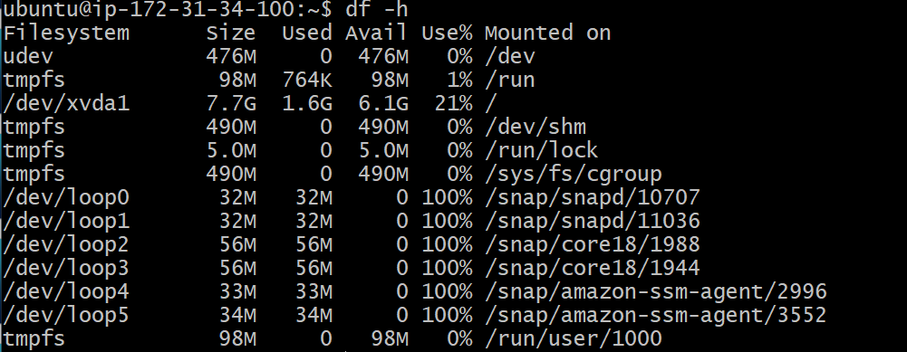
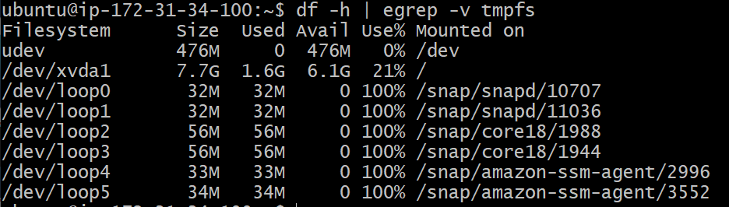
File system fileters
df –h : display file system
du: disk usage
df -h | egrep -v tmpfs

Slide 83
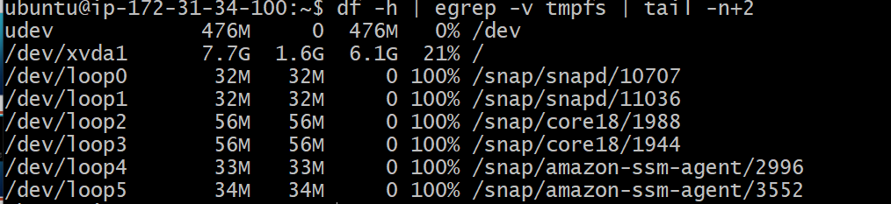
Get rid of column names
df -h | egrep -v tmpfs | tail -n+2

Slide 84
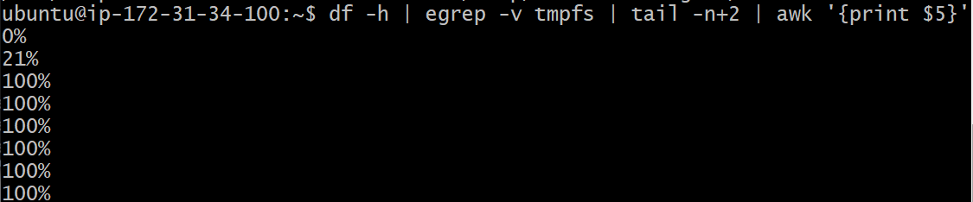
df -h | egrep -v tmpfs | tail -n+2 | awk '{print $5}'

Slide 85
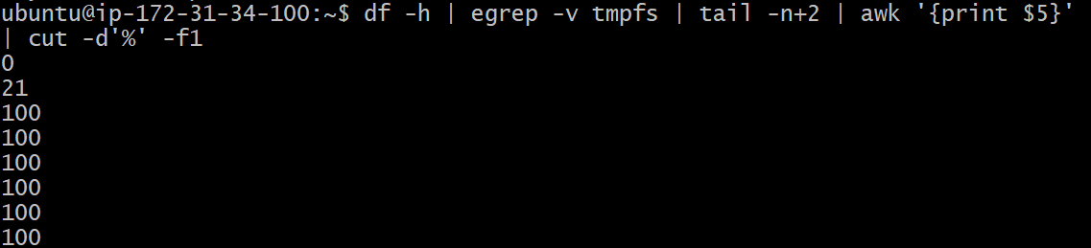
Remove % and display first field –f1
df -h | egrep -v tmpfs | tail -n+2 | awk '{print $5}'| cut -d'%' -f1

Slide 86
Get the file systems which is > 70%
a=`df -h | egrep -v "tmpfs|devtmpfs" | tail -n+2 | awk '{print $5}' | cut -d'%' -f1`
for i in $a
do
if [ $i -ge 70 ]
then
echo Check disk space $i `df -h | grep $i`
fi
done
Use back tick for command

Slide 87
Difference between df and du
du is used more than df in day to day project as it shows the disk usage as per directory level. df is disk free space and shows at file system level. Another command is dfspace which would also be used.

