Slide 1

AirBook
С любезното съдействие на:
Мирела Влаева
Станислав Христов

Slide 2
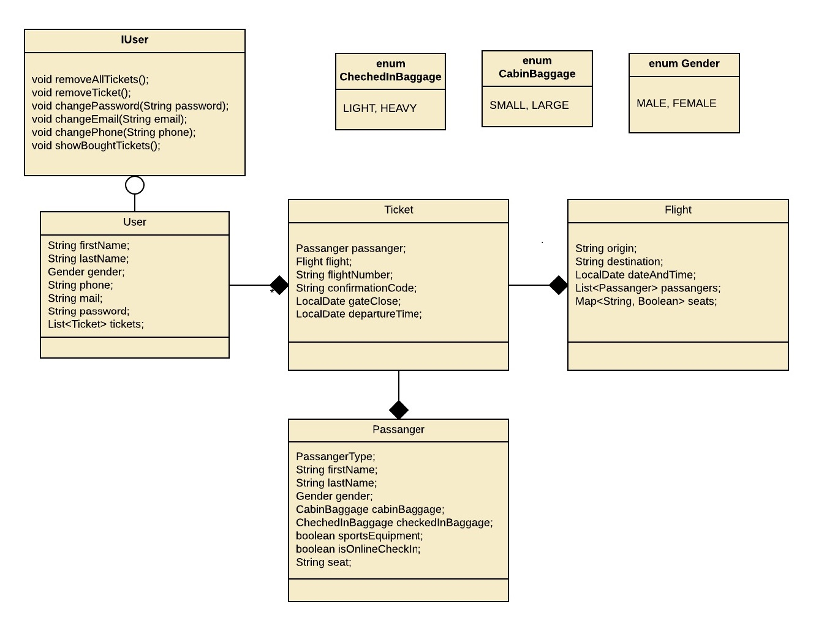
Class Diagram

Slide 3
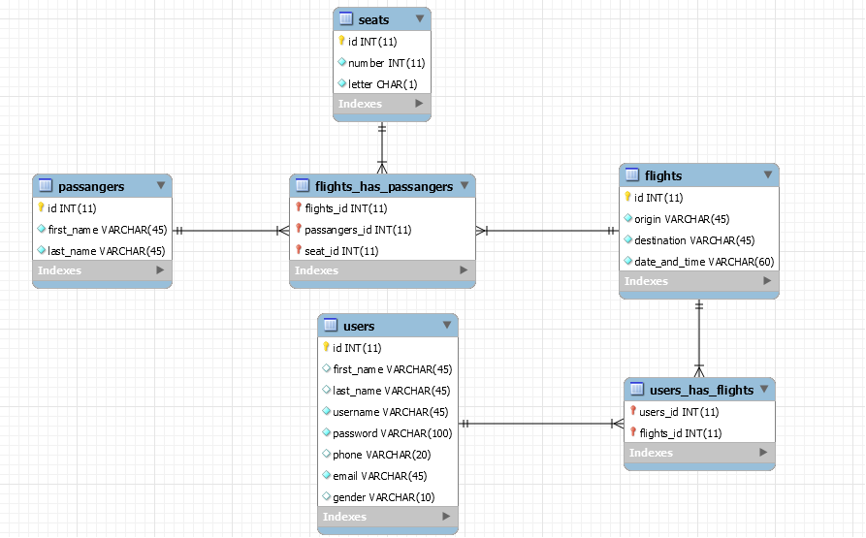
Database Diagram

Slide 4
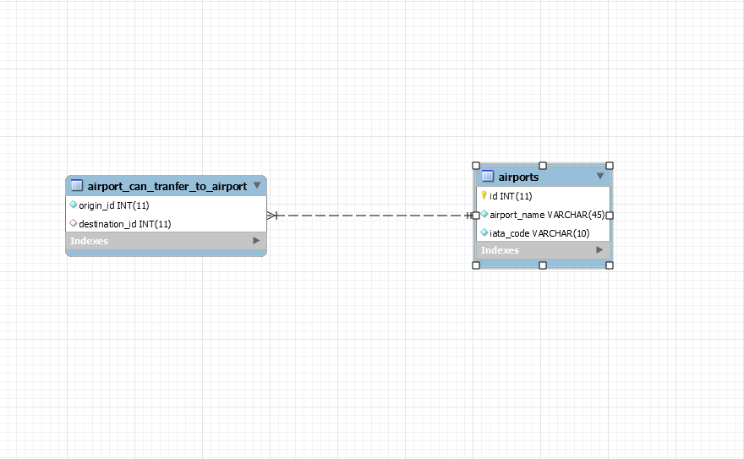
Database Diagram(2)

Slide 5
Used Technologies
Framework: Spring
Back-end: Java
JSTL in web technology
Front-end: HTML, CSS, JS
REST service
Javadoc

Slide 6


Slide 7


