Slide 1



AI-Adaptive Reliable File Transfer over UDP
COMPUTER NETWORKS PROJECT
Sender
117
118
Machine-learning retransmission timeouts versus TCP's RFC 6298, with RACK loss detection
Simulated network
ACK
Receiver
Madhavarapu Venkata Lakshmi Jyothiradithya
24BCI0184 · B.Tech CSE (Information Security) · Computer Networks
Notes:
Good morning. My project builds a reliable file-transfer protocol from scratch on top of UDP, and then asks one research question: can machine learning decide when to resend a lost packet better than TCP's own formula, RFC 6298? I also added RACK, the loss-detection method modern Linux TCP uses, and compared all of them on the same simulated networks. Everything you will see was measured on 420 real transfers.

Slide 2



When should a lost packet be resent?
THE PROBLEM
UDP promises nothing
Datagrams can be lost, delayed, duplicated or reordered, and UDP will not tell you.
Resend too early
Packets that were only late get sent twice: wasted bandwidth when the network is already struggling.
Resend too late
After a real loss the sender sits idle, and one missing packet can stall the whole window behind it.
With an 80 ms timeout, 4.5 % of delivered packets would be resent for nothing.
Notes:
UDP gives us ports and a checksum and nothing else. To make it reliable we number every chunk, acknowledge it, and resend it if the acknowledgement does not return in time. The hard part is "in time". The chart shows 776 real round-trip times our sender measured on the heavy-jitter network. Put the timeout at 80 milliseconds and the red bars are packets whose acknowledgement was simply late: 4.5 percent would be resent for nothing. Move it to the right and you waste less, but every real loss waits longer before it is repaired. That trade-off is the whole project.

Slide 3



What this project builds and measures
CONTRIBUTIONS
Reliable transport over UDP
Four ways to time a resend
Selective Repeat, 64 packets in flight, per-packet timers, cumulative + selective ACKs, CRC-32 per packet, SHA-256 per file.
RFC 6298 baseline, an ML timeout (v1 random forest, v2 quantile boosting) and RACK loss detection from RFC 8985.
A reproducible network
Honest evaluation
A proxy process that adds delay, jitter, loss, bursts, duplication, reordering and corruption, deterministically per packet.
420 transfers, paired by seed, exact Wilcoxon tests, 136 automated tests and a live lab in the browser.
Notes:
Four pieces. First, a complete reliable transport over UDP. Second, four strategies for deciding when to resend: the standard formula, two machine-learning models, and RACK, which detects loss from the acknowledgement pattern. Third, a network simulator that is deterministic per packet, so every strategy faces exactly the same network. Fourth, an evaluation: 420 transfers, statistical tests, 136 automated tests and a live lab.

Slide 4


Three processes, one simulated network
ARCHITECTURE
Sender
Proxy
Receiver
sender.py
proxy.py
receiver.py
Chunker
1,200-byte chunks, SHA-256 of the file
Delay and jitter
fixed, ramping, heavy-tailed
Validation
length, CRC-32, HMAC, filename
DATA
DATA
Selective Repeat engine
64 in flight, one timer per packet
Loss
random or in bursts
Reorder buffer
at most one window
ACK
ACK
Timeout manager
RFC 6298 or ML, Karn's rule, backoff
Dup · reorder · corrupt
the CRC must catch it
Atomic commit
.part file, SHA-256, rename
RACK
loss detection without waiting for timers
Notes:
The system is three separate processes. The sender reads the file, keeps up to 64 packets in flight with one timer each, and asks the timeout manager how long to wait. The proxy in the middle plays the network: it adds delay, jitter, loss, duplication, reordering and corruption. The receiver validates every datagram, buffers out-of-order chunks, and only commits the file after the SHA-256 matches. Because the impairment lives in a separate proxy, the same sender and receiver run unchanged over a real network.

Slide 5



A 24-byte header, every bit with a job
WIRE FORMAT
0
8
16
24
31
CRC-32 per packet
magic 0x5255
version
type
Catches every single-bit error, but anyone can recompute it.
flags
reserved
payload length
transfer ID
SHA-256 per file
Proves the reassembled file is bit-identical.
sequence number (chunk)
cumulative ACK
HMAC-SHA256, optional
CRC-32 checksum
Only a shared key proves who sent the data.
payload 0–1,200 bytes (+ optional 16-byte HMAC)
1,268 bytes maximum on the wire, below IPv6's 1,280-byte minimum MTU: never fragmented.
Notes:
This is our packet header, drawn the way RFCs draw them: 32 bits per row, big-endian. The sequence number counts chunks, not bytes, so wrap-around would need a 5-terabyte file. The cumulative ACK field is what makes lost acknowledgements harmless. There are three different integrity checks and they do different jobs: CRC-32 catches accidental corruption, SHA-256 proves the whole file is identical, and only the optional HMAC with a shared key proves who sent it. The largest datagram is 1,268 bytes on the wire, under the 1,280-byte minimum MTU of IPv6, so IP never fragments our packets.

Slide 6
Selective Repeat resends only what is lost
TRANSPORT LOGIC
Sender
Receiver
Window of 64 packets
1
DATA 0
Keeps a 300 ms path busy; stop-and-wait would manage 4 KB/s.
DATA 1
DATA 2
✕
ACK 0 · cum 1
One timer per packet
2
RTO
ACK 2 · cum 1
Only the missing chunk is resent; out-of-order chunks wait in a bounded buffer.
3
Selective + cumulative ACK
DATA 1 resent
Each ACK names its packet and the next chunk needed, so lost ACKs cost nothing.
ACK 1 · cum 3
4
Karn's rule
A resent packet gives no RTT sample: its ACK could belong to either copy.
Notes:
Here is Selective Repeat in action. Data 0, 1 and 2 leave back to back. Data 1 is lost. Data 2 arrives with a gap before it, so the receiver buffers it and acknowledges it selectively, while the cumulative field still says 'I need chunk 1'. When the timer for chunk 1 expires, the sender resends only chunk 1, not the whole window. When it arrives, the receiver can write 1 and 2 in order and the cumulative ACK jumps forward. Karn's rule says the ACK for a resent packet is never used to measure RTT, because we cannot tell which copy it belongs to.

Slide 7

TCP's answer: the RFC 6298 formula
BASELINE
for every valid RTT sample R:
RTTVAR = 3/4·RTTVAR + 1/4·|SRTT − R|
SRTT = 7/8·SRTT + 1/8·R
RTO = SRTT + 4·RTTVAR
on timeout: RTO doubles (backoff)
Bug found in testing: runaway backoff
With 64 timers, one outage doubled the RTO dozens of times. A backoff epoch fixed it: a 3 MB transfer went from 22 s to 4.3 s.
Eight samples after the spike the timeout is still 177 ms. That inertia is what a learned model can trim.
Notes:
This is the baseline every TCP stack uses. It keeps a smoothed RTT and a smoothed deviation, and sets the timeout four deviations above the average. The chart shows its weakness: one 250-millisecond spike on a 100-millisecond path, and eight samples later the timeout is still 177 milliseconds. One honest story from testing: with 64 timers, one outage made the timeout double dozens of times. I fixed it with a backoff epoch, so it doubles once per round, and a 3-megabyte transfer went from 22 seconds to 4.3.

Slide 8
Teaching a model when to give up waiting
MACHINE LEARNING
1 Collect
2 Features
3 Label
4 Train
5 Guard
224 real transfers on 7 networks, logged at every RTT sample
12 numbers from the last 16 RTTs and 64 sends: past only
95th percentile of the RTTs of packets sent in the next 0.5 s
v1: random forest
v2: quantile gradient boosting
Clamp to 0.5–2× RFC; fall back to RFC when unsure
Why the 95th percentile?
A timeout is a threshold, not a forecast. Aiming at the mean would time out half of all packets; P95 sets an explicit budget of about 5 % late packets. The future is used only to build the label, never as an input.
No leakage
Data split by whole runs, never rows: training seeds 0–19, validation 100–105, test 200–205, experiments 1000+. The model ships as JSON (no pickle) and runs in pure Python.
Notes:
The model's job is to predict a good timeout from recent history. We collected 224 real transfers and, at every RTT sample, logged 12 features computed only from the past. The label is the 95th percentile of the round-trip times of packets sent in the next half-second: a threshold that about 95 percent of packets will beat. Whatever the model says is clamped to between half and twice the formula's value, and if it is missing, warming up or produces something invalid, we fall back to the formula. Data is split by whole runs, so the model is never tested on runs it saw.

Slide 9
Version 2 fixes what version 1 got wrong
VERSION 2
Errors are not symmetric
Quantile (pinball) loss at q = 0.75: predicting too short costs 3× more than too long.
Trained on the wrong traffic
A second round of 182 transfers driven by v1 itself, so v2 sees the situations an ML sender creates.
Tuned on paper, not on the wire
Quantile and margin chosen on 147 real validation transfers, with the rule fixed in advance.
Rule: no more than 1.15× RFC's waste, then the best goodput. v2 is the lean option, not the fast one.
Notes:
Version 1 taught me three things, and version 2 answers each. First, a timeout that is too short costs far more than one that is too long, so v2 uses quantile loss, which penalises under-prediction three times more. Second, v1 was trained only on traffic controlled by the formula, so I collected a second round of 182 transfers controlled by v1 itself. Third, v1 looked great offline and was wasteful online, so v2's final settings were chosen on 147 real transfers, with the rule written down before looking: no more than 1.15 times the formula's waste, then the best speed. The chart shows the trade-off clearly: the chosen point matches the formula's speed with 43 percent less waste on validation.

Slide 10
RACK: notice the loss before the timer fires
PROTOCOL UPGRADE · RFC 8985
A packet P is lost if
a packet sent after P was delivered, and
now ≥ P.sent + RTT + reordering window
FIRST ATTEMPT, REJECTED
“Three later ACKs = lost”
~3,400
Reordering window = min RTT / 4
Adapts: grows when a resend proves unnecessary, resets after 16 clean repairs.
resends for a 900-chunk file on the lossy network, almost all unnecessary. Per-packet jitter reorders bursts, so the classic rule fires constantly. Time-based RACK: 6.
No backoff
A RACK resend is not a timeout; the timer remains the safety net.
Notes:
While analysing v1, I saw that the bigger cost was waiting for timers at all. TCP solves that with fast retransmit. My first attempt used the textbook rule: three later packets acknowledged means the earlier one is lost. On our network it fired about 3,400 resends for a 900-chunk file, because jitter reorders packets sent back to back. So I implemented RACK from RFC 8985, which Linux uses: a packet is lost only if something sent after it has been delivered and it has been outstanding longer than one RTT plus a reordering window. The window adapts when RACK catches its own mistakes. On the same transfer it made 6 resends instead of 3,400.

Slide 11
Every strategy meets the exact same network
METHOD
fate of a packet copy =
BLAKE2b(seed, direction, type, seq, copy)
Network | Conditions
stable | 10 ms one way, ±1 ms, no loss
high_latency | 150 ms one way, 0.5 % loss
lossy | 25 ms, 5 % data + 2 % ACK loss
bursty_loss | bad periods with 50 % loss
jitter_heavy | heavy-tailed delay spikes
changing | delay ramps 15 → 120 ms
dup_reorder | dup, reorder, corrupt, late ACKs
Paired design. “The 2nd copy of chunk 117 is lost” is true in every run, so differences come from the strategy, not luck.
7 networks × 10 seeds × 6 strategies = 420 transfers of 1 MiB, every file SHA-256 verified.
Exact Wilcoxon signed-rank test on the 10 paired differences per network.
Notes:
To compare strategies fairly, luck must be equal. The proxy decides the fate of each packet copy from a hash of its identity, not from a shared random stream, so if the second copy of chunk 117 is lost for one strategy, it is lost for all of them. Every network and seed was run once per strategy: 420 transfers in total, each verified by SHA-256 twice. On the right are the seven networks, from calm to chaotic. Differences are tested with an exact Wilcoxon signed-rank test on the paired runs.

Slide 12
Only the combination is faster and leaner
RESULTS · AVERAGE OF 6 LOSSY NETWORKS, VS RFC 6298
ML v1
RFC + RACK
ML v2 + RACK
+4.6 %
+4.9 %
+4.3 %
goodput
goodput
goodput
2.47×
1.30×
0.88×
unnecessary resends
unnecessary resends
unnecessary resends
Faster, but wasteful.
A shorter formula (K = 2) does the same.
Faster on every lossy network,
with a little more waste.
The only strategy better
on both counts.
Notes:
Here is the headline, averaged over the six networks that have loss. The first ML model made transfers +4.6 percent faster but caused 2.5 times as many unnecessary resends, and simply shortening the formula does the same thing. RACK alone, with no machine learning, was faster on every lossy network with only a little more waste. The best result came from combining the two: ML version 2 behind RACK was +4.3 percent faster and wasted 12 percent fewer resends. It is the only strategy better than the formula on both counts.

Slide 13
Learned timeouts trade speed for waste
SPEED VERSUS WASTE
Top-left is better
More goodput for less wasted traffic.
Alone, ML slides along one line
v1 sits near the shorter formula (fast, wasteful); v2 sits low-left (lean, slower).
RACK moves the frontier
Add RACK and v2 lands top-left of the baseline: faster and leaner.
Notes:
This chart puts every strategy on two axes: how much faster than the formula, and how much more wasteful. Top-left is better. On their own, the learned timeouts slide along one trade-off line: v1 sits next to the shorter formula, fast but wasteful; v2 sits at the lean, slower end. They are not smarter than a well-chosen formula; they pick a point on the same curve. RACK changes the curve itself, and with RACK repairing most losses, v2 lands above and to the left of the baseline.

Slide 14
The combination is never slower than RFC
PER NETWORK · 10 PAIRED SEEDS EACH
3 of 6
networks where ML v2 + RACK is significantly faster (p < 0.05); slower on none.
5 of 6
networks where RACK alone is significantly faster.
−2 %
on the loss-free network: extra Python computation costs a little when nothing goes wrong.
Notes:
Network by network: ML v1, in orange, helps most networks but hurts the changing one. RACK, in pink, is positive everywhere. The combination, in green, is never slower than the formula on any lossy network and is significantly faster on 3 of them. To be honest about cost: on the loss-free network the new strategies are about 2 percent slower, because the sender is CPU-bound in Python and the bigger model and RACK's bookkeeping take time.

Slide 15



Better on paper is not better on the wire
THE LESSON
Offline, held-out runs | RFC 6298 | ML v1
Timeout error | 10.0 ms | 5.7 ms
Packets timing out early | 7.2 % | 5.1 %
Online, real transfers
Unnecessary resends | 1.00× | 2.47×
Errors arrive together
When a slow period starts, every in-flight timer fires at once.
Feedback loop
Each early timeout removes an RTT sample (Karn), right when conditions change.
v1 beat the formula on both offline measures, then caused 2.5× the waste in real transfers.
Unseen conditions
Models do not extrapolate beyond their training networks.
A model that never saw the changing network: 25.3 ms error vs the formula's 18.9 ms. Trees do not extrapolate.
Notes:
This is the main lesson of the project. On held-out test runs, the first model beat the formula on both measures: lower error, and fewer packets that would time out early. Then in real transfers it caused two and a half times the waste. A timeout is a decision inside a feedback loop, not a forecast. When a slow period begins, all in-flight timers fire together; each early timeout removes an RTT sample because of Karn's rule; and models do not extrapolate. A model that never saw the changing network was less accurate on it than the plain formula. That is why version 2 was calibrated on real transfers.

Slide 16
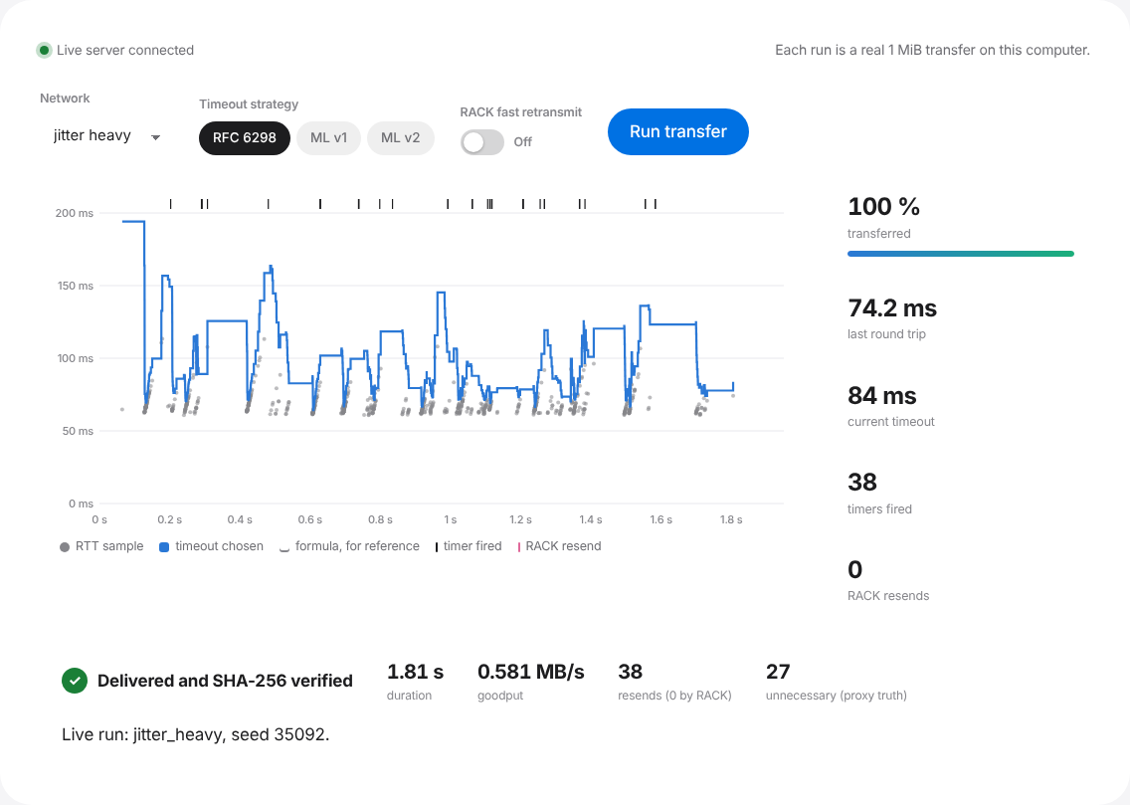
Tested thoroughly, and runnable live
ENGINEERING · LIVE DEMO
136
420/420
automated tests: fuzzing, bit flips, RTO maths, RACK timing, crashes, path traversal
transfers SHA-256 verified, twice
3
0
bugs found by testing and fixed
runtime dependencies: Python standard library only
python3 lab_server.py → localhost:8000
Notes:
Some numbers on quality. 136 automated tests, including fuzzing with random datagrams, every single-bit flip, hand-checked RTO maths and RACK timing. Every one of the 420 files was verified twice. Testing found three real bugs: the runaway backoff, a filename clash that only an independent re-hash caught, and the naive fast retransmit. Everything runs on the Python standard library. On the right is the live lab: one command starts a local server, and from the browser I can run a real transfer and watch every round trip, timeout and resend as it happens. If time allows, I will demonstrate it now.

Slide 17

Reliable always. Smarter only together
CONCLUSION
Reliability works
Limits
One machine, loopback, simulated delay
No congestion control
10 seeds per network
Next
Real links with tc netem
Congestion control (AIMD)
Train on real-network traces
All 420 files arrived intact through loss, bursts, jitter, duplication, reordering and corruption.
ML alone trades, it does not win
A learned timeout picks a point on the speed–waste curve; a shorter formula reaches the same points.
Loss detection is the bigger lever
RACK plus ML v2: +4.3 % goodput with 12 % fewer unnecessary resends.
Notes:
To conclude. The reliability layer works: every file arrived intact. Machine learning on its own does not beat a well-chosen formula; it chooses a point on the same speed-versus-waste trade-off. The bigger lever is detecting loss earlier, and with RACK in place, the calibrated ML timeout made transfers both faster and leaner than TCP's formula. The limits: one machine with simulated delay, no congestion control, and ten seeds per network. Next I would test on real links with tc netem, add congestion control, and train on real traces.

Slide 18
Thank you
Questions, or a live transfer?
FIN_ACK OK
Madhavarapu Venkata Lakshmi Jyothiradithya
24BCI0184 · Computer Networks
Notes:
Thank you. I am happy to take questions, or to run a live transfer on any of the seven networks.

