Slide 1
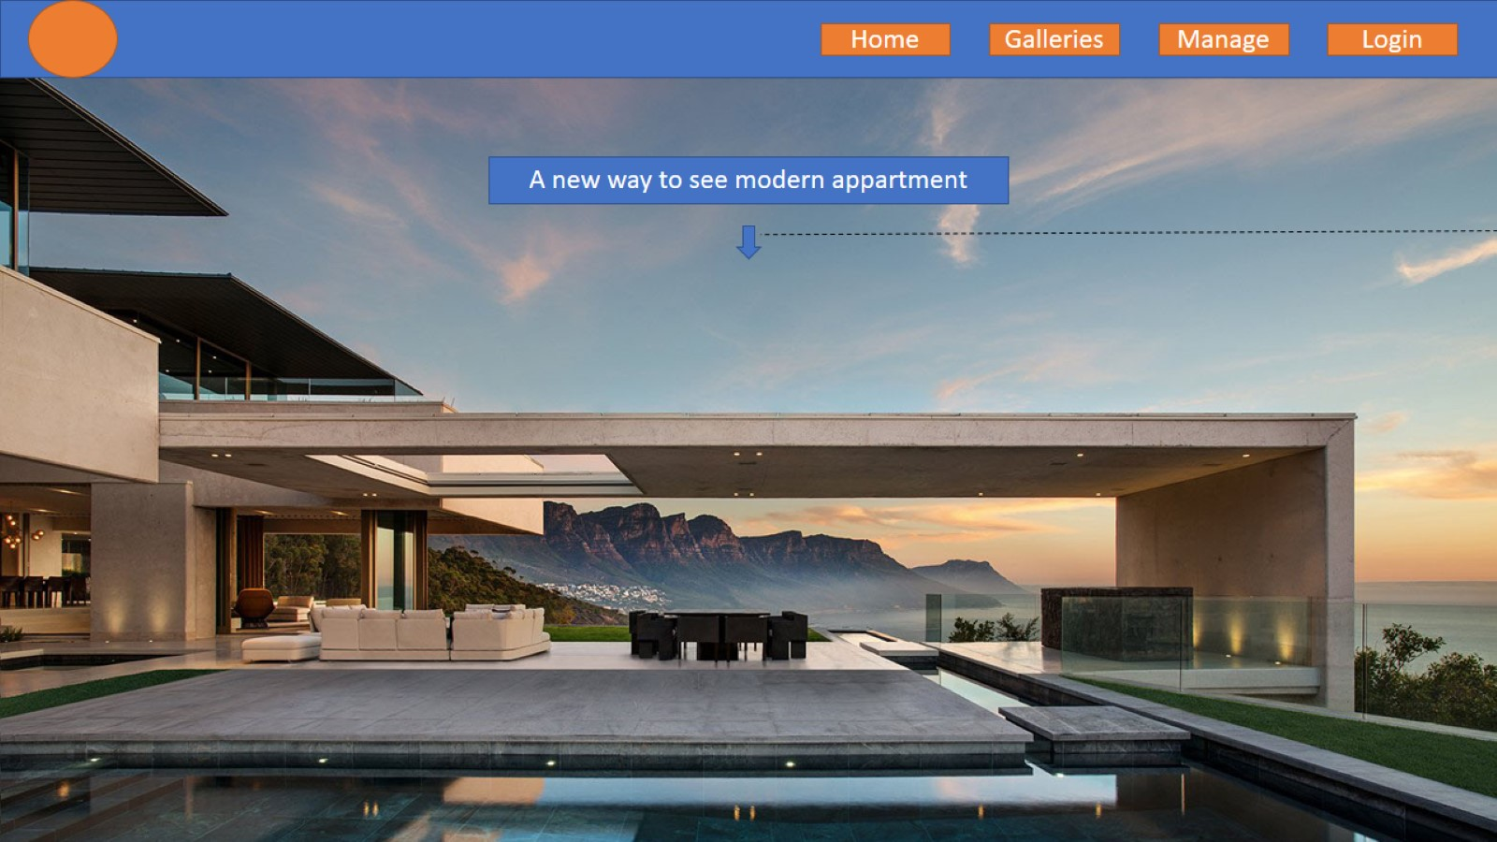

Slide 2
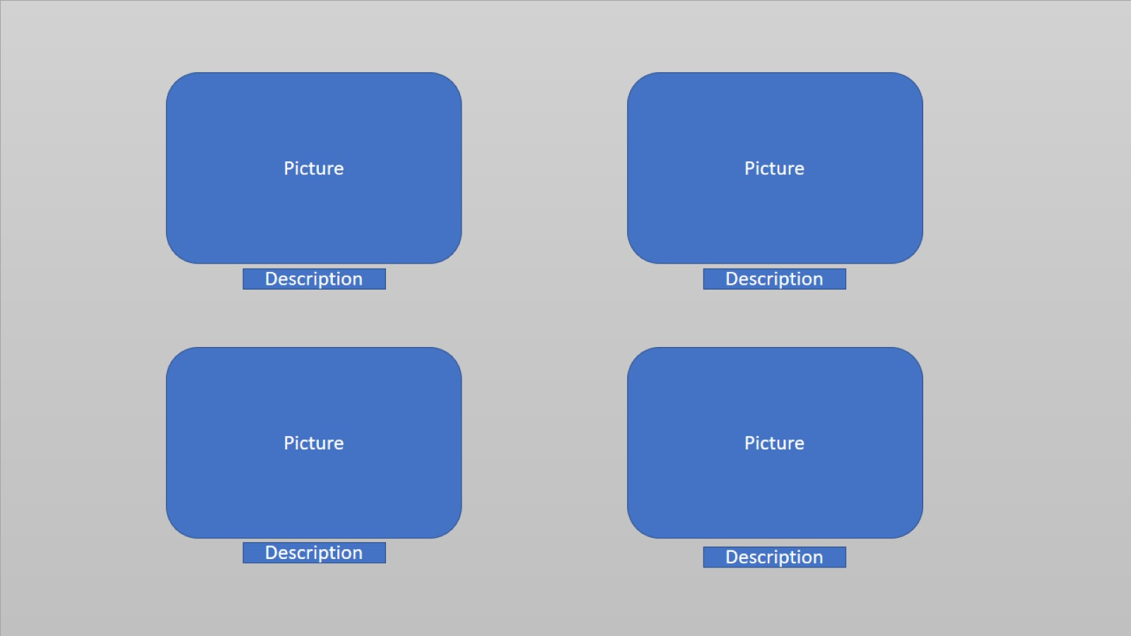

Slide 3
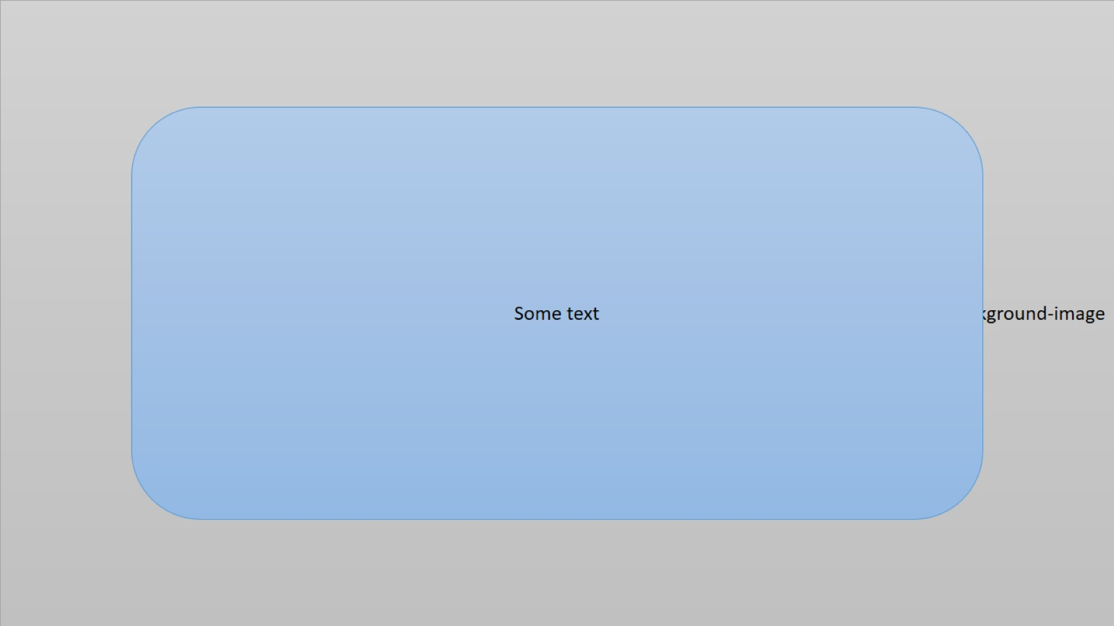

Slide 4
Title
Text
Text
Text
Image
Image

Slide 5
Contact
Social
2018 Mohamed Serhir

Slide 6
COLLECTION
What are you looking for ?
Search

Slide 7
Living room
Text
Text
Text

Slide 8
Outdoor
Text
Text
Text

Slide 9
Bedroom
Text
Text
Text

Slide 10
Kitchen
Text
Text
Text

Slide 11
Bathroom
Text
Text
Text

Slide 12
Contact
Social
2018 Mohamed Serhir

Slide 13
ADD
REMOVE
title
URL
Description
Remove
URL
Add

Slide 14
Contact
Social
2018 Mohamed Serhir

Slide 15
Image
SIGN IN
Username
Password
LOGIN
SIGN UP

Slide 16
Contact
Social
2018 Mohamed Serhir

