Slide 1
Flask React Chat App
Runs on kubernetes.
Team Members -
Suraj Mandal
Harsh Arvindbhai Tejani
Vedavyas MVN

Slide 2
Agenda
Description about application
App Installation(locally)
Dockerfile
docker-compose.yml
GitHub action to create docker image, push to docker hub
Kubernetes deployment and services
GitHub action to deploy the application on miniKube

Slide 3
To get started: Local
Run commands in terminal/PowerShell
brew install poetry
poetry shell
poetry install
Docker
docker-compose up
Kubernetes
make build
make push
make deploy

Slide 4

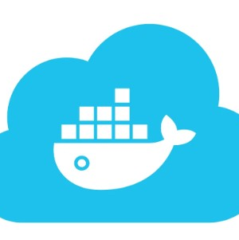

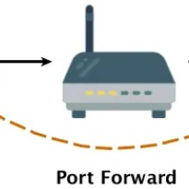
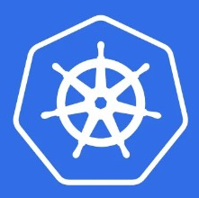
Flow
Local Development
Push to GitHub
GitHub Actions
Build Image
Push to Docker
Clone repo to GCP
Start Kubernetes using definition file
Port forwarding
Check Availability
Scale and Manage using ad hoc commands/dashboard

Slide 5
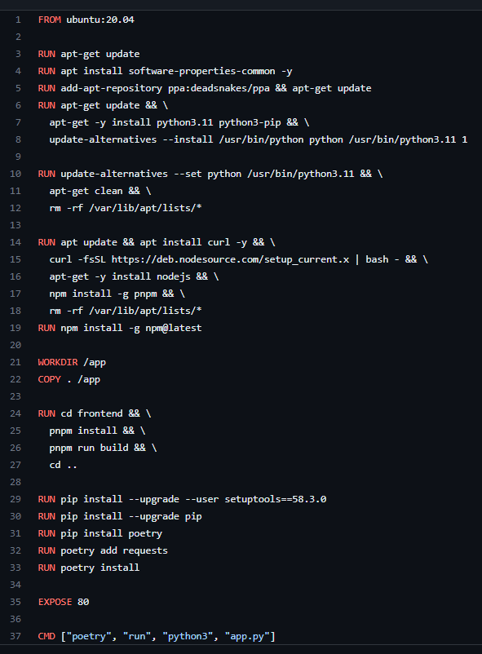
Dockerfile
Ubuntu image
Update/Install all packages in image
Install/update python, nodejs, npm
Set working directory to app, copy everything to app
Install and run frontend using pnpm
Install poetry to manage packages/dependencies that are needed to app.
Letting docker know that port 80 is available
CMD to execute instruction once container runs.

Slide 6
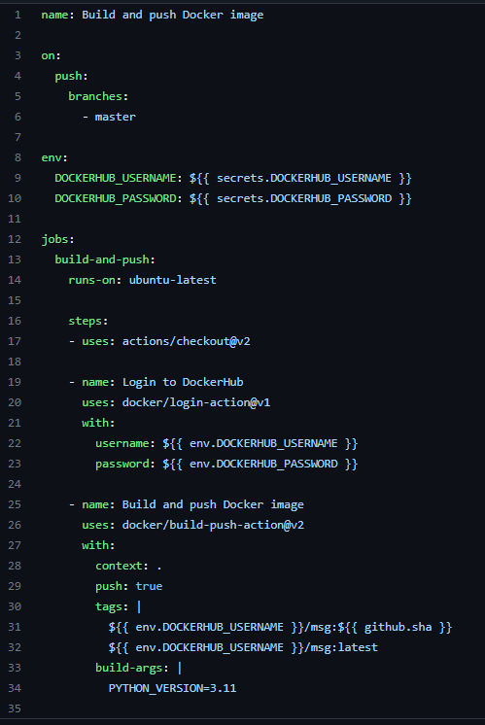
Create docker image, push to docker hub
Build, push image to docker hub

Slide 7
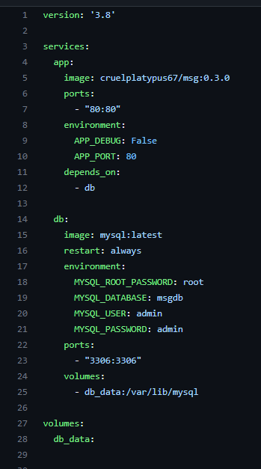
docker-compose.yml
Create a service named app, db
Tag the ran image from Dockerfile with name with key “image”
Forward all requests to port 80
Get mysql image latest
Create an session with credentials give in yaml file
Listen to port 3306, a default port for mysql
A volume that is described in db service will be used to store data in separate container volume db_data, to not lose last session data.

Slide 8
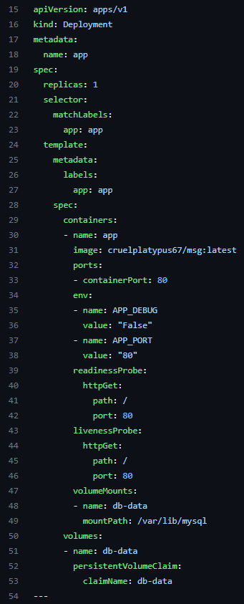
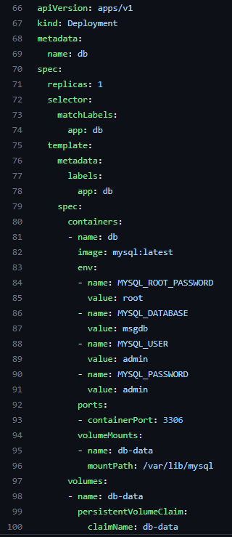
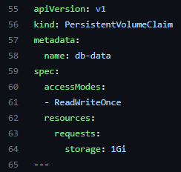
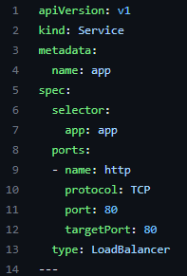
Kubernetes deployment and services
kube-def.yaml

Slide 9
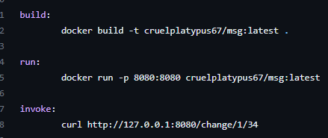


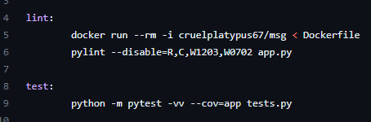
Kubernetes deployment and services
Build, run an image
Run kube
Test the syntax using lint

Slide 10
Thankyou

