Slide 1
Pedestrian tracking
VUT FIT POVa
Lukáš Petrovič, Filip Šťastný, Martin Vondráček
2019-01-09

Slide 2
Processing pipeline

Slide 3
Human detection in 2D
OpenPose deep neural network
Pretrained model with COCO dataset
Left hip, right hip, neck → bounding box

Slide 4
Person view matching
Same person captured by multiple cameras at the same time
Image histograms

Slide 5
Triangulation
Distance calculation based on height of average person’s torso
Distance planes in 3D
Intersection of two planes → person‘s position

Slide 6
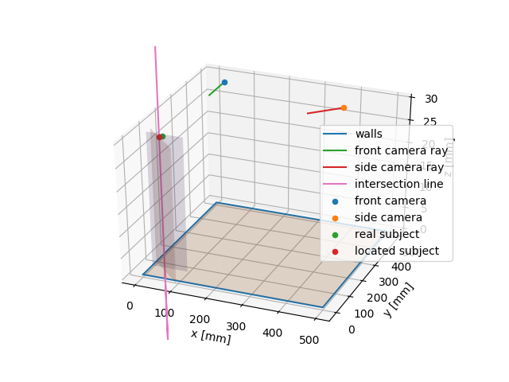
Triangulation

Slide 7
Person tracking
Based on image histograms

Slide 8
Visualisation
Shows position and orientation of cameras and path of all tracked people
User interaction in a separate thread

Slide 9
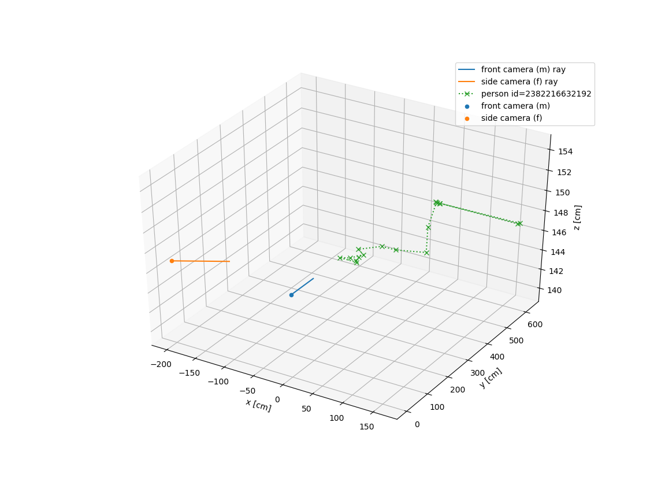
Visualisation

Slide 10
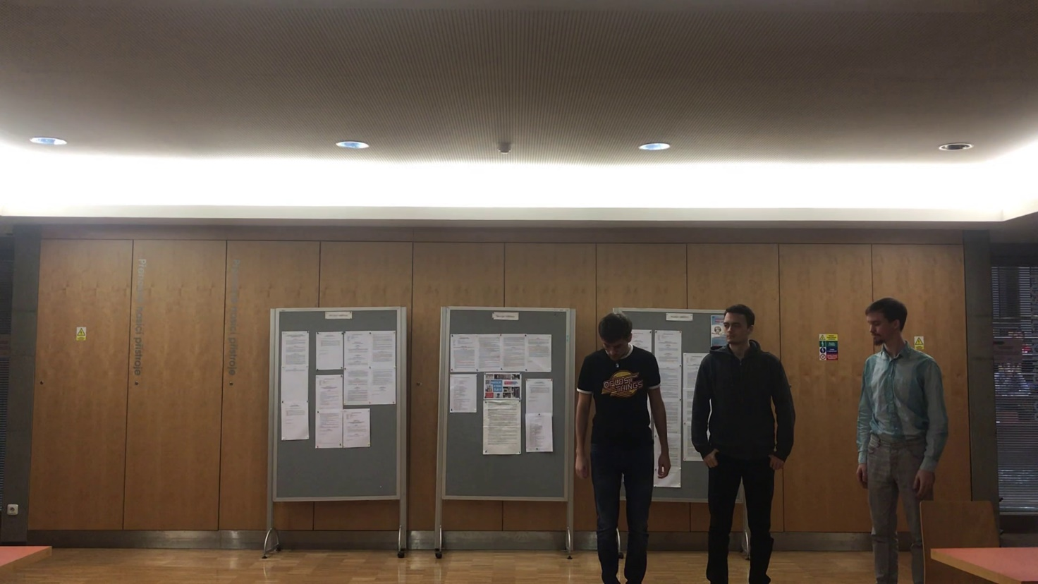
Test data
Own images, COCO dataset for OpenPose

Slide 11
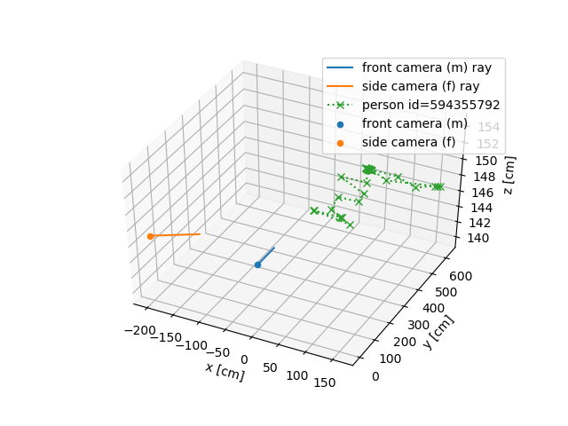
Evaluation

Slide 12
Thank you for your attention.

