Slide 1
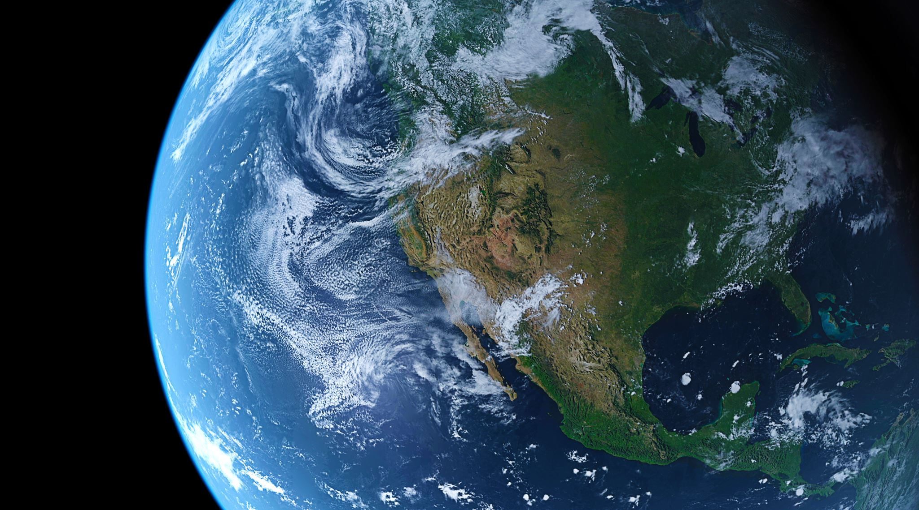

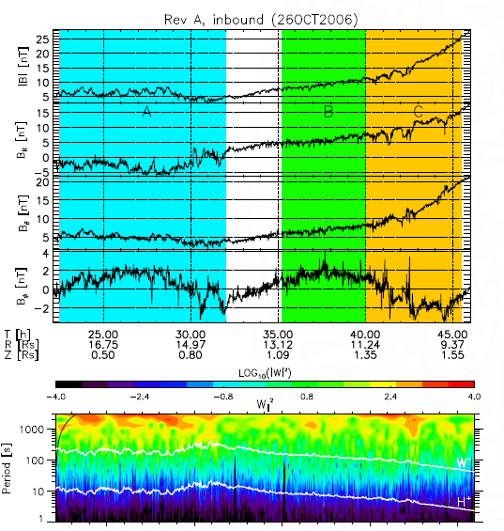
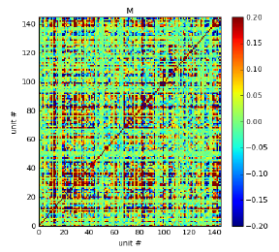
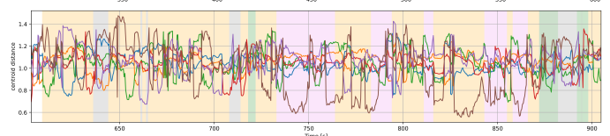
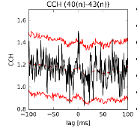
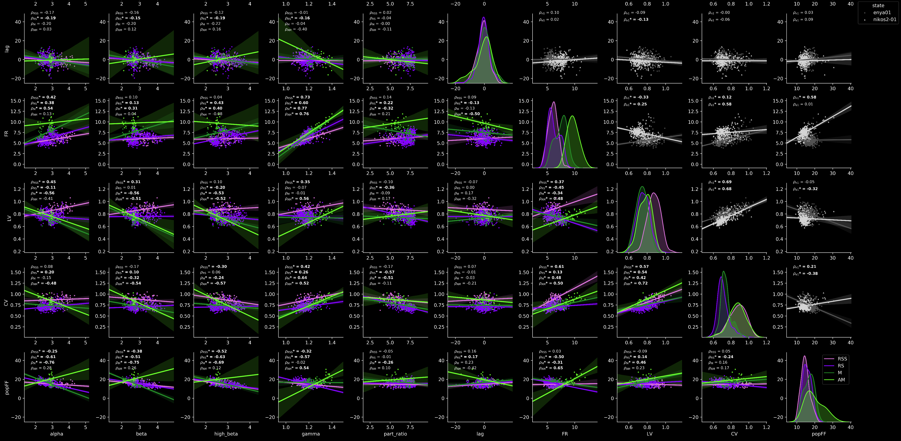
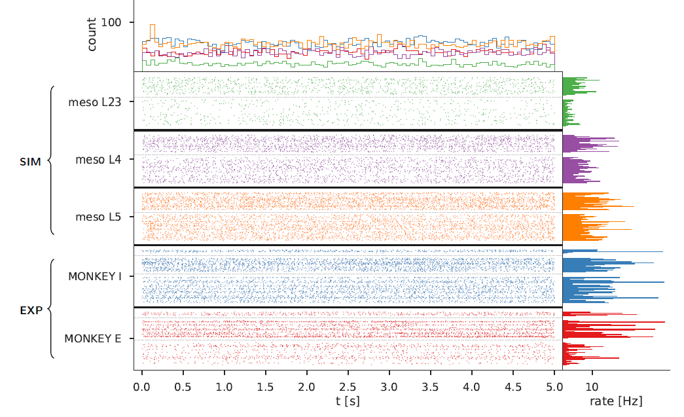
https://mvonpapen.github.io/
Mitch von Papen
Cologne
Father of two
Scientist 4 Future
2011 - 2014 : PhD in Geophysics
2014 - 2018 : PostDoc in Computational Neuroscience,
Since 2018 : Data Science Consultant
Skills
Statistics: Time Series Analysis, Causal Inference, Graph Theory,
Redimensionalization, Clustering, Validation, Modeling
Code: Python, Docker, R, Jupyter, Matlab, Git
Business: Projectmanagement, Agile, Consulting, Marketing
Editor for the Scientists4Future Podcast

Slide 2
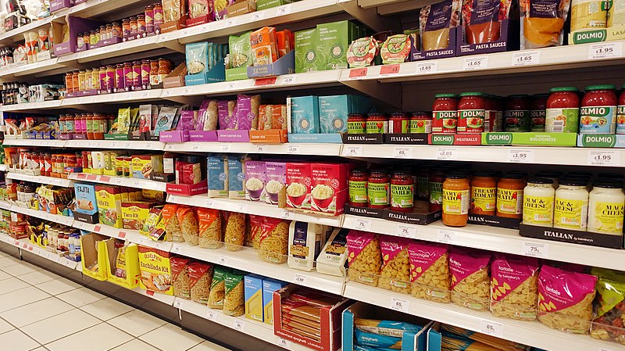



Sustainable Foods
Dietary
Gluten | Vegan
Rating
CO2 footprint | Water-use
Filter
Palm Oil | No-Nestle
"Dieses Foto" von Unbekannter Autor ist lizenziert gemäß CC BY-SA
"Dieses Foto" von Unbekannter Autor ist lizenziert gemäß CC BY-NC

