Slide 1
Tourism on Europe’s Economy
Matthew Voynovich
Data Analytics F25

Slide 2
Why is it of interest?
A lot of European Countries’ economies are heavily influenced by tourism and other social factors (Italy, Croatia, Greece) (mostly southern Europe)
Covid specifically shook up tourism and affected a lot of countries long term. The goal is to see how much tourism effects these countries and whether it is a negative or positive thing.

Slide 3
Hypothesis
An increase in tourist arrivals and related tourism expenditures are associated with an increase in the country’s GDP
Predict the GDP growth rate (or just GDP) based on tourism statistics/indicators (number of tourists, tourism revenue) and certain control variables (population, exports, etc)
  Try to correlate a % increase in tourism with % increase in GDP
Identification of which countries are most sensitive to tourism (via feature importance or coefficients).
Predictions

Slide 4
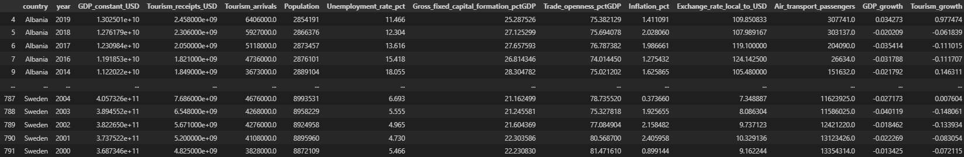
Source of Data
Source: World Bank - GDP (current US$), GDP growth (%), international tourism receipts,
international arrivals, population, etc
The data covers around 30-40 european countries over 20-30 years
Data is typically served as annual factors
Data quality is typically good but smaller nations may have some missing data or statistics

Slide 5
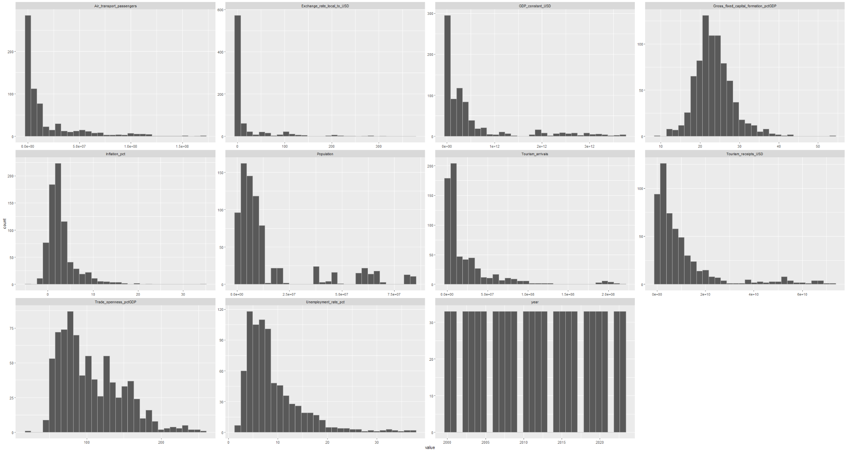
Distributions/EDA

Slide 6
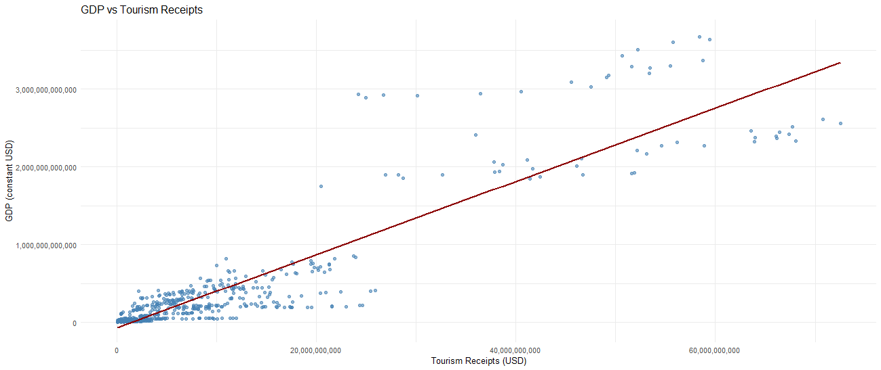
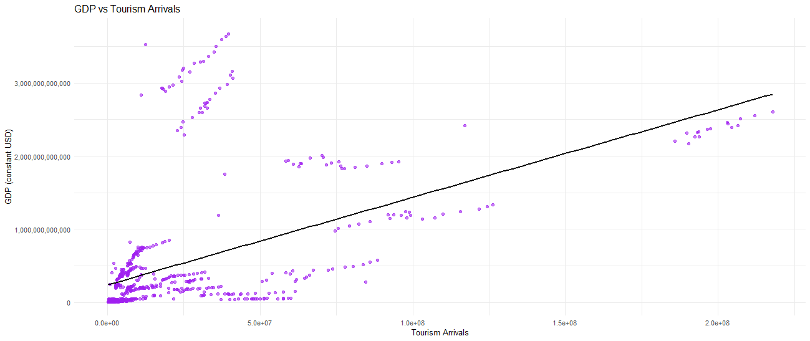
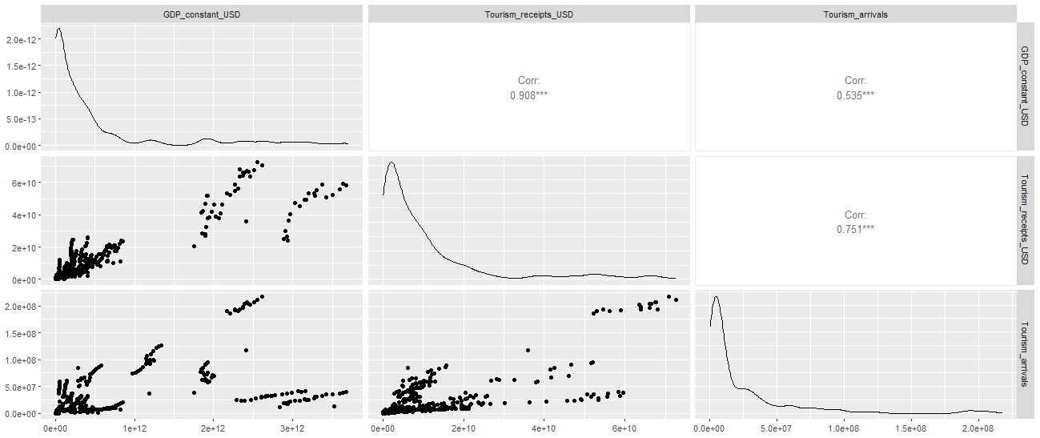
EDA Cont.

Slide 7
Modeling pt. 1
For our first question we wanted to see how well we could predict country gdp growth with tourism indicators plus the control variables we saw from the snapshot of the data.
For this we did two models:
Random forest
LightGBM (Gradient Boosting Model)
And then we evaluated with a train-test split of 80-20

Slide 8

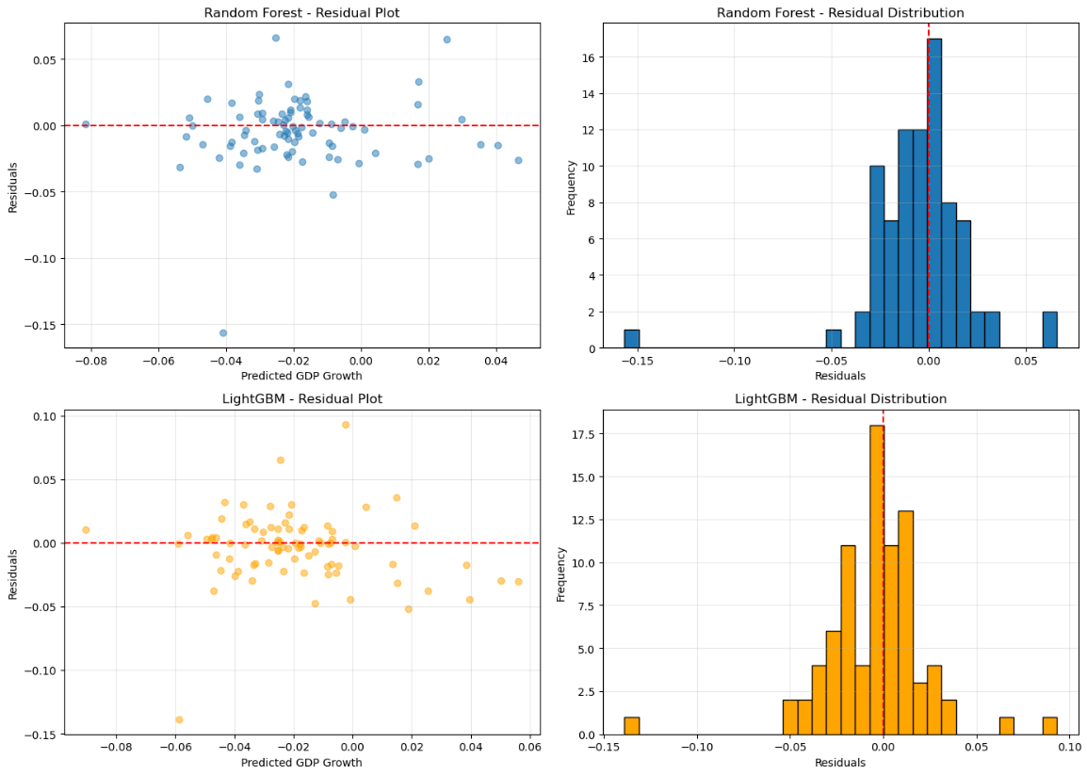
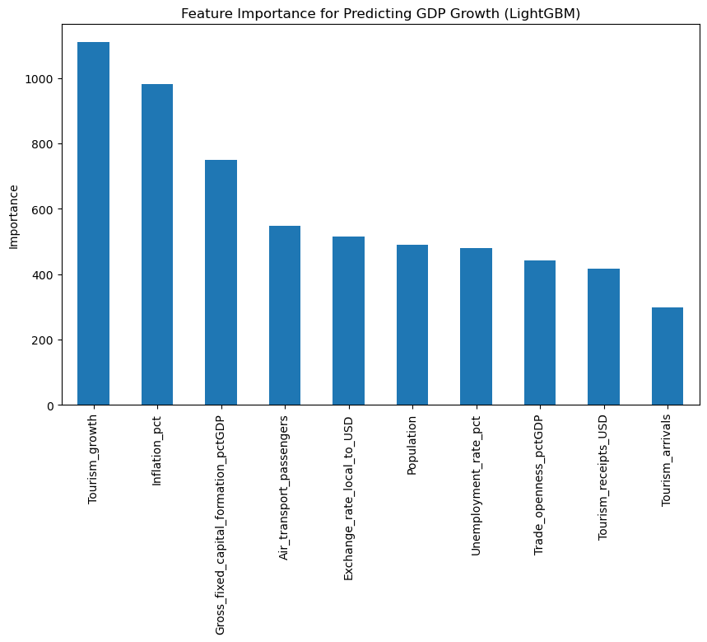
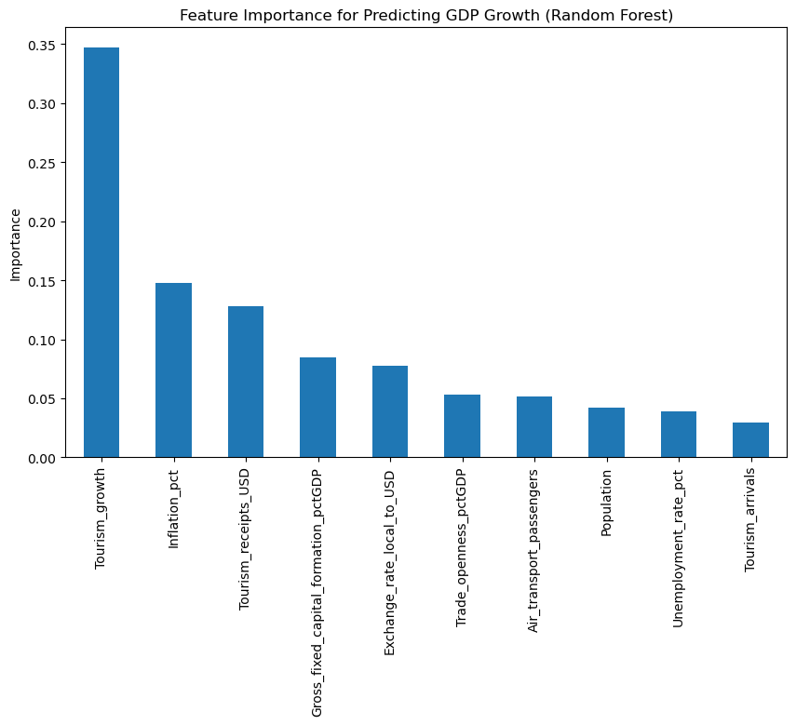
Modeling pt. 1
For GDP growth, an R^2 of .43 is pretty decent because of volatility and they are noisy. If it was just GDP then it would have been bad

Slide 9
Modeling pt. 2
We wanted an indication of which countries are most sensitive to tourism. Thus, we train models on a per country basis and get their feature importances.
For this task, we use two models:
Random Forest
XGBoost
We will see the feature importances for both and then also test their R^2 with respect to time series cross validation to see if tourism factors are predictive. Trains on past and tests on future.

Slide 10
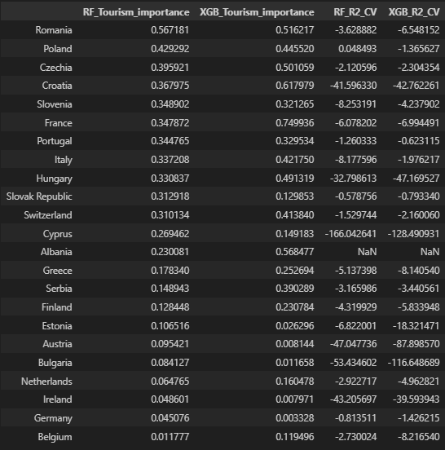
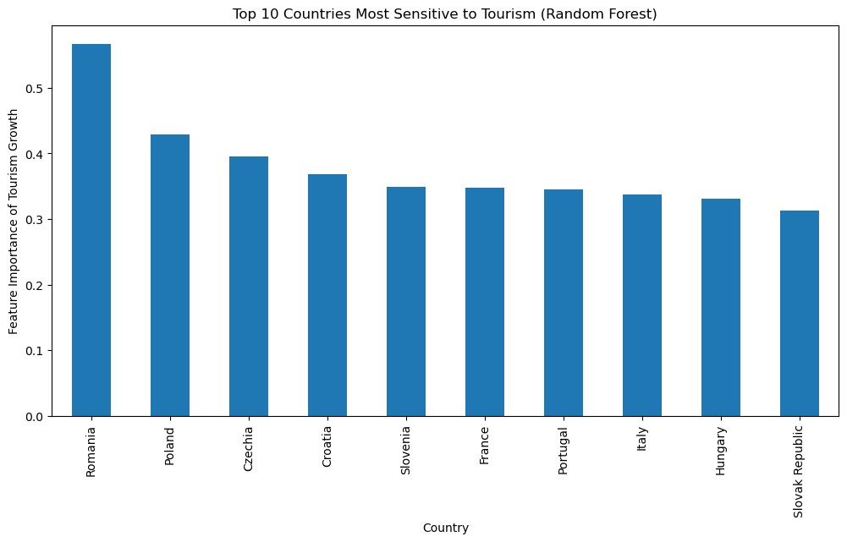
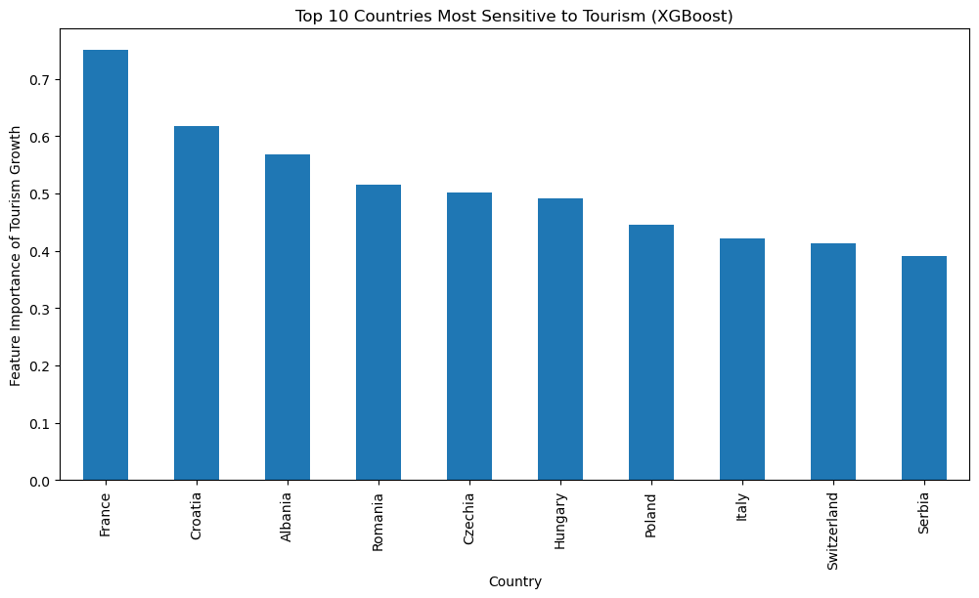
Modeling pt. 2
Random Forest feature importance is likely better as XGBoost is more sensitive to noise and over fitting (very easy for small data sets like on 30 yrs of a country’s data)
Low Time Series Cross validation R^2 reveals that tourism features have contemporaneous relationships not predictive.
Feature importances still tells
  How strongly tourism growth correlates with GDP growth in your historical data
  How much tourism helps the model explain past GDP growth variation
  Which countries are more tourism-sensitive
  This is all Independent of predictive accuracy.

Slide 11
Conclusions
Predicting European GDP Growth with tourism indicators:
When aggregating across European countries and using an 80–20 train-test split, the model explains roughly 40% of the variance in GDP growth. This suggests tourism indicators, along with standard economic controls, are moderately associated with GDP growth across Europe.
While the model generalizes better than per-country forecasts due to the larger dataset, it should not be interpreted as a strong predictive model for year-ahead GDP, as temporal dynamics and country-specific effects are not explicitly accounted for.
Per Country Modeling:
Tourism impacts GDP contemporaneously. Feature importance shows which countries’ GDP is most sensitive to tourism activity, with tourism-heavy economies (e.g., Greece, Spain, Croatia) showing the strongest relationships.
Limited predictive power. Time-series cross-validation reveals that tourism growth alone cannot reliably forecast future GDP growth. Negative or low R² values highlight high volatility and the influence of other macroeconomic factors.

