Slide 1
Phoneme–Viseme Based Deepfake Detection Using Fine-Grained Cross-Modal Analysis
3rd International Conference on Computing and Machine Learning (CML 2026)
March 8, 2026 | Online Presentation
Sikkim Manipal University, Sikkim, India
Paper ID: 771
Presenter: Kateghar Tilak
Srikanth Cherukuvada, Usha Aluru, Kateghar Tilak, Kasanagottu Sai Maniteja, Mallikarjun Patil, Paidi Geethika
Department of CSE (AI & ML)
Padmasri Dr. B V Raju Institute of Technology, Narsapur, Medak, Telangana, India, 502313

Slide 2
Problem Statement
The state-of-the-art in deep fake technology has improved to such a level that audio-visual videos are created that are indistinguishable from real ones. These advanced deep fake technologies have the capability to ensure that the audio and video are synchronized over the entire length of the video. This makes the traditional visual artifact-based approaches ineffective in detecting deep fake videos.
The traditional approaches to deep fake video detection were based on single-modal analysis. These approaches were based on detecting facial or audio anomalies in the video. However, these approaches are not effective when the audio and video in the video are jointly synthesized to a high level of quality.
Even in videos that are synchronized to a high level, there are usually small inconsistencies in phonemes and visemes. These inconsistencies are hard to detect for humans but can be captured using fine-grained computational models.
The challenge is to build a system that captures these small phoneme and viseme inconsistencies rather than relying on coarse synchronization or fusion-based approaches.

Slide 3
Proposed Solution
This work proposes a phoneme–viseme based deepfake detection framework that models the interaction between speech and corresponding lip movements at a fine-grained level.
The proposed method extracts phoneme-aware audio representations using a pretrained Wav2Vec 2.0 model and viseme-oriented visual features using a ResNet-18 backbone.
The audio and visual streams are temporally aligned to ensure that each speech segment corresponds to the correct visual frame.
A cross-modal attention mechanism is then applied to learn the relationship between phoneme embeddings and viseme embeddings. This enables the model to identify inconsistencies between spoken words and mouth articulation.
Finally, the aligned cross-modal representation is used for binary classification to determine whether the video is real or fake.

Slide 4
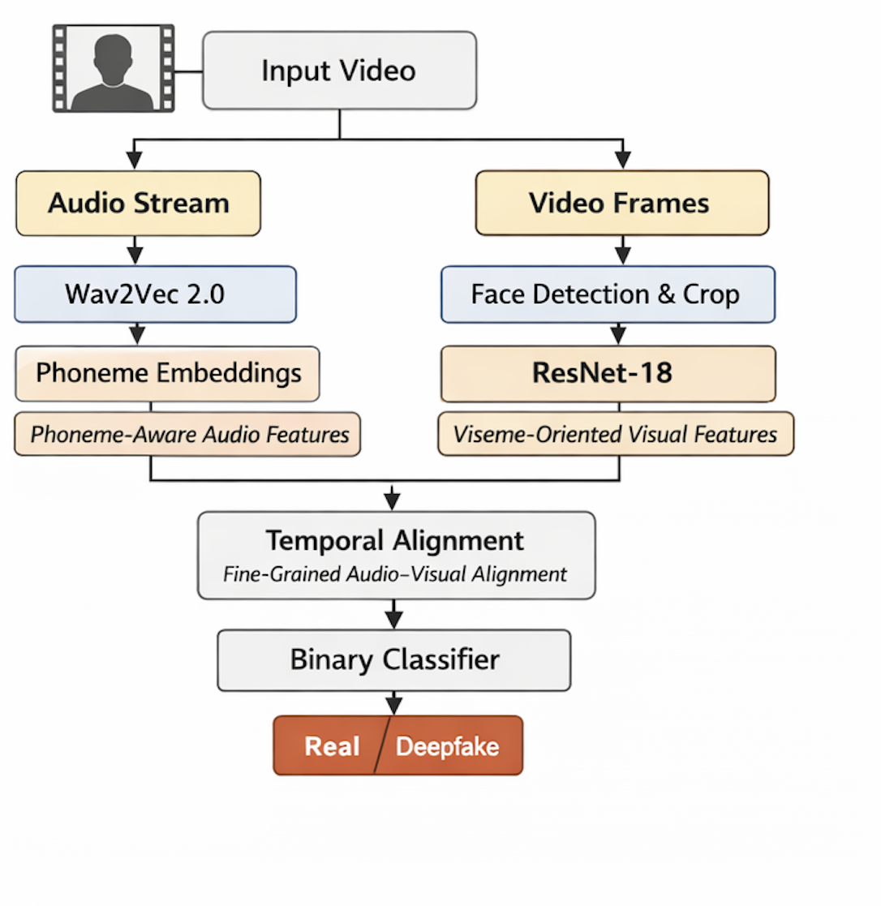

Methodology
The proposed architecture consists of the following stages:
Metadata creation and dataset preparation.
Audio feature extraction using Wav2Vec 2.0.
Visual feature extraction focusing on the mouth region.
Temporal alignment between audio and visual embeddings.
Cross-modal attention to capture phoneme–viseme correspondence.
Binary classification using fully connected layers.
The framework focuses on modeling articulation consistency rather than global synchronization.
Fig. 1. Phoneme-Viseme Based Deepfake Detection Framework

Slide 5
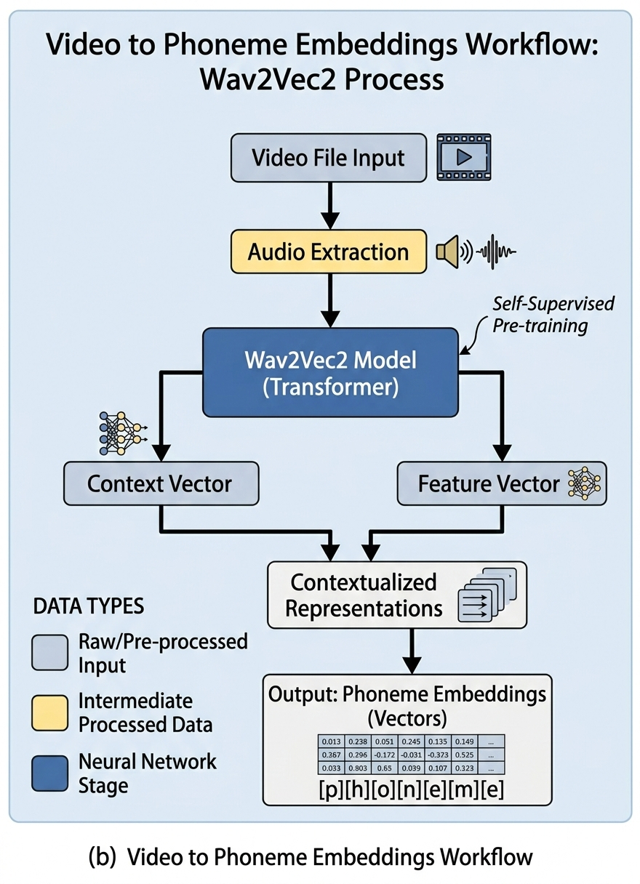
Phoneme-Aware Audio Feature Extraction
The speech signal extracted from each video is processed using a Wav2Vec 2.0 model, which is a pre-trained model to produce speech embeddings.
These speech embeddings represent the phonetic and linguistic characteristics of the speech signal without any requirement of phoneme alignment.
The audio representation maintains the fine-grained phonetic characteristics of the speech signal, which is necessary for alignment with lip movements.
To increase efficiency, the extracted audio embeddings are cached and used during the training process.
Fig. 2. Audio Embeddings

Slide 6
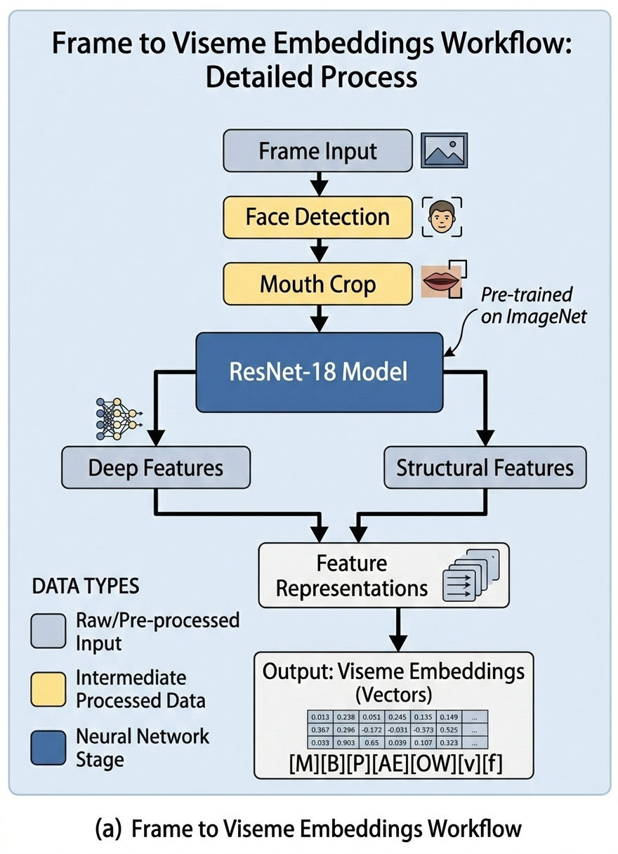
Viseme-Oriented Visual Feature Extraction
For the visual stream, face detection and alignment are performed to isolate the mouth region from each frame.
The cropped mouth images are passed through a ResNet-18 backbone to extract visual features representing lip movements.
These viseme-oriented features capture articulation patterns corresponding to speech sounds.
The focus on the mouth region allows the model to learn articulation-specific information instead of global facial features.
Fig. 3. Video Embeddings

Slide 7
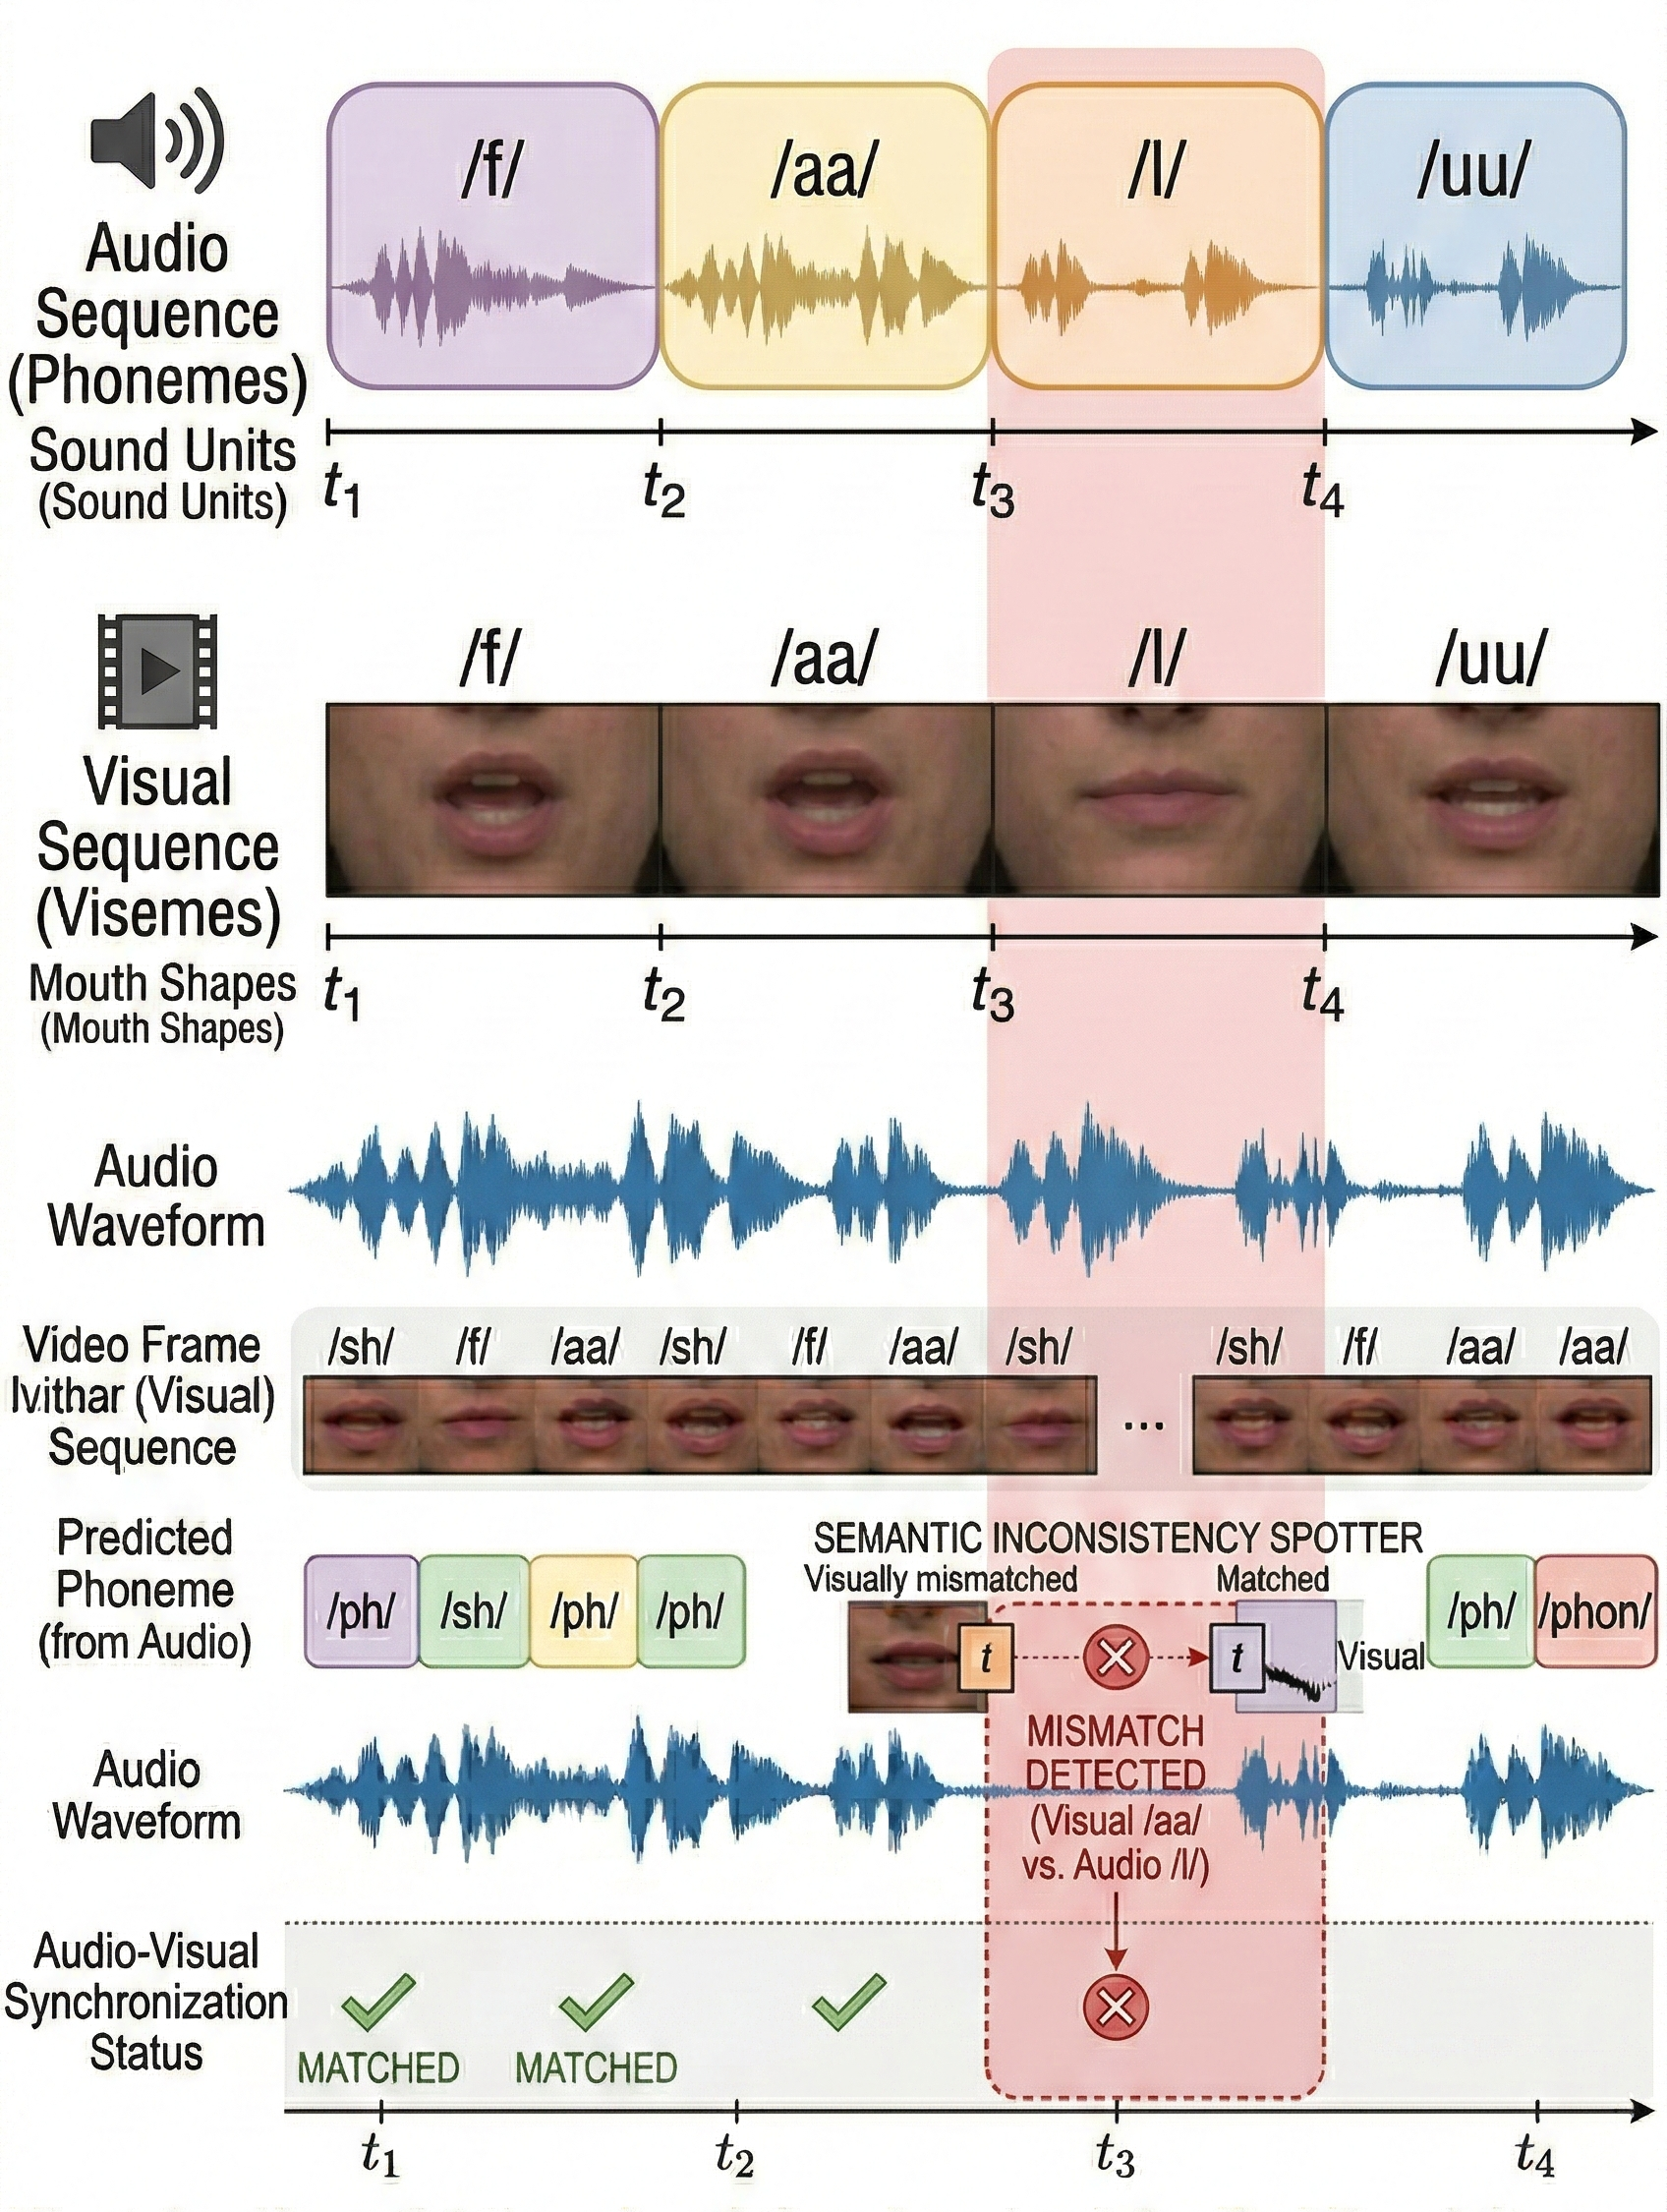
Temporal Alignment
The extracted audio and visual embeddings are aligned on the basis of their timestamps. This guarantees that the appropriate alignment between the audio and visual embeddings is achieved.
At every time step [t], the audio embedding corresponding to the phoneme is matched with the visual embedding.
This provides a one-to-one correspondence between the entire sequence and thus enables interaction.
If the model has not been aligned, the model would incorrectly identify the mismatch between the unrelated audio and visual frames.
Fig. 4. Timeline diagram showing aligned audio and visual frames.

Slide 8
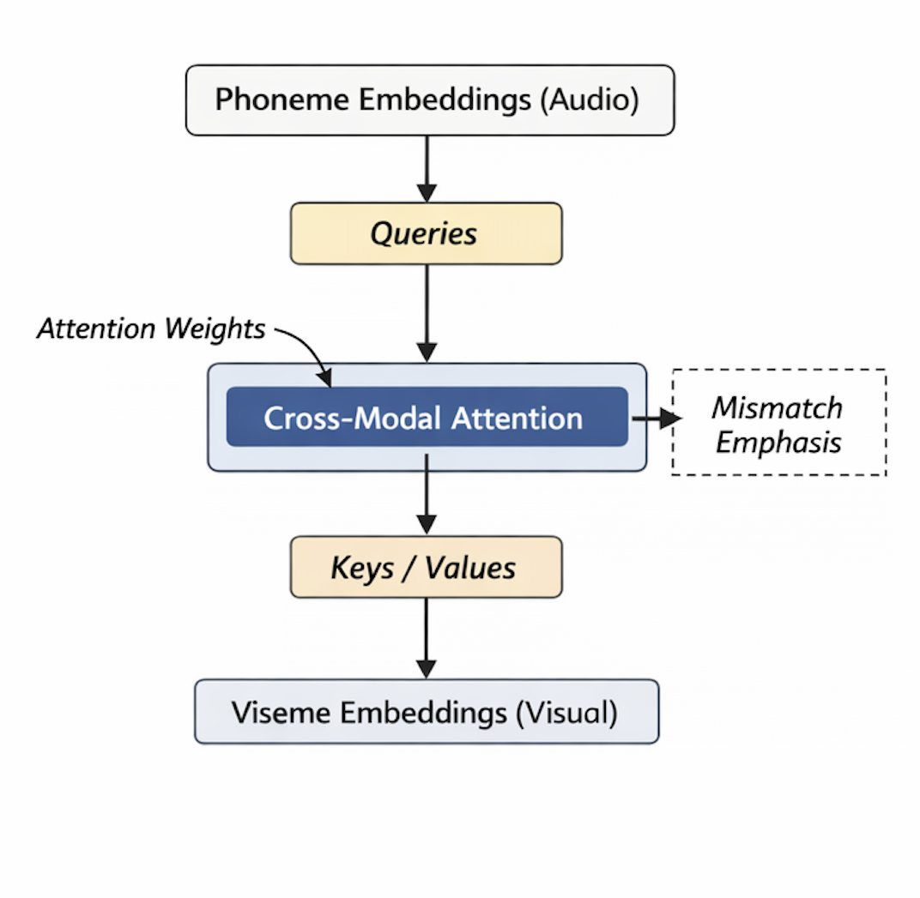
Cross-Modal Attention Mechanism
The core component of the framework is the cross-modal attention mechanism.
In this setup:
Audio embeddings act as queries. Visual embeddings act as keys and values.
The attention mechanism computes weighted interactions between audio and visual features, highlighting areas where articulation inconsistencies occur.
This mechanism enables the model to dynamically focus on visual evidence corresponding to specific speech sounds.
Unlike late fusion methods, this representation-level interaction allows the detection of fine-grained phoneme–viseme mismatches.
Fig. 5. Cross-Modal Attention Framework

Slide 9
Implementation
Tools and Technology Stack
Programming Environment
Python
Jupyter Notebook
Deep Learning Framework
PyTorch
Audio Processing
Wav2Vec 2.0 (pretrained model)
Torchaudio
Visual Processing
OpenCV (frame extraction)
Face detection and mouth cropping
ResNet-18 (pretrained CNN backbone)

Slide 10
Implementation
Tools and Technology Stack
Data Handling
NumPy
Pandas
Metadata-based dataset management
Visualization
Matplotlib
Scikit-learn (ROC curve, confusion matrix)
Hardware
T4 GPU provided by the Google Colab environment (for training acceleration)
Data Preprocessing Pipeline
The implementation begins with structured metadata generation for the FakeAV dataset. Each entry contains:
Video path
Label (real or fake)
Subject identity

Slide 11
Implementation
Data Preprocessing Pipeline
This ensures reproducibility and subject-independent splitting.
From each video:
Audio is extracted and resampled.
Frames are extracted from the video stream.
Face detection is performed.
Mouth region is cropped and resized.
This preprocessing pipeline ensures that both audio and visual inputs are standardized before feature extraction
Audio Feature Extraction
Speech signals are passed through a pretrained Wav2Vec 2.0 model implemented in PyTorch.
The model generates contextual phoneme-aware embeddings without requiring explicit phoneme segmentation.

Slide 12
Implementation
Audio Feature Extraction
To improve training efficiency:
Extracted embeddings are cached to disk
Feature reuse avoids repeated forward passes
This significantly reduces computational overhead during multiple training epochs.
Visual Feature Extraction
For the visual stream, the following are used:
OpenCV is used to extract frames
Face detection is used to extract the face region
Normalization of the mouth region is done
The cropped images are then passed through a ResNet-18 backbone to obtain feature embeddings that are viseme-oriented.
The choice of the ResNet-18 is due to a good balance between efficiency and effectiveness.

Slide 13
Implementation
Temporal Alignment
Audio and visual embeddings are aligned frame-wise using timestamps.
For each time step [t]:
Phoneme embedding aₜ corresponds to visual embedding vₜ
This ensures that the attention mechanism compares semantically relevant audio and visual information.
Improper alignment would lead to incorrect mismatch detection.
Cross-Modal Attention Module
The attention mechanism is implemented using PyTorch tensor operations.
Audio embeddings are used as queries. Visual embeddings are used as keys and values.
The attention layer computes weighted interactions between modalities, enabling the model to focus on visual articulation evidence corresponding to speech sounds.
The attended output is globally pooled and passed through a fully connected layer for classification
Classification Layer
This layer is responsible to predict the outcome of the deepfake detection such as whether the video is Real (or) Fake.

Slide 14
Implementation
Training Configuration
Training is performed using:
Optimizer: AdamW
Loss Function: Binary Cross Entropy
Learning Rate: 1 × 10⁻⁴
Weight Decay: 1 × 10⁻²
Batch Size: 32
Epochs: 50
To address dataset imbalance:
Class weighting is applied
To select the optimal operating point:
Validation F1-score is computed across thresholds
Optimal threshold = 0.05
Same threshold applied to test set
Early stopping is incorporated to prevent overfitting.

Slide 15
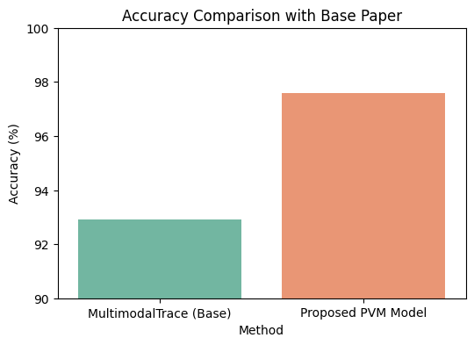
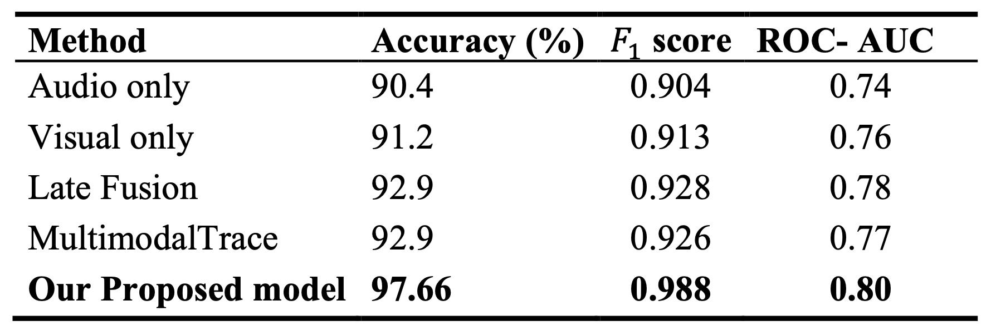
Results
Quantitative Results
The proposed phoneme–viseme based framework achieves:
Accuracy: 97.66%
F1-Score: 0.988
ROC-AUC: 0.80
The model demonstrates stable performance across validation and test splits, indicating strong generalization under subject-independent evaluation.
Comparison with Baselines

Slide 16
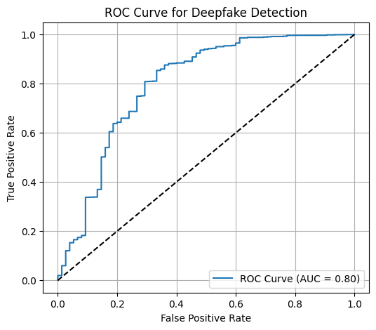
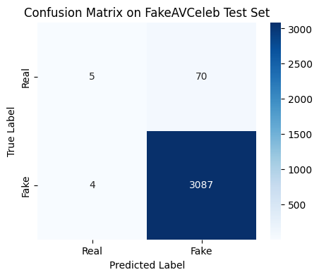
Results
ROC Curve and Confusion Matrix
The confusion matrix shows the relation of Low false positives and Low false negatives
The ROC curve confirms consistent discrimination across operating thresholds.
The optimized threshold (0.05) yields the best balance between precision and recall under class imbalance conditions.

Slide 17
Challenges
One of the major issues that had to be addressed was the computational complexity involved in processing the audio-visual data. The processing of the data, especially in the case of the Wav2Vec 2.0 model for the extraction of phoneme-aware embeddings and ResNet-18 for the extraction of viseme-oriented features, was a major computational challenge.
Another major challenge that was observed was in the precise temporal alignment of the audio and video data. It was observed that any kind of misalignment in the phoneme embeddings and the corresponding viseme features would impact the performance of the cross-modal attention mechanism.
There was a significant imbalance in the data set, with a higher number of manipulated samples compared to the authentic samples. This had to be addressed while making the predictions.
Another major challenge that was observed was in the stability of the model, especially because of the cross-modal attention mechanism, which is prone to becoming sensitive to noisy features.
Finally, one of the major issues that had to be addressed was in making sure that all the experiments were performed in a similar fashion, so that a comparison with the baseline models could be made.

Slide 18
Conclusion and Future Work
Conclusion
In this research, a deepfake detection framework based on phoneme and viseme is proposed. This framework aims to capture the fine-grained cross-modal inconsistencies between speech and lip movement.
The model uses a cross-modal attention mechanism to integrate phoneme-aware audio embeddings and viseme-oriented visual features, which allows the model to capture inconsistencies in speech and lip movement that cannot be identified using traditional models.
The performance of the model is tested using the FakeAV dataset, and the model shows good performance with an accuracy of 97.66% and F1-score of 0.988, which proves that fine-grained articulation consistency is a reliable forensic feature for deepfake detection.
Future Work
Future extensions of this work include:
Evaluating the framework on additional large-scale datasets to study cross-dataset generalization.
Enhancing temporal modeling for improved robustness under extreme compression or noise.
Improving probability calibration to increase ROC-AUC performance.
Exploring lightweight model variants for real-time deployment.

Slide 19
Thank You

