Slide 1
Phoneme–Viseme Based Deepfake Detection Using Fine-Grained Cross-Modal Analysis
3rd International Conference on Computing and Machine Learning (CML 2026)
March 8, 2026 | Online Presentation
Sikkim Manipal University, Sikkim, India
Paper ID: 771
Presenter: Kateghar Tilak
Srikanth Cherukuvada, Usha Aluru, Kateghar Tilak, Kasanagottu Sai Maniteja, Mallikarjun Patil, Paidi Geethika
Department of CSE (AI & ML)
Padmasri Dr. B V Raju Institute of Technology, Narsapur, Medak, Telangana, India, 502313

Slide 2
Problem Statement
The state-of-the-art in deep fake technology has improved to such a level that audio-visual videos are created that are indistinguishable from real ones. These advanced deep fake technologies have the capability to ensure that the audio and video are synchronized over the entire length of the video. This makes the traditional visual artifact-based approaches ineffective in detecting deep fake videos.
The traditional approaches to deep fake video detection were based on single-modal analysis. These approaches were based on detecting facial or audio anomalies in the video. However, these approaches are not effective when the audio and video in the video are jointly synthesized to a high level of quality.
Even in videos that are synchronized to a high level, there are usually small inconsistencies in phonemes and visemes. These inconsistencies are hard to detect for humans but can be captured using fine-grained computational models.
The challenge is to build a system that captures these small phoneme and viseme inconsistencies rather than relying on coarse synchronization or fusion-based approaches.

Slide 3
Proposed Solution
This work proposes a phoneme–viseme based deepfake detection framework that models the interaction between speech and corresponding lip movements at a fine-grained level.
The proposed method extracts phoneme-aware audio representations using a pretrained Wav2Vec 2.0 model and viseme-oriented visual features using a ResNet-18 backbone.
The audio and visual streams are temporally aligned to ensure that each speech segment corresponds to the correct visual frame.
A cross-modal attention mechanism is then applied to learn the relationship between phoneme embeddings and viseme embeddings. This enables the model to identify inconsistencies between spoken words and mouth articulation.
Finally, the aligned cross-modal representation is used for binary classification to determine whether the video is real or fake.

Slide 4
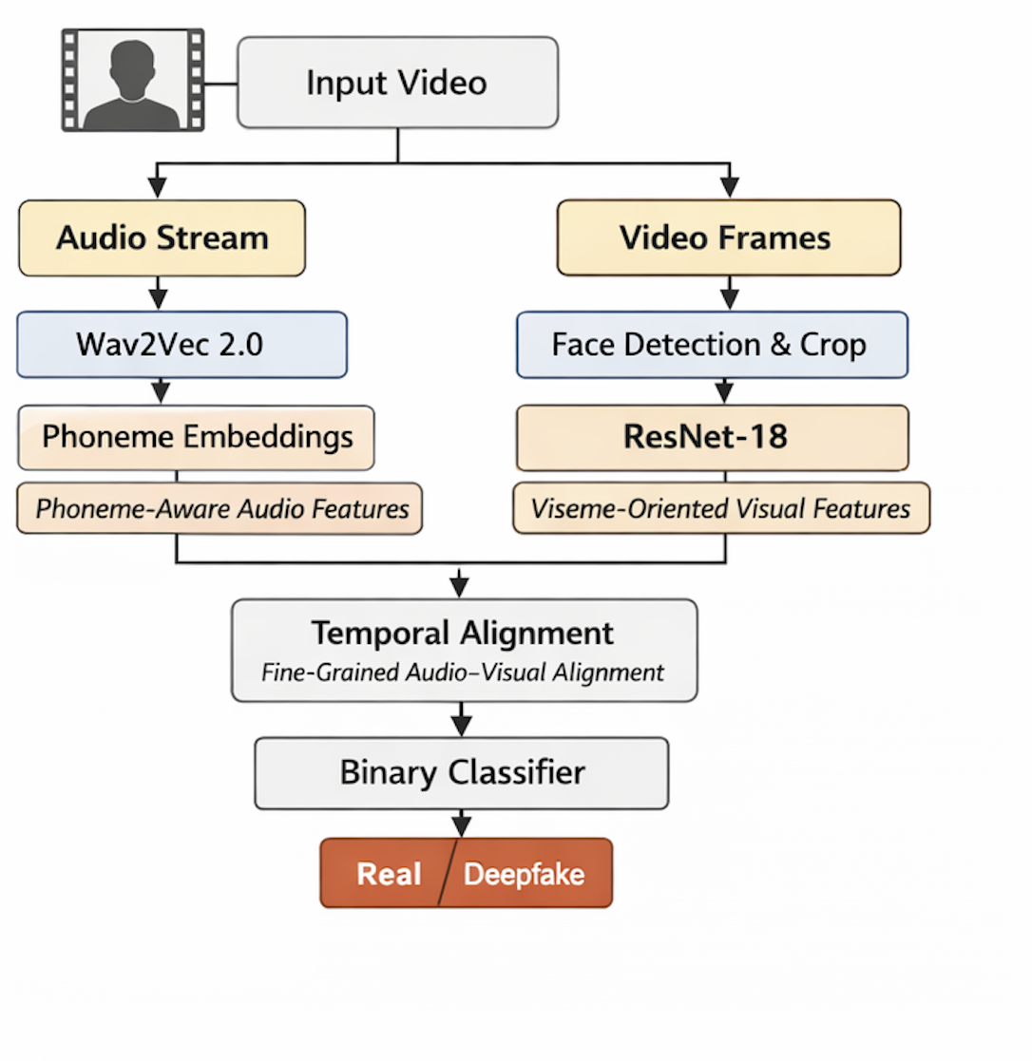

Methodology
The proposed architecture consists of the following stages:
Metadata creation and dataset preparation.
Audio feature extraction using Wav2Vec 2.0.
Visual feature extraction focusing on the mouth region.
Temporal alignment between audio and visual embeddings.
Cross-modal attention to capture phoneme–viseme correspondence.
Binary classification using fully connected layers.
The framework focuses on modeling articulation consistency rather than global synchronization as shown in the Fig. 1..
Fig. 1. Phoneme-Viseme Based Deepfake Detection Framework

Slide 5
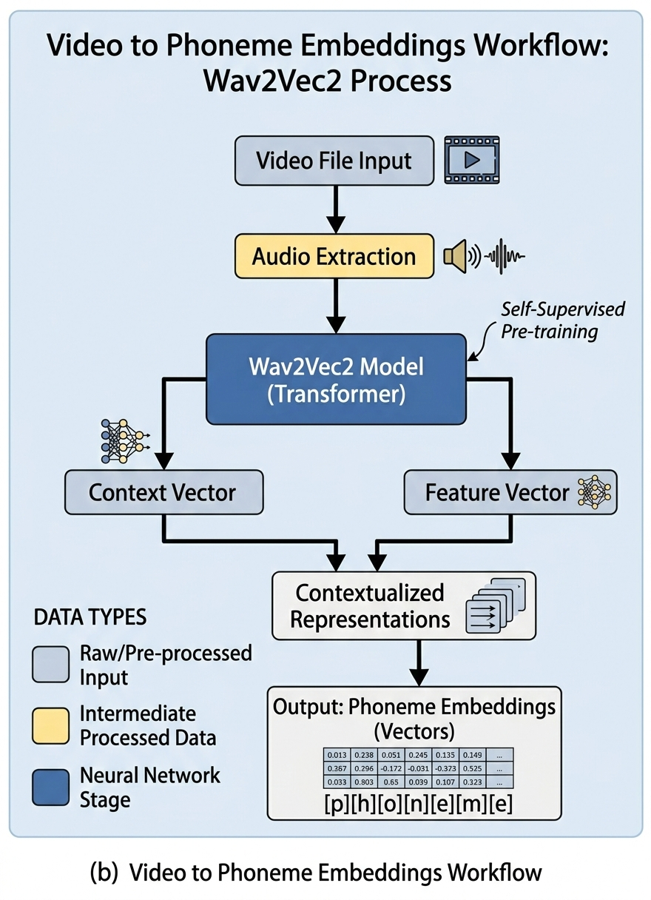
Phoneme-Aware Audio Feature Extraction
The speech signal extracted from each video is processed using a Wav2Vec 2.0 model, which is a pre-trained model to produce speech embeddings as shown in the Fig. 2..
These speech embeddings represent the phonetic and linguistic characteristics of the speech signal without any requirement of phoneme alignment.
The audio representation maintains the fine-grained phonetic characteristics of the speech signal, which is necessary for alignment with lip movements.
Fig. 2. Audio Embeddings

Slide 6
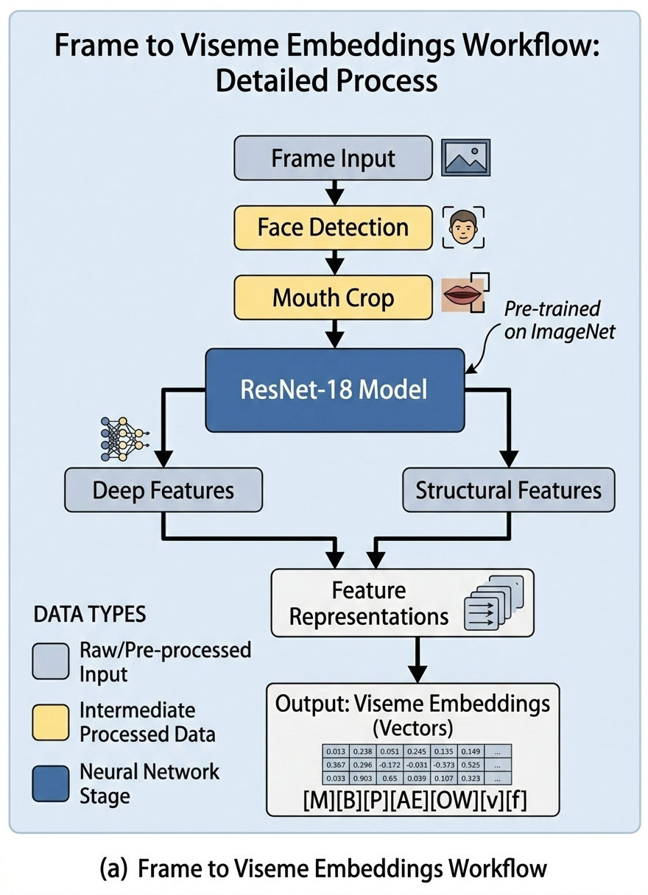
Viseme-Oriented Visual Feature Extraction
For the visual stream, face detection and alignment are performed to isolate the mouth region from each frame as shown in the Fig. 3..
The cropped mouth images are passed through a ResNet-18 backbone to extract visual features representing lip movements.
These viseme-oriented features capture articulation patterns corresponding to speech sounds.
The focus on the mouth region allows the model to learn articulation-specific information instead of global facial features.
Fig. 3. Video Embeddings

Slide 7
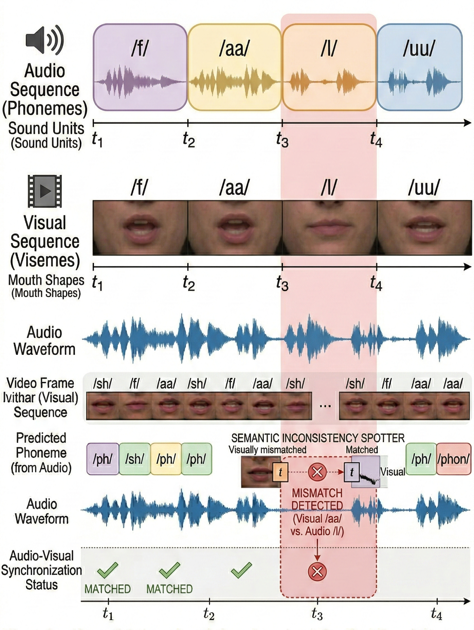
Temporal Alignment
The extracted audio and visual embeddings are aligned on the basis of their timestamps. This guarantees that the appropriate alignment between the audio and visual embeddings is achieved as shown in the Fig. 4..
At every time step [t], the audio embedding corresponding to the phoneme is matched with the visual embedding.
This provides a one-to-one correspondence between the entire sequence and thus enables interaction.
If the model has not been aligned, the model would incorrectly identify the mismatch between the unrelated audio and visual frames.
Fig. 4. Timeline diagram showing aligned audio and visual frames.

Slide 8
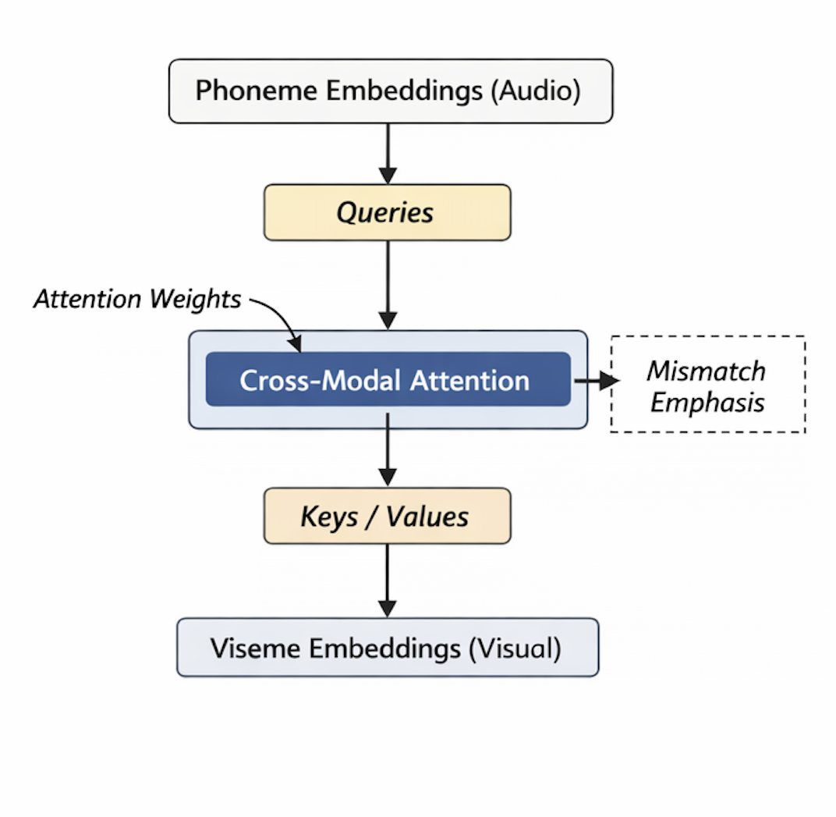
Cross-Modal Attention Mechanism
The core component of the framework is the cross-modal attention mechanism which is as represented in the Fig. 5..
In this setup:
Audio embeddings act as queries. Visual embeddings act as keys and values.
The attention mechanism computes weighted interactions between audio and visual features, highlighting areas where articulation inconsistencies occur.
This mechanism enables the model to dynamically focus on visual evidence corresponding to specific speech sounds.
Unlike late fusion methods, this representation-level interaction allows the detection of fine-grained phoneme–viseme mismatches.
Fig. 5. Cross-Modal Attention Framework

Slide 9
Dataset Information
FakeAVCeleb v1.2
A large-scale audio-visual deepfake dataset designed to analyze inconsistencies between speech and facial articulation.
Contains 21k+ videos with controlled combinations of real and manipulated audio and video streams
Enables evaluation of multimodal deepfake detection systems
Manipulation Categories
RealVideo – RealAudio
FakeVideo – RealAudio
RealVideo – FakeAudio
FakeVideo – FakeAudio
Labeling Strategy
RealVideo–RealAudio → Real
Any manipulated audio or video → Fake
Data Handling
Subject-wise train / validation / test split
Prevents identity leakage between splits
Ensures fair generalization and unbiased evaluation
Reference: FakeAVCeleb Dataset (Khalid et al.)

Slide 10
Key Technologies used in the Implementation
Python & Deep Learning Frameworks: Python will be used as the primary programming language along with deep learning libraries such as PyTorch for implementing and training neural network models.
Audio Feature Extraction (Wav2Vec 2.0): The Wav2Vec 2.0 model will be used to extract phoneme-aware speech embeddings from audio signals to capture linguistic and acoustic patterns.
Computer Vision Techniques: OpenCV and ResNet-18 CNN architecture will be used for face detection, mouth region extraction, and viseme-based visual feature extraction from video frames.
Cross-Modal Learning and Attention Mechanisms: Cross-modal attention techniques will be used to integrate audio and visual features, enabling the detection of phoneme–viseme inconsistencies in manipulated videos.
Dataset and Evaluation Tools: The FakeAV dataset will be used for training and testing the model, while performance will be evaluated using metrics such as Accuracy, Precision, Recall, and F1-Score.

Slide 11
Implementation
Data Preprocessing Pipeline
This ensures reproducibility and subject-independent splitting.
From each video:
Audio is extracted and resampled.
Frames are extracted from the video stream.
Face detection is performed.
Mouth region is cropped and resized.
This preprocessing pipeline ensures that both audio and visual inputs are standardized before feature extraction
Audio Feature Extraction
Speech signals are passed through a pretrained Wav2Vec 2.0 model implemented in PyTorch.
The model generates contextual phoneme-aware embeddings without requiring explicit phoneme segmentation.

Slide 12
Implementation
Visual Feature Extraction
For the visual stream, the following are used:
OpenCV is used to extract frames
Face detection is used to extract the face region
Normalization of the mouth region is done
The cropped images are then passed through a ResNet-18 backbone to obtain feature embeddings that are viseme-oriented.
The choice of the ResNet-18 is due to a good balance between efficiency and effectiveness
Temporal Alignment
Audio and visual embeddings are aligned frame-wise using timestamps.
For each time step [t]:
Phoneme embedding aₜ corresponds to visual embedding vₜ
This ensures that the attention mechanism compares semantically relevant audio and visual information.
Improper alignment would lead to incorrect mismatch detection.

Slide 13
Implementation
Cross-Modal Attention Module
The attention mechanism is implemented using PyTorch tensor operations.
The audio embeddings are used as queries and the visual embeddings are used as keys and values.
The attention layer computes weighted interactions between modalities, enabling the model to focus on visual articulation evidence corresponding to speech sounds.
The attended output is globally pooled and passed through a fully connected layer for classification
Classification Layer
This layer is responsible to predict the outcome of the deepfake detection such as whether the video is Real (or) Fake.

Slide 14
Implementation
Training Configuration
Training is performed using:
Optimizer: AdamW
Loss Function: Binary Cross Entropy
Learning Rate: 1 × 10⁻⁴
Weight Decay: 1 × 10⁻²
Batch Size: 32
Epochs: 50
To address dataset imbalance:
Class weighting is applied
To select the optimal operating point:
Validation F1-score is computed across thresholds
Optimal threshold = 0.05
Same threshold applied to test set
Early stopping is incorporated to prevent overfitting.

Slide 15
Quantitative Results
The proposed phoneme–viseme based framework achieves:
Accuracy: 97.66%
F1-Score: 0.988
ROC-AUC: 0.80
The model demonstrates stable performance across validation and test splits, indicating strong generalization under subject-independent evaluation.
Comparison with Baselines
Method | Accuracy (%) | F1​-Score | ROC- AUC
Audio only | 90.4 | 0.904 | 0.74
Visual only | 91.2 | 0.913 | 0.76
Late Fusion (Baseline) | 92.9 | 0.928 | 0.78
Our Proposed model | 97.66 | 0.988 | 0.8

Slide 16
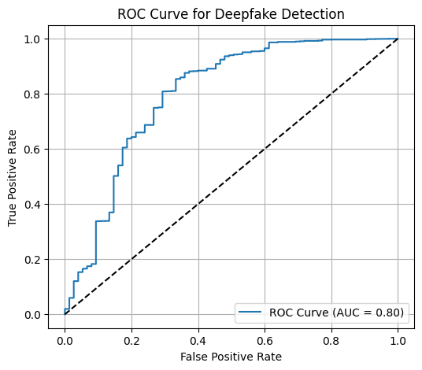
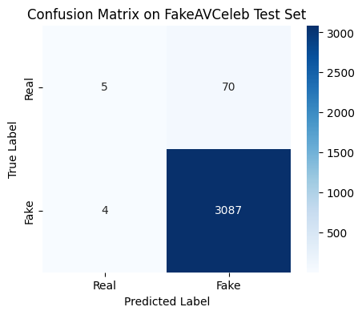
Quantitative Results
ROC Curve and Confusion Matrix
The confusion matrix shows the relation of Low false positives and Low false negatives
The ROC curve confirms consistent discrimination across operating thresholds.
The optimized threshold (0.05) yields the best balance between precision and recall under class imbalance conditions.

Slide 17
Conclusion and Future Work
Conclusion
In this research, a deepfake detection framework based on phoneme and viseme is proposed. This framework aims to capture the fine-grained cross-modal inconsistencies between speech and lip movement.
The model uses a cross-modal attention mechanism to integrate phoneme-aware audio embeddings and viseme-oriented visual features, which allows the model to capture inconsistencies in speech and lip movement that cannot be identified using traditional models.
The performance of the model is tested using the FakeAV dataset, and the model shows good performance with an accuracy of 97.66% and F1-score of 0.988, which proves that fine-grained articulation consistency is a reliable forensic feature for deepfake detection.
Future Work
Future extensions of this work include:
Evaluating the framework on additional large-scale datasets to study cross-dataset generalization.
Enhancing temporal modeling for improved robustness under extreme compression or noise.
Improving probability calibration to increase ROC-AUC performance.
Exploring lightweight model variants for real-time deployment.

Slide 18
Thank You

