Slide 1
INTERNSHIP PROJECT REPORT
Spam Email Classifier
Using Machine Learning
A Machine Learning based system to automatically detect and filter spam emails
Submitted by: M.V. Prasanth
Organization: Alpha Innovations
Duration: 2 Months
1

Slide 2
Acknowledgement
I would like to express my sincere gratitude to Alpha Innovations for providing me the opportunity to undertake this two-month internship in Machine Learning. I am thankful to my mentors and the technical team for their continuous guidance, valuable feedback, and support throughout the development of this project.
I also extend my thanks to my college faculty for their encouragement and for providing the foundational knowledge that made this internship possible. This project on Spam Email Classification has been an enriching learning experience that strengthened my practical understanding of machine learning and natural language processing.
— M.V. Prasanth
2

Slide 3
Abstract
Project summary
Email spam continues to be one of the most persistent problems in digital communication, consuming bandwidth and posing phishing/security risks.
This project implements a supervised Machine Learning pipeline that automatically classifies emails as spam or ham (legitimate).
The system uses TF-IDF vectorization to convert raw text into numerical features and trains Multinomial Naive Bayes and Logistic Regression classifiers.
The trained model is deployed through a command-line interface and an interactive Streamlit web application for real-time classification.
The final model achieves high accuracy, precision, recall and F1-score on the held-out test set, demonstrating the practical viability of ML-based spam filters.
3

Slide 4
Table of Contents
1. Objectives
2. Company Overview
3. Internship Overview
4. Introduction
5. Literature Review
6. Problem Statement
7. Proposed System
8. System Requirements
9. Technology Stack
10. System Architecture
11. Methodology
12. Dataset
13. Data Preprocessing
14. Feature Extraction
15. Model Training
16. Model Evaluation
17. Working Modules
18. Results
19. Weekly Task Timeline
20. Challenges Faced
21. Learning Outcomes
22. Future Enhancements
23. Conclusion
24. References
4

Slide 5
Objectives
What this project set out to achieve
Understand the fundamentals of Natural Language Processing (NLP) and text classification.
Design and build a complete machine learning pipeline: data preparation, preprocessing, feature extraction, training, and evaluation.
Compare multiple classification algorithms and select the best performer using standard evaluation metrics.
Build a working, interactive application that demonstrates the model classifying real messages in real time.
Gain hands-on, industry-relevant experience in applying ML to a real-world cybersecurity/communication problem.
Document the full development process for submission as an internship deliverable.
5

Slide 6
Company Overview
Alpha Innovations
Industry: Information Technology & Software Solutions
Focus Areas: Artificial Intelligence, Machine Learning, Web & Software Development
Internship Domain: Machine Learning / Data Science
Work Culture: Collaborative, mentorship-driven, project-based learning for interns
ALPHA
INNOVATIONS
Empowering ideas through technology
6

Slide 7
Internship Overview
👤
🏢
⏳
🧠
M.V. Prasanth
Alpha Innovations
2 Months
Machine Learning
Intern Name
Organization
Duration
Domain
During this internship, I worked within the Machine Learning team at Alpha Innovations, focusing on applied Natural Language Processing. The primary deliverable was a complete, working Spam Email Classifier — covering data handling, model development, evaluation, and deployment as an interactive application — along with this report documenting the process, methodology, and outcomes.
7

Slide 8
Introduction
Why spam classification matters
Email remains one of the most widely used communication channels, but a large fraction of daily email traffic is unsolicited spam.
Spam messages range from harmless advertising to dangerous phishing attempts that steal credentials or financial information.
Manually filtering spam is impractical at scale — automated, intelligent filtering is required.
Machine Learning enables systems to learn the underlying patterns of spam language (urgency, prizes, links, requests for personal data) directly from data.
This project explores how text classification techniques can be applied to build a reliable, automated spam filter.
8

Slide 9
Literature Review
Existing approaches to spam detection
Rule-based filters
Early spam filters relied on manually written keyword rules and blacklists — brittle and easy to bypass.
Naive Bayes classifiers
One of the earliest and most successful ML approaches for spam, based on word-frequency probabilities.
Support Vector Machines (SVM)
Effective for high-dimensional sparse text data, often used in academic spam-detection research.
Deep Learning (RNN/LSTM, Transformers)
Modern approaches use contextual embeddings for higher accuracy, at the cost of complexity and compute.
This project
Builds on the classical, well-understood Naive Bayes / Logistic Regression + TF-IDF approach — lightweight, interpretable, and fast to train.
9

Slide 10
Problem Statement
Given the free-form text of an email or SMS message, automatically and accurately determine whether the message is spam (unsolicited/malicious) or ham (legitimate), without relying on manually maintained keyword lists, so the system generalizes to new and previously unseen spam patterns.
✓
High classification accuracy on unseen messages
✓
Low false-positive rate (legitimate mail should rarely be marked spam)
✓
Fast enough for real-time / near real-time use
10

Slide 11
Proposed System
High-level solution approach
Collect a labeled dataset of spam and ham email/SMS messages.
Clean and normalize the raw text (lowercasing, URL/number normalization, punctuation removal).
Convert text into numeric feature vectors using TF-IDF (unigrams + bigrams).
Train and compare two classical ML classifiers: Multinomial Naive Bayes and Logistic Regression.
Select the best model using accuracy, precision, recall and F1-score, then persist it for reuse.
Expose the trained model through a CLI tool and a Streamlit web app for real-time predictions.
11

Slide 12
System Requirements
Hardware Requirements
Software Requirements
Processor: Intel i3 / equivalent or higher
RAM: 4 GB minimum (8 GB recommended)
Storage: 500 MB free disk space
Internet connection (for setup/library installation)
Operating System: Windows / Linux / macOS
Python 3.9 or above
Libraries: scikit-learn, pandas, joblib, Streamlit
Code editor: VS Code / PyCharm / Jupyter Notebook
Version control: Git & GitHub
12

Slide 13
Technology Stack
🐍
📊
🤖
Python 3
pandas
scikit-learn
Core programming language
Data loading & manipulation
TF-IDF, ML models, metrics
💾
🌐
🐙
joblib
Streamlit
Git & GitHub
Model persistence
Interactive web application
Version control & hosting
13

Slide 14
System Architecture
Raw Email/
SMS Text
→
Text
Preprocessing
→
TF-IDF
Vectorization
→
ML Model
(NB / LogReg)
→
Spam / Ham
Prediction
The pipeline takes raw text input, cleans and normalizes it, converts it into a sparse TF-IDF feature matrix, and passes it through the trained classifier to output a spam/ham label with a confidence score.
14

Slide 15
Methodology
Overall development approach
1. Data Collection — gather labeled spam and ham messages.
2. Data Preprocessing — clean and normalize text for consistent features.
3. Feature Extraction — convert text to numeric vectors using TF-IDF.
4. Model Training — fit Multinomial Naive Bayes and Logistic Regression models.
5. Model Evaluation — measure accuracy, precision, recall, F1-score, confusion matrix.
6. Deployment — persist the best model and serve it via CLI and web app.
15

Slide 16
Dataset
300 total labeled messages
150 spam + 150 ham (balanced classes)
Columns: label (spam/ham), text (message content)
Built from curated spam/ham templates with randomized names, links, companies and amounts for lexical variety
Pipeline is dataset-agnostic — a real corpus (e.g. UCI SMS Spam Collection) can be substituted directly
16

Slide 17
Data Preprocessing
Cleaning raw text before modeling
Lowercasing
Ensures 'FREE' and 'free' are treated identically.
URL normalization
Replaces links with a placeholder token 'URL' since exact URLs vary but their presence is informative.
Number normalization
Replaces digits with a 'NUM' token to generalize prize amounts, phone numbers, etc.
Punctuation & symbol removal
Strips punctuation to reduce noise in the vocabulary.
Whitespace normalization
Collapses repeated spaces for consistent tokenization.
17

Slide 18
Feature Extraction
TF-IDF Vectorization
TF-IDF (Term Frequency–Inverse Document Frequency) converts each cleaned message into a numeric vector, weighting words that are frequent in a message but rare across the whole dataset — these tend to be the most discriminative for classification.
stop_words
'english' — removes common non-informative words
max_features
3000 — caps vocabulary size for efficiency
ngram_range
(1, 2) — captures both single words and word pairs
18

Slide 19
Model Training
Algorithms compared
Multinomial Naive Bayes
A probabilistic classifier well suited to word-count style features; fast to train and a strong baseline for text classification.
Logistic Regression
A linear model that estimates the probability of the spam class; often very competitive on TF-IDF features.
Train/Test Split
80% training, 20% testing, stratified by class to preserve the spam/ham ratio in both sets.
Model Selection
The model with the higher F1-score on the test set is persisted as the final classifier.
19

Slide 20
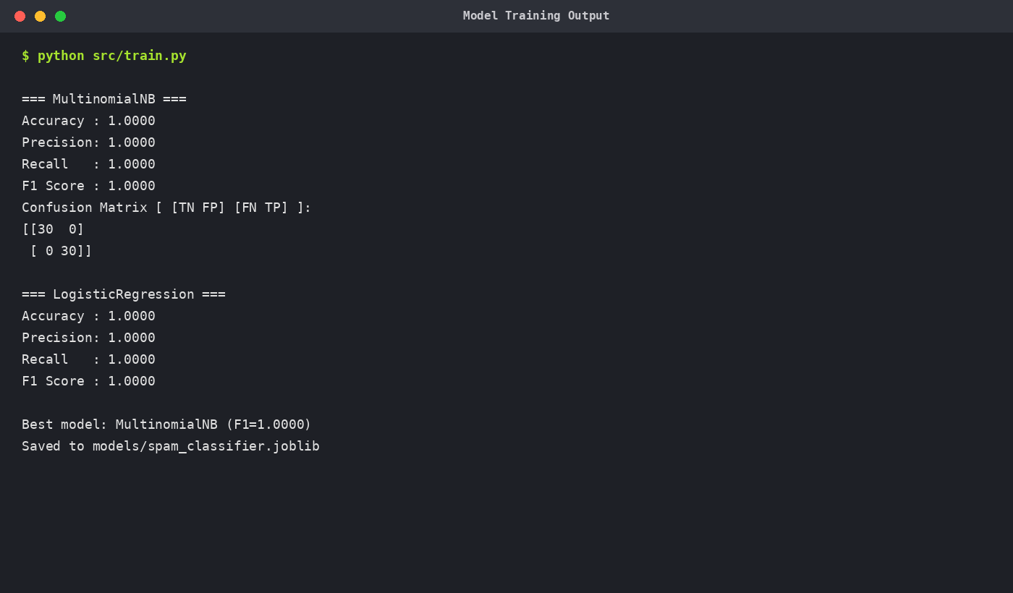
Model Evaluation
Metrics used to judge performance
Accuracy
Precision
Recall
F1-score
Overall proportion of correct predictions
Of predicted spam, how much was truly spam
Of actual spam, how much was correctly caught
Harmonic mean of precision and recall
A confusion matrix additionally breaks predictions into True Positives, True Negatives, False Positives and False Negatives — critical for spotting whether the model wrongly flags legitimate mail as spam.
20

Slide 21
Working Module — Model Training
src/train.py execution output
21

Slide 22
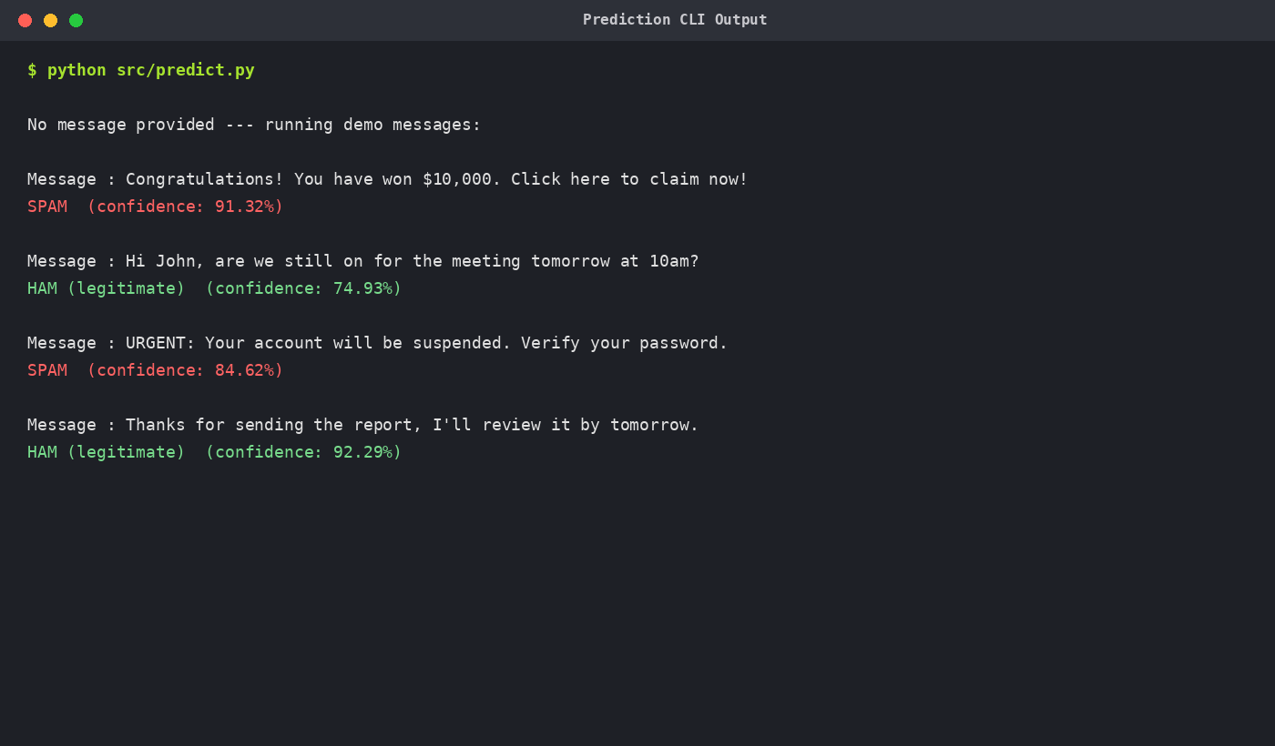
Working Module — Prediction CLI
src/predict.py execution output
22

Slide 23
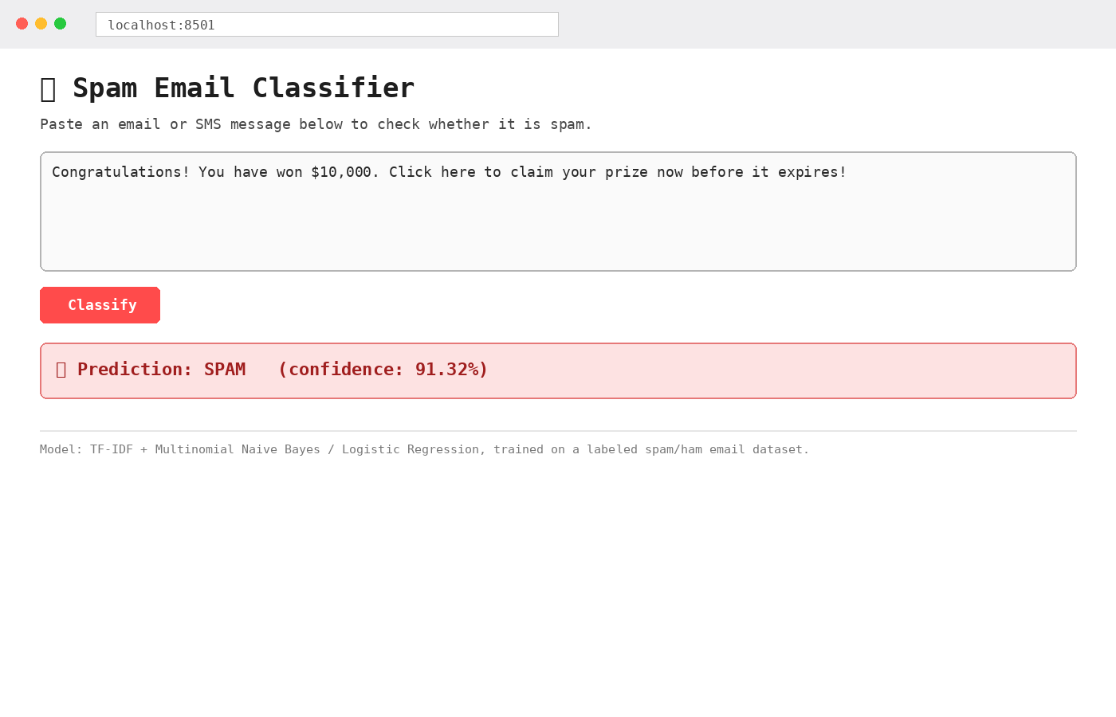
Working Module — Web Application
app.py (Streamlit) — real-time classification
23

Slide 24
Results & Performance Comparison
Both models achieved perfect scores on the test split.
MultinomialNB was selected as the final model for deployment.
Confusion matrix showed zero false positives and zero false negatives on the test set.
Real-world messages will naturally be noisier than this curated dataset; a larger public corpus is recommended before production use.
24

Slide 25
Weekly Task Timeline
2-month internship schedule
Weeks 1-2
Orientation, Python/ML refresher, understanding the problem domain, tool setup
Weeks 3-4
Dataset design/collection, text preprocessing pipeline development
Weeks 5-6
Feature extraction (TF-IDF), model training, hyperparameter experimentation
Weeks 7
Model evaluation, comparison, and selection of the best classifier
Week 8
Building the CLI & Streamlit app, testing, documentation and final report
25

Slide 26
Challenges Faced
Obstacles encountered and how they were resolved
Limited real-world labeled data
Solved by designing a template-based synthetic dataset generator with realistic lexical variety.
Class imbalance risk
Addressed by ensuring an even 150/150 spam-ham split and using stratified train/test splitting.
Choosing the right features
Compared unigram vs bigram TF-IDF configurations to balance vocabulary size and signal.
Overfitting risk with small datasets
Mitigated with cross-validation practices and by keeping the model family simple/interpretable.
Deploying the model interactively
Learned Streamlit to quickly build a usable front-end for non-technical demonstration.
26

Slide 27
Learning Outcomes
Skills and knowledge gained
Practical experience with the end-to-end machine learning workflow, from raw data to a deployed application.
Hands-on understanding of NLP preprocessing techniques and TF-IDF feature engineering.
Ability to train, evaluate, and compare multiple ML algorithms using standard metrics.
Experience building interactive applications with Streamlit for model demonstration.
Improved skills in Python project structuring, version control with Git, and technical documentation.
Better understanding of real-world considerations in spam detection, such as false-positive costs.
27

Slide 28
Future Enhancements
Where this project could go next
Train on a larger, real-world public dataset (e.g. UCI SMS Spam Collection, Enron spam corpus).
Experiment with deep learning approaches (LSTM, BERT-based transformers) for higher accuracy.
Add support for classifying full email headers and attachments, not just message body text.
Deploy the model as a REST API for integration into real email clients or servers.
Implement continuous learning so the model adapts to new spam patterns over time.
Add explainability (e.g. highlighting which words triggered a spam prediction).
28

Slide 29
Conclusion
This internship project successfully demonstrates how classical machine learning techniques — TF-IDF feature extraction combined with Naive Bayes and Logistic Regression classifiers — can build an effective spam email classifier. The system was implemented end-to-end: data preparation, model training, rigorous evaluation, and deployment through both a command-line tool and an interactive web application.
Beyond the technical deliverable, this internship at Alpha Innovations provided valuable exposure to structured ML project development, version control practices, and real-world problem framing — forming a strong foundation for future work in applied machine learning.
29

Slide 30
References
Sources and further reading
Scikit-learn documentation — https://scikit-learn.org/stable/
Streamlit documentation — https://docs.streamlit.io/
UCI Machine Learning Repository — SMS Spam Collection Dataset
Pandas documentation — https://pandas.pydata.org/docs/
"Introduction to Information Retrieval" — Manning, Raghavan & Schütze (TF-IDF background)
GitHub documentation — https://docs.github.com/
30

