Slide 1

Knowledge Distillation for Singing Voice Detection
Soumava Paul, Gurunath Reddy M, K. Sreenivasa Rao, Partha Pratim Das
Indian Institute of Technology, Kharagpur, India
soumavap@iitkgp.ac.in, {mgurunathreddy, ksrao}@sit.iitkgp.ernet.in, ppd@cse.iitkgp.ac.in

Slide 2
Popular Singing Voice Detection Methods
Schluter CNN
Uses 80-D Mel-spectrograms of 115 consecutive audio frames (1.6 sec) as input
Architecture: Conv64-Conv32-Max-Conv128-Conv64-Max-Dense256-Dense64-Dense2
Total number of Parameters – 1.4M
Leglaive RNN
Uses 80-D concatenated Mel-spectrograms of harmonic and percussive components of 218 consecutive audio frames (3.5 sec) as input
Architecture: 3 stacked BiLSTM units of sizes 30, 20, 40 followed by shared Dense Layer
Total number of Parameters – 65.7K
Benchmark Performance of both models set by Lee et al. in 2018.

Slide 3
Limitations of Current Methods
Little attention has been paid in existing literature, to the optimal structure of DNNs for Singing Voice Detection.
Huge memory, computation power, and time needed to train these models.
From deployment point of view, these networks are all the more non-optimal owing to their large inference times.
Model Compression and Knowledge Distillation are two well-known techniques in Deep Learning literature to address such issues.

Slide 4
Dataset
For comparison with previous literature [Lee et al., 2018], we use the Jamendo dataset, a publicly available dataset with singing voice annotations.
It contains 93 copyright-free songs, collected and annotated by [Ramona et al., 2008].
Official split contains 61 files for training and 16 each for validation and test.
In accordance with Lee et al., we report Accuracy, Precision, Recall, F-measure, False Positive Rate (FPR) and False Negative Rate (FNR) on this dataset.

Slide 5

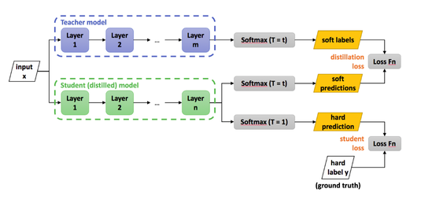


Knowledge Distillation

Slide 6
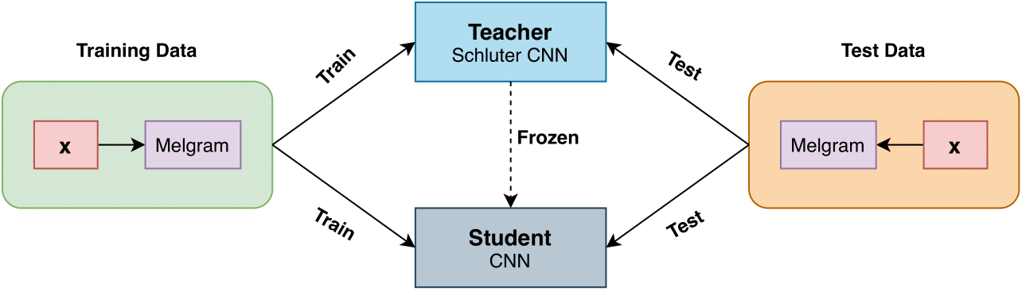
Knowledge Distillation with Schluter CNN

Slide 7
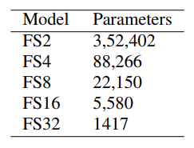
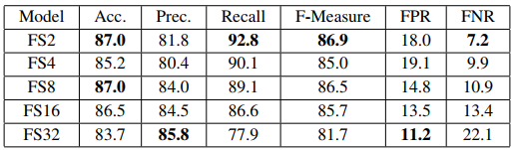
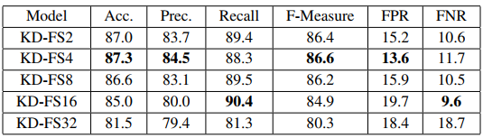
Knowledge Distillation with Schluter CNN
Model | Acc | Prec | Rec | F1 | FPR | FNR
SCNN | 86.8 | 83.7 | 89.1 | 86.3 | 15.1 | 10.9
Lowest number of channels among all layers in architecture is 32. We define a variable “Filter scale“ (abbreviated as FS) with values in {2, 4, 8, 16, 32}.
We divide number of channels in each layer by FS to reduce the overall number of model parameters
Highest reduction achieved with student networks nearly 1000x with FS32.

Slide 8
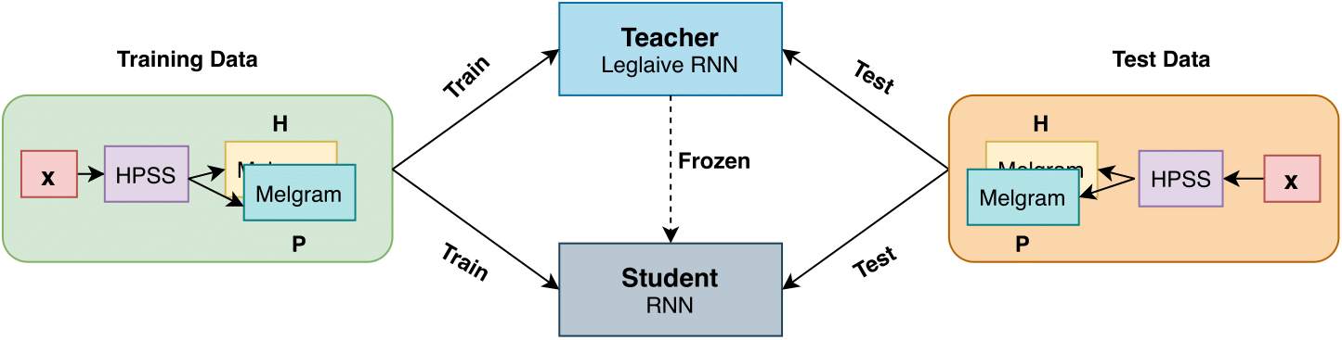
Knowledge Distillation with Leglaive RNN

Slide 9
Knowledge Distillation with Leglaive RNN
We remove the last 2 BiLSTM layers of sizes 20 and 40.
This gives close to 2.5x reduction in size for our student model, SRNN with a total of 26, 762 (26.8K) parameters.
Model | Acc | Prec | Rec | F1 | FPR | FNR
LRNN | 87.5 | 86.1 | 87.2 | 86.6 | 12.2 | 12.8
SRNN | 87.6 | 84.5 | 90.6 | 87.5 | 14.6 | 9.4
KD-SRNN | 88.9 | 85.7 | 91.5 | 88.5 | 13.4 | 8.5

Slide 10
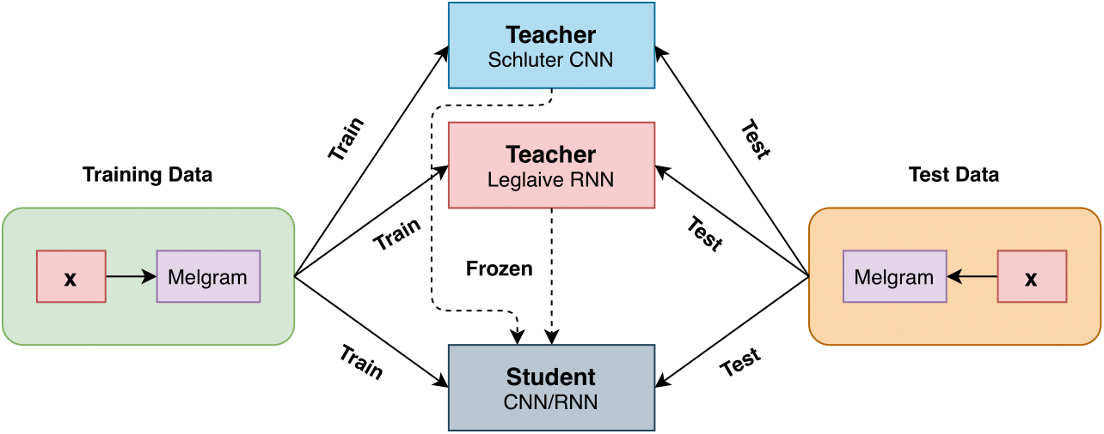
Ensemble Knowledge Distillation

Slide 11

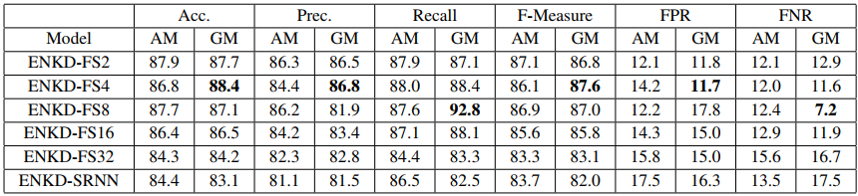
Ensemble Knowledge Distillation
Schluter CNN and Leglaive RNN used as teachers
Their soft targets are combined by AM or GM
Features used are the same as that of Schluter CNN

Slide 12
Result Summary
Features | Model | Acc | Prec | Rec | F1 | FPR | FNR
Mel-Spectrograms of Audio Signal | Schluter CNN | 86.8 | 83.7 | 89.1 | 86.3 | 15.1 | 10.9
 | ENKD-FS4-GM | 88.4 | 86.8 | 88.4 | 87.6 | 11.7 | 11.6
 | ENKD-FS8-GM | 87.1 | 81.9 | 92.8 | 87.0 | 17.8 | 7.2
Mel-Spectrograms of Harmonic & Percussive Components | Leglaive RNN | 87.5 | 86.1 | 87.2 | 86.6 | 12.2 | 12.8
 | KD-SRNN | 88.9 | 85.7 | 91.5 | 88.5 | 13.4 | 8.5

Slide 13
Major Contributions
We show that the optimal CNN-based model is more than 250 times smaller (trade-off between accuracy and parameter count) than the model used by Schluter et al.
The optimal RNN-based model is at least 2.5 times smaller than the one used by Leglaive et al.
Moreover, we show that, with knowledge distillation on smaller student models, it's possible to obtain accuracies substantially higher than the current state-of-the-art.

Slide 14
Future Work
Extend our methods to other publicly available SVD datasets like MIR-1K, RWC Popular Music Database, and MedleyDB.
Ensemble Knowledge Distillation with features used by Leglaive et al. [2015].
Train student models on subset of the training data and compare their performance with student/teacher models that learn from the entire data.
Multi-step knowledge distillation techniques like the Teacher Assistant model (Mirzadeh et al. [2019]).

Slide 15
References
[1] M. Ramona, G. Richard, and B. David, “Vocal detection in music with support vector machines,” in 2008 IEEE International Conference on Acoustics, Speech and Signal Processing. IEEE, 2008, pp. 1885–1888
[2] S. Leglaive, R. Hennequin, and R. Badeau, “Singing voice detection with deep recurrent neural networks,” in IEEE International Conference on Acoustics, Speech and Signal Processing (ICASSP). IEEE, 2015, pp. 121–125
[3] J. Schluter and T. Grill, “Exploring data augmentation for improved singing voice detection with neural networks.” in ISMIR, 2015, pp. 121–126
[4] K. Lee, K. Choi, and J. Nam, “Revisiting singing voice detection: A quantitative review and the future outlook,” arXiv preprint arXiv:1806.01180, 2018
[5] G. Hinton, O. Vinyals, and J. Dean, “Distilling the knowledge in a neural network,” arXiv preprint arXiv:1503.02531, 2015

Slide 16
Thank You!

