Slide 1
Single Testability Principle
An introduction

Slide 2

TDD Foundation
Kent Beck, Test Driven Development: By Example
https://smile.amazon.com/Test-Driven-Development-Kent-Beck/dp/0321146530
Internal thought process of doing TDD.
Best $40 you could ever spend on your career.

Slide 3
STP: Definition
A unit should require only a single mode of testing to be verified.
Multiple modes of testing is an indicator of excessive complexity
Indicates the need to decompose a unit

Slide 4
Test Modes
A testing mode is simply a way in which testing of a unit is completed.
Single Testability defines the following modes
Unit
Integration – Surprise inside!
Collaboration

Slide 5
Sample App
Adds two numbers, entered via the console. Records what happens, and prints the result.
Simple and designed to distinguish the testing modes.
Is not production code!

Slide 6
Unit Tests
What is a unit test?
What characteristics are true about a unit tested this way?

Slide 7
Unit Tests
Fully isolated unit.
No external dependencies.
Receives data as parameters or properties.
Returns data via return values, properties, events.
Tested only with simple assertions

Slide 8
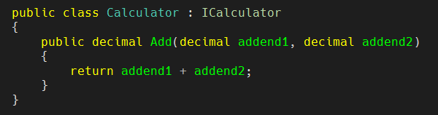
Calculator.cs
No dependencies!

Slide 9
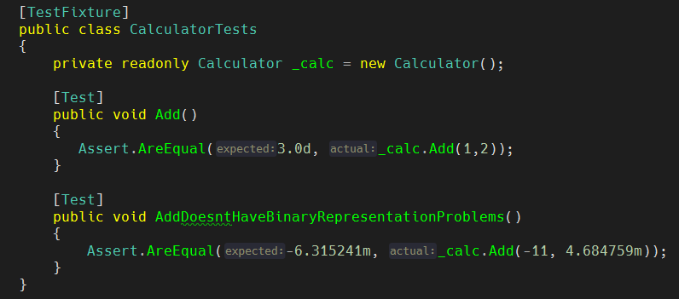
CalculatorTests.cs

Slide 10
Integration Tests
What is an Integration test?
What characteristics are true about a unit tested this way?

Slide 11
Integration Tests
Use with a unit with a highly complex or opaque dependency
Database Wrappers (often use inheritance)
Frameworks
Http call wrappers
Executes the real dependency
Faster/Easier than mocking or stubbing (if even possible)
Often much less code than layering/abstracting

Slide 12
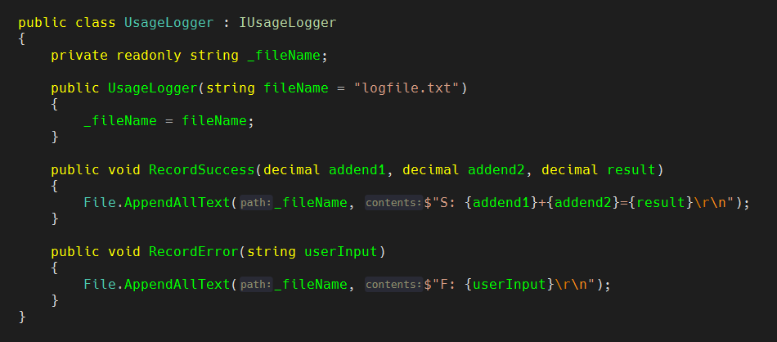
UsageLogger.cs
Using the file system, which is an opaque dependency

Slide 13
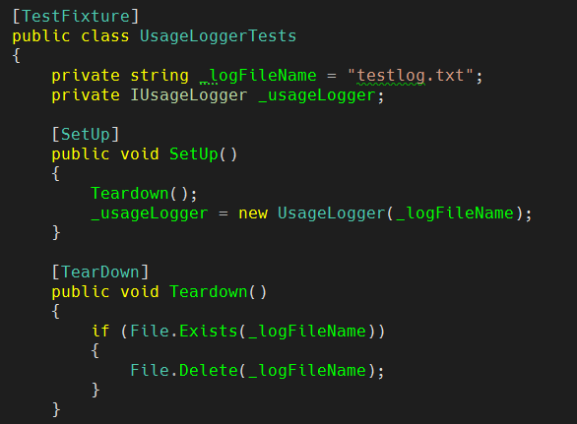
UsageLoggerTests.cs (Part 1)
Setup and Teardown manage the concrete resources

Slide 14
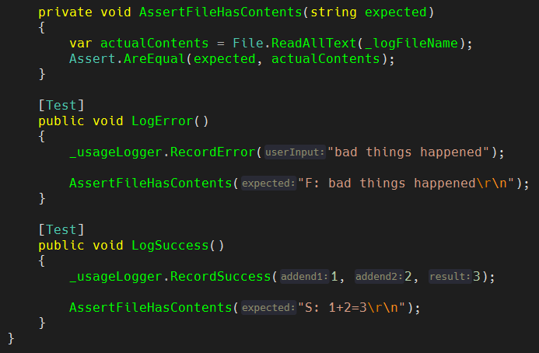
UsageLoggerTests.cs (Part 2)

Slide 15
Integration Testing Database Wrappers
Sql is code. So is what ORM frameworks create.
It must be executed to prove it’s right.
Start a transaction in test setup, add test data
Rollback in the teardown.
Transaction free? GIGUGDG!
Get, Insert, Get, Update, Get, Delete, Get

Slide 16
Collaboration Tests
What is an Collaboration test?
What characteristics are true about a unit tested this way?

Slide 17
Collaboration Tests
Validates a unit correctly coordinates work among multiple Collaborators
Dependencies → Collaborators
Collaborators are usually faked/mocked/stubbed, and injected
Collaborators are usually Unit or Integration tested.

Slide 18
Example Collaboration Units
Controllers
Presenters
Any code unit that coordinates work amongst multiple Collaborators

Slide 19
Important Rule
Only use conditionals to decide whether to utilize other collaborators.

Slide 20
Conditionals Rule Example
Yes
If (collaborator1.X) collaborator2.Y()
else
collaborator3.Z();
No!
If (collaborator1.X)
_fieldZ = DateTime.Now()
Violates STP, requires Unit testing. Beware test factorials!
Move this state assignment into another collaborator.

Slide 21
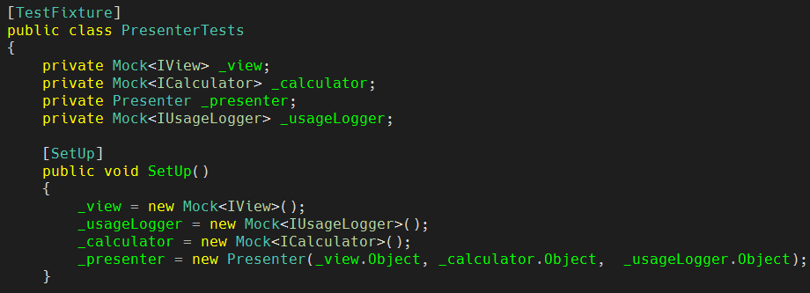
PresenterTests.cs
Setup unit, and mock dependencies

Slide 22
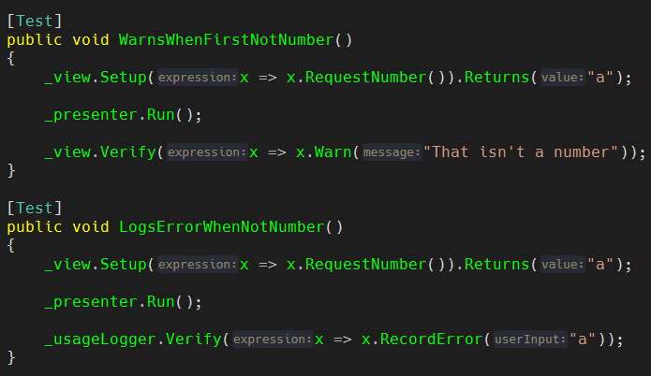
PresenterTests.cs
Verify behavior

Slide 23
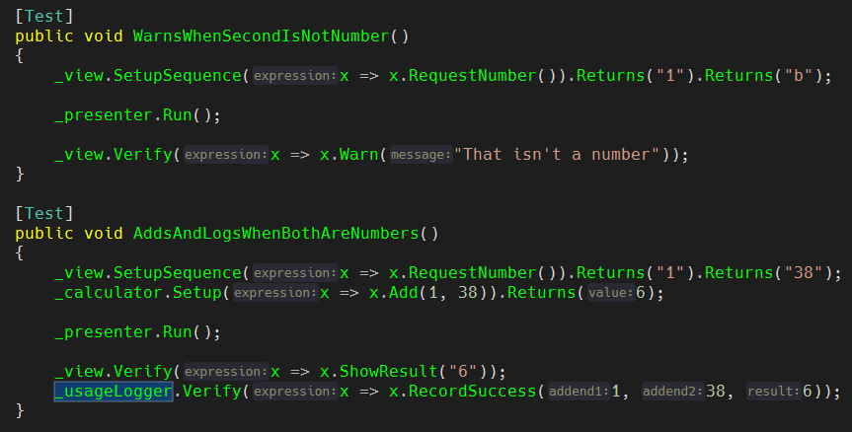
PresenterTests.cs
Verify behavior

Slide 24
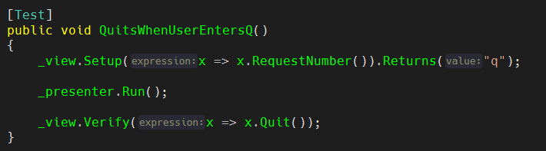
PresenterTests.cs
Verify behavior

Slide 25
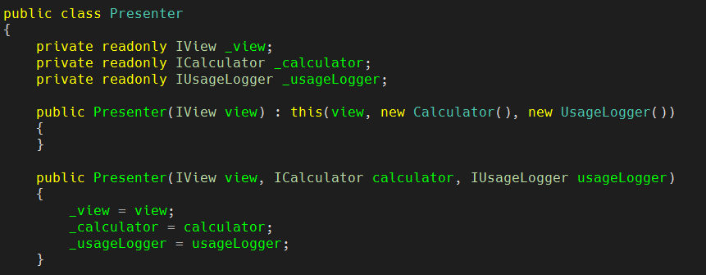
Presenter.cs
Accepts dependencies via Constructor

Slide 26
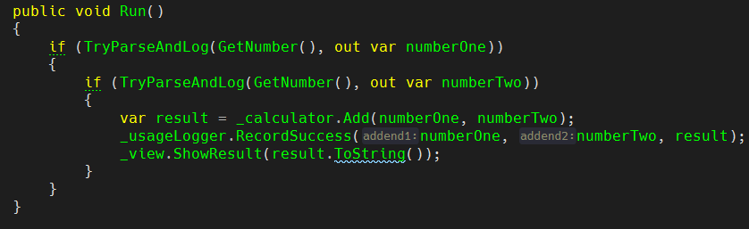
Presenter.cs
Conditionals invoke Collaborators

Slide 27
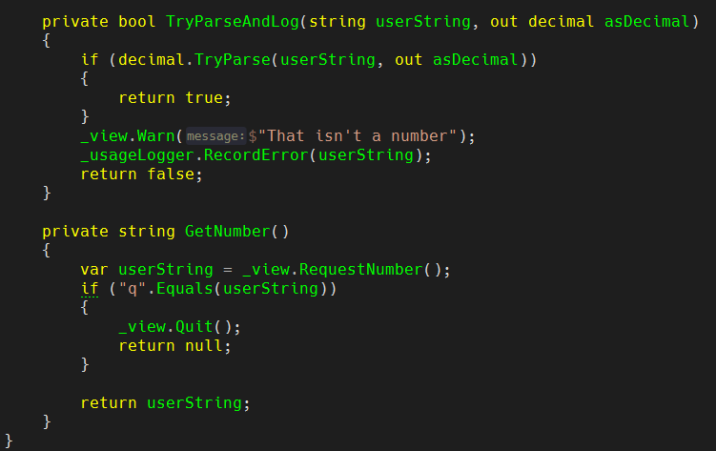
Presenter.cs
Conditionals should only invoke Collaborators

Slide 28
Did you spot the error?
We broke the rule!
Where?

Slide 29
We broke the rules!

Slide 30
New Branch
git checkout better

Slide 31
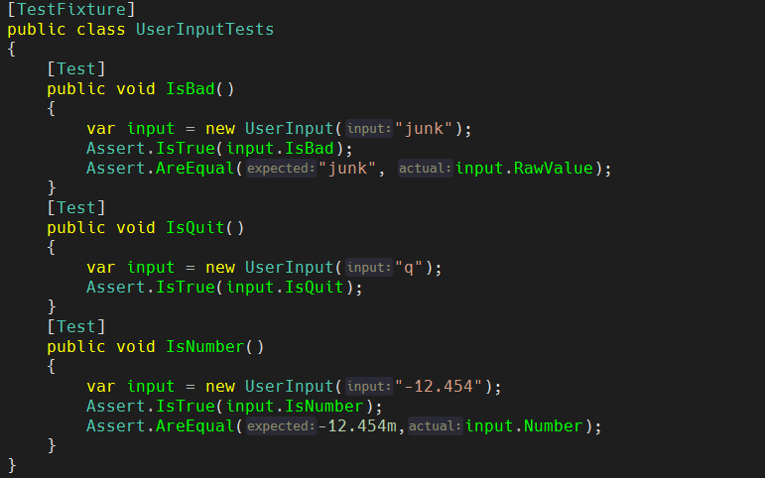
UserInputTests.cs

Slide 32
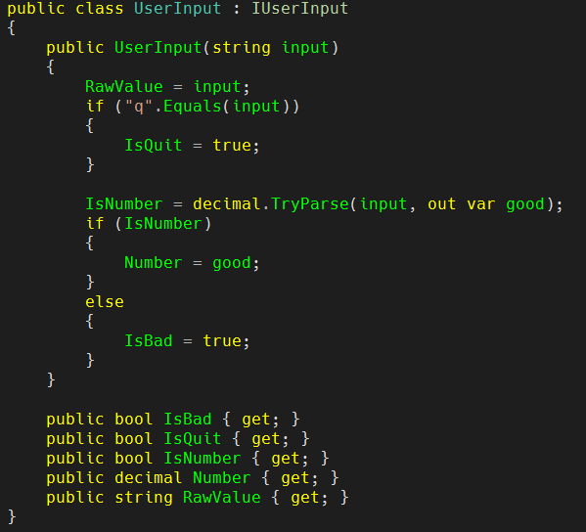
UserInput.cs

Slide 33
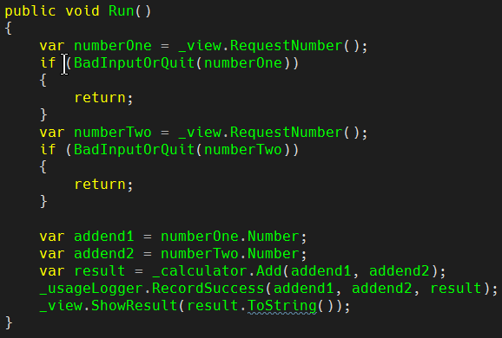
Presenter.cs

Slide 34
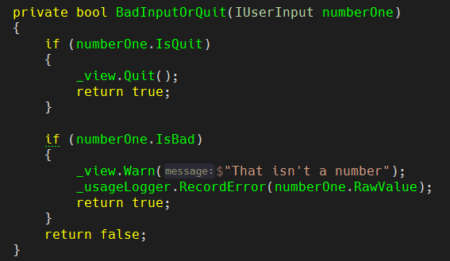
Presenter.cs

Slide 35
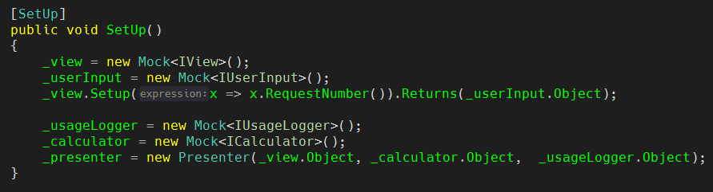
PresenterTests.cs
Another Mock!

Slide 36
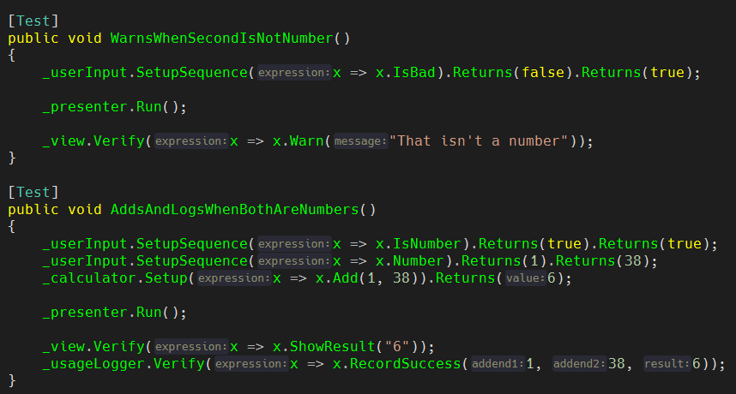
PresenterTests.cs

Slide 37
Order of development
0. Think of the units you will build.
1. Unit units first. Isolated == Easy, Fast
2. Integration units next. Usually will move data from the Units.
3. Collaboration units last. Will accept the Unit and Integration units are Collaborators. Code is usually obvious when collaborators are complete.
4. Find where you broken the rule!

Slide 38
Reference
https://github.com/mvphelps/SingleTestabilityPrinciple

Slide 39
Questions?

Slide 40
Thank you!
Michael Phelps, Phelps Consulting
mvphelps@gmail.com
Copyright 2020, All Rights Reserved

