Slide 1
Statistical Analysis of Fitness Data Final Project
By Megan Pokal
DSC 530 -T301 Data Exploration and Analysis (2253-1)
Matthew Metzger

Slide 2
Introduction
Hypothesis:
Are the number of steps a day significantly correlated with the number of calories spent, as measured by Fitbits?
Goal: Explore the relationship between physical activity and calories burned.

Slide 3
Five Variables
Total Steps: Number of steps taken on a given day.
Total Distance: Distance covered (in km) based on steps.
Calories: Total calories burned.
Sedentary Minutes: Minutes spent in sedentary activities:
Fitbit defines sedentary activity by using metabolic equivalents (METS). MET is equal to the Basic metabolic rate (BMR) which is estimated based on person's height and weight.
1 Sedentary minute = 1 MET = 1 BMR.
5. Very Active Minutes: Minutes spent in very active physical activity:
Fitbit defines very active minute as >6 METS = >6 BMR

Slide 4
Dataset
Mobius. “Fitbit Fitness Tracker Data.” Kaggle, 2 Mar. 2024, www.kaggle.com/datasets/arashnic/fitbit.

Slide 5
Total Steps - Statistics
Statistics:
Count: 940
Mean: 7,637 steps
Min: 0 steps
Max: 36,019 steps
Standard Deviation: 5,087 steps
25th Percentile: 3,790 steps
Median (50th Percentile): 7,406 steps
75th Percentile: 10,727 steps
Outliers: 12 outliers detected.
Mode: 0

Slide 6
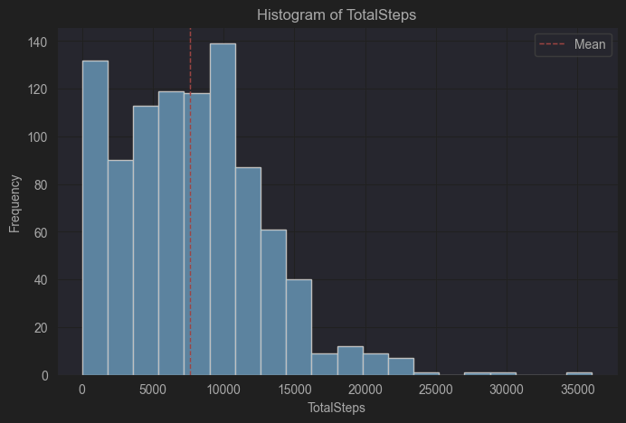
Total Steps - Histogram

Slide 7
Total Distance - Statistics
Statistics:
Count: 940
Mean: 5.49 km
Min: 0 km
Max: 28.03 km
Standard Deviation: 3.92 km
25th Percentile: 2.62 km
Median: 5.25 km
75th Percentile: 7.71 km
Outliers: 23 outliers detected.
Mode: 0 km

Slide 8
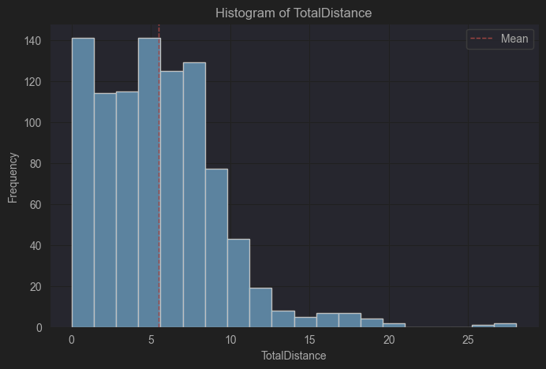
Total Distance - Histogram

Slide 9
Very Active Minutes - Statistics
Statistics:
Count: 940
Mean: 21.16 minutes
Min: 0 minutes
Max: 210 minutes
Standard Deviation: 32.84 minutes
25th Percentile: 0 minutes
Median: 4 minutes
75th Percentile: 32 minutes
Outliers: 65 outliers detected.
Mode: 0 minutes

Slide 10
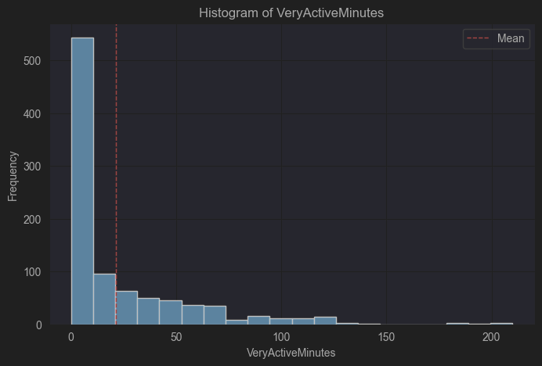
Very Active Minutes - Histogram

Slide 11
Sedentary Minutes - Statistics
Statistics:
Count: 940
Mean: 991.21 minutes
Min: 0 minutes
Max: 1,440 minutes
Standard Deviation: 301.27 minutes
25th Percentile: 730 minutes
Median: 1,058 minutes
75th Percentile: 1,230 minutes
Outliers: No outliers detected.
Mode: 1,440 minutes

Slide 12
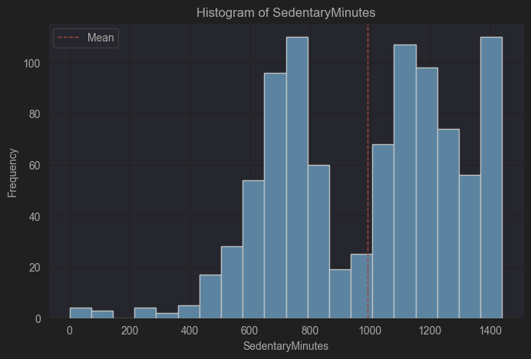
Sedentary Minutes - Histogram

Slide 13
Calories - Statistics
Statistics:
Count: 940
Mean: 2,303.61 calories
Min: 0 calories
Max: 4,900 calories
Standard Deviation: 718.17 calories
25th Percentile: 1,829 calories
Median: 2,134 calories
75th Percentile: 2,793 calories
Outliers: 16 outliers detected.
Mode: 1,980 calories

Slide 14
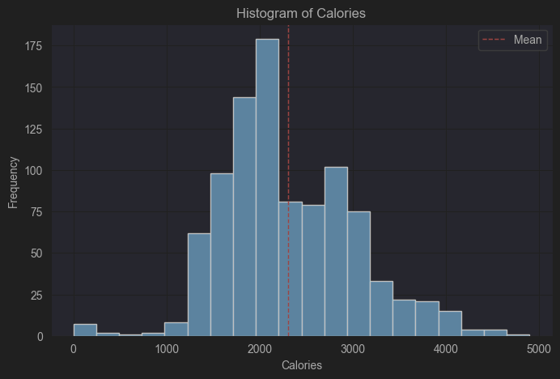
Calories - Histogram

Slide 15
Outlier's
Total Steps: Values ranged up to 36,019 steps, with 12 outliers
Total Distance: Range from 0km to 28.03km, with 23 outliers
Very Active Minutes: Spanned from 0 to 210 Minutes, with 65 outliers
Calories: Range from 0 to 4,900, with 16 extreme values.
These outliers may have skewed the descriptive statistics, leading to reduced accuracy.
Further analysis could determine if they are from data entry errors or extreme behavior.

Slide 16
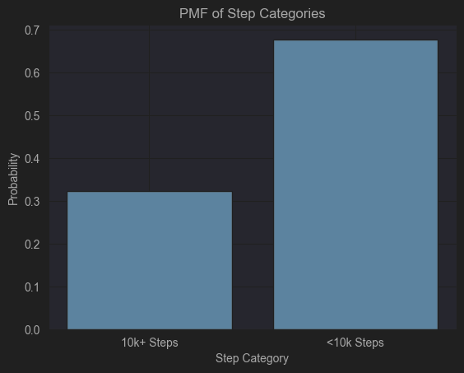
PMF of Step Categories
Probability of a Fitbit user performing more than 10k steps compared to the probability of a user performing less than 10k steps.

Slide 17
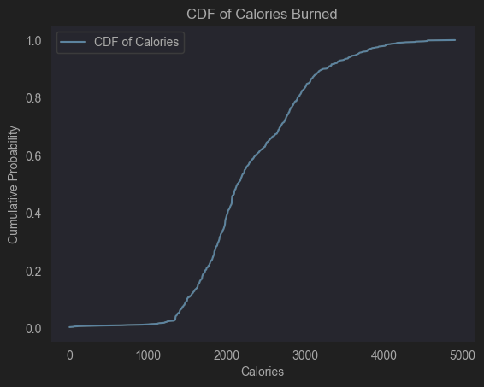
CDF of Calories Burned
Cumulative Distribution Function (CDF) curve passes through about 2,000 at 0.5, indicating that the number of daily calories burned are below 2,000.
This shows a positive trend that more users were burning calories daily, at high amounts.

Slide 18
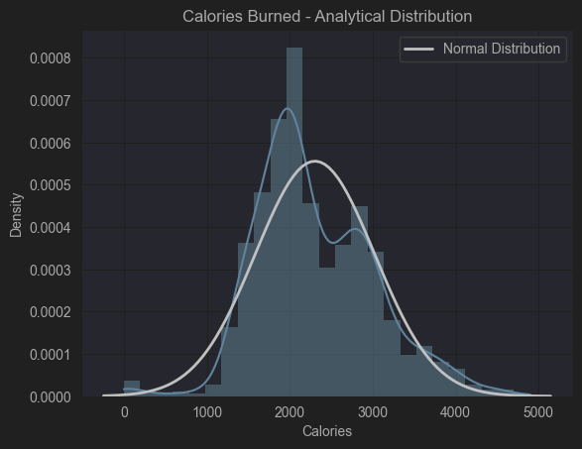
Calories Burned – Analytical Distribution

Slide 19
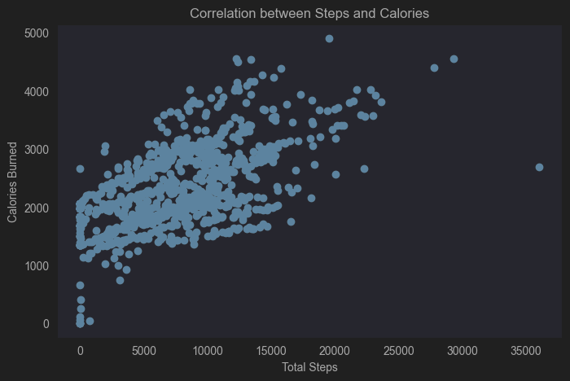
Correlation between Steps and Calories

Slide 20
Correlation Analysis
Pearson Correlation: Total Steps vs. Calories
Correlation: 0.59 (Moderate positive correlation)
T-statistic: 31.83
P-value: 4.11e-153 (< 0.001) (Highly significant)
As steps increase, calories burned also tend to increase.

Slide 21
Regression Analysis - Statistics
OLS Regression Results
Dependent Variable: Calories
Independent Variables: Total Steps and Very Active Minutes
R-squared: 0.438 (43.8% of calories burned can be explained by Total Steps and Very Active Minutes)
F-statistic: 365.3
P-value: 5.08e-118 (< 0.001) (Model is statistically significant)

Slide 22
Regression Analysis - Coefficients
OLS Regression Coefficients
Intercept: 1,767.98 (Calories burned on a day with zero steps and very active minutes)
Total Steps: 0.046 (For every additional step, calories burned increase by 0.046)
Very Active Minutes: 8.72 (For every additional minute of very active activity, calories burned increase by 8.72)
Total Steps and Very Active Minutes are both significant predictors of calories burned.

Slide 23
Challenges and Limitations
Outliers in Total Steps and Very Active Minutes may have influenced the analysis
The Durbin-Watson Statistic (0.560) showed autocorrelation, which suggests a need for model refinement.
There was a lack of variables like age, heart rate, and dietary factors that could improve the outcome.
The analysis relied on a single source, the Fitbit Tracker, which could introduce source bias.

Slide 24
Summary
Objective: Determine if there is a significant correlation between daily steps and calories burned.
Conclusion:
Positive correlation between Total Steps and Calories Burned (Pearson Correlation = 0.59, P-value: 4.11e-153)
Regression Analysis showed Total Steps and Very Active Minutes significantly predict calorie loss (P-value: 5.08e-118 ,R-Squared = 0.438)

