Slide 1
Introduction to
Machine Learning
Theory: Alejandro Ceccatto
Laboratory: Pablo Granitto

Slide 2
Machine Learning
The field of Machine Learning is concerned with the question of how to construct computer programs that automatically improve with experience
The purpose of this course is to present the key algorithms and theory that form the core of Machine Learning

Slide 3
Machine Learning
Interdisciplinary nature of the material: Statistics, Artificial Intelligence, Information Theory, etc.
Basic question:
How to program computers to learn?

Slide 4
Machine Learning
Intelligent Data Analysis: Intelligent application of data analytic tools (Statistics) and application of “intelligent” data analytic tools (Machine Learning)
Modern world: Data-driven world (industrial, commercial, financial, scientific activities)

Slide 5
Why Machine Learning?
Recent progress in algorithms and theory
Growing flood of online data
Computational power available
Budding industry

Slide 6
Why Machine Learning?
Niches for Machine Learning:
  Data Mining: using historical data to improve decisions
    Medical records → medical knowledge
  Software applications we can’t program by hand
    Autonomous driving
    Speech recognition
  Self customizing programs
    Newsreader that learns user interests

Slide 7
Why Machine Learning?
Data Mining
  Data: Recorded facts
  Information: Set of patterns, or expectations, that underlie the data
  Data Mining: Extraction of implicit, previously unknown, and potentially useful information from data
  Machine Learning: Provides the technical basis of data mining

Slide 8
Why Machine Learning?
Typical Datamining Tasks
  Risk of Emergency Cesarean Section
    Given
    9714 patient records, each describing a pregnancy and birth
    Each patient record contains 215 features
    Learn to predict:
    Classes of patients at high risk for emergency cesarean section

Slide 9
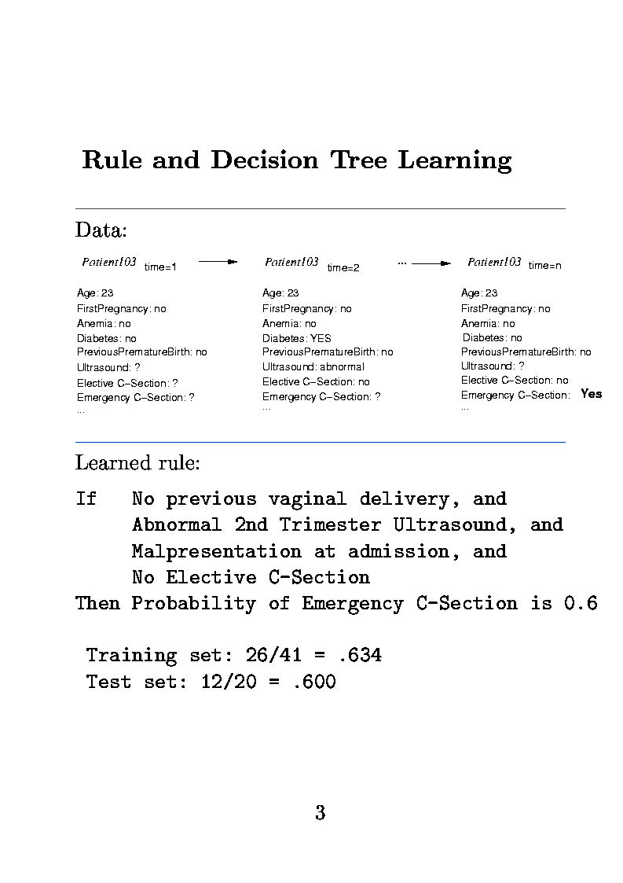
Why Machine Learning?

Slide 10
Why Machine Learning?
  One of the learned rules:
    IF No previous vaginal delivery, and Abnormal 2nd Trimester Ultrasound, and Malpresentation at admission
    THEN Probability of Emergency C-Section 0.6
  Over training data: 16/41=0.63
  Over Test Data: 12/20=0.60

Slide 11
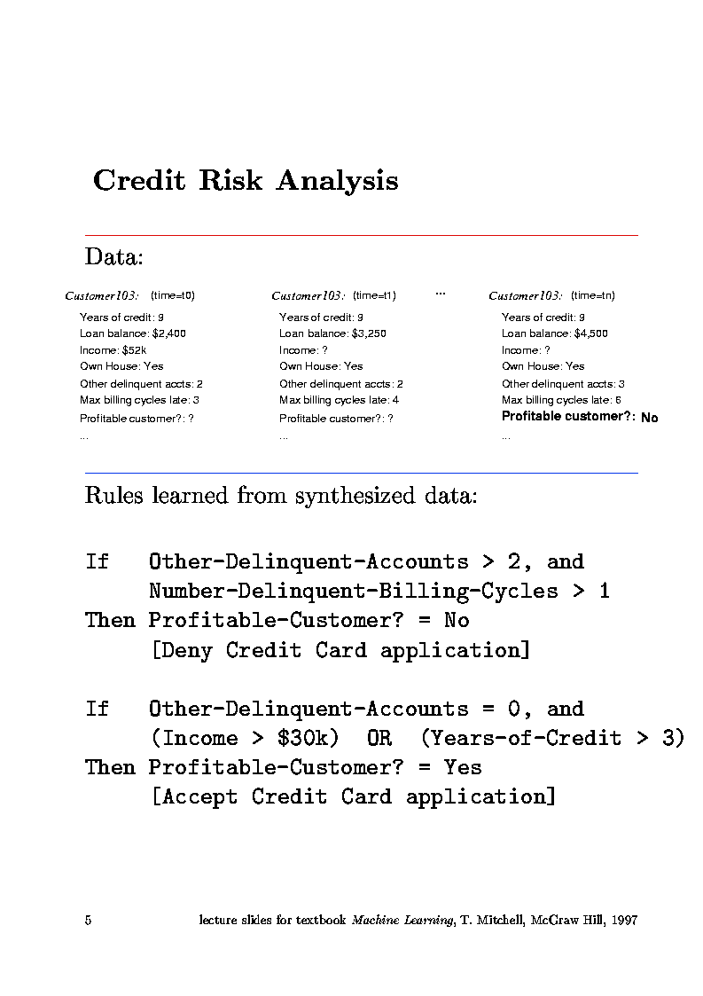
Why Machine Learning?
  Credit Risk Analysis

Slide 12
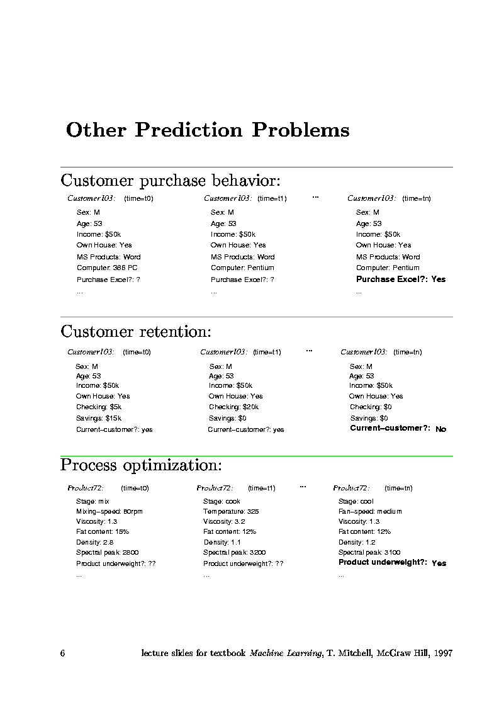
Why Machine Learning?
  Customer Retention

Slide 13
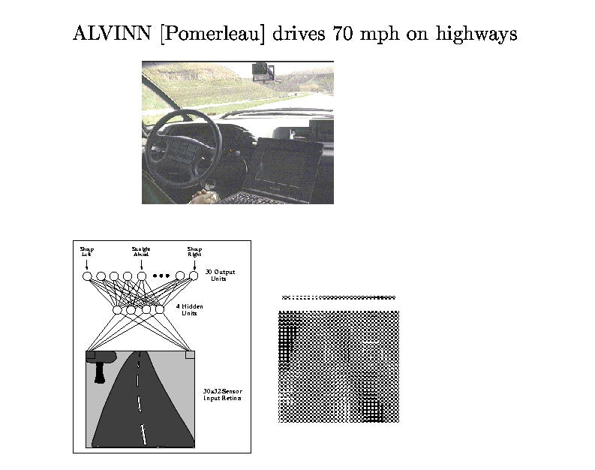
Why Machine Learning?
  Problems Too Difficult to Program by Hand

Slide 14

Why Machine Learning?
  Software that Customizes to User

Slide 15
Where is This Headed?
  Today: tip of the iceberg
    First-generation algorithms: neural nets, decision trees, regression....
    Applied to well-formated databases
  Tomorrow: enormous impact
    Learn accross mixed-media data and multiple databases
    Learn by active experimentation
    Learn decisions rather than predictions
    Cumulative, life-long learning

