Slide 1
1. Introduction
How to program computers to learn?
  Learning: Improving automatically with experience
Example: Computers learning from medical records which treatments are most effective for new diseases
Added value: Better understanding of human learning abilities

Slide 2
1. Introduction
1.1 Well-Posed Learning Problems
  Definition:
  A computer program is said to learn from experience E with respect to some class of tasks T and performance measure P, if its performance at tasks in T, as measured by P, improves with experience E

Slide 3
1. Introduction
Example
  Task T: Playing checkers
  Training Experience E: Playing games against itself
  Performance Measure P: Percentage of games won against opponents

Slide 4
1. Introduction
1.2 Designing a Learning System
  Choosing the training experience:
    Direct (teacher)
    Indirect (credit assignment)
    Distribution of examples

Slide 5
1. Introduction
  Choosing the target function
    Legal moves are known a priori, but the best search strategy is not known
    Target function: ChooseMove B → M
      B: legal board states M: optimal legal move
    Alternatively: Real function V : B → ℜ
    Learning task: Discover an operational description of the ideal target function V (function approximation)

Slide 6
1. Introduction
  Choosing a Representation for the Target Function
  V(b) = w₀ + w₁ X₁ +...+ w₆ X₆
    X_{1,2} : Number of black/red pieces on the board
    X_{3,4} : Number of black/red kings on the board
    X_{5,6} : Number of black/red pieces threatened (can be captured on red/black next turn)

Slide 7
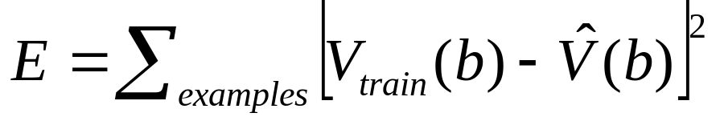
1. Introduction
  Choosing a Function Approximation Algorithm
    Training examples (b,V_{train}(b))
    Rule for estimating training values:
    V_{train}(b) ← V[Successor(b)]
  Adjusting the Weights

Slide 8
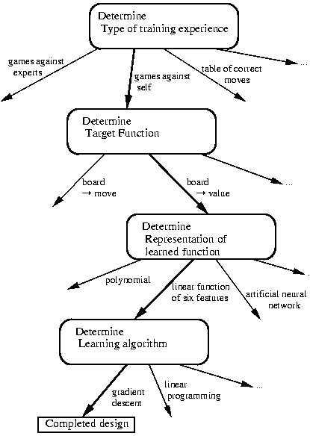
1. Introduction
  Design Choices

Slide 9
1. Introduction
1.3 Some Issues in Machine Learning
  What algorithms can approximate functions well (and when)?
  How does number of training examples influence accuracy?
  How does complexity of hypothesis representation impact it?
  How does noisy data influence accuracy?
  What clues can we get from biological learning systems?

