Slide 1
2. Concept Learning
2.1 Introduction
  Concept Learning: Inferring a boolean-valued function from training examples of its inputs and outputs

Slide 2
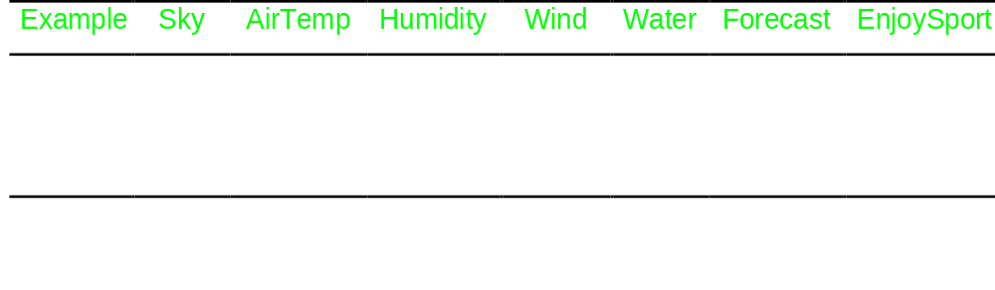
2. Concept Learning
2.2 A Concept Learning Task:
  “Days in which Aldo enjoys his favorite water
  sport”

Slide 3
2. Concept Learning
Hypothesis Representation
  Simple representation: Conjunction of constraints on the 6 instance attributes
    indicate by a “?” that any value is acceptable
    specify a single required value for the attribute
    indicate by a “∅” that no value is acceptable
    Example:
    h = (?, Cold, High, ?, ?, ?)
    indicates that Aldo enjoys his favorite sport on cold days with high humidity (independent of the other attributes)

Slide 4
2. Concept Learning
  h(x)=1 if example x satisfies all the constraints
  h(x)=0 otherwise
  Most general hypothesis: (?, ?, ?, ?, ?, ? )
  Most specific hypothesis: (∅, ∅, ∅, ∅, ∅, ∅)

Slide 5
2. Concept Learning
Notation
  Set of instances X
  Target concept c : X → {0,1} (EnjoySport)
  Training examples {x , c(x)}
  Data set D ⊂ X
  Set of possible hypotheses H
  h ∈ H h : X → {0,1}
  Goal: Find h / h(x)=c(x)

Slide 6
2. Concept Learning
Inductive Learning Hypothesis
Any hypothesis h found to approximate the target function c well over a sufficiently large set D of training examples x, will also approximate the target function well over other unobserved examples in X

Slide 7
2. Concept Learning
2.3 Concept Learning as Search
  Distinct instances in X : 3.2.2.2.2.2 = 96
  Distinct hypotheses
    syntactically 5.4.4.4.4.4 = 5120
    semantically 1 + (4.3.3.3.3.3) = 973

Slide 8
2. Concept Learning
General-to-Specific Ordering of hypotheses
  h₁=(sunny,?,?,Strong,?,?) h₂=(Sunny,?,?,?,?,?)
  Definition: h₂ is more_general_than_or_equal_to h₁
  (written h₂ ≥g h₁) if and only if
  (∀x∈X) [ h₁(x)=1 → h₂(x)=1]
  ≥g defines a partial order over the hypotheses space for any concept learning problem

Slide 9
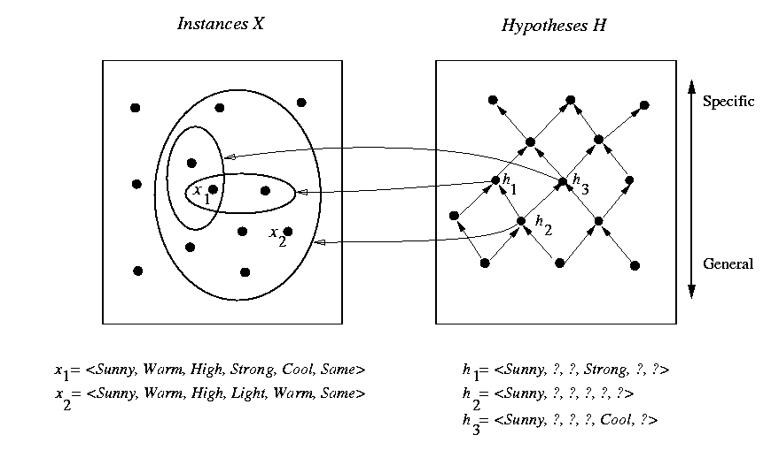
2. Concept Learning

Slide 10
2. Concept Learning
2.4 Finding a Maximally Specific Hypothesis
  Find-S Algorithm
    h₁ ← (∅, ∅, ∅, ∅, ∅, ∅)
    h₂ ← (Sunny,Warm,Normal,Strong,Warm,Same)
    h₃ ← (Sunny,Warm,?,Strong,Warm,Same)
    h₄ ← (Sunny,Warm,?,Strong,?,?)

Slide 11
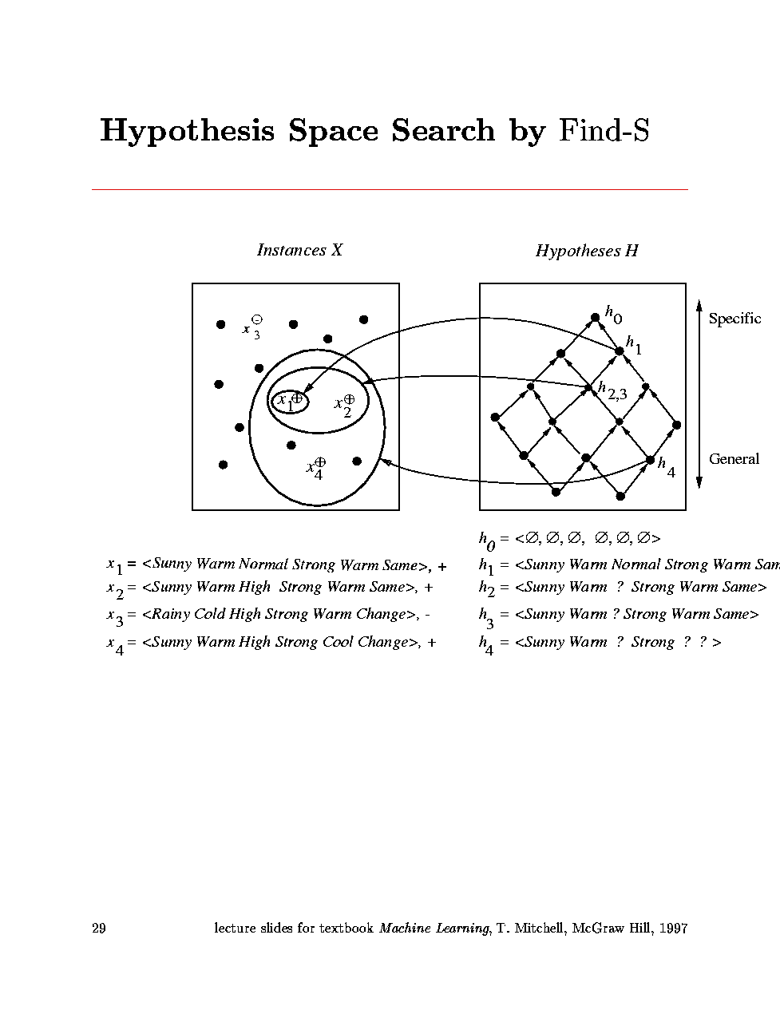
2. Concept Learning

Slide 12
2. Concept Learning
Questions left unanswered:
  Has the learner converged to the correct concept?
  Why prefer the most specific hypothesis?
  Are the training examples consistent?
  What is there are several maximally specific hypotheses?

Slide 13
2. Concept Learning
2.5 Version Spaces and
the Candidate-Elimination Algorithm
  The Candidate-Elimination Algorithm outputs a description of the set of all hypotheses consistent with the training examples
  Representation
    Consistent hypotheses
    Consistent(h,D) ≡ (∀ {x,c(x)} ∈ D) h(x) = c(x)

Slide 14
2. Concept Learning
  Version Space
    VS_{H,D} ≡{h ∈ H | Consistent(h,D)}
  The List-Then-Eliminate Algorithm
    Initialize the version space to H
    Eliminate any hypothesis inconsistent with any training example
  ⇒ the version space shrinks to the set of hypothesis consistent with the data

Slide 15
2. Concept Learning
Compact Representation for Version Spaces
  General Boundary G(H,D): Set of maximally general members of H consistent with D
  Specific Boundary S(H,D): set of minimally general (i.e., maximally specific) members of H consistent with D

Slide 16
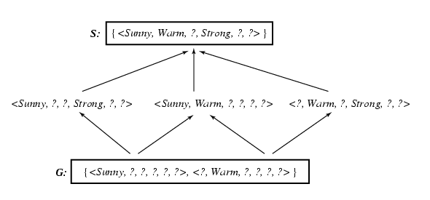
2. Concept Learning

Slide 17
2. Concept Learning
Theorem: Version Space Representation
  For all X, H, c and D such that S and G are well defined,
  VS_{H,D} ≡ {h ∈ H | (∃ s ∈ S) (∃ g ∈ G) (g ≥g h ≥g s )}

Slide 18
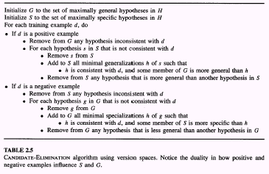
2. Concept Learning
Candidate-Elimination Learning Algorithm

Slide 19
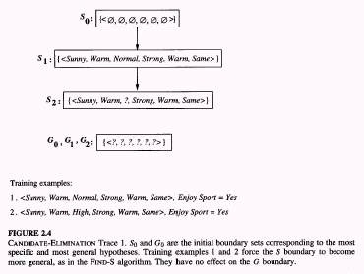
2. Concept Learning

Slide 20
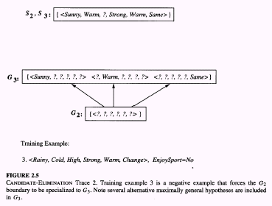
2. Concept Learning

Slide 21
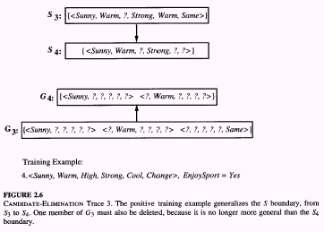
2. Concept Learning

Slide 22
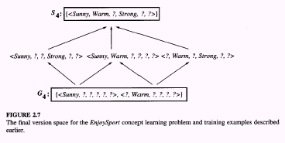
2. Concept Learning

Slide 23
2. Concept Learning
Remarks
  Will the Candidate-Elimination converge to the correct hypothesis?
  What training example should the learner request next?
  How can partially learned concepts be used?

Slide 24
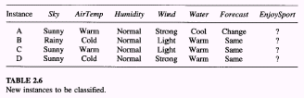
2. Concept Learning
A=yes B=no C=1/2 yes - 1/2 no D=1/3 yes - 2/3 no

Slide 25
2. Concept Learning
2.7 Inductive Bias
  Can a hypothesis space that includes every possible hypothesis be used ?
  The hypothesis space previously considered for the EnjoySport task is biased. For instance, it does
  not include disjunctive hypothesis like:
  Sky=Sunny or Sky=cloudy

Slide 26
2. Concept Learning
  An unbiased H must contain the power set of X
  PowerSet (X) = the set of all subsets of X
  |Power Set (X)| = 2^{|X |} (= 2⁹⁶ ~10²⁸ for EnjoySport)
Unbiased Learning of EnjoySport
  H =Power Set (X)

Slide 27
2. Concept Learning
  For example, “Sky=Sunny or Sky=Cloudy” ∈ H :
  (Sunny,?,?,?,?,?) ∨ (Cloudy,?,?,?,?,?)
  Suppose x₁ , x₂ , x₃ are positive examples and x₄ , x₅ negative examples
  ⇒ S:{(x₁ ∨ x₂ ∨ x₃)} G:{¬(x₄ ∨ x₅)}
  In order to converge to a single, final target concept, every instance in X has to be presented!

Slide 28
2. Concept Learning
  Voting?
  Each unobserved instance will be classified positive by exactly half the hypotheses in the version space and negative by the other half !!
The Futility of Bias-Free Learning
  A learner that makes no a priori assumptions regarding the target concept has no rational basis for classifying unseen instances

Slide 29
2. Concept Learning
  Notation (Inductively inferred from):
  (D_{c} ∧ x_{i})  L(x_{i}, D_{c})
  Definition Inductive Bias B:
  (∀ x_{i}∈X) [(B ∧ D_{c} ∧ x_{i}) L(x_{i}, D_{c})]
  Inductive bias of the Candidate-Elimination algorithm:
  The target concept c is contained in the hypothesis space H

Slide 30
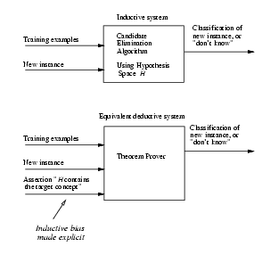
2. Concept Learning

