Slide 1
3. Decision Tree Learning
3.1 Introduction
  Method for approximation of discrete-valued target functions (classification)
  One of the most widely used method for inductive inference
  Capable of learning disjunctive hypothesis (searches a completely expressive hypothesis space)
  Can be represented as if-then rules
  Inductive bias: preference for small trees

Slide 2
3. Decision Tree Learning
Method for approximation of discrete-valued target functions (classification)
One of the most widely used method for inductive inference
Capable of learning disjunctive hypothesis (searches a completely expressive hypothesis space)
Can be represented as if-then rules
Inductive bias: preference for small trees

Slide 3
3. Decision Tree Learning
3.2 Decision Tree Representation
  Each node tests some attribute of the instance
  Decision trees represent a disjunction of conjunctions of constraints on the attributes
  Example:
  (Outlook=Sunny ∧ Humidity=Normal)
  ∨ (Outlook = Overcast)
  ∨ (Outlook=Rain ∧ Wind=Weak)

Slide 4
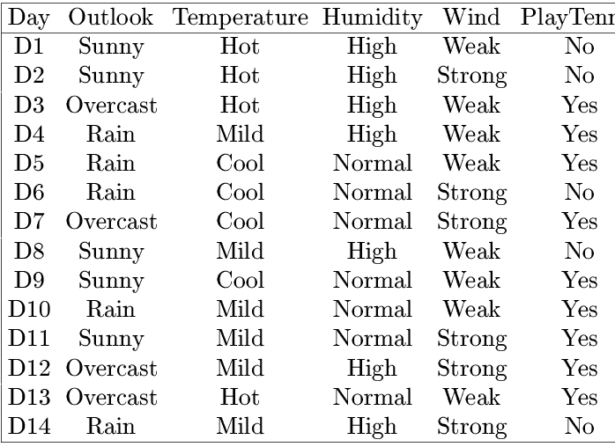
3. Decision Tree Learning
Example: PlayTennis

Slide 5
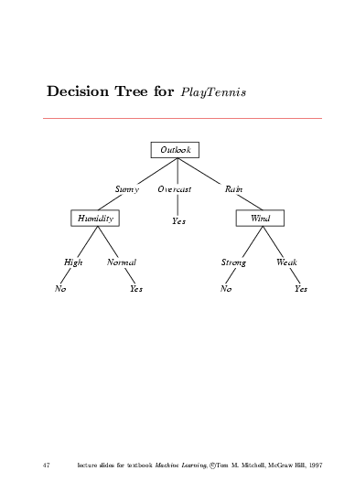
3. Decision Tree Learning
Decision Tree for PlayTennis

Slide 6
3. Decision Tree Learning
3.3 Appropiate Problems for DTL
  Instances are represented by attribute-value pairs
  The target function has discrete output values
  Disjunctive descriptions may be required
  The training data may contain errors
  The training data may contain missing attributes values

Slide 7
3. Decision Tree Learning
3.4 The Basic DTL Algorithm
  Top-down, greedy search through the space of possible decision trees (ID3 and C4.5)
  Root: best attribute for classification
  Which attribute is the best classifier?
  ⇒ answer based on information gain

Slide 8
3. Decision Tree Learning
Entropy
  Entropy(S)≡ - p log₂ p - p log₂ p
  p_{()} = proportion of positive (negative) examples
  Entropy specifies the minimum number of bits of information needed to encode the classification of an arbitrary member of S
  In general: Entropy(S) = - ∑ _{i=1,c} p_{i} log₂ p_{i}

Slide 9
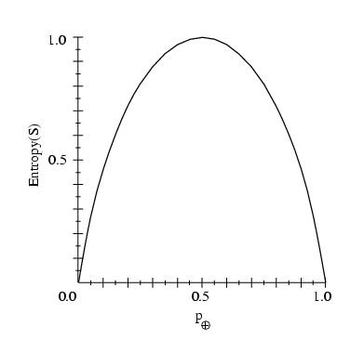
3. Decision Tree Learning

Slide 10
3. Decision Tree Learning
Information Gain
  Measures the expected reduction in entropy given the value of some attribute A
  Gain(S,A) ≡ Entropy(S) - ∑_{v∈Values(A)} |S_{v}|Entropy(S)/|S|
  Values(A): Set of all possible values for attribute A
  S_{v}: Subset of S for which attribute A has value v

Slide 11
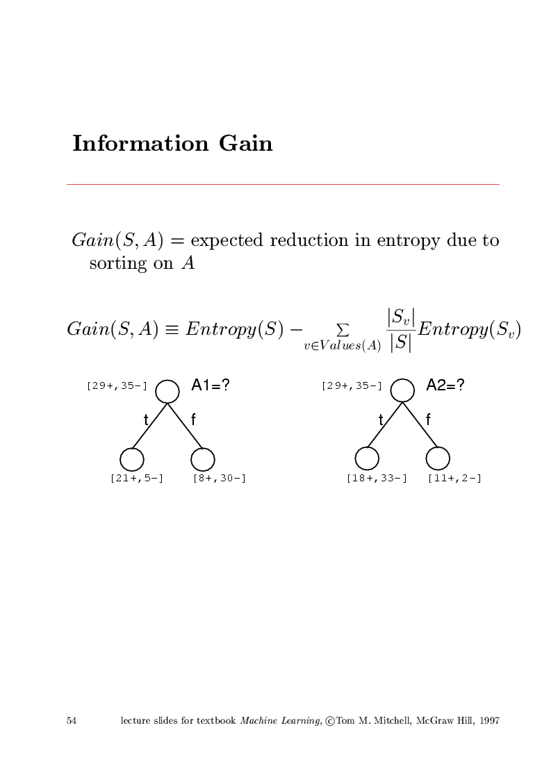
3. Decision Tree Learning
Example

Slide 12
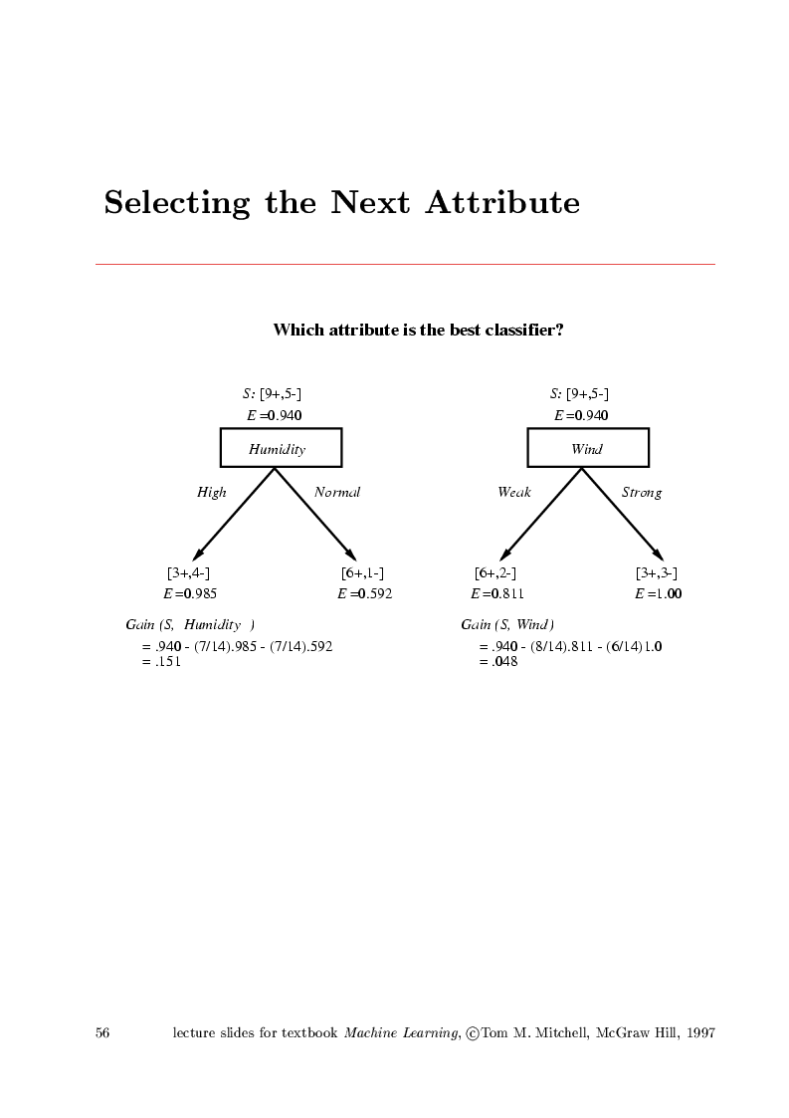
3. Decision Tree Learning
Selecting the Next Attribute

Slide 13
3. Decision Tree Learning
PlayTennis Problem
  Gain(S,Outlook) = 0.246
  Gain(S,Humidity) = 0.151
  Gain(S,Wind) = 0.048
  Gain(S,Temperature) = 0.029
  ⇒ Outlook is the attribute of the root node

Slide 14
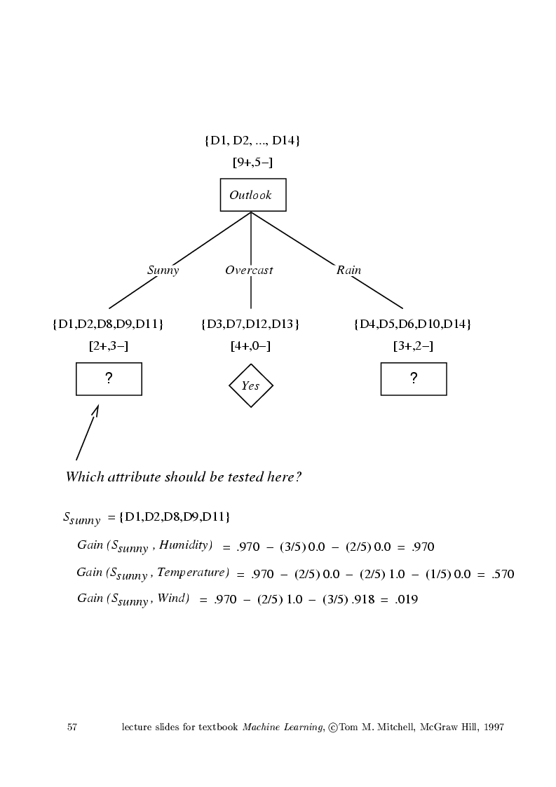
3. Decision Tree Learning

Slide 15
3. Decision Tree Learning
3.5 Hypothesis Space Search in Decision Tree
Learning
  ID3’s hypothesis space for all decision trees is a complete space of finite discrete-valued functions
  ID3 maintains only a single current hypothesis as it searches through the space of trees
  ID3 in its pure form performs no backtracking in its search
  ID3 uses all training examples at each step in the search (statistically based decisions)

Slide 16
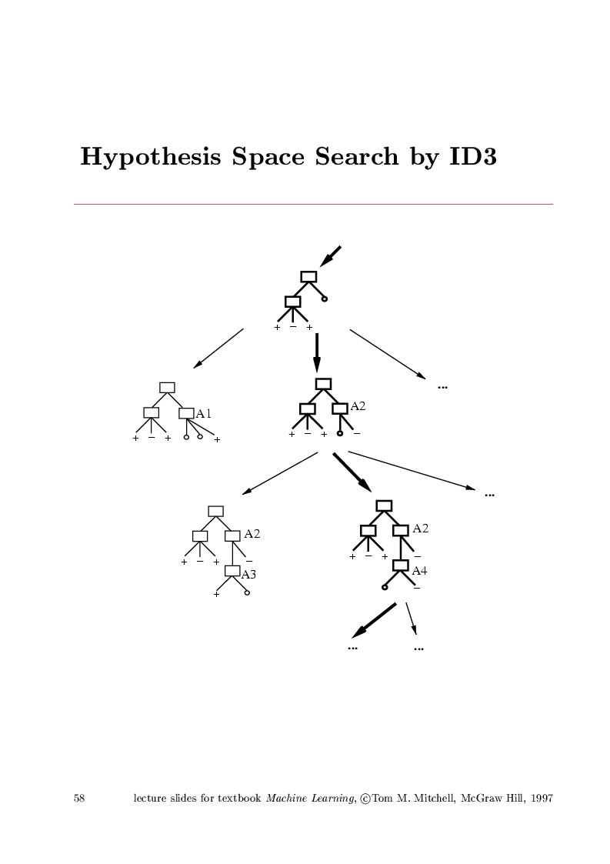
3. Decision Tree Learning
Hypothesis Space Search

Slide 17
3. Decision Tree Learning
3.6 Inductive Bias in DTL
  Approximate Inductive bias of ID3: Shorter trees are preferred over larger trees. Trees that place high information gain attributes close to the root are preferred.
  ID3 searches incompletely a complete hypothesis space (preference bias)
  Candidate-Elimination searches completely an incomplete hypothesis space (language bias)

Slide 18
3. Decision Tree Learning
Why Prefer Short Hypotheses?
Occam’s Razor:
“Prefer the simplest hypothesis
that fits the data”

Slide 19
3. Decision Tree Learning
3.7 Issues in Decision Tree Learning
Avoiding Overfitting the Data
  stop growing the tree earlier
  post-prune the tree
  How?
  Use a separate set of examples
  Use statistical tests
  Minimize a measure of complexity of training examples plus decision tree

Slide 20
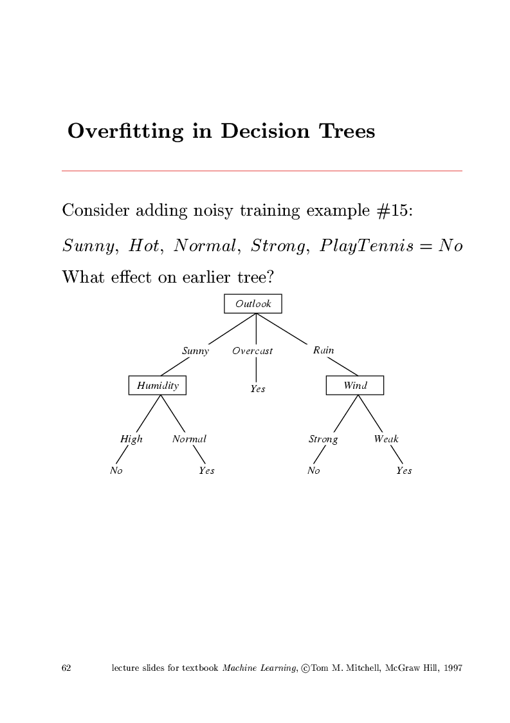
3. Decision Tree Learning

Slide 21
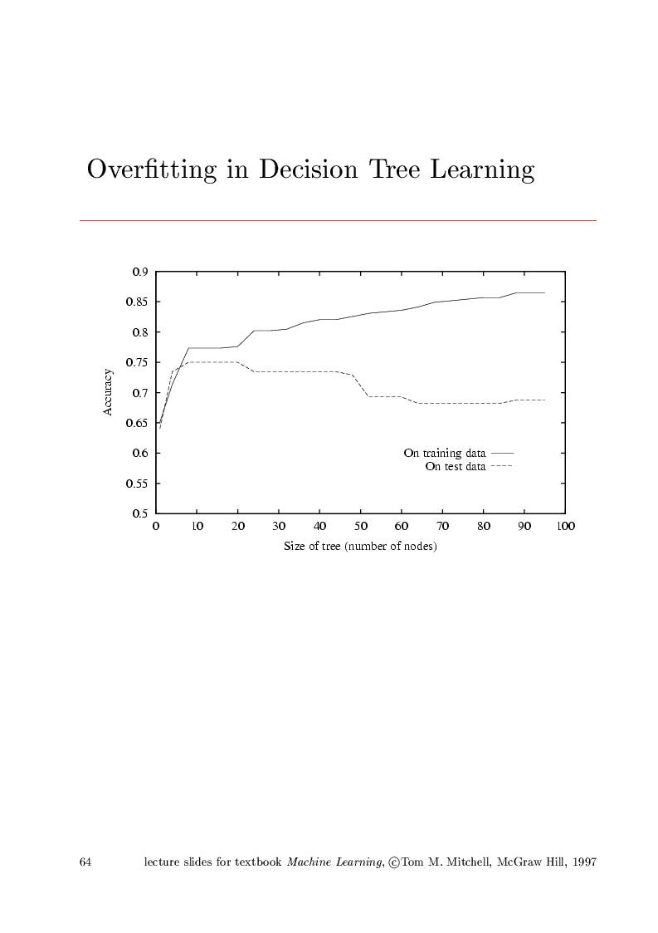
3. Decision Tree Learning

Slide 22
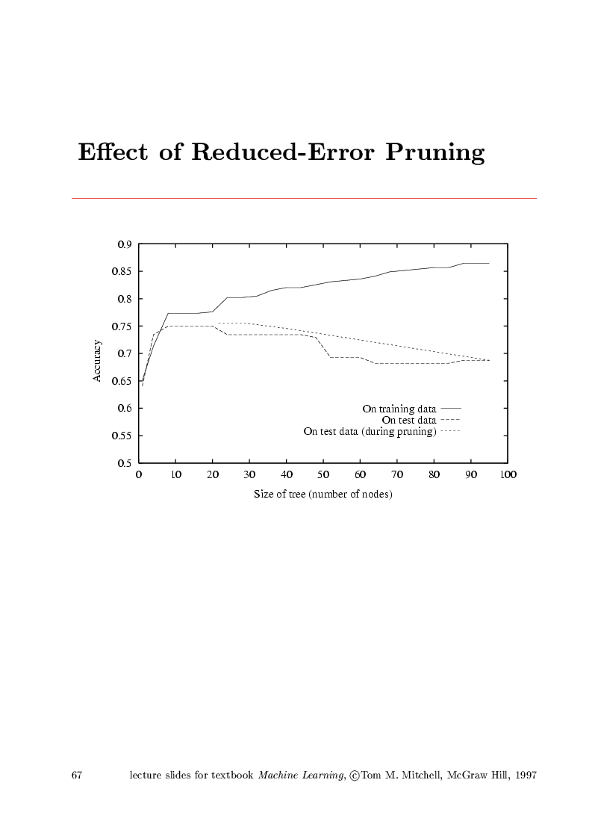
3. Decision Tree Learning

Slide 23
3. Decision Tree Learning
Reduced-Error Pruning
  Nodes are pruned iteratively, always choosing the node whose removal most increases the decision tree accuracy over the validation set
Rule Pos-Pruning
  Example:
  IF (Outlook=Sunny) ∧(Humidity=High)
  THEN PlayTennis = No

Slide 24
3. Decision Tree Learning
Advanced Material
  Incorporating continuous-valued attributes
  Alternative Measures for Selecting Attributes
  Handling Missing Attribute Values
  Handling Attributes with Different Costs

