Slide 1
5. Evaluating Hypotheses
5.1 Motivation
Two key difficulties when only limited data is available:
  Bias in the estimate
  Variance in the estimate

Slide 2
5. Evaluating Hypotheses
5.2 Estimating Hypothesis Accuracy
  Given a hypothesis h and a data sample containing n examples drawn at random from D, what is the best estimate of the accuracy of h over future instances?
  What is the probable error in this accuracy estimate?

Slide 3
5. Evaluating Hypotheses
Sample Error and True Error
  Sample error of hypothesis h with respect to target function f and data sample S is
  error_{S}(h) = (1/n) ∑_{x∈S} {δ_{K}[f(x)-h(x)] -1}
  True error of hypothesis h with respect to target function f and distribution D is
  error_{D}(h) = Pr_{x∈D} [f(x) ≠ h(x)]
  How good an estimate of error_{D}(h) is error_{S}(h)?

Slide 4
5. Evaluating Hypotheses
Confidence Intervals
  For discrete-valued hypotheses, n ≥ 30 and error_{S}(h)=r/n,
  statistical theory asserts:
  The most probable value of error_{D}(h) is error_{S}(h)
  With approximately N% probability, error_{D}(h) lies in the interval:
  error_{S}(h) ± z_{N}[error_{S}(h)(1- error_{S}(h))/n]^{1/2}
  Example: N = 95 z_{N} ≅ 1.96
Rule of Thumb: n error_{S}(h) [1-error_{S}(h)] ≥ 5

Slide 5
5. Evaluating Hypotheses
5.3 Basics of Sampling Theory
  Error Estimation
    How does the deviation between sample error and
    true error depend on the size of the data sample?
  Estimating error_{D}(h) from testing h on a random sample
  of n instances is equivalent to estimating the probability p
  that a bent coin will turn up heads from a random sample
  of n tosses ⇒ Binomial Distribution

Slide 6
5. Evaluating Hypotheses
Binomial Distribution
    Random variable Y with two possible values
    Probability of Y=1 is p, independent of other trials
    R=number of trials with Y=1 in a series of n trials
    Pr(R=r ) = [n!/r!(n-r)!] p^{r} (1-p)^{n-r}
  Mean and Variance
    E(Y) = np Var(Y) = np(1-p)

Slide 7
5. Evaluating Hypotheses
Estimators, Bias, and Variance
    error_{D}(h) = p
    Estimator: error_{S}(h) = r/n
  Estimation Bias: E(Y) - p (= 0)
  Variance: σ_{errorS(h)} = [p(1-p)/n]^{1/2}

Slide 8
5. Evaluating Hypotheses
Confidence Interval
  An N% confidence interval for some parameter p is an interval that contains p with N% probability
  How can we derive confidence intervals for error_{D}(h)?
  Answer: Using the fact that error_{S}(h) follows a binomial probability distribution

Slide 9
5. Evaluating Hypotheses
  For n ≥ 30 the binomial distribution becomes equivalent to a Normal distribution
  If a random variable Y obeys a Normal distribution N(μ,σ), then:
  the measured value y will fall N% of the time into the interval μ ± z_{N}σ
  the mean μ will fall N% of the time into the interval y ± z_{N}σ

Slide 10
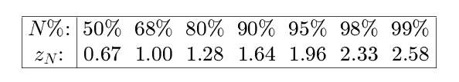
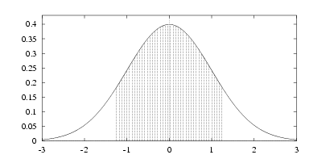
5. Evaluating Hypotheses

Slide 11
5. Evaluating Hypotheses
  Then,
  σ_{errorS(h)} = [p(1-p)/n]^{1/2}
  ≈ {error_{S}(h)[1- error_{S}(h)]/n}^{1/2}
  With approximately N% probability, error_{D}(h) lies
  in the interval:
  error_{S}(h) ± z_{N}[error_{S}(h)(1- error_{S}(h))/n]^{1/2}

Slide 12
5. Evaluating Hypotheses
  Two-Sided and One-Sided Bounds
  Example: What is the probability that error_{D}(h) is at most E?
  A 100(1-α)% confidence interval with lower bound L
  and upper bound U implies a 100(1- α/2)%
  confidence interval with lower bound L and no upper
  bound or with upper bound U and no lower bound

Slide 13
5. Evaluating Hypotheses
5.4 General Approach
  Identify p [=error_{D}(h) in our case]
  Define the estimator Y [= error_{S}(h)]
  Determine the probability distribution D_{Y}
  Determine the N% confidence interval according to D_{Y}

Slide 14
5. Evaluating Hypotheses
  Central Limit Theorem
    Consider n independent, identically distributed random variables Y₁.....Y_{n} , governed by an arbitrary distribution with mean μ and (finite) standard deviation σ. For n→∞,
    (Y-μ)/σ_{n}
    where
    Y=∑_{i=1,n} Y_{i} σ_{n} = σ/n^{1/2}
    is distributed according to N(μ=0,σ=1)

Slide 15
5. Evaluating Hypotheses
5.5 Diference in Error of Two Hypotheses
  d ≡ error_{D}(h) - error_{D}(h´)
  Estimator: d∗ ≡ error_{S}(h) - error_{S´}(h´)
    Unbiased E[d∗] = d
    Normally distributed N(μ=d,σ=σ∗)
  σ∗ ≈ error_{S}(h)[1- error_{S}(h)]/n
  + error_{S´}(h´)[1- error_{S´}(h´)]/n´

Slide 16
5. Evaluating Hypotheses
Hypothesis Testing
  What is the probability that error_{D}(h) > error_{D}(h´)?
  Pr(d>0) ⇒ d∗ < μ∗ + z_{N} σ∗
  Example:
  n = n´=100 error_{S}(h)=0.30 error_{S´}(h´)=0.20
  ⇒ σ∗ = 0.061 d∗ < μ∗ + 1.64 σ∗
  Probability that error_{D}(h) > error_{D}(h´) is ~ 0.95

Slide 17
5. Evaluating Hypotheses
5.6 Comparing Learning Algorithms
  What is an appropriate test for comparing learning algorithms?
  How can we determine whether an observed difference between algorithms is significant?

Slide 18
5. Evaluating Hypotheses
  We wish to estimate:
  E_{S⊂D} [error_{D}(L(S)) - error_{D}(L´(S))]
  L(S): hypothesis output by learning method L
  Estimator:
  ET₀[errorT₀ (L(S₀)) - errorT₀ (L´(S₀))] (D₀ = S₀∪T₀)

Slide 19
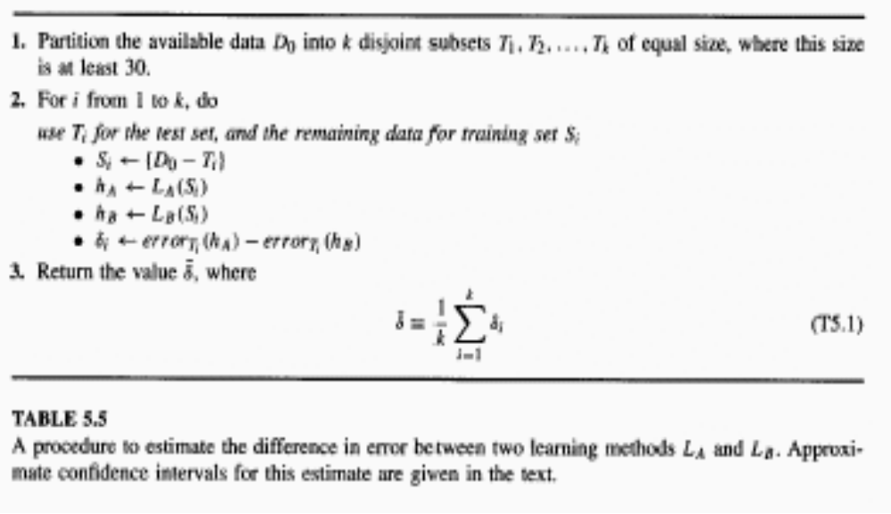
5. Evaluating Hypotheses

Slide 20
5. Evaluating Hypotheses
  Actually, δ is an estimator of:
  E_{S⊂D0} [error_{D}(L(S)) - error_{D}(L´(S))]
  Confidence Interval
  δ ± t_{N,k-1}s_{δ} s_{δ} = [∑_{i=1,k} (δ_{i} - δ)²/k(k-1)]^{1/2}
  Degrees of freedom = k-1
  t_{N,k-1} → z_{N} for k → ∞

Slide 21
5. Evaluating Hypotheses
Paired t-test
  Given k independent, identically distributed random variables Y₁.....Y_{k} , we wish to estimate the mean μ of the probability distribution governing these Y_{i}
  The estimator we will use is the sample mean Y = (1/k) ∑_{i=1,k}Y_{i}
  Answer:
Y ± t_{N,k-1}s_{Y} s_{Y} = [∑_{i=1,k} (Y_{i} -Y)²/k(k-1)]^{1/2}

