Slide 1
6. Bayesian Learning
6.1 Introduction
  Bayesian learning algorithms calculate explicit probabilities for hypotheses
  Practical approach to certain learning problems
  Provide useful perspective for understanding learning algorithms

Slide 2
6. Bayesian Learning
  Drawbacks:
  Typically requires initial knowledge of many probabilities
  In some cases, significant computational cost required to determine the Bayes optimal hypothesis (linear in the number of candidate hypotheses)

Slide 3
6. Bayesian Learning
6.2 Bayes Theorem
  Best hypothesis ⇒ most probable hypothesis
  Notation
  P(h): prior probability of hypothesis h
  P(D): prior probability that dataset D be observed
  P(D|h): prior probability of D given h
  P(h|D): posterior probability of h

Slide 4
6. Bayesian Learning
Bayes Theorem
  P(h|D) = P(D|h) P(h) / P(D)
Maximum a posteriori hypothesis
  h_{MAP} ≡ argmax_{h∈H} P(h|D)
  = argmax_{h∈H} P(D|h) P(h)
Maximum likelihood hypothesis
  h_{ML} = argmax_{h∈H} P(D|h)
  = h_{MAP} if we assume P(h)=constant

Slide 5
6. Bayesian Learning
Example
  P(cancer) = 0.008 P(¬cancer) = 0.992
  P(+|cancer) = 0.98 P(- |cancer) = 0.02
  P(+|¬cancer) = 0.03 P(- |¬cancer) = 0.97
  For a new patient the lab test returns a positive
  result. Should be diagnose cancer or not?
  P(+|cancer)P(cancer)=0.0078 P(-|¬cancer)P(¬cancer)=0.0298
  ⇒ h_{MAP} = ¬cancer

Slide 6
6. Bayesian Learning
6.3 Bayes Theorem and Concept Learning
  What is the relationship between Bayes theorem and concept learning?
  Brute Force Bayes Concept Learning
  1. For each hypothesis h∈H calculate P(h|D)
  2. Output h_{MAP} ≡ argmax_{h∈H} P(h|D)

Slide 7
6. Bayesian Learning
  We must choose P(h) and P(D|h) from prior knowledge
  Let’s assume:
  1. The training data D is noise free
  2. The target concept c is contained in H
  3. We consider a priori all the hypotheses equally probable
  ⇒ P(h) = 1/|H| ∀ h∈H

Slide 8
6. Bayesian Learning
  Since the data is assumed noise free:
  P(D|h)=1 if d_{i}=h(x_{i}) ∀ d_{i} ∈ D
  P(D|h)=0 otherwise
  Brute-force MAP learning
  If h is inconsistent with D:
  P(h|D) = P(D|h).P(h)/P(D) = 0.P(h)/P(D) = 0
  If h is consistent with D:
  P(h|D) = 1. (1/|H|) / (|VS_{H,D}| / |H|) = 1/ |VS_{H,D}|

Slide 9
6. Bayesian Learning
  ⇒ P(D|h)=1/|VS_{H,D}| if h is consistent with D
  P(D|h)=0 otherwise
  Every consistent hypothesis is a MAP hypothesis
  Consistent Learners
  Learning algorithms whose outputs are hypotheses that commit zero errors over the training examples (consistent hypotheses)

Slide 10
6. Bayesian Learning
  Under the assumed conditions, Find-S is a consistent learner
  The Bayesian framework allows to characterize the behavior of learning algorithms, identifying P(h) and P(D|h) under which they output optimal (MAP) hypotheses

Slide 11
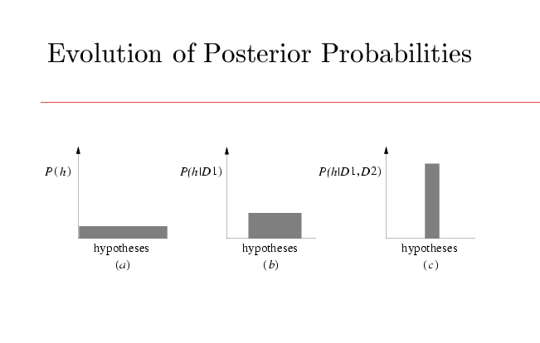
6. Bayesian Learning

Slide 12
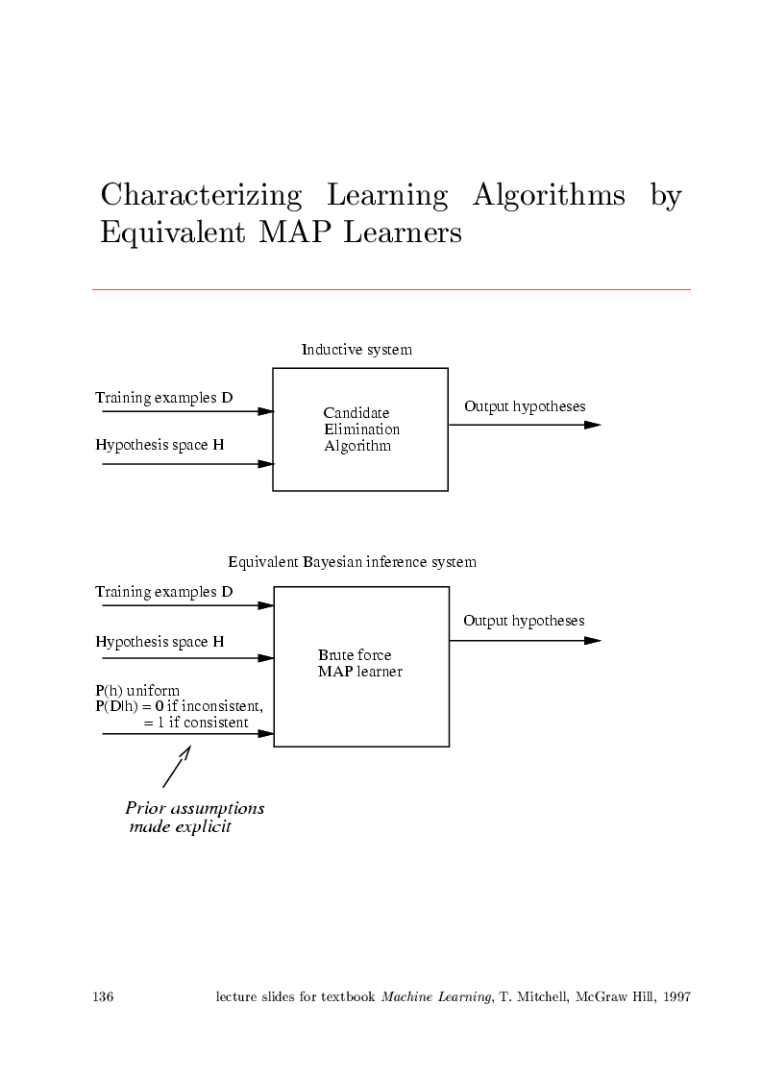
6. Bayesian Learning

Slide 13
6. Bayesian Learning
6.4 Maximum Likelihood and LSE Hypotheses
Learning a continuous-valued target function (regression or curve fitting)
H = Class of real-valued functions defined over X
h : X → ℜ L learns f : X → ℜ
(x_{i},d_{i}) ∈ D d_{i} = f(x_{i}) + ε_{i} i=1,m
f : noise-free target function ε: white noise N(0,σ)

Slide 14
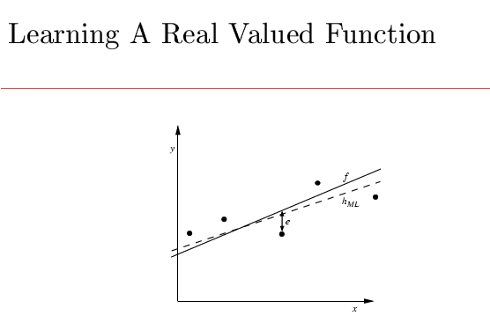
6. Bayesian Learning

Slide 15
6. Bayesian Learning
Under these assumptions, any learning algorithm that minimizes the squared error between the output hypothesis predictions and the training data will output a ML hypothesis:
  h_{ML} = argmax_{h∈H} p(D|h)
  = argmax_{h∈H} ∏_{i=1,m} p(d_{i}|h)
  = argmax_{h∈H} ∏_{i=1,m} exp{-[d_{i}-h(x_{i})]²/2σ²}
  = argmin_{h∈H} ∑_{i=1,m} [d_{i}-h(x_{i})]² = h_{LSE}

Slide 16
6. Bayesian Learning
6.5 ML Hypotheses for Predicting Probabilities
  We wish to learn a nondetermnistic function
f : X → {0,1}
  that is, the probabilities that f(x)=0 and f(x)=1
  Training data D = (x_{i},d_{i})
  We assume that any particular instance x_{i} is independent of hypothesis h

Slide 17
6. Bayesian Learning
  Then
  P(D|h) = ∏_{i=1,m} P(x_{i},d_{i}|h) = ∏_{i=1,m} P(d_{i}|h, x_{i}) P(x_{i})
  P(d_{i}|h,x_{i}) = h(x_{i}) if d_{i}=1
  P(d_{i}|h,x_{i}) =1-h(x_{i}) if d_{i}=0
  ⇒ P(d_{i}|h,x_{i}) = h(x_{i})^{di} [1-h(x_{i})]^{1-di}

Slide 18
6. Bayesian Learning
  h_{ML} = argmax_{h∈H} ∏_{i=1,m} h(x_{i})^{di} [1-h(x_{i})]^{1-di}
  = argmax_{h∈H} ∑_{i=1,m} d_{i} log[h(x_{i})] + [1-d_{i}] log[1-h(x_{i})]
  = argmin_{h∈H} [Cross Entropy]
  Cross Entropy ≡
  - ∑_{i=1,m} d_{i} log[h(x_{i})] + [1-d_{i}] log[1-h(x_{i})]

Slide 19
6. Bayesian Learning
  ML and Gradient Search in ANNs
  ∂G/∂w_{jk} = ∑_{i=1,m} [d_{i}-h(x_{i})] / [h(x_{i})][1-h(x_{i})] . ∂h(x_{i})/∂w_{jk}
  Single layer of sigmoid units:
  ∂h(x_{i})/∂w_{jk} = [h(x_{i})][1-h(x_{i})] x_{ijk}
  Updating rule: wji ← wji + Δwji
  Δwji = η ∑_{i=1,m} [d_{i}-h(x_{i})] xijk

Slide 20
6. Bayesian Learning
6.6 Minimum Description Length Principle
h_{MAP} = argmax_{h∈H} P(D|h) P(h)
= argmin_{h∈H} {-log₂P(D|h)-log₂P(h)}
  ⇒ short hypotheses are preferred
  Description Length L_{C}(h): Number of bits required to encode message h using code C

Slide 21
6. Bayesian Learning
  - log₂P(h) ≡ L_{CH}(h): Description length of h under the optimal (most compact) encoding of H
  - log₂P(D|h) ≡ L_{CD |h}(D|h): Description length of training data D given hypothesis h
⇒ h_{MAP} = argmin_{h∈H} {L_{CH}(h) + L_{CD |h}(D|h)}
MDL Principle:
  Choose h_{MDL} = argmin_{h∈H} {L_{C1}(h) + L_{C2}(D|h)}

Slide 22
6. Bayesian Learning
6.7 Bayes Optimal Classifier
What is the most probable classification of a new instance given the training data?
Answer: argmax_{vj∈V} ∑_{h∈H} P(v_{j}|h) P(h|D)
where v_{j} ∈V are the possible classes
⇒ Bayes Optimal Classifier

Slide 23
6. Bayesian Learning
6.8 Gibbs Algorithm
    1. Choose a hypothesis h from H at random, according to the posterior probability distribution
    2. Use h to predict the classification of the next instance x
  Over target concepts drawn at random according to the prior probability assumed by the learner, the misclassification error of the Gibbs algorithm is, at most, twice the expected error of the optimal Bayes classifier.

Slide 24
6. Bayesian Learning
6.9 Naïve Bayes Classifier
  Given the instance x=(a₁,a₂,...,a_{n})
  v_{MAP} = argmax_{vj∈V} P(x|v_{j}) P(v_{j})
  The Naïve Bayes Classifier assumes conditional independence of attribute values :
  v_{NB} = argmax_{vj∈V} P(v_{j}) ∏_{i=1,n} P(a_{i}|v_{j})

Slide 25
6. Bayesian Learning
6.10 An Example: Learning to Classify Text
  Task: “Filter WWW pages that discuss ML topics”
    Instance space X contains all possible text documents
    Training examples are classified as “like” or “dislike”
  How to represent an arbitrary document?
    Define an attribute for each word position
    Define the value of the attribute to be the English word found in that position

Slide 26
6. Bayesian Learning
  v_{NB} = argmax_{vj∈V} P(v_{j}) ∏_{i=1,Nwords} P(a_{i}|v_{j})
  V≡ {like,dislike} a_{i} ≈50.000 distinct words in English
  ⇒ We must estimate ~ 2 x 50.000 x N_{words} conditional probabilities P(a_{i}|v_{j})
  This can be reduced to 2 x 50.000 terms by considering
  P(a_{i}=w_{k}|v_{j}) = P(a_{m}=w_{k}|v_{j}) ∀ i,j,k,m

Slide 27
6. Bayesian Learning
  How to choose the conditional probabilities?
  m-estimate:
  P(w_{k}|v_{j}) = (n_{k} + 1) / (N_{words} + |Vocabulary|)
  n_{k} : number of times word w_{k} is found
  |Vocabulary| : total number of distinct words
  Concrete example: Assigning articles to 20 usenet newsgroups ⇒ Accuracy: 89%

Slide 28
6. Bayesian Learning
6.11 Bayesian Belief Networks
  Bayesian belief networks assume conditional independence only between subsets of the attributes
  Conditional independence
    Discrete-valued random variables X,Y,Z
    X is conditionally independent of Y given Z if
    P(X |Y,Z)= P(X |Z)

Slide 29
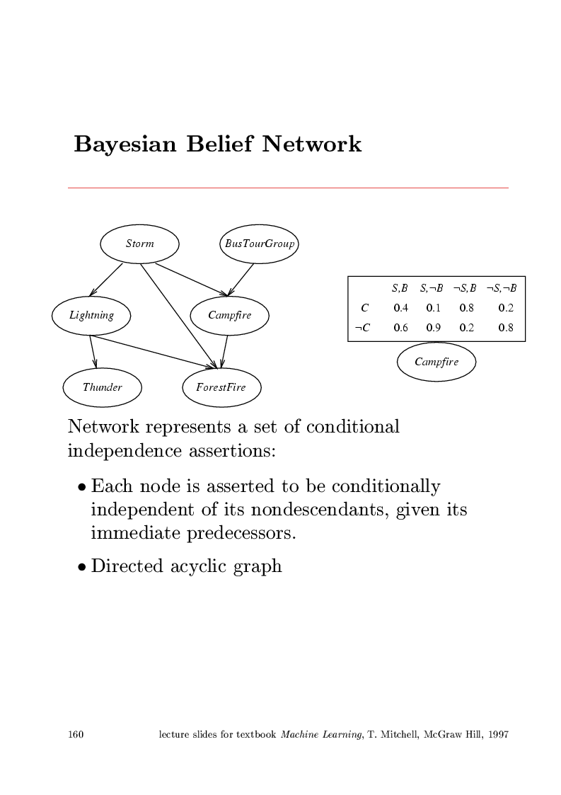
6. Bayesian Learning

Slide 30
6. Bayesian Learning
  Representation
    A Bayesian network represents the joint probability distribution of a set of variables
    Each variable is represented by a node
    Conditional independence assumptions are indicated by a directed acyclic graph
    Variables are conditionally independent of its nondescendents in the network given its inmediate predecessors

Slide 31
6. Bayesian Learning
  The joint probabilities are calculated as
  P(Y₁,Y₂,...,Y_{n}) = ∏_{i=1,n} P [Y_{i}|Parents(Y_{i})]
  The values P [Y_{i}|Parents(Y_{i})] are stored in tables associated to nodes Y_{i}
  Example:
  P(Campfire=True|Storm=True,BusTourGroup=True)=0.4

Slide 32
6. Bayesian Learning
  Inference
    We wish to infer the probability distribution for some variable given observed values for (a subset of) the other variables
    Exact (and sometimes approximate) inference of probabilities for an arbitrary BN is NP-hard
    There are numerous methods for probabilistic inference in BN (for instance, Monte Carlo), which have been shown to be useful in many cases

Slide 33
6. Bayesian Learning
  Learning Bayesian Belief Networks
  Task: Devising effective algorithms for learning BBN
  from training data
  Focus of much current research interest
  For given network structure, gradient ascent can be
  used to learn the entries of conditional probability tables
  Learning the structure of BBN is much more difficult,
  although there are successful approaches for some
  particular problems

Slide 34
6. Bayesian Learning
6.12 The Expectation-Maximization Algorithm

