Slide 1
8. Instance-Based Learning
8.1 Introduction
  Instance-Based Learning: Local approximation to the target function that applies in the neighborhood of the query instance
  Cost of classifying new instances can be high: Nearly all computations take place at classification time
  Examples: k-Nearest Neighbors
  Radial Basis Functions: Bridge between instance-based learning and artificial neural networks

Slide 2
8. Instance-Based Learning
8.2 k-Nearest Neighbor Learning
  Instance x = [ a₁(x), a₂(x),..., a_{n}(x) ] ∈ℜ^{n}
  d(x_{i},x_{j}) = [ (x_{i}-x_{j}).(x_{i}-x_{j}) ]^{½} = Euclidean Distance
  Discrete-Valued Target Functions
  ƒ : ℜ^{n} → V = {v₁, v₂,.., v_{s})

Slide 3
8. Instance-Based Learning
  Prediction for a new query x: (k nearest neighbors of x)
  ƒ(x) = argmax_{v∈V} ∑_{i=1,k} δ[v,ƒ(x_{i})]
  δ[v,ƒ(x_{i})] = 1 if v =ƒ(x_{i}) , δ[v,ƒ(x_{i})] = 0 otherwise
  Continuous-Valued Target Functions
  ƒ(x) = (1/k) ∑_{i=1,k} ƒ(x_{i})

Slide 4
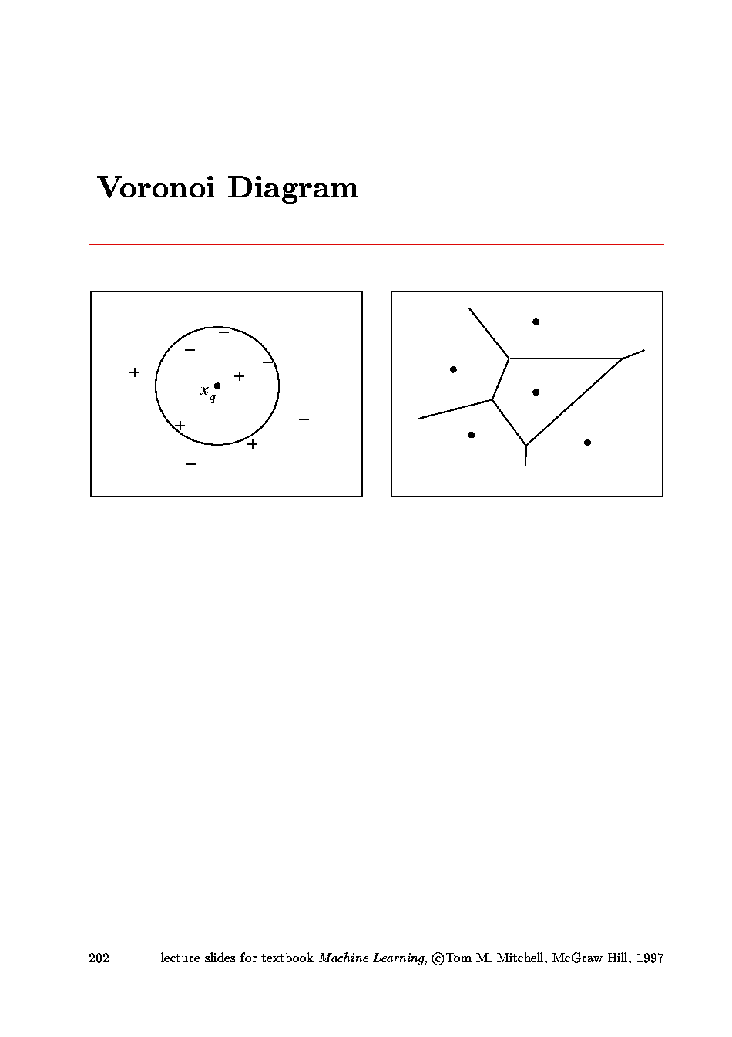
8. Instance-Based Learning

Slide 5
8. Instance-Based Learning
Distance-Weighted k-NN
ƒ(x) = argmax_{v∈V} ∑_{i=1,k} w_{i} δ[v,ƒ(x_{i})]
ƒ(x) = ∑_{i=1,k} w_{i} ƒ(x_{i}) / k ∑_{i=1,k} w_{i}
w_{i} = [d(x_{i},x)]⁻²
→ Weights more heavily closest neighbors

Slide 6
8. Instance-Based Learning
Remarks for k-NN
  Robust to noise
  Quite effective for large training sets
  Inductive bias: The classification of an instance will be most similar to the classification of instances that are nearby in Euclidean distance
  Especially sensitive to the curse of dimensionality
  Elimination of irrelevant attributes by suitably chosen the metric:
  d(x_{i},x_{j}) = [ (x_{i}-x_{j})..(x_{i}-x_{j}) ]^{½}

Slide 7
8. Instance-Based Learning
8.3 Locally Weighted Regression
Builds an explicit approximation to ƒ(x) over a local region surrounding x (usually a linear or quadratic fit to training examples nearest to x)
Locally Weighted Linear Regression:
ƒ_{L}(x) = w₀ + w₁ x₁ + ...+ w_{n} x_{n}
E(x) = ∑_{i=1,k} [ƒ_{L}(x_{i})-ƒ(x_{i})]² (x_{i} nn of x)

Slide 8
8. Instance-Based Learning
Generalization:
ƒ_{L}(x) = w₀ + w₁ x₁ + ...+ w_{n} x_{n}
E(x) = ∑_{i=1,N} K[d(x_{i},x)] [ƒ_{L}(x_{i})-ƒ(x_{i})]²
K[d(x_{i},x)] = kernel function
Other possibility:
ƒ_{Q}(x) = quadratic function of x_{j}

Slide 9
8. Instance-Based Learning
8.4 Radial Basis Functions
Approach closely related to distance-weighted regression and artificial neural network learning
ƒ_{RBF}(x) = w₀ + ∑_{µ=1,k} w_{µ} K[d(x_{µ},x)]
K[d(x_{µ},x)] = exp[-d²(x_{µ},x)/ 2σ²_{µ}] = Gaussian kernel function

Slide 10
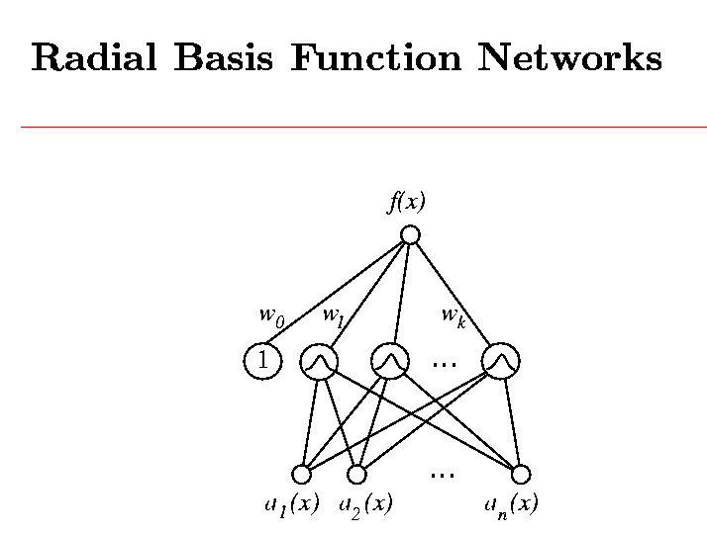
8. Instance-Based Learning

Slide 11
8. Instance-Based Learning
Training RBF Networks
1st Stage:
Determination of k (=number of basis functions)
x_{µ} and σ_{µ} (kernel parameters)
→ Expectation-Maximization (EM) algorithm
2nd Stage:
Determination of weights w_{µ}
→ Linear Problem

Slide 12
8. Instance-Based Learning
8.6 Remarks on Lazy and Eager Learning
Lazy Learning: stores data and postpones decisions until a new query is presented
Eager Learning: generalizes beyond the training data before a new query is presented
Lazy methods may consider the query instance x when deciding how to generalize beyond the training data D (local approximation)
Eager methods cannot (they have already chosen their global approximation to the target function)

