Slide 1
Digital Portfolio
STUDENT NAME: PRABAKARAN V
REGISTER NO AND NMID:4D1A58DBC8A18B59EE24CB15500E8398
DEPARTMENT:BSC COMPUTER SCIENCE
COLLEGE:SSS COLLEGE ARTS &SCIENCE
UNIVERSITY:THIRUVALLUVAR UNIVERSITY

Slide 2
DIGITAL PORTFOLIO USING HTML , CSS , JAVASCRIPT

Slide 3
AGENDA
1.Problem Statement
2.Project Overview
3.End Users
4.Tools and Technologies
5.Portfolio design and Layout
6.Features and Functionality
7.Results and Screenshots
8. Conclusion
9.Github Link

Slide 4
PROBLEM STATEMENT
Intoday’s digital-first world,individual soften struggle to present their skills,achievements, and creative work in a structured and accessible way.
Traditional resumes,paper portfolios ,orstatic documents failto show case interactive projects, design aesthetics, and multimedia elements effectively.
This creates a gap between talent and opportunities ,asemployers ,clients oraudiencesfinditdifficult toevaluate the complete potentialof an individual.
A digital portfol iosolves this problem by providing a dynamic,user-friendly platform where a person can highlight their skills, experiences, and projects in an engaging and professional manner.
However,creating sucha portfolio often faces challenges like: Lack of technical knowledge todesign and develop one. Difficulty in organizing and curating content to reflect true strengths. Limited accessibility and poor compatibility across devices. Absence of personalization that differentiates the individual from others.

Slide 5
PROJECT OVERVIEW
The goal of this project is to create a professional, visually appealing, and interactive digital portfolio that highlights personal skills, achievements, and creative work.
It serves as both a self-promotion tool and a platform to showcase academic, professional, and personal projects.

Slide 6
WHO ARE THE END USERS?
To showcase skills,projects, and achievements.
To highlightwork samples, casestudies, and career growth. To track teaching methods, lesson plans, and achievements To present services, products, and success stories. End users: Recruiters, H R managers, admission committees, teachers, or internship providers Clients, employers, collaborators, or agencies. School administrators, students, parents, or education boards.Customers, investors, business partners.

Slide 7
TOOLS AND TECHNIQUES
Tools (on Mobile with CodePen) 1. CodePen App / Mobile Browser Use codepen.io on Chrome or Safari. Login to save and edit your portfolio.
3. CSS (Styling) To design your portfolio with colors, fonts, layouts. Mobile-friendly design with Flexbox or Grid.
5. External Libraries/Frameworks (Optional) Bootstrap / TailwindCSS – for responsive design quickly. FontAwesome – for icons. Google Fonts – for stylish text.
2. HTML (Structure) For content like your name, about section, skills, projects, contact details.
4. JavaScript (Interactivity) Add animations, sliders, form validation, or project filters.

Slide 8
◻ Techniques
Responsive Design
Use@media queries so your portfolio looks good on mobile & desktop
2. Navigation Menu (Hamburger) Simple mobile-friendly navigation at the top.
3. Sections Header – Name & tagline. About Me – Short bio with photo. Skills – List with icons or progress bars. Projects – Grid or card layout with images/links. Contact – Email or form.
4. Animations CSS transitions (:hover) or small JavaScript scroll effects. Example: fade-in sections while scrolling.
5. CodePen Embeds If you build mini projects in CodePen, you can embed them inside your portfolio.

Slide 9
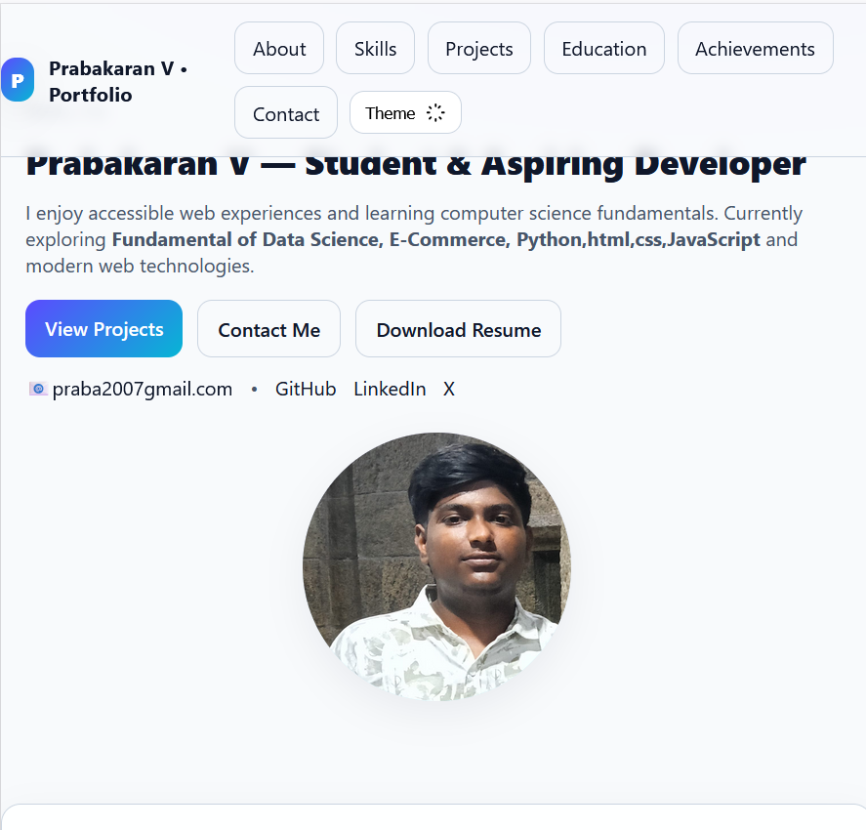
POTFOLIO DESIGN AND LAYOUT

Slide 10
FEATURES AND FUNCTIONALITY
Features of a Digital Portfolio
1. Personal Branding Name, tagline, professional role, and profile photo. A personal logo or unique color theme.
1. Interactive Animations
Smooth scroll to sections.
Fade-in or slide-up animations when scrolling.
2. Search or Filter Projects Filter projects by category (e.g., Web, Mobile, Design).
2. About Section Short bio or career summary. Background, education, and interests.
3. Embedded Media CodePen, GitHub repos, YouTube videos, or Behance designs.
4. Theme Toggle Dark mode / light mode switch.
3. Skills Showcase Technical and soft skills (with icons, progress bars, or charts). Categorized (e.g., Web Development, Design, Tools).
5. Analytics (Optional) Google Analytics to track views.

Slide 11
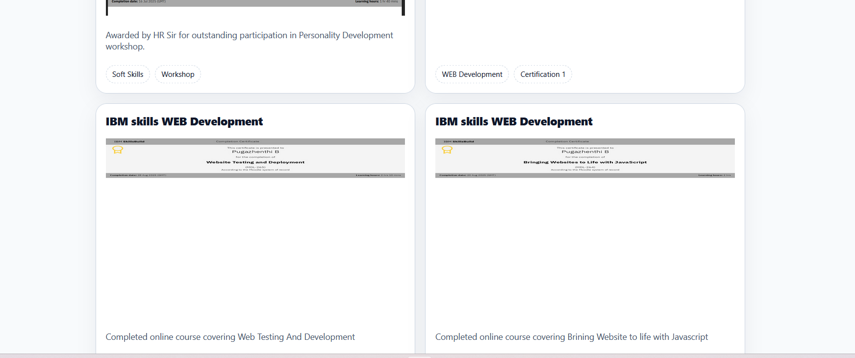
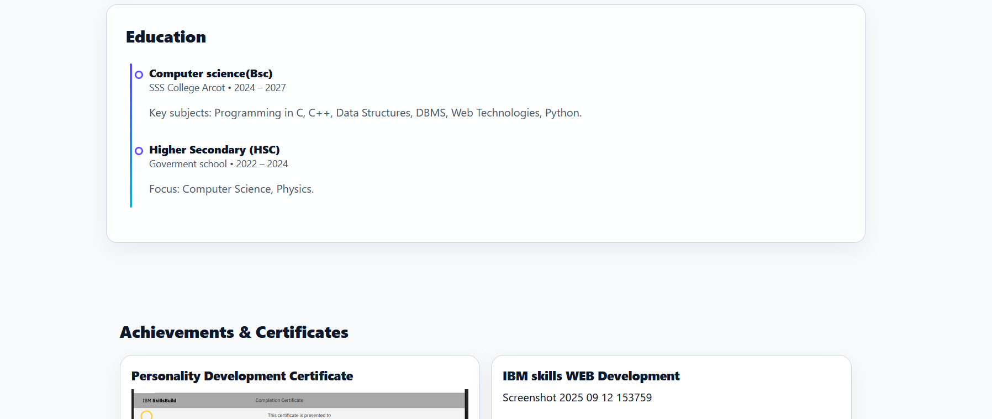
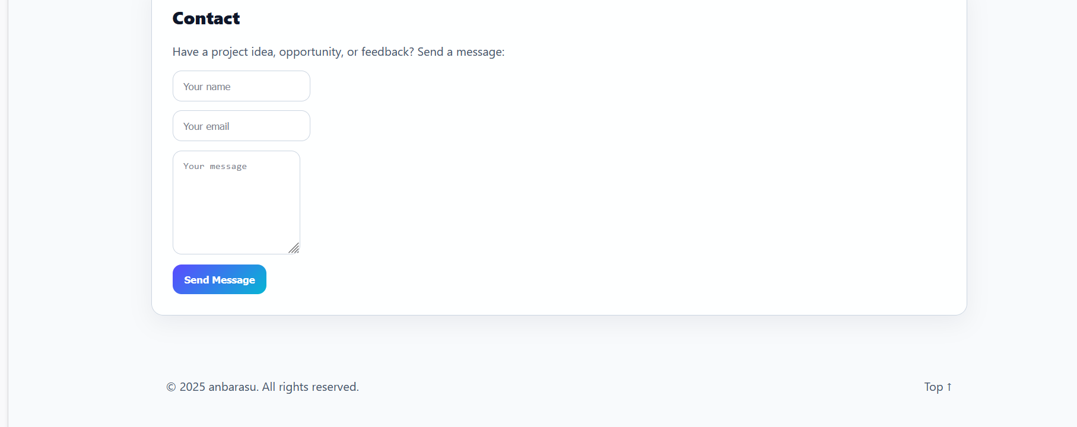
RESULTS AND SCREENSHOTS

Slide 12
CONCLUSION
The Employee Salary Prediction System successfully demonstrates the end-to-end application of machine learning in solving a real-world HR analytics challenge. By simulating realistic salary data and applying advanced modeling techniques, the system achieved high prediction accuracy and practical insights into salary dynamics.
The use of SHAP for model explainability added transparency, enabling users to understand key salary drivers. The Streamlit-based deployment ensured accessibility through a user-friendly web interface.
This project highlights the effectiveness of combining data science, domain knowledge, and cloud deployment to deliver a scalable, production-ready solution for compensation intelligence.

