Slide 1
KAVERI 3.0 · DEPARTMENT OF STAMPS AND REGISTRATION, GOVERNMENT OF KARNATAKA
Business Requirements Document
User Management Module
Identity · Passwordless authentication · Sanctioned post occupancy · RBAC · Officer lifecycle
Document BRD-K3-UM-001 | Version 4.18 | 04 September 2026 Author: Nandha Kumar (Business Analyst) | Status: In review — pending Domain Expert sign-off
Notes:
Walkthrough of the User Management BRD v4.18 for the KAVERI 3.0 platform. All diagrams in this deck are the approved figures embedded in the BRD itself.

Slide 2
CONTENTS
Agenda
A walkthrough of BRD-K3-UM-001 v4.18. Every process diagram shown is the approved figure embedded in the BRD; the editable .drawio sources sit under ProcessDiagrams/User_Management.
— 1. Introduction, scope and business objectives
— 2. Identity and passwordless authentication — Citizens, DSR Officers, Other Department users
— 3. Posts, roles and role-based access control
— 4. DSR Officer lifecycle — creation, transfer, occupancy and temporary absence
— 5. Non-functional requirements, reporting, acceptance and sign-off
KAVERI 3.0 · User Management BRD v4.18 · Department of Stamps and Registration, Government of Karnataka
2

Slide 3
BRD-K3-UM-001
Document control
Field | Value
Document ID | BRD-K3-UM-001
Version | 4.18 (04 September 2026)
Status | In review — pending Domain Expert sign-off
Module | User Management
Author (BA) | Nandha Kumar
Product Owner | Prashanth
Domain expert / reviewer | Prabhakar Naik
Target audience | Kaveri IT Cell, Department of Stamps and Registration, Government of Karnataka
Legal basis (primary) | Information Technology Act 2000; Indian Registration Act 1908; Aadhaar Act 2016
State rules (primary) | Karnataka e-Governance hosting and security norms; MeitY / CERT-In / STQC / GIGW
KAVERI 3.0 · User Management BRD v4.18 · Department of Stamps and Registration, Government of Karnataka
3

Slide 4
01
Introduction and Scope
Why the module exists, what it replaces, and where its boundaries lie.
4

Slide 5
SECTIONS 1.1 – 1.2
Purpose and background
PURPOSE
BACKGROUND
— Defines the business requirements for the KAVERI 3.0 User Management module.
— Covers identity, passwordless authentication, sanctioned post occupancy, RBAC and officer lifecycle.
— Applies to Citizens, DSR Officers and Other Department users.
— Is the agreed basis for design, development, testing and sign-off.
— KAVERI 3.0 needs one platform service for users, roles, posts and module access.
— Replaces fragmented Kaveri 2.0 user administration.
— One User Master and one Role Master — no separate stores per category.
— OTP-only login with no passwords; post-based DSR access; Application Admin maintains privilege mapping.
KAVERI 3.0 · User Management BRD v4.18 · Department of Stamps and Registration, Government of Karnataka
5

Slide 6
SECTION 1.3
Scope
In scope for the User Management module:
— User registration and profile management for Citizens, DSR Officers and Other Department users (single User Master).
— Passwordless authentication, session policy, Citizen lost-mobile reset, DSR post selection and additional charge (§6.2–6.5).
— Unified Role Master; Posts and Sanctioned Posts masters; office and officer hierarchies; RBAC via Module, Function and Resource mapping (§6.5).
— DSR lifecycle: post assignment, Transfer Out / In, occupancy refresh, Temporary Absence and Temporary Charge (§6.6).
— Administrative user management, audit logging and reporting (§6.7–8).
KAVERI 3.0 · User Management BRD v4.18 · Department of Stamps and Registration, Government of Karnataka
6

Slide 7
SECTION 3
Business objectives
— Provide a secure and reliable mechanism for users to register and access the system.
— Enable administrators to manage user accounts and access rights efficiently.
— Enforce role-based access control to protect sensitive data and functionality.
— Maintain the DSR Officer Hierarchy Master aligned to the departmental organisation chart.
— Support Module Function and Resource masters with Role–Module–Function mapping and runtime enforcement.
— Reduce support overhead on account access issues through reliable OTP delivery.
— Ensure compliance with organisational security and data privacy policies.
— Provide auditability of user actions for security and compliance reporting.
KAVERI 3.0 · User Management BRD v4.18 · Department of Stamps and Registration, Government of Karnataka
7

Slide 8
SCALE OF THE SPECIFICATION
The module at a glance
84
3
19
8
Functional requirements, FR-UM-001 to FR-UM-084
User categories in a single User Master
Approved process and structure diagrams
Business modules under the Module Master
40
0
24
7 yrs
Posts in the Posts Master across 8 divisions
Passwords stored — OTP-only authentication
Non-functional requirements across 6 categories
Minimum audit-log retention
Counts taken from BRD v4.18. Detailed requirement text remains authoritative in Section 6 of the document.
KAVERI 3.0 · User Management BRD v4.18 · Department of Stamps and Registration, Government of Karnataka
8

Slide 9
SECTION 4
Stakeholders
Name / Role | Department | Responsibility
Kaveri IT Cell | Engineering | Reviews technical feasibility
Citizens (Public users) | External | Self-register and access citizen portal services
DSR Officers & Other Department users | Government | Access departmental modules via OTP + biometrics
Prashanth | Product Owner | Owns scope and signs off UAT
Prabhakar Naik | Domain Expert | Confirms departmental rules, hierarchies and role mapping
KAVERI 3.0 · User Management BRD v4.18 · Department of Stamps and Registration, Government of Karnataka
9

Slide 10
02
Identity and Authentication
One User Master, three categories, and no passwords anywhere in the platform.
10

Slide 11
SECTION 6.5.2
Three user categories, one User Master
Differentiation is by User Category on users and Role Category on roles — there are no separate masters per category.
User category | Username | Authentication | Lost-mobile reset
Public (Citizen) | Preferred Username chosen at registration (FR-UM-062) | Username + Captcha + OTP to mobile | Self-service: 3 of 5 security questions + PIN to registered email + OTP to new mobile (FR-UM-056)
DSR Officer | KGID (FR-UM-062, FR-UM-064) | Username (KGID) + Captcha + OTP to mobile + Biometrics, then post selection (FR-UM-052) | Not available — administrator changes the mobile with reason and audit (FR-UM-065)
Other Department | KGID (FR-UM-062, FR-UM-064) | Username (KGID) + Captcha + OTP to mobile + Biometrics | Not available — administrator changes the mobile with reason and audit (FR-UM-065)
KAVERI 3.0 · User Management BRD v4.18 · Department of Stamps and Registration, Government of Karnataka
11

Slide 12
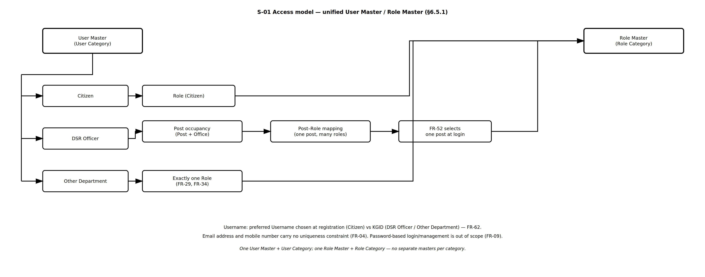
SECTION 6.5.1
How identity resolves to access
S-01 Access Model · FR-UM-004, FR-UM-009, FR-UM-029, FR-UM-034, FR-UM-052, FR-UM-062
— Citizens hold a Citizen role; Other Department users hold exactly one role; DSR Officers derive roles from post occupancy via Post–Role mapping.
— The Username is the single unique login identifier across the whole User Master — email and mobile carry no uniqueness constraint.
KAVERI 3.0 · User Management BRD v4.18 · Department of Stamps and Registration, Government of Karnataka
12
Notes:
One User Master and one Role Master. Category drives the creation path, the authentication factors and the eligible roles.

Slide 13
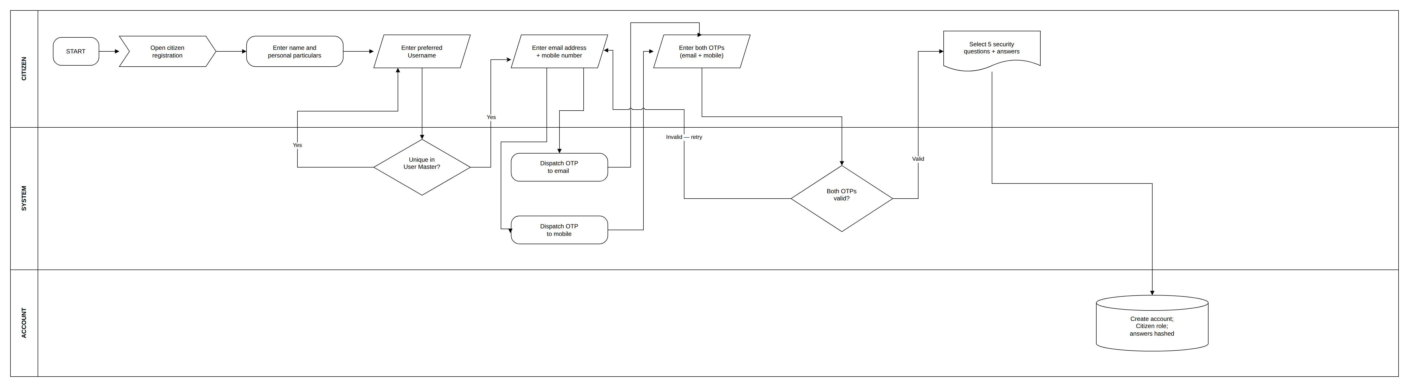
SECTION 6.1.1
Citizen self-registration
P-01 Citizen Self-Registration · FR-UM-001, FR-UM-055, FR-UM-062, FR-UM-063
— Instant self-registration with no approval workflow; the citizen chooses their own Username, checked for availability across the entire User Master.
— Email and mobile are each verified by a separate OTP before the account is created; five security questions are captured for lost-mobile reset only.
KAVERI 3.0 · User Management BRD v4.18 · Department of Stamps and Registration, Government of Karnataka
13
Notes:
Steps: open registration and enter particulars; choose Username and check availability (FR-UM-062); enter email and mobile; two separate OTPs dispatched (FR-UM-063); enter both OTPs; select five security questions and answers (FR-UM-055); account created with Citizen role and answers stored hashed.

Slide 14
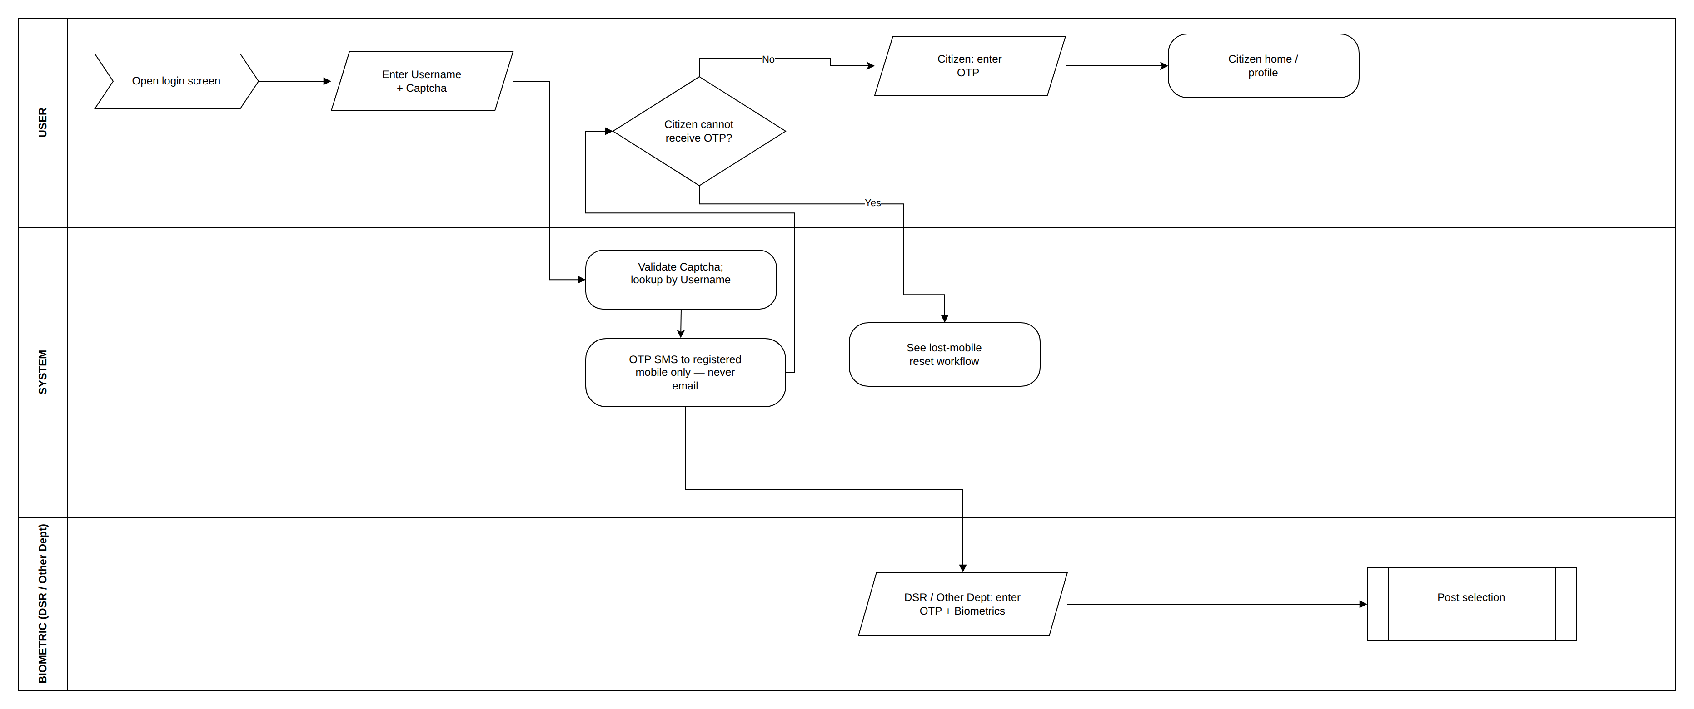
SECTION 6.5.2.1
Login across all categories
P-02 Login — All User Categories · FR-UM-004–FR-UM-007, FR-UM-010, FR-UM-011, FR-UM-062
— The account resolves from the Username alone, so no category selection is needed at the login screen.
— The login OTP is never emailed — it is sent only by SMS to the registered mobile (FR-UM-010).
KAVERI 3.0 · User Management BRD v4.18 · Department of Stamps and Registration, Government of Karnataka
14
Notes:
Captcha is validated before OTP dispatch for all categories (FR-UM-011). DSR and Other Department users add biometrics; DSR Officers then continue to post selection (FR-UM-052). A Citizen who cannot receive the OTP leaves login for the lost-mobile reset flow.

Slide 15
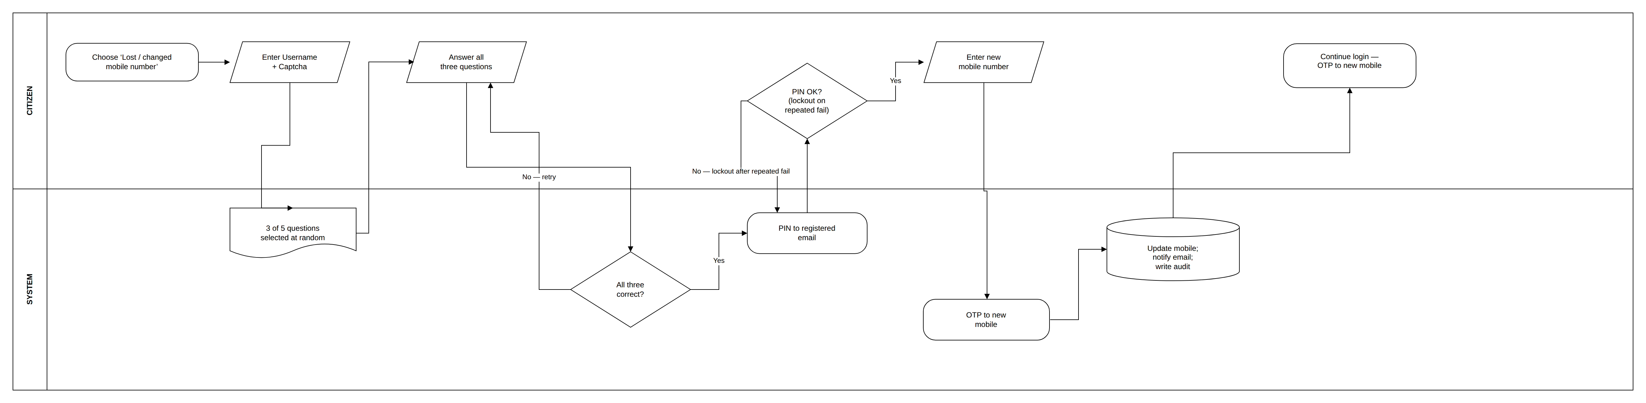
SECTION 6.5.2.2
Citizen lost-mobile reset
P-03 Citizen Lost-Mobile Reset · FR-UM-056 — three of five questions plus a PIN to the registered email
— Two independent proofs are required before the mobile may be changed: three randomly selected security questions and a single-use PIN sent to the registered email.
— The new mobile number is itself OTP-verified before the change takes effect; the completed change is notified to the email and audit-logged.
KAVERI 3.0 · User Management BRD v4.18 · Department of Stamps and Registration, Government of Karnataka
15
Notes:
Available only to Public users (Citizens). Failed answers and PIN entries are rate-limited; five failures lock the reset flow for thirty minutes.

Slide 16
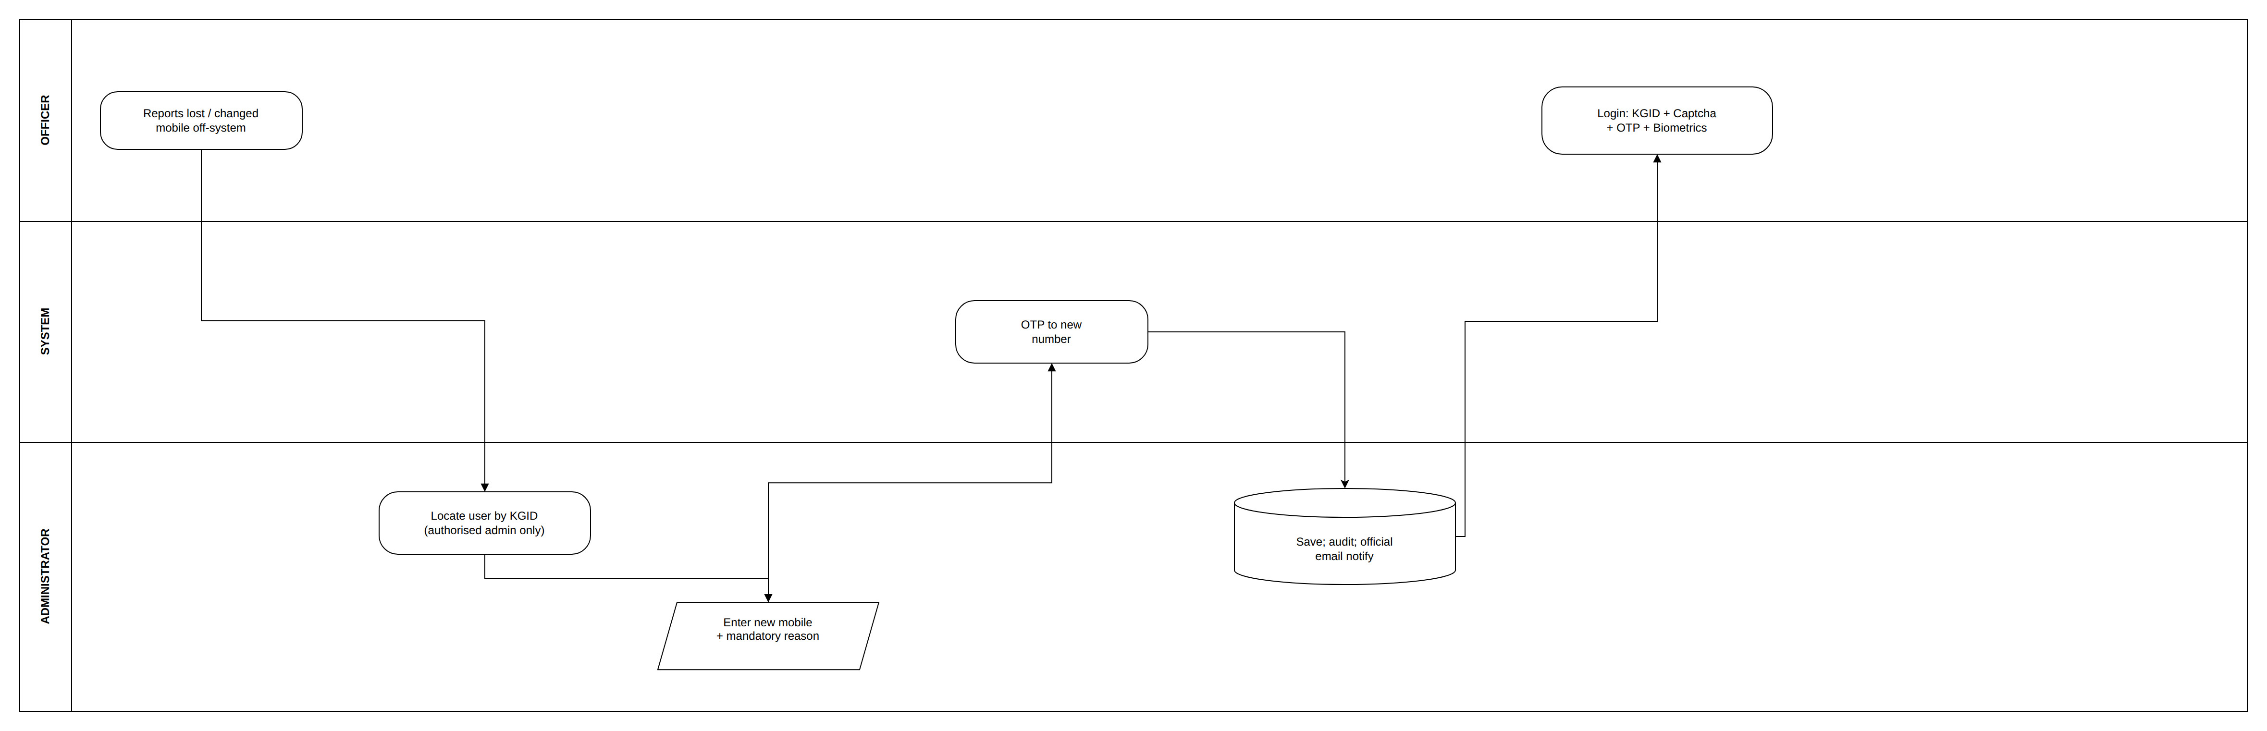
SECTION 6.5.2.3
Departmental mobile change — administrator only
P-04 Departmental Mobile Change · FR-UM-065 — no self-service path for departmental users
— DSR Officers and Other Department users hold no security questions and are never offered the FR-UM-056 reset path.
— An authorised administrator records a mandatory reason; the new number is OTP-verified and the change is audit-logged and notified on official email.
KAVERI 3.0 · User Management BRD v4.18 · Department of Stamps and Registration, Government of Karnataka
16
Notes:
This keeps departmental authentication factors under departmental control and removes any pre-login route to redirect an officer's OTP.

Slide 17
FR-UM-069 – FR-UM-076
OTP and session policy
Applies to every user category. The 15-minute idle timeout matters most on shared SRO counter machines, where the session post is fixed for the whole session.
Control | Rule | Requirement
Login OTP validity | 5 minutes from dispatch (IST) | FR-UM-069
Registration OTP / reset PIN validity | 10 minutes from dispatch | FR-UM-069
Code length | 6 numeric digits | FR-UM-070
Incorrect entries per code | Maximum 3, then the code is invalidated | FR-UM-071
Resend cooldown | 30 seconds; maximum 3 resends per channel per 15 minutes | FR-UM-072
Failed-login lockout | 5 failures lock the Username for 15 minutes | FR-UM-073
Idle timeout | 15 minutes of inactivity ends the session | FR-UM-074
Absolute session limit | 8 hours from login, even if the user is active | FR-UM-075
Concurrent sessions | One per Username — last login wins | FR-UM-076
KAVERI 3.0 · User Management BRD v4.18 · Department of Stamps and Registration, Government of Karnataka
17

Slide 18
03
Posts, Roles and Access Control
Access follows the post an officer occupies — not a privilege attached to the person.
18

Slide 19
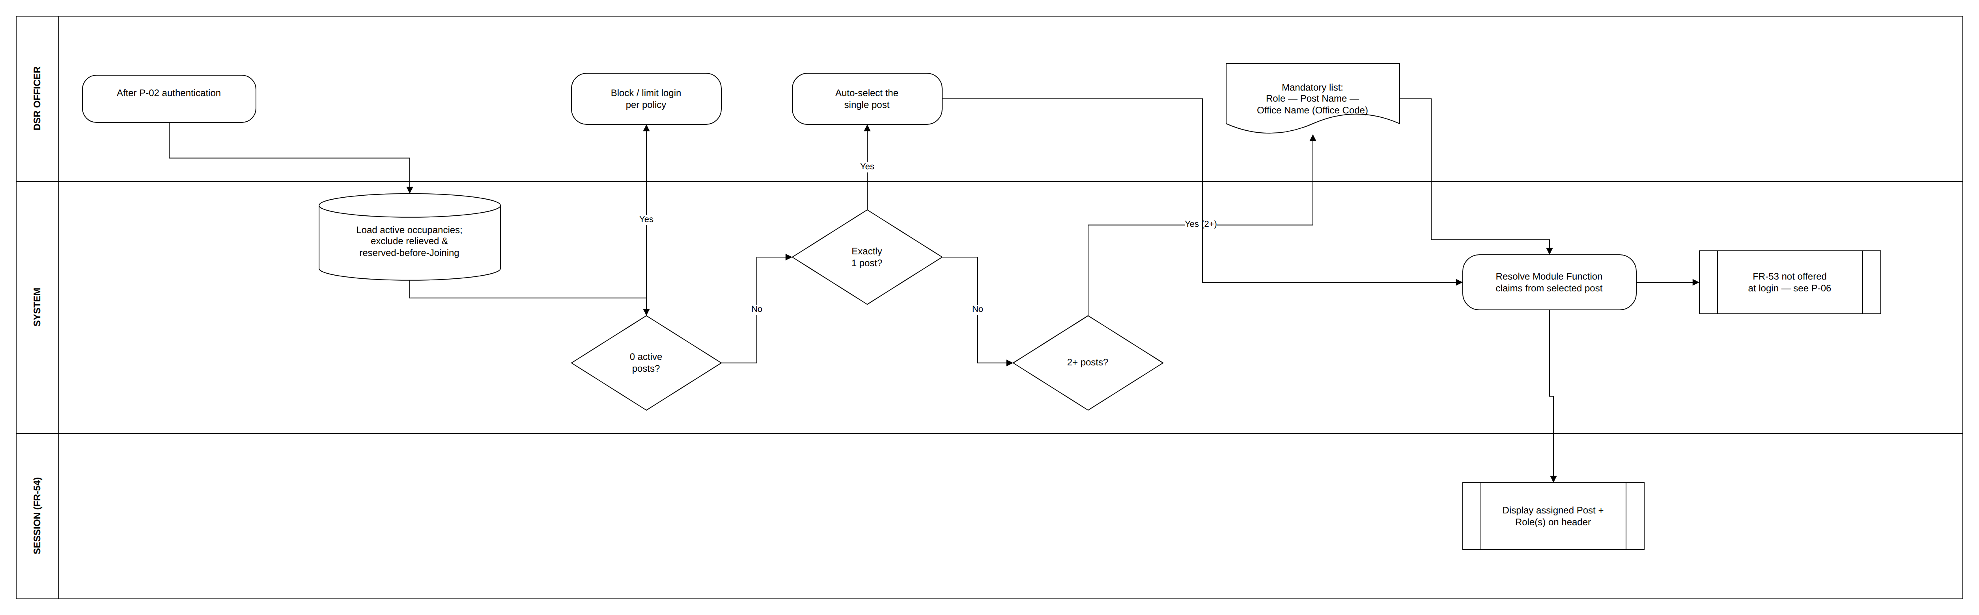
SECTION 6.5.2.4
DSR Officer post selection at login
P-05 DSR Login Post Selection · FR-UM-052 — mandatory when more than one occupancy is active
— One active occupancy auto-selects and skips the screen; two or more force a mandatory choice labelled Role — Post Name — Office Name (Office Code).
— Claims derive from the selected post only via Post–Role mapping — never from the union of other posts the officer holds.
KAVERI 3.0 · User Management BRD v4.18 · Department of Stamps and Registration, Government of Karnataka
19
Notes:
Relieved occupancies and Transfer In occupancies before their Joining Date are excluded from the list (FR-UM-058, FR-UM-061, FR-UM-068). Additional charge is not offered during the login flow.

Slide 20
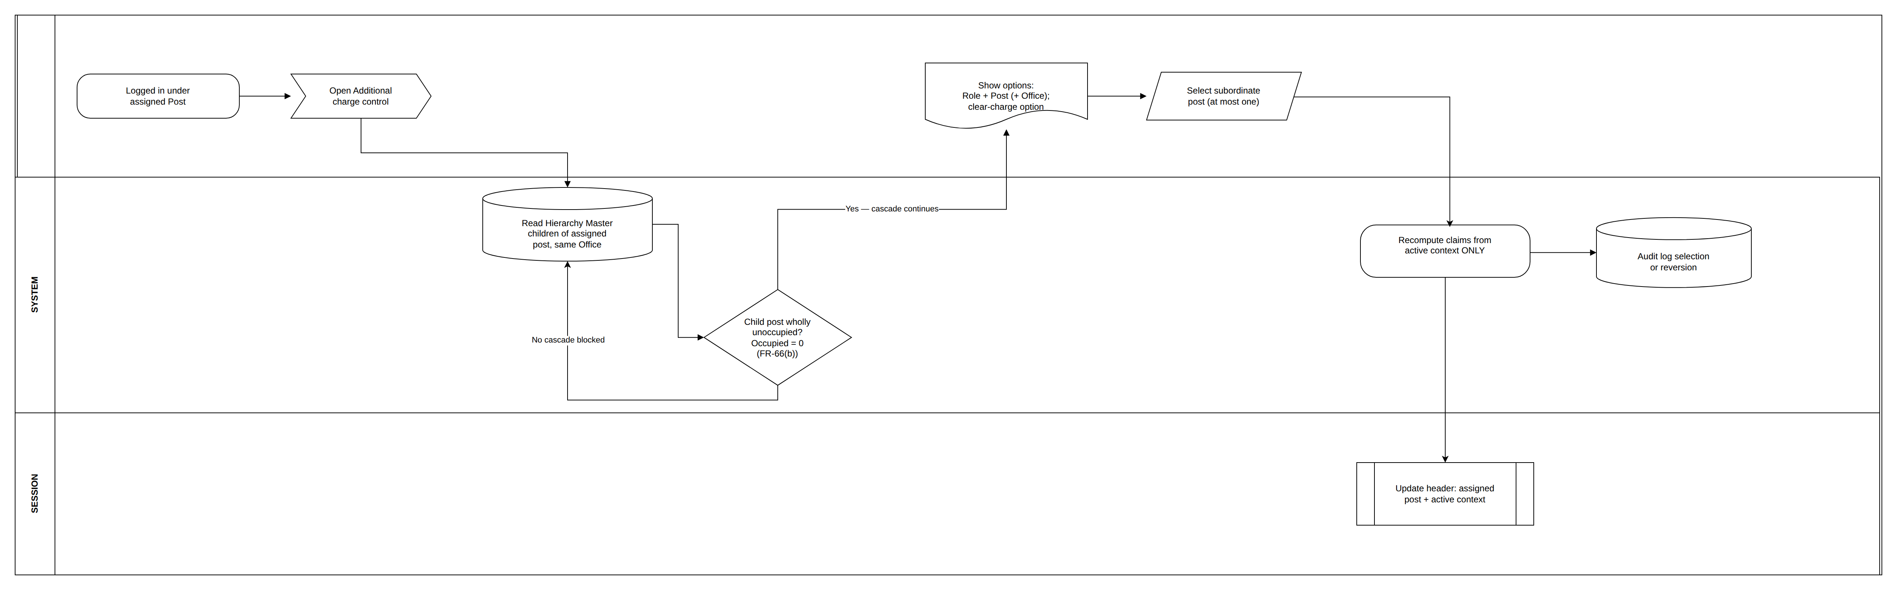
SECTION 6.5.2.5
Additional charge of an unoccupied subordinate post
P-06 Additional Charge After Login · FR-UM-053, FR-UM-054 — post-login, same office, no order required
— A subordinate post qualifies only when it is wholly unoccupied at that office (Occupied = 0); any occupant blocks both the post and the cascade beneath it.
— While additional charge is active, privileges come from that post alone — a Sub-Registrar acting as FDA loses SR signing until switch-back.
KAVERI 3.0 · User Management BRD v4.18 · Department of Stamps and Registration, Government of Karnataka
20
Notes:
Temporary in-office cover for the session, taken after login without logout and without a Transfer Order. At most one additional charge post at a time; selection, switch-back and reversion are all audit-logged.

Slide 21
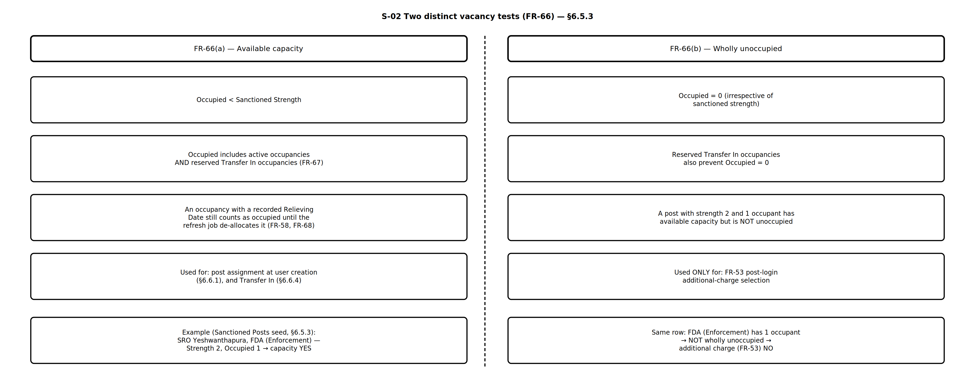
SECTION 6.5.3
Two distinct vacancy tests
S-02 Two Vacancy Tests · FR-UM-066(a) available capacity vs FR-UM-066(b) wholly unoccupied
— Available capacity (Occupied < Sanctioned Strength) governs post assignment at user creation and Transfer In.
— Wholly unoccupied (Occupied = 0) governs additional charge only — a post with strength 2 and one occupant has capacity but is not unoccupied.
KAVERI 3.0 · User Management BRD v4.18 · Department of Stamps and Registration, Government of Karnataka
21
Notes:
Occupied includes active occupancies and reserved Transfer In occupancies (FR-UM-067). An occupancy with a recorded Relieving Date still counts as occupied until the midnight refresh job de-allocates it.

Slide 22
SECTIONS 6.5.3 – 6.5.4
Role Master — DSR roles by division
Divisions come from the Division Master, not free text. Role names must be unique — FDA (Admin) and FDA (Enforcement) are distinct roles, never a shared FDA.
Division (FR-UM-077) | Roles under Role Category = DSR
Secretariat | ACS / Principal Secretary / Secretary
Top Management | IGR
Admin, Law & Computers | DIGR (Admin, Law & Computers), AIGR (Admin), HQA (Admin), Sub Registrar (Admin), FDA (Admin), SDA (Admin), Typist (Admin), HQA (RTI), FDA (RTI), SDA (RTI), Statistical Inspector, Accountant Superintendent (Admin)
Vigilance | DIGR (Vigilance), Law Officer
Computers | AIGR (Computers), System Integrator, PMU, Application Developer, HQA / Project Manager (Comp), Sub Registrar (Computers), FDA (Computers), SDA (Computers)
Enforcement | DIGR (Enforcement), DRO, HQA (Enforcement), Sub-Registrar (SR), FDA (Enforcement), SDA (Enforcement), DEO
Intelligence & Audit | DIGR (Intelligence), AIGR (Audit), HQA (Audit), Superintendent (Audit), FDA (Audit), SDA (Audit), Typist (Audit)
DIGR CVC | DIGR CVC, JD Town Planning
KAVERI 3.0 · User Management BRD v4.18 · Department of Stamps and Registration, Government of Karnataka
22

Slide 23
SECTION 6.5.6
The privilege chain
Access is modelled as User → Role(s) → Module Function(s) → Resource(s). DSR organisational roles are never named after application services.
Level | Master | Maintained by | Purpose
1 | Module Master | Application Admin | Business modules — Registration of Documents, Marriage Registration, Encumbrance Search, Certified Copy, Stamp Duty / Payments, Firm / Society Registration, User Management, MIS / Dashboards
2 | Module Function Master | Application Admin | Functions under each module — VIEW, ADD, EDIT, APPROVE, SIGN, PRINT, APPLY, ISSUE, ADMIN
3 | Resource Master | Application Admin | APIs and URLs linked to each Module Function, with an Is Public flag for unauthenticated endpoints
4 | Role–Module–Function mapping | Application Admin | Which roles may perform which Module Functions; role names must match the Role Master exactly (FR-UM-050)
KAVERI 3.0 · User Management BRD v4.18 · Department of Stamps and Registration, Government of Karnataka
23

Slide 24
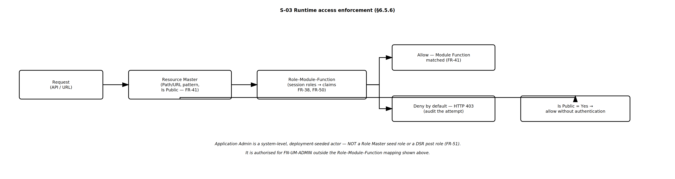
SECTION 6.5.6
Runtime access enforcement
S-03 Runtime Enforcement · FR-UM-038, FR-UM-041, FR-UM-050, FR-UM-051
— Every API or URL request is matched against the Resource Master and the session's Role–Module–Function claims.
— Deny by default — an unmatched request returns HTTP 403 and the attempt is audited. Only resources flagged Is Public bypass authentication.
KAVERI 3.0 · User Management BRD v4.18 · Department of Stamps and Registration, Government of Karnataka
24
Notes:
Application Admin is a system-level actor outside the Role Master and Role–Module–Function mapping (FR-UM-051), and maintains all masters in this section. Maker-checker is not required.

Slide 25
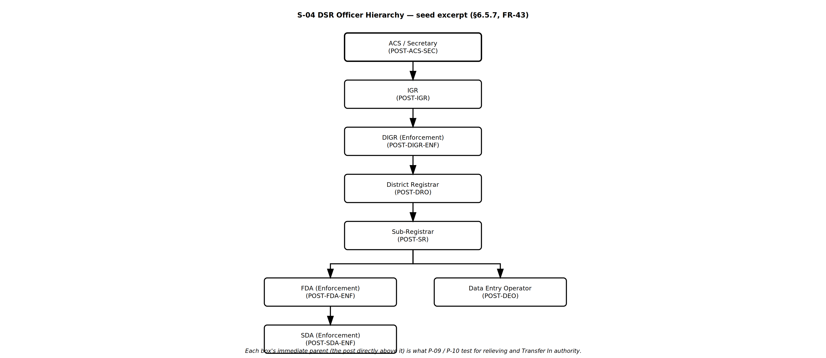
SECTION 6.5.7
DSR Officer Hierarchy Master
S-04 Officer Hierarchy Tree · FR-UM-043 — each post's immediate parent drives relieving and Transfer In authority
— Authority is granted by immediate parentage only: IGR may act on DIGR, DIGR (Enforcement) on DRO, DRO on Sub-Registrar, SR on FDA and DEO.
— Seeing a post lower in the tree does not confer authority over it — IGR cannot relieve a Sub-Registrar directly.
KAVERI 3.0 · User Management BRD v4.18 · Department of Stamps and Registration, Government of Karnataka
25

Slide 26
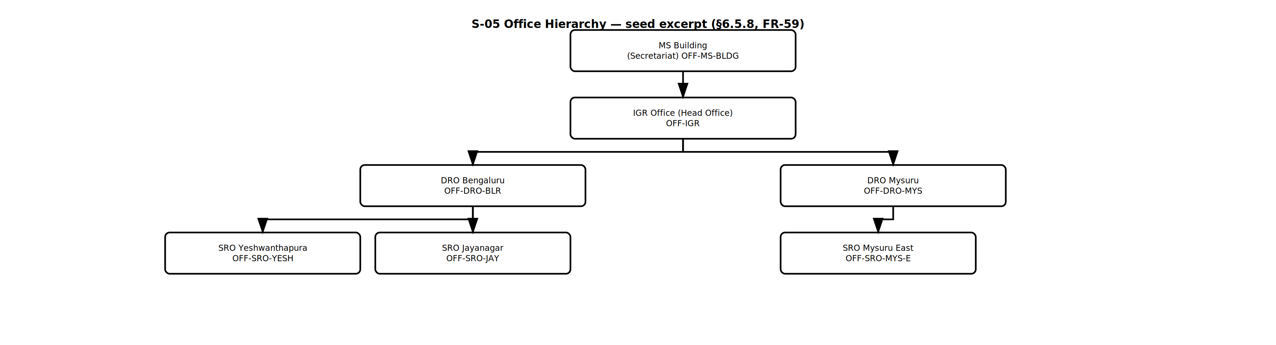
SECTION 6.5.8
Office Hierarchy Master
S-05 Office Hierarchy Tree · FR-UM-059 — MS Building → IGR Head Office → District Registrar Offices → Sub-Registrar Offices
— Maintained separately from the Officer Hierarchy; it scopes which offices a superior can see for Transfer Out and Transfer In.
KAVERI 3.0 · User Management BRD v4.18 · Department of Stamps and Registration, Government of Karnataka
26

Slide 27
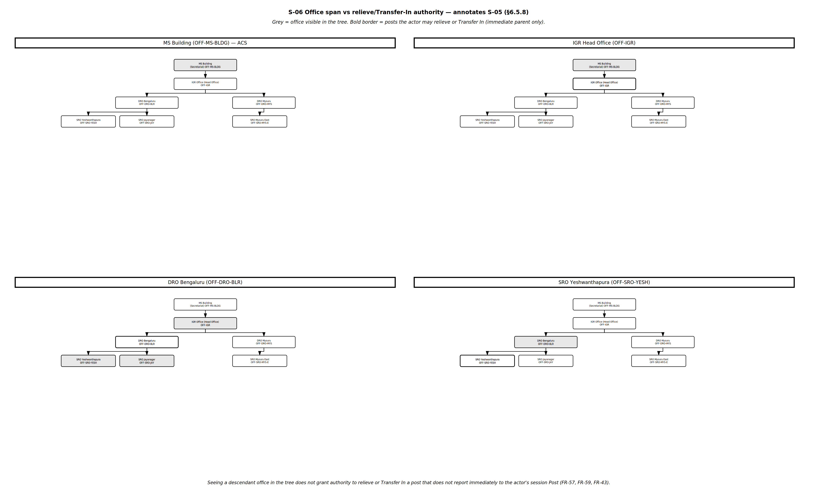
SECTION 6.5.8
Office span is visibility, not authority
S-06 Span vs Action · FR-UM-057, FR-UM-059, FR-UM-043
— Both tests must pass: the target office must fall in the actor's office span, and the actor's session Post must be the immediate parent of the target Post.
KAVERI 3.0 · User Management BRD v4.18 · Department of Stamps and Registration, Government of Karnataka
27
Notes:
Grey shading marks offices visible in the tree; a bold border marks posts the actor may actually relieve or Transfer In. Seeing a descendant office does not grant authority over the posts in it.

Slide 28
04
Officer Lifecycle
Creation, transfer, the midnight occupancy refresh, and temporary absence.
28

Slide 29
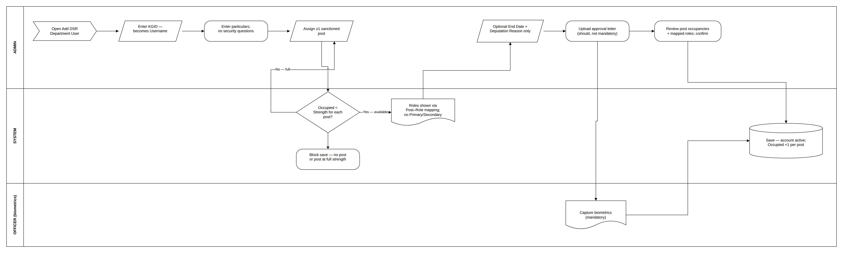
SECTION 6.6.1
DSR Officer creation with post assignment
P-07 DSR Officer User Creation · FR-UM-017, FR-UM-030, FR-UM-045–048, FR-UM-062, FR-UM-066(a)
— KGID is entered first because it becomes the Username; at least one sanctioned post with available capacity must be assigned or the save is blocked.
— Roles are shown through Post–Role mapping — there is no Primary/Secondary model, and no security questions are captured for this category.
KAVERI 3.0 · User Management BRD v4.18 · Department of Stamps and Registration, Government of Karnataka
29
Notes:
An optional End Date with a Deputation Reason covers time-bound deputations only; it is not a substitute for Transfer Out relieving (FR-UM-057). Biometrics capture is mandatory.

Slide 30
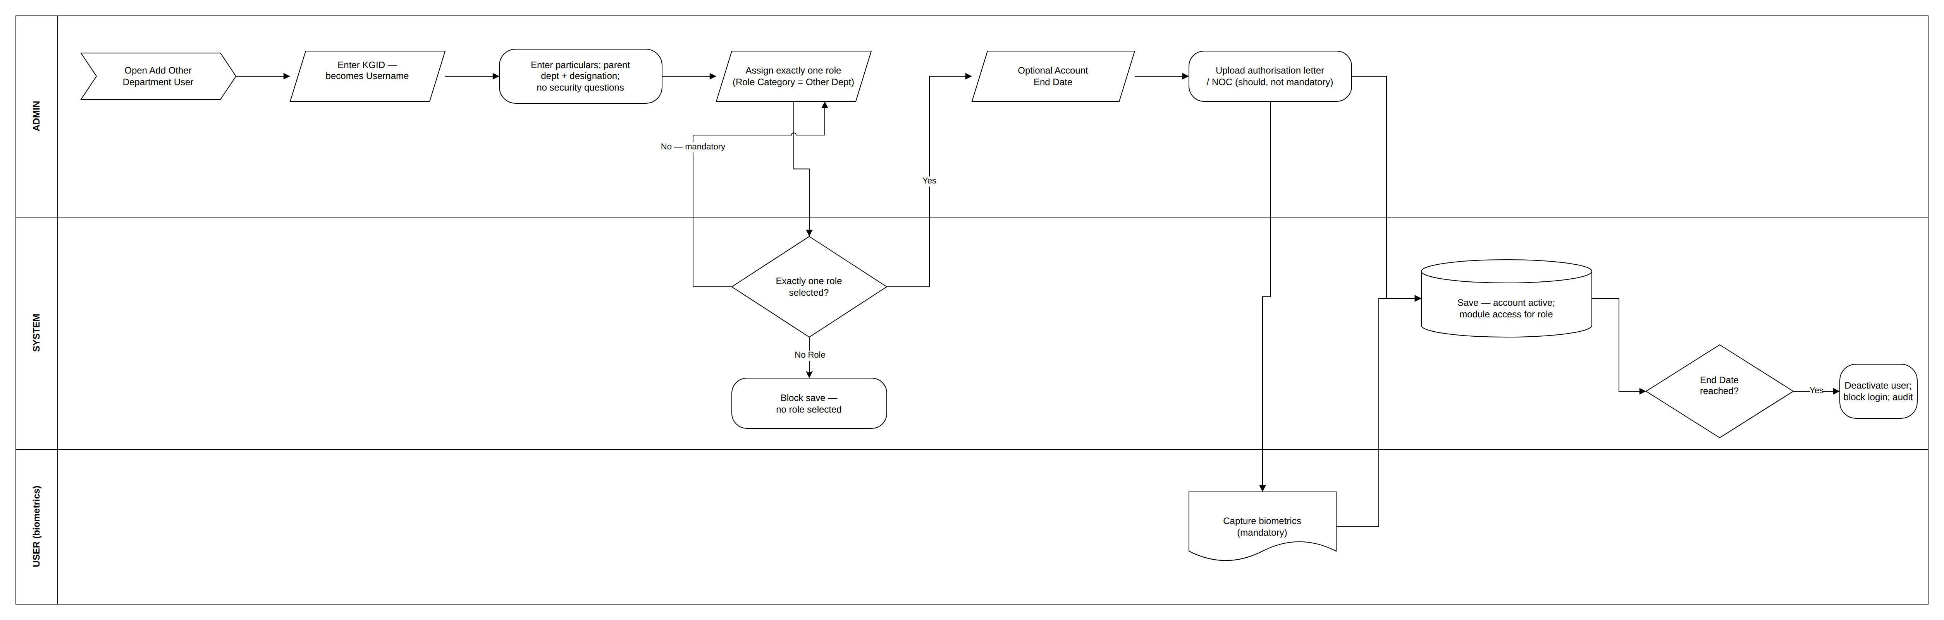
SECTION 6.6.2
Other Department user creation
P-08 Other Department User Creation · FR-UM-029, FR-UM-033, FR-UM-034, FR-UM-062, FR-UM-064
— Exactly one role is selected from the Role Master filtered to Role Category = Other Department; no role means no save.
— An optional Account End Date deactivates the user and blocks login on that date, with an audit entry.
KAVERI 3.0 · User Management BRD v4.18 · Department of Stamps and Registration, Government of Karnataka
30
Notes:
Stored in the same User Master with User Category = Other Department. Parent department and designation are captured; biometrics are mandatory; an authorisation letter or NOC is recommended but not mandatory to save.

Slide 31
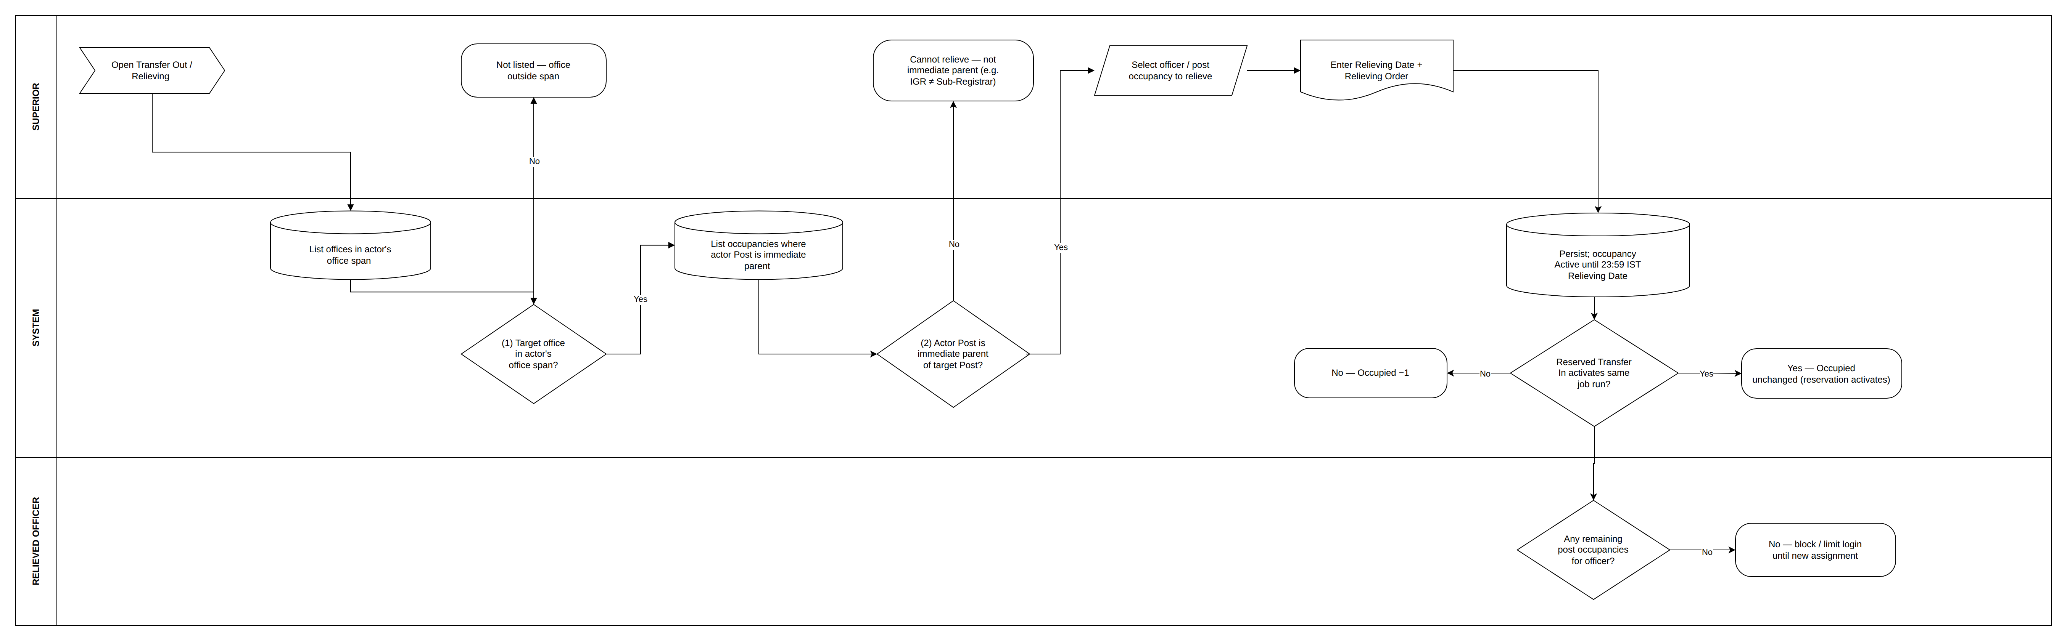
SECTION 6.6.3
Transfer Out and relieving
P-09 Transfer Out / Relieving · FR-UM-057, FR-UM-058, FR-UM-059, FR-UM-043, FR-UM-067, FR-UM-068
— The superior sees only offices in their office span, and within those only occupancies where their session Post is the immediate parent.
— The occupancy stays active until 23:59 IST of the Relieving Date; the midnight job then de-allocates it and adjusts the occupied count.
KAVERI 3.0 · User Management BRD v4.18 · Department of Stamps and Registration, Government of Karnataka
31
Notes:
Relieving Date and Relieving Order are mandatory. If a reserved Transfer In activates in the same job run the occupied count is unchanged; otherwise it decreases by one. An officer left with no occupancies has login blocked or limited per policy.

Slide 32
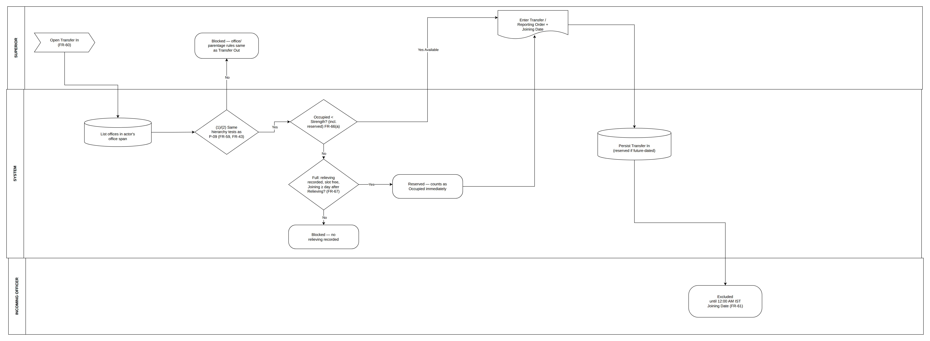
SECTION 6.6.4
Transfer In
P-10 Transfer In · FR-UM-060, FR-UM-061, FR-UM-066(a), FR-UM-067
— A post with available capacity is selectable without any prior relieving; a post at full strength may receive a future-dated Transfer In only when relieving is already recorded.
— Recording it reserves capacity immediately, so a second Transfer In cannot take the same slot.
KAVERI 3.0 · User Management BRD v4.18 · Department of Stamps and Registration, Government of Karnataka
32
Notes:
Transfer / Reporting Order and Joining Date are mandatory. The incoming officer cannot log in under that post before 12:00 AM IST on the Joining Date (FR-UM-061); the midnight job activates the reserved occupancy that day.

Slide 33
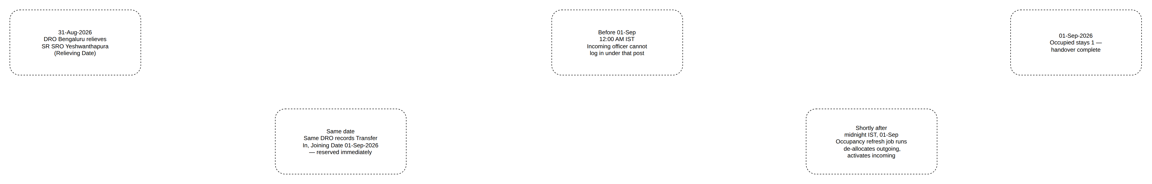
SECTION 6.6.4
Worked example — handover with reservation
P-12 Handover Timeline · DRO Bengaluru → SRO Yeshwanthapura, 31-Aug to 01-Sep-2026
— Relieving on 31-Aug and Transfer In joining 01-Sep coexist: capacity is reserved on the day the Transfer In is recorded, and the occupied count stays at 1 throughout.
— IGR at Head Office cannot perform this Transfer In, because Sub-Registrar does not report immediately to IGR.
KAVERI 3.0 · User Management BRD v4.18 · Department of Stamps and Registration, Government of Karnataka
33

Slide 34
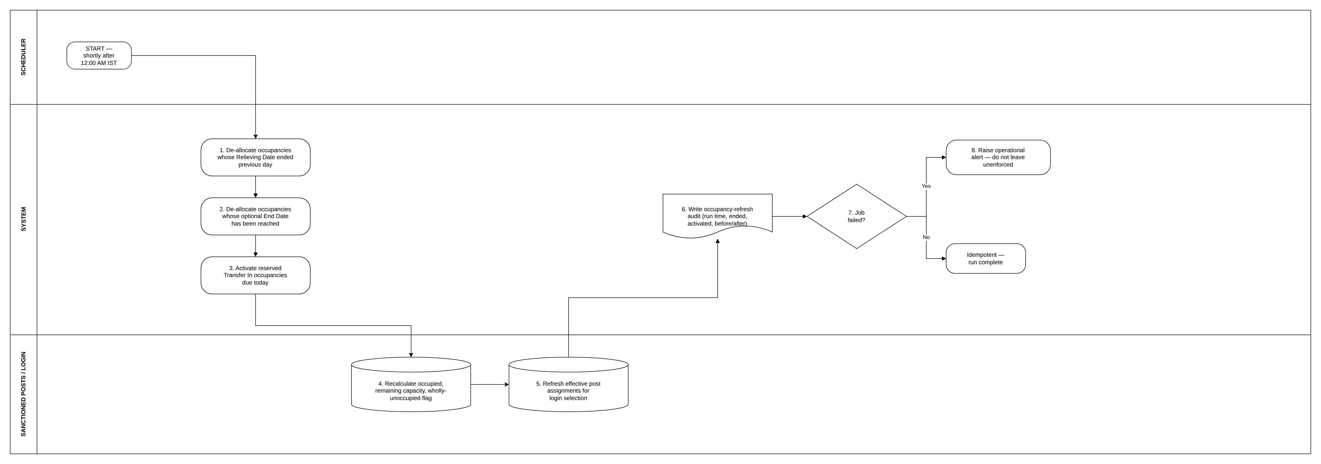
SECTION 6.6.5
The midnight occupancy refresh job
P-11 Occupancy Refresh Job · FR-UM-068 — idempotent, runs shortly after 12:00 AM IST
— Occupancy changes must not wait for a user to log in: relieving, End Dates and reserved Transfer In activations all take effect on the correct calendar day.
— The job recalculates occupied counts and the wholly-unoccupied flag, refreshes login post selection, writes an audit record, and alerts on failure.
KAVERI 3.0 · User Management BRD v4.18 · Department of Stamps and Registration, Government of Karnataka
34

Slide 35
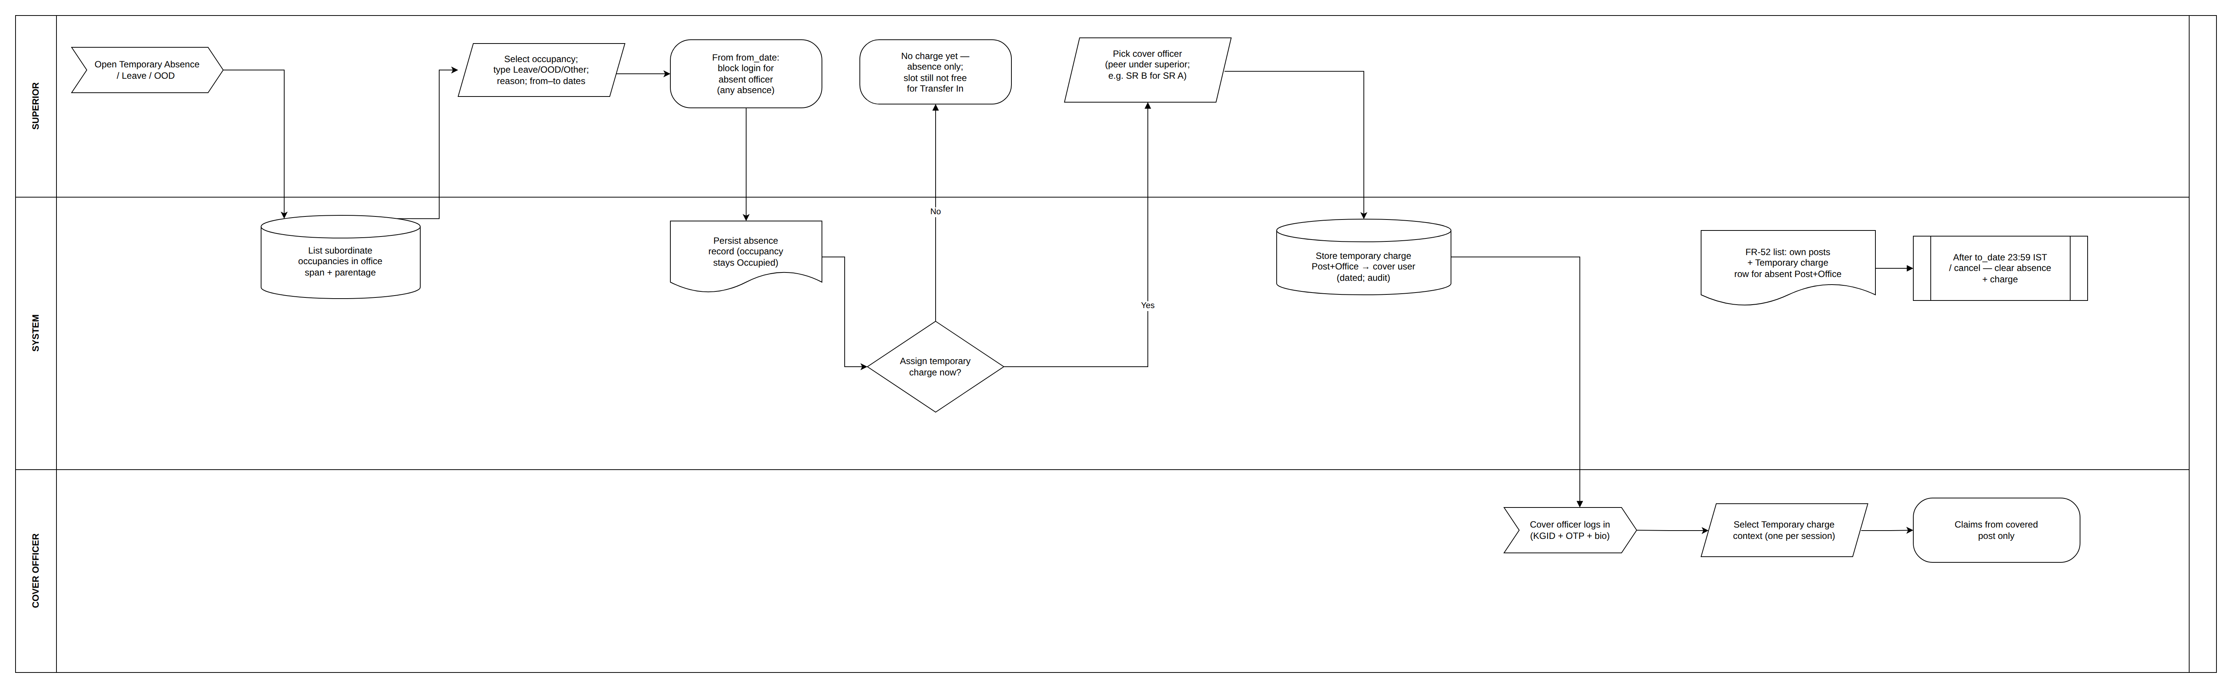
SECTION 6.6.6
Temporary absence — Leave, OOD and cover
P-13 Temporary Absence and Temporary Charge · FR-UM-079 – FR-UM-084
— Absence is recorded by the hierarchy superior only and does not free the slot — Occupied is unchanged and Transfer In must not treat the post as vacant.
— While an effective absence exists the officer's login is blocked entirely; the superior may assign temporary charge to a peer under them, including at another office.
KAVERI 3.0 · User Management BRD v4.18 · Department of Stamps and Registration, Government of Karnataka
35
Notes:
Example: a District Registrar records Leave for the Sub-Registrar of SRO Yeshwanthapura and gives temporary charge to the Sub-Registrar of SRO Jayanagar. The cover officer sees a Temporary charge row at post selection and receives the covered post's claims when it is chosen. Distinct from FR-UM-053 additional charge, which requires Occupied = 0. Full HRMS leave balances and payroll are out of scope.

Slide 36
05
Quality, Reporting and Sign-off
Non-functional requirements, reports, acceptance criteria and open risks.
36

Slide 37
SECTION 7 — 24 REQUIREMENTS ACROSS 6 CATEGORIES
Non-functional requirements
SECURITY AND PERFORMANCE
AVAILABILITY, AUDIT AND COMPLIANCE
— No password storage anywhere; the login OTP goes only to the registered mobile.
— TLS 1.2 or higher for all data in transit; biometric handling complies with the Aadhaar Act 2016 and UIDAI guidelines.
— Security-question answers stored hashed, never displayed, never entered by an administrator.
— OTP dispatch within 5 seconds; authentication completes within 2 seconds after verification.
— Minimum 500 concurrent authenticated sessions at launch, validated in performance testing.
— The occupancy refresh job completes before the first login of the day; failure raises an operational alert.
— Disaster recovery targets RPO ≤ 24 hours and RTO ≤ 4 hours.
— All create, update, delete, login, recovery, access-control and transfer actions logged with timestamp and actor.
— Audit logs retained for at least 7 years unless a longer DSR records-retention rule applies.
— Bilingual Kannada and English citizen UI, GIGW accessibility, data residency in India, DPDP Act 2023 compliance.
KAVERI 3.0 · User Management BRD v4.18 · Department of Stamps and Registration, Government of Karnataka
37

Slide 38
SECTION 8
Reporting requirements
— Active, inactive and suspended users; role and permission assignments across all users.
— Audit log of login attempts, successful and failed, over a selected date range.
— Sanctioned post occupancy — sanctioned strength, occupied count, remaining capacity and wholly-unoccupied flag per office (FR-UM-066).
— Role-to-Module mapping showing which modules and functions each role holds.
— A single contact-change and recovery report covering Citizen lost-mobile recovery, administrator-initiated mobile changes and email changes.
— Additional charge report (FR-UM-053) and Temporary Absence / Temporary Charge report (FR-UM-079–084).
— Occupancy-refresh report per midnight run, with before and after occupied counts (FR-UM-068).
— Transfer Out / Transfer In history and officer posting / service history.
KAVERI 3.0 · User Management BRD v4.18 · Department of Stamps and Registration, Government of Karnataka
38

Slide 39
SECTION 9
Acceptance criteria
Accepted when Section 6 is implemented and passes QA including these UAT scenarios, Section 7 is verified, the Product Owner signs off UAT, and security review closes with no critical or high findings.
— FR-UM-052 an officer with two occupancies must choose a post before home; a single occupancy auto-selects.
— FR-UM-053 additional charge lists only wholly unoccupied posts at the same office; privileges switch until switch-back.
— FR-UM-058 / 068 relieving holds through 23:59 IST of the Relieving Date; the midnight job then de-allocates and updates counts.
— FR-UM-061 / 067 future-dated Transfer In against a full post requires recorded relieving; login is blocked until the Joining Date.
— FR-UM-069–076 OTP validity, code length, lockout, idle timeout, 8-hour session cap and single active session all enforced.
— FR-UM-079–084 absence blocks login, keeps Occupied unchanged, and temporary charge appears for the cover officer until the to_date.
— Role mapping Role–Module–Function mapping completed and Domain Expert confirmed for every active role and module before go-live.
KAVERI 3.0 · User Management BRD v4.18 · Department of Stamps and Registration, Government of Karnataka
39

Slide 40
SECTION 10 — 24 RISKS LOGGED
Key risks and mitigations
Risk | Impact | Mitigation
Role–Module–Function mapping incomplete at go-live | High | Only a handful of roles have seeded mappings; Application Admin with Domain Expert sign-off must complete the matrix for every active role and module.
Unauthorised relieving or Transfer In | High | Scope to offices under the actor (FR-UM-059), then immediate-parent posts only (FR-UM-043, FR-UM-057).
Vacancy tests confused in build | High | FR-UM-066 defines available capacity and wholly unoccupied separately; additional charge uses Occupied = 0.
Double-booking a full post during handover | High | FR-UM-067 reserves capacity when relieving is recorded, so a second Transfer In cannot take the slot.
Leave / OOD treated as a vacancy | High | FR-UM-081 keeps Occupied; temporary charge is superior-assigned and distinct from FR-UM-053.
Account takeover via lost-mobile reset | High | Two independent proofs, OTP verification of the new number, rate limiting, email notification and audit.
Re-authentication may slow high-volume SRO counters | Medium | Measure end-to-end re-authentication time in performance testing with Kaveri IT Cell.
KAVERI 3.0 · User Management BRD v4.18 · Department of Stamps and Registration, Government of Karnataka
40

Slide 41
SECTION 12
Approval and next steps
Signatories: Prashanth (Product Owner) · Prabhakar Naik (Domain Expert) · Kaveri IT Cell Lead (IT Security / Engineering)
— Domain Expert review of the officer hierarchy, office hierarchy and Post–Role mapping seed data.
— Application Admin to complete Role–Module–Function mapping for every active role and module before go-live.
— Department to confirm the PII retention and purge policy for dormant Citizen accounts.
— Performance testing with Kaveri IT Cell to validate peak-load and re-authentication timings at SRO counters.
— Product Owner sign-off on UAT, then baseline the BRD for design and development.
Source of record: BRD_User_Management_v4.18.docx · Editable diagram sources: ProcessDiagrams/User_Management/*.drawio
KAVERI 3.0 · User Management BRD v4.18 · Department of Stamps and Registration, Government of Karnataka
41

