Slide 1
Deep Learning Research Trend
Taeoh Kim, MVP LAB Seminar
Episode 1a - 2017.7.7

Slide 2
Contents
Tips / Keywords / Trends of Deep Learning
cs231n course of 2017-spring/summer
https://github.com/terryum/awesome-deep-learning-papers
References

Slide 3
Data-Driven Machine Learning
Category by NETWORK
Artificial Intelligence
Machine Learning
Deep Learning
DNN
CNN
RNN

Slide 4
Data-Driven Machine Learning
Category by LABEL/Objective
Artificial Intelligence
Machine Learning
Supervised
Learning
Un-Supervised
Learning
Reinforce
ment
Learning

Slide 5
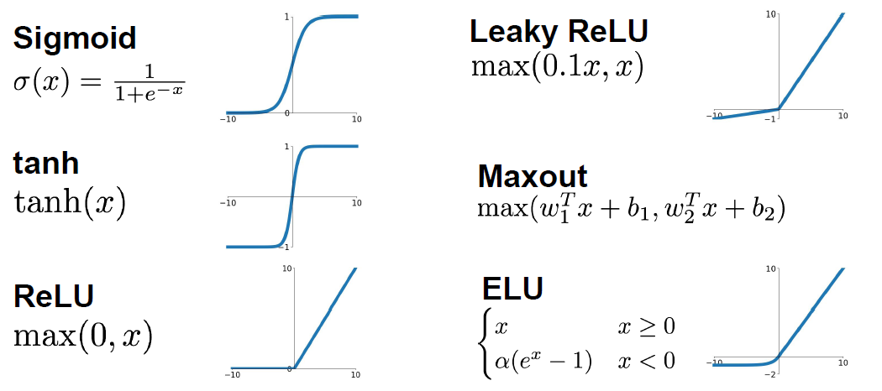
Activation Functions
For Non-linearly, Normalization & Activation
use ReLU or (LRU / Maxout / ELU / tanh)
do not use Sigmoid
Images from cs231n

Slide 6
Learning Flow
Define Networks
Define Loss Function
Optimization: Weight Update using BackProp.
Number of Layers / Parameters / Bias
Pre/Post-Processing and Regularizer
Initial Value
Loss = Difference ( Prediction , Real )
Calculate Gradient of Loss
Gradient Descent!
Stochastic- GD (Update one-by-one)
Adaptive Learning Rate (ADAM-Optimizer)

Slide 7
Regularizations
To Avoid Overfitting
Solution:
A Lot of Data
Validation Set
Dropout (DropConnect)
Regularization Loss Term (Weight-Decay)
use Batch Normalization (2015)
: It Normalizes Batch and Trains
Linear Parameters from Mean/Variance

Slide 8
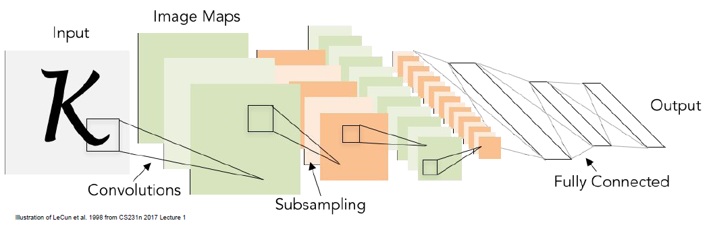
Convolution and Pooling
LeNet, 1998 by LeCun
CNN is Very Good for Image and Visuals
Convolution/Pooling → 2D Operations
and Sparse Connections
Images from cs231n

Slide 9
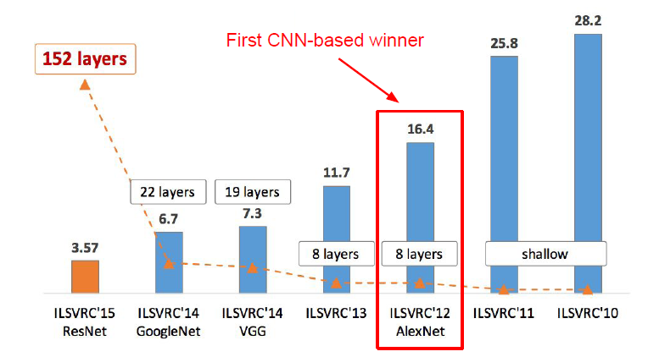
Pretrained Models
Images from cs231n

Slide 10
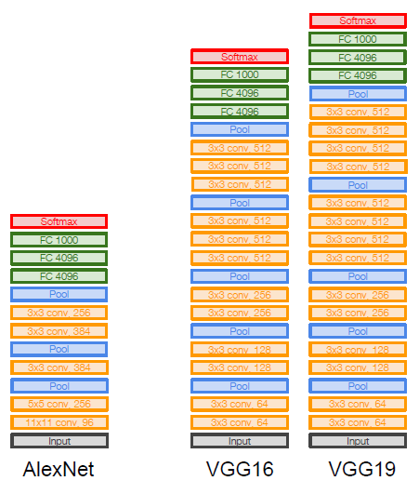
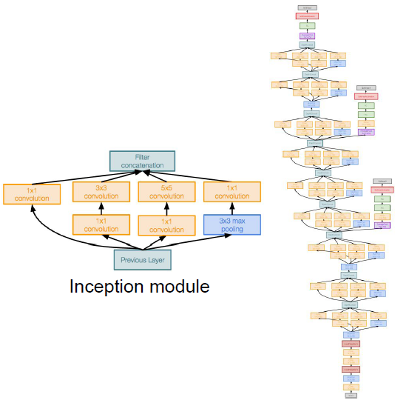
Pretrained Models
AlexNet(2012), VGG(2014)
GoogleNet(2014)
Images from cs231n

Slide 11
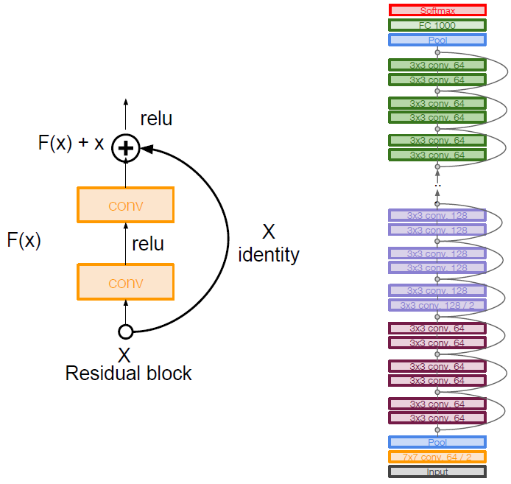
Pretrained Models
ResNet(2015)
152 Layer
Images from cs231n

Slide 12
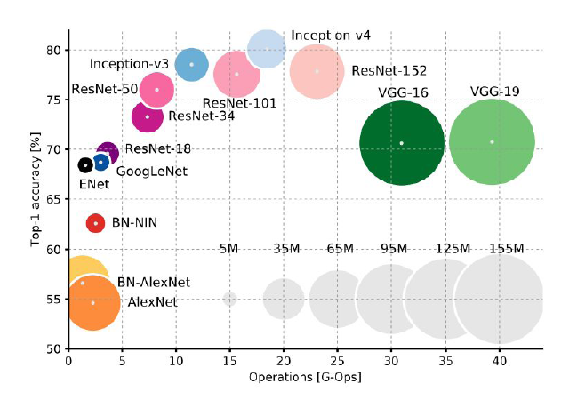
Pretrained Models
use What You Want!
Images from cs231n

Slide 13
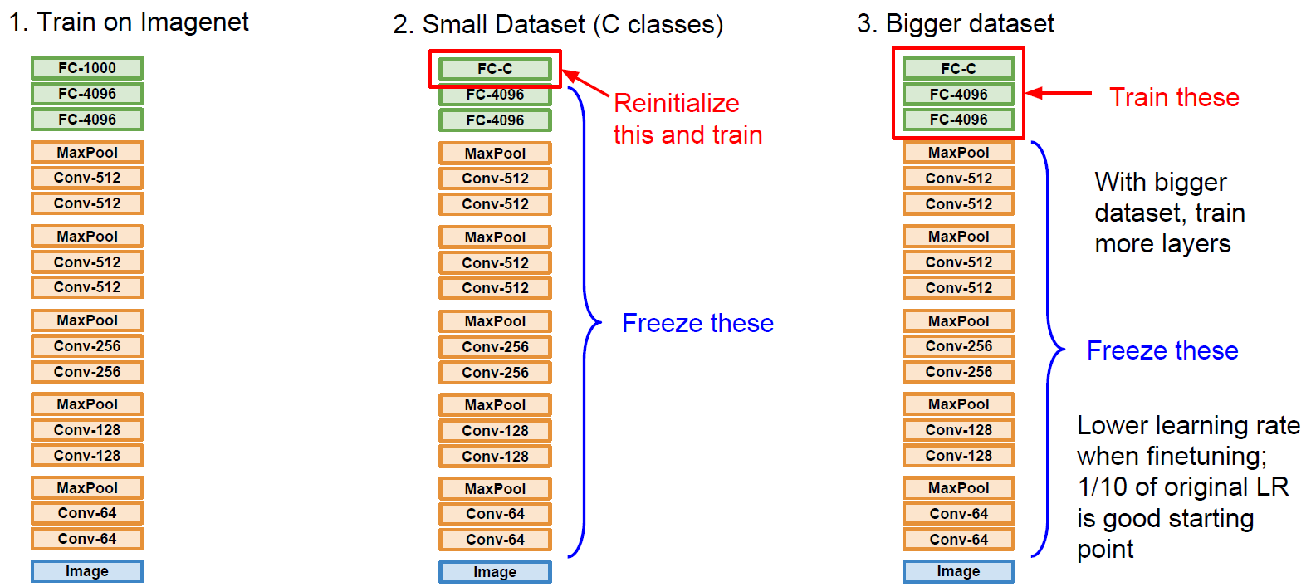
Transfer Learning
Images from cs231n

Slide 14
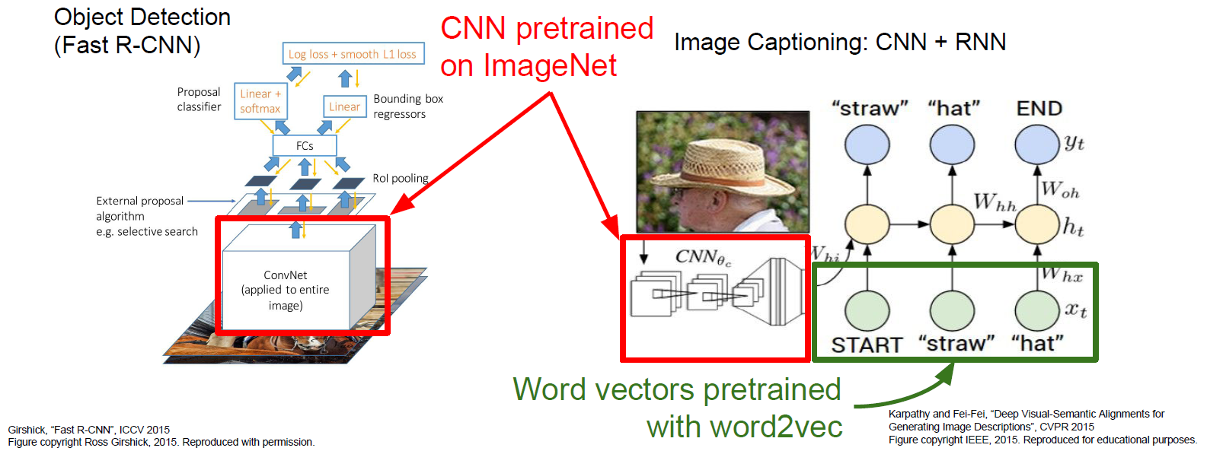
Transfer Learning: Case Examples
R-CNN / Image Captioning
Images from cs231n

Slide 15
Research Trend @ CVPR 2017.07
:Still Deep Learning

Slide 16
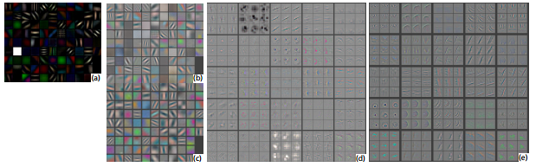
Hot Papers of Some Research Areas
https://github.com/terryum/awesome-deep-learning-papers/blob/master/README.md
Visualization/Understanding Deep Larning
- Visualizing and understanding convolutional networks (2014)
- Understanding deep learning requires rethinking generalization (2017)

Slide 17
Hot Papers of Some Research Areas
https://github.com/terryum/awesome-deep-learning-papers/blob/master/README.md
Optimization/Regularization
Training very deep networks (2015)
Batch normalization: Accelerating deep network training by reducing internal covariate shift (2015)
Layer Normalization (2016)
Learning to learn by gradient descent by gradient descent (2016)
Accurate, Large Minibatch SGD:Training ImageNet in 1 Hour (2017)
Batch renormalization: Towards reducing minibatch dependence in batch-normalized models (2017)

Slide 18
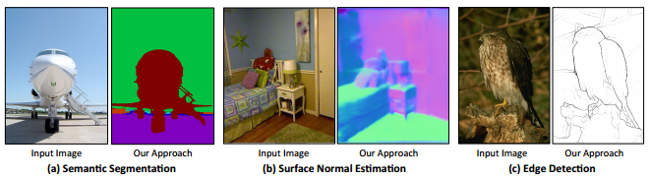
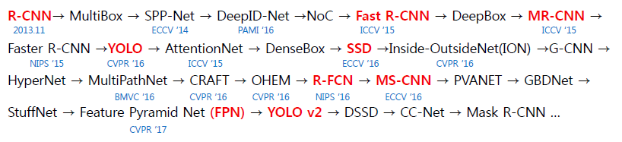
Hot Papers of Some Research Areas
https://github.com/terryum/awesome-deep-learning-papers/blob/master/README.md
Segmentation/Detection
- PixelNet: Representation of the pixels, by the pixels, and for the pixels (2017)

Slide 19
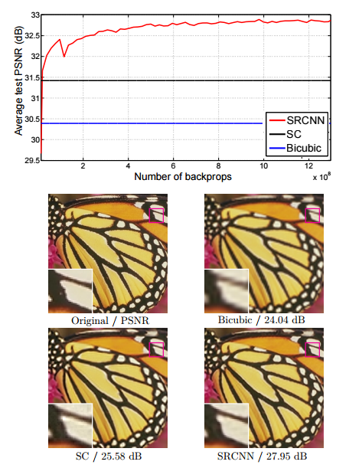
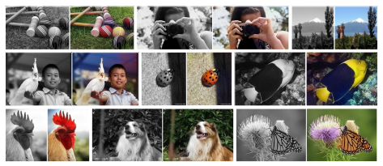
Hot Papers of Some Research Areas
https://github.com/terryum/awesome-deep-learning-papers/blob/master/README.md
Computational Photography
- Image Super-Resolution Using Deep Convolutional Networks (2016)
- A neural algorithm of artistic style (2015)
- Colorful image colorization (2016)

Slide 20
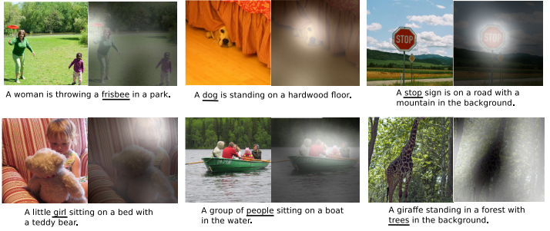
Hot Papers of Some Research Areas
https://github.com/terryum/awesome-deep-learning-papers/blob/master/README.md
RNN / NLP
- Show, attend and tell: Neural image caption generation with visual attention (2015)

Slide 21
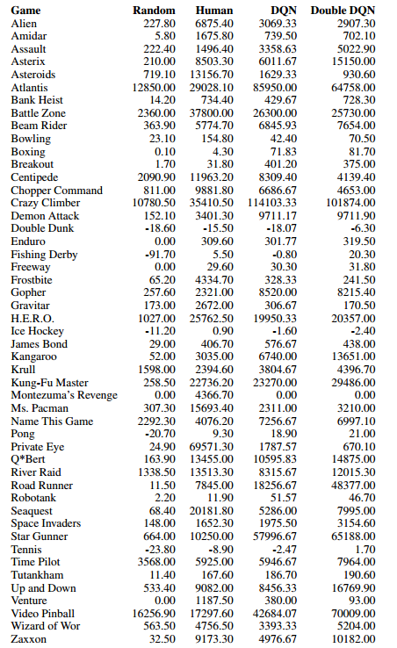
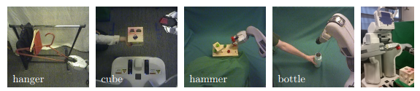
Hot Papers of Some Research Areas
https://github.com/terryum/awesome-deep-learning-papers/blob/master/README.md
Reinforcement Learning
- End-to-end training of deep visuomotor policies (2016)
- Asynchronous methods for deep reinforcement learning (2016)
- Deep Reinforcement Learning with Double Q-Learning (2016)

Slide 22
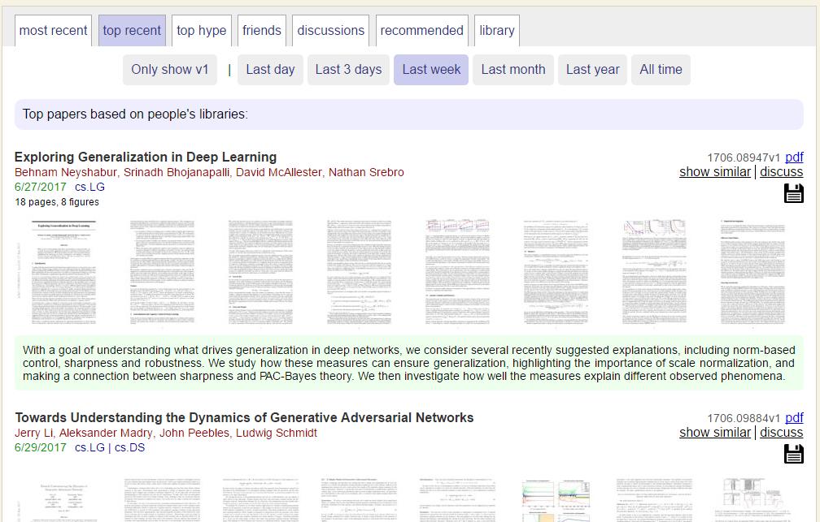
How to find RECENT HOT PAPERS?
http://www.arxiv-sanity.com/

Slide 23
Deep-Learning Frameworks.
2016
2017
Caffe (Berkeley)
Caffe2 (Facebook)
Torch
(NYU/Facebook)
PyTorch
(Facebook)
Theano
(Montreal)
Tensorflow
(Google)
Paddle
(Baidu)
CNTK
(Microsoft)
MXNet
(UW,CMU,MIT,HK,Amazon)

Slide 24
Deep-Learning Frameworks
Tensorflow: 직접 Graph를 만들고 Network를 만들고.. 자유도가 매우 높지만 그만큼 어렵다.
High-Level Wrappers
Keras
TFLearn
TensorLayer
tf.layers
TFSlim
tf.contrib.learn
PrettyTensor (Google)
Sonnet (DeepMind)
Ships with Tensorflow

Slide 25
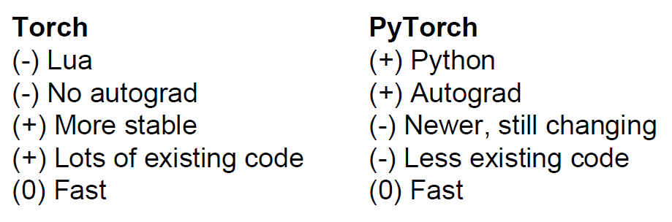
Deep-Learning Frameworks
PyTorch: 16년 말부터 나오는 논문들이 PyTorch로 주로 구현됨. 이유는? 문법이 Tensorflow-Wrapper 수준으로 쉽고 간결하다. 속도도 나름 빠르며 RNN 등을 구성할 때도 쉽다. 하지만 Windows Build는 아직 부족하며 Error 발생시 찾아볼 자료가 부족
Images from cs231n

Slide 26
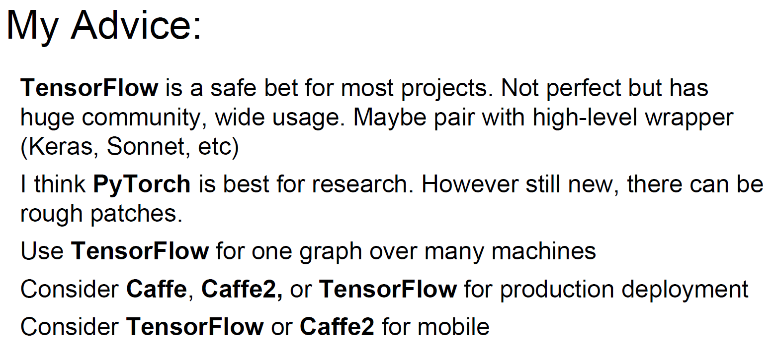
Deep-Learning Frameworks
Advice from cs231n
Images from cs231n

Slide 27
Thank You
Qusetion?

