Slide 1
Conditional Random Fields

Slide 2
목차
Generative Vs. Discriminative Model
Graph Models
Log-linear Models
CRF
CRF in Deep Learning
끝

Slide 3
Discriminative Vs. Generative

Slide 4
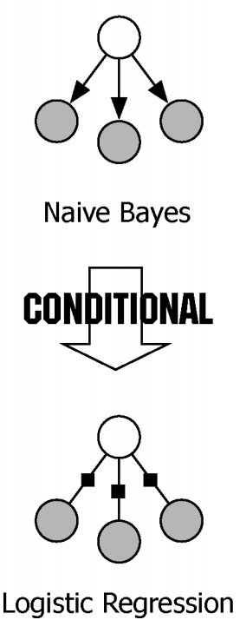
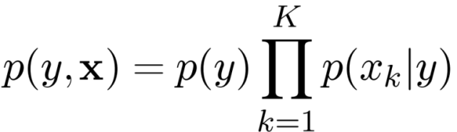
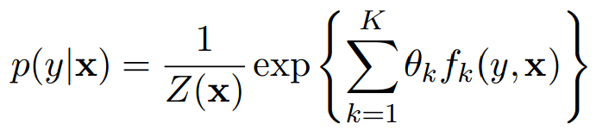
Discriminative Vs. Generative
Generative Model: A model that generate observed data randomly
Naïve Bayes: once the class label is known, all the features are independent
Discriminative: Directly estimate the posterior probability; Aim at modeling the “discrimination” between different outputs
MaxEnt classifier: linear combination of feature function in the exponent,
Both generative models and discriminative models describe distributions over (y , x), but they work in different directions.

Slide 5
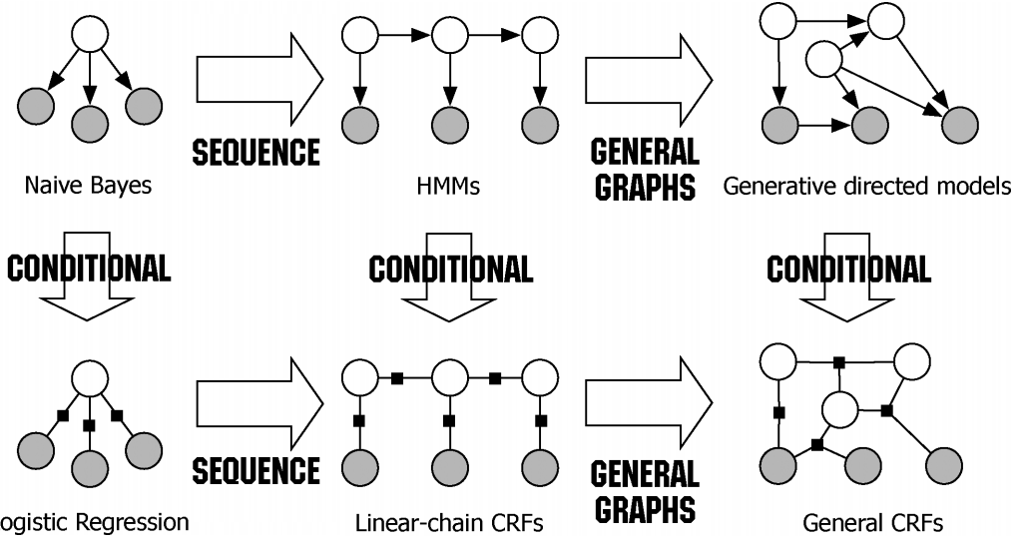
Generative Vs. Discriminative
=observable
=unobservable

Slide 6
Graph Models

Slide 7
Graphical model notation

Slide 8
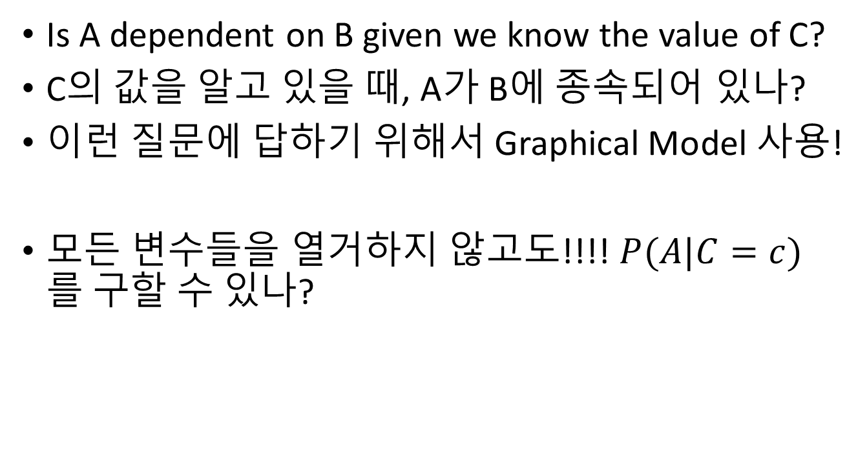
Why Graphical Models??
Is A dependent on B given we know the value of C?
C의 값을 알고 있을 때, A가 B에 종속되어 있나?
이런 질문에 답하기 위해서 Graphical Model 사용!
모든 변수들을 열거하지 않고도!!!! $P(A|C=c)$를 구할 수 있나?

Slide 9
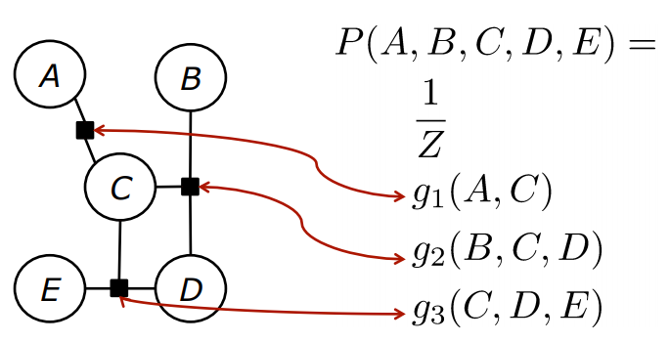
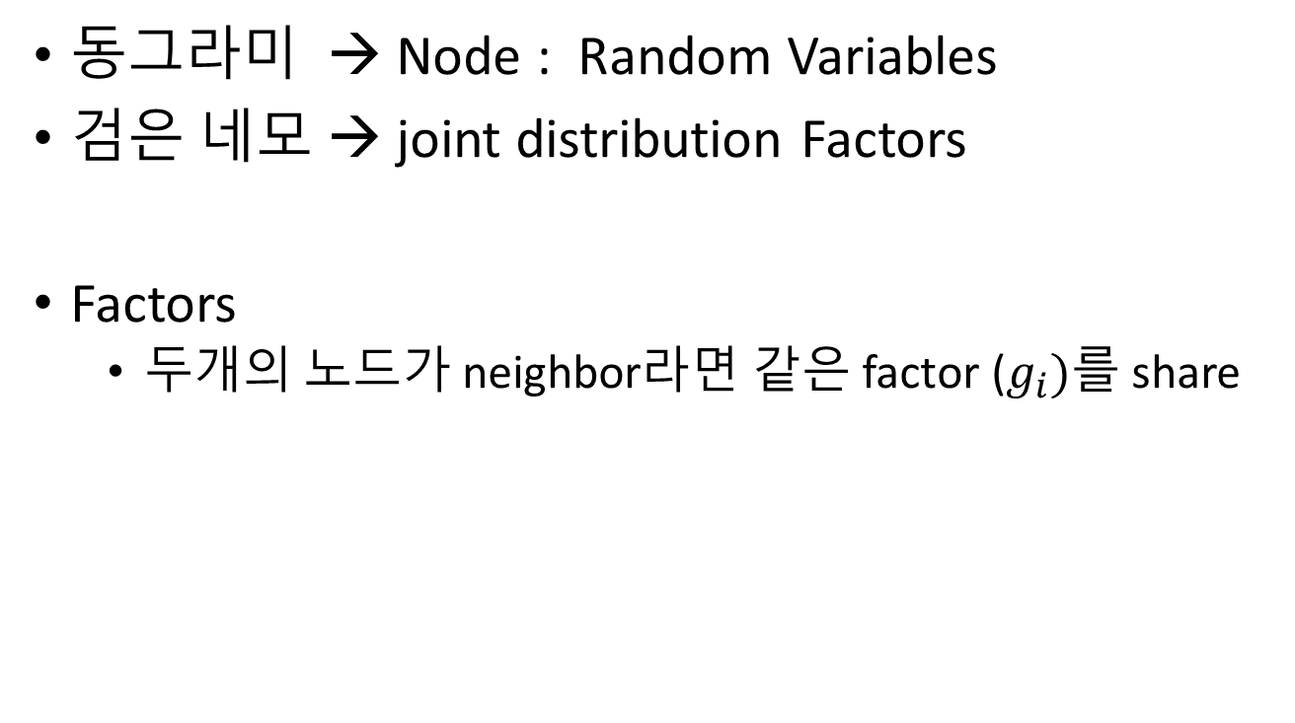
Factor Graphs
동그라미 → Node : Random Variables
검은 네모 → joint distribution Factors
Factors
두개의 노드가 neighbor라면 같은 factor ($g_{i})$를 share

Slide 10
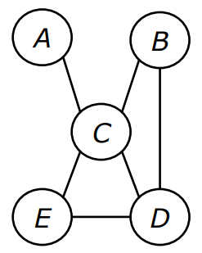
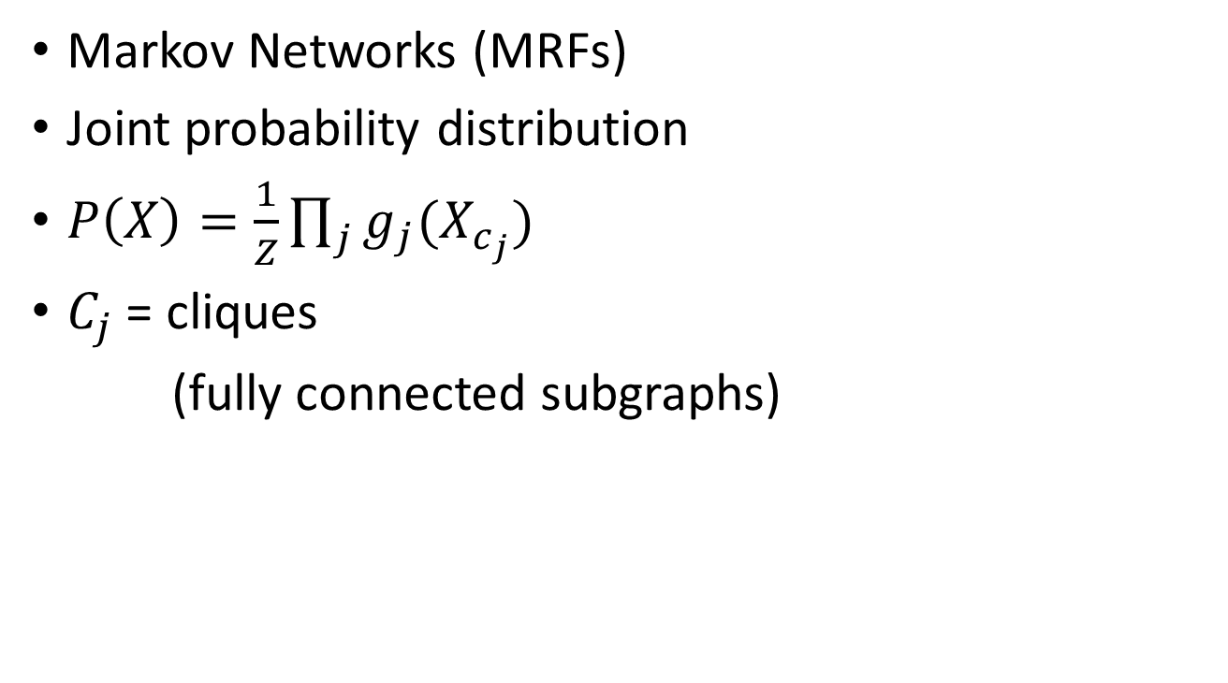
Undirected Graphs
Markov Networks (MRFs)
Joint probability distribution
$P\left(X\right)=\frac{1}{Z}\prod_{j}{g_{j}(X_{c_{j}})}$
$C_{j}$ = cliques
(fully connected subgraphs)

Slide 11
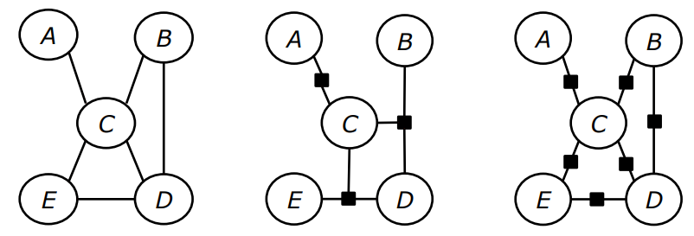
Factors Graphs vs. Undirected Graphs
Node들은 항상 같은 neighbor를 갖음
모든 graph들은 같은 conditional independence 관계를 포함함

Slide 12
Log-Linear Models

Slide 13
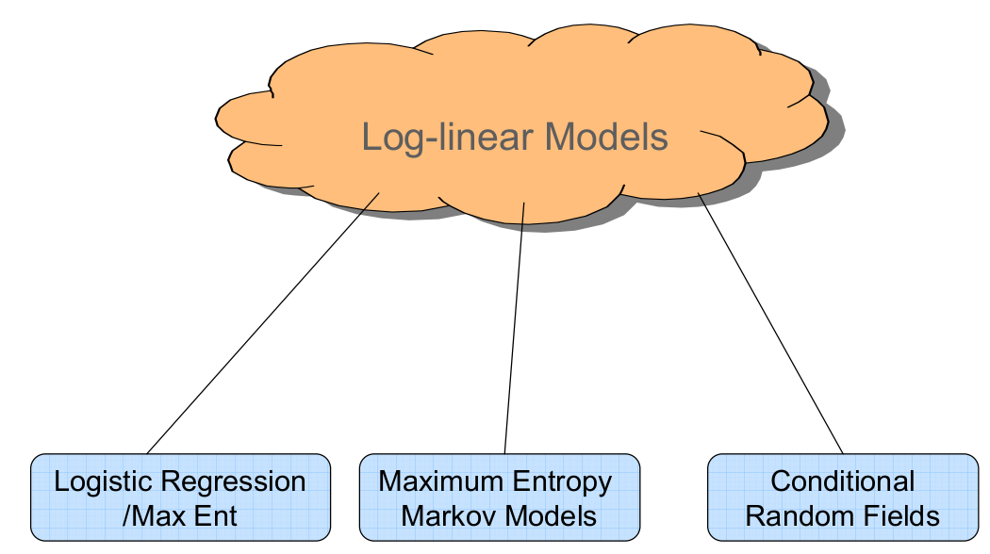

Log-Linear Models
X → input
Y → target label
General log-linear model
$$p(y|x;w)=\frac{\exp{\sum_{j}{w_{j}F_{j}\left(x,y′\right)}}}{\sum_{y′}{\exp{\sum_{j}{w_{j}F_{j}\left(x,y′\right)}}}}$$
Weight for given feature function
Normalization Term
(Partition Function)
feature function
Input(data)와 label(target) 공간에서의 서로의 관계 고려

Slide 14
CRF Conditional Random Fields

Slide 15
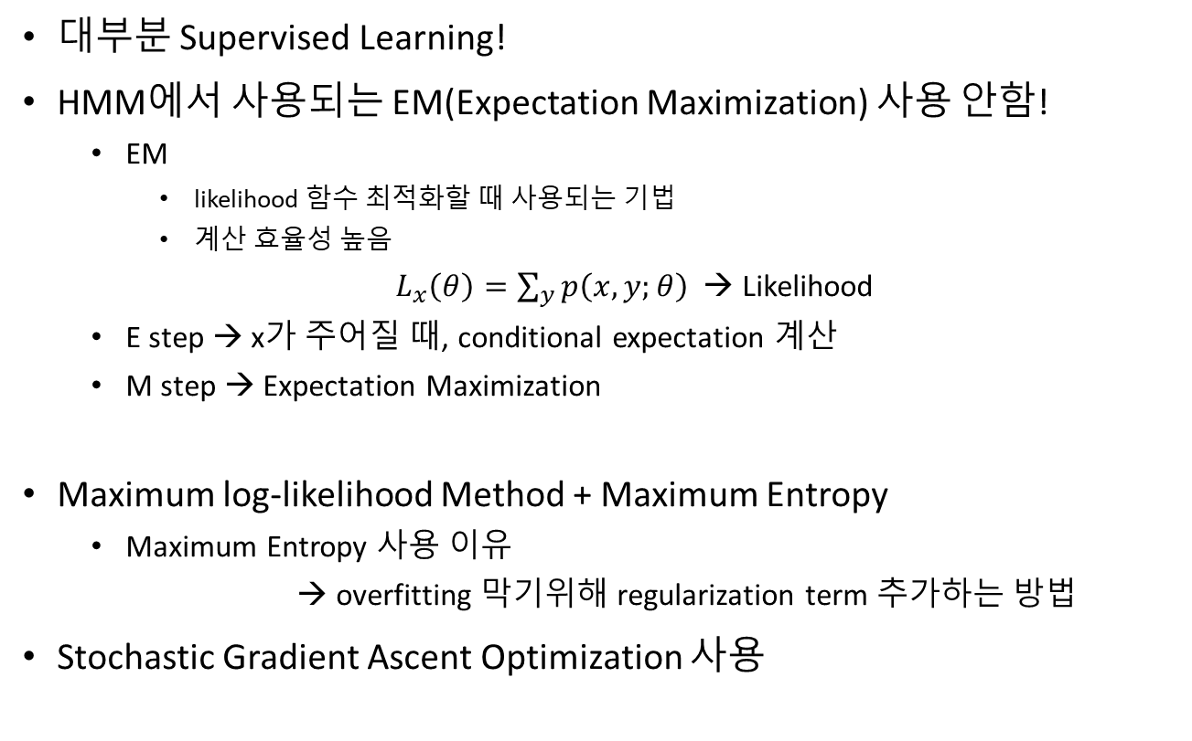
Conditional Random Fields
대부분 Supervised Learning!
HMM에서 사용되는 EM(Expectation Maximization) 사용 안함!
EM
likelihood 함수 최적화할 때 사용되는 기법
계산 효율성 높음
$L_{x}\left(θ\right)=\sum_{y}{p\left(x,y;θ\right)}$ → Likelihood
E step → x가 주어질 때, conditional expectation 계산
M step → Expectation Maximization
Maximum log-likelihood Method + Maximum Entropy
Maximum Entropy 사용 이유
→ overfitting 막기위해 regularization term 추가하는 방법
Stochastic Gradient Ascent Optimization 사용

Slide 16
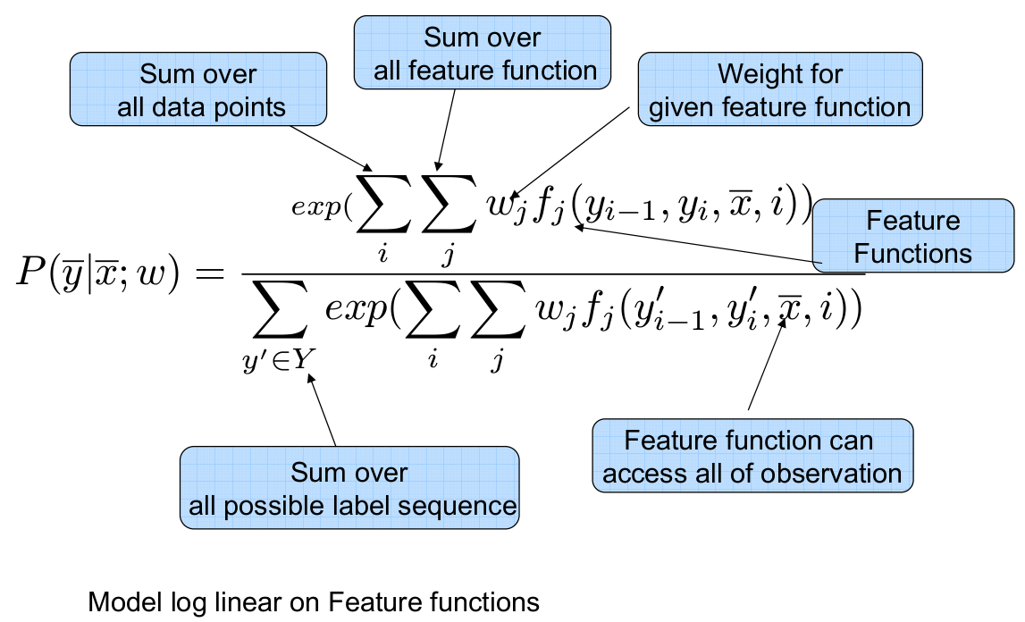
Conditional Random Fields

Slide 17
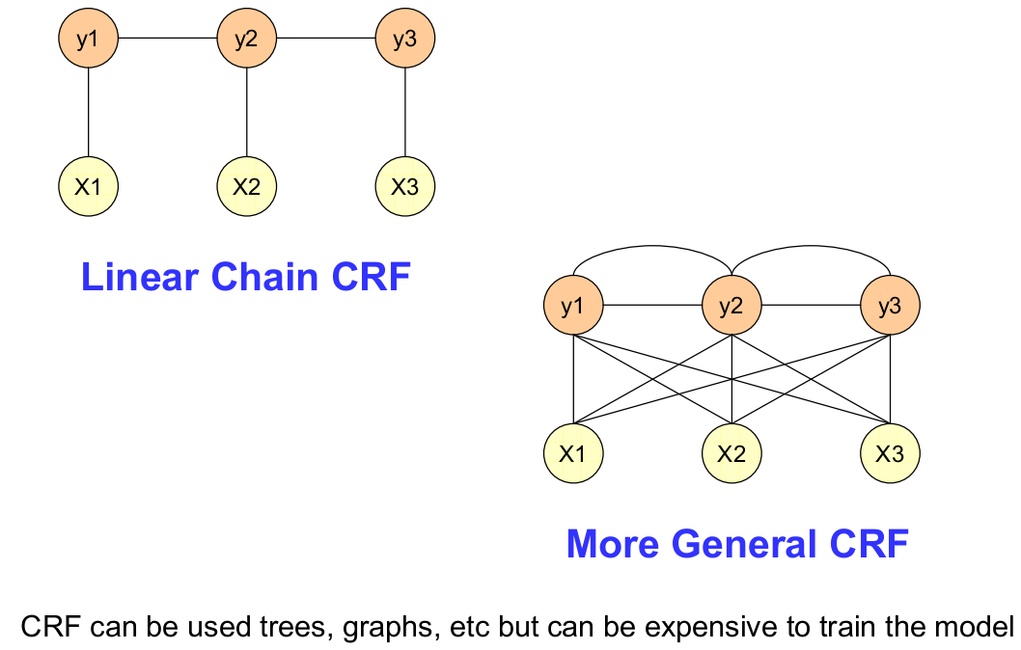
Conditional Random Fields
각 state들의 dependency를 추가할 수 있음
복잡한 CRF 모델 생성 가능

Slide 18
CRF Vs. HMM & MEMM

Slide 19
Naïve Bayes Vs. Conditional Random Fields
Naïve Bayes Model
CRF
Input(data) 와 class(target)의 likelihood를 최대화하면서 학습 (MLE)
Feature들은 독립적이라 가정
Feature 가중치 또한 독립적
Class(target)의 조건부 likelihood를 최대화하면서 학습
Feature 가중치에 의해 독립성 정도 판단
Undirectional Graph model
가중치는 edge factor에 의해 결정
Sequence prediction에 효과적임

Slide 20
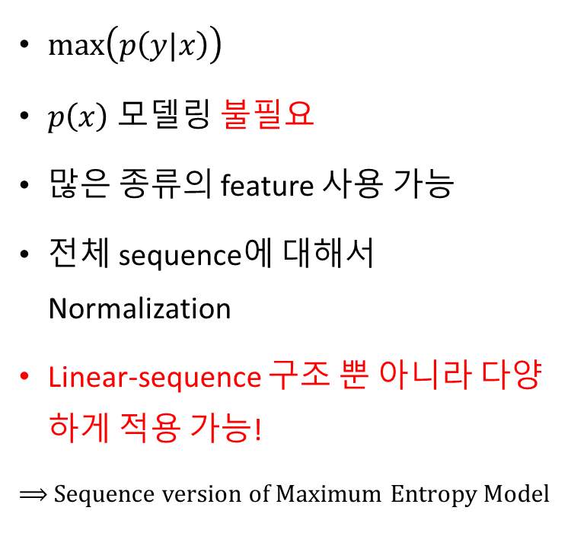
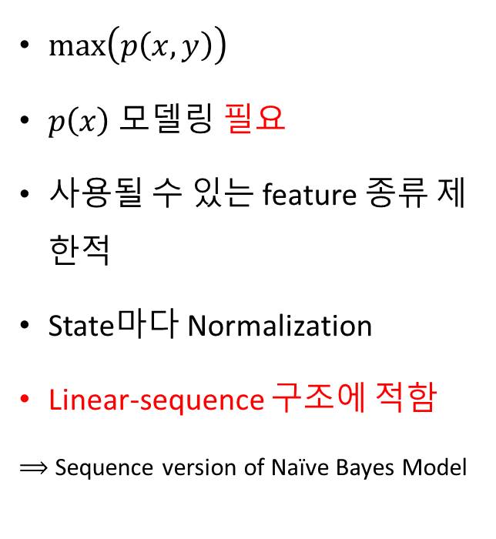
HMM(hidden Markov Model) Vs. Conditional Random Fields
HMM
CRF
$\max\left(p\left(x,y\right)\right)$
$p\left(x\right)$ 모델링 필요
사용될 수 있는 feature 종류 제한적
State마다 Normalization
Linear-sequence 구조에 적함
$⟹$ Sequence version of Naïve Bayes Model
$\max\left(p\left(y|x\right)\right)$
$p\left(x\right)$ 모델링 불필요
많은 종류의 feature 사용 가능
전체 sequence에 대해서 Normalization
Linear-sequence 구조 뿐 아니라 다양하게 적용 가능!
$⟹$ Sequence version of Maximum Entropy Model

Slide 21
MEMM(Max Ent Markov Model) Vs. Conditional Random Fields
MEMM
CRF
모든 state마다 Exponential model 존재
이 모델은 다음 state의 조건부확률 알려줌
State마다 normalization 존재하지 않음
Whole sequenc에 대한 normalization

Slide 22
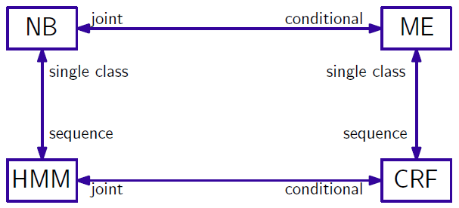
CRF, MEMM, HMM
NB → Naïve Bayes Model
HMM → Hidden Markov Model
ME(MEMM) → Maximum Entropy Model(Max Ent Markov Model)
CRF → Conditional Random Field

Slide 23
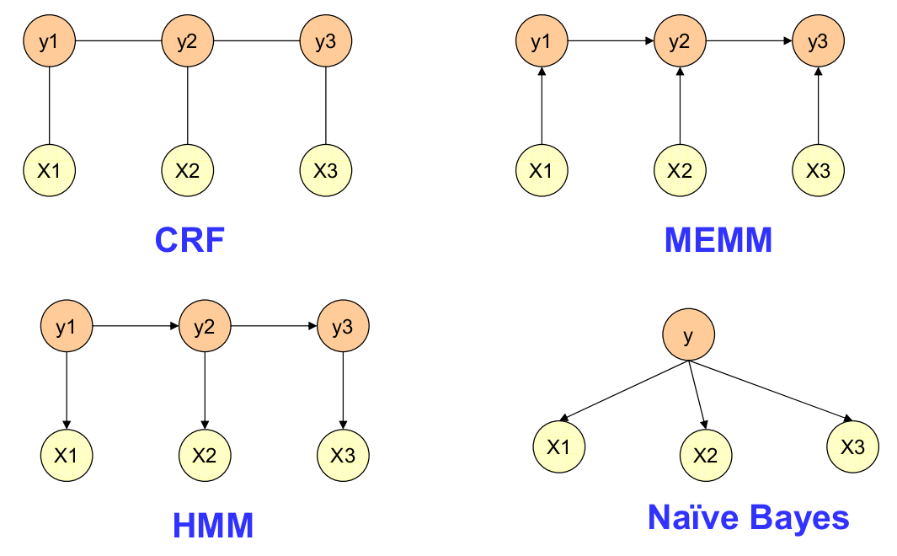
CRF, MEMM, HMM
현재 y에서 input X, 과거 y 추론!
(Label Biased Problem)
Input X에서 y 추론
현재 y를 바탕으로 과거 y 추론
Long-range 에 효과적이지 못함
모든 feature 독립!
Transition function(전이함수)
Observation/Emission(출력함수)

Slide 24
How to use CRF in Deep Learning ????????????

Slide 25
Conventional usage of CRF
Natural Language Processing (NLP)
Sequence
Image Segmentation
Super-pixel

Slide 26
CRF in Deep Learning
Post-processing
DL 결과 값에서 CRF 를 통해 확률적 보정을 통하여 결과 도출하는 방법
특히 Image Segmentation 분야에서 주로 쓰임
CRF Layer
자체적으로 CRF Layer를 두어, 인접 pixel 또는 인접 event 간 확률을 고려하는 Layer를 두고 학습하는 방법

Slide 27
CRF in Deep Learning
Image Segmentation
Güçlü, Umut, et al. "End-to-end semantic face segmentation with conditional random fields as convolutional, recurrent and adversarial networks." arXiv preprint arXiv:1703.03305 (2017).
Zheng, Shuai, et al. "Conditional random fields as recurrent neural networks." Proceedings of the IEEE International Conference on Computer Vision. 2015.
Chen, Liang-Chieh, et al. "Deeplab: Semantic image segmentation with deep convolutional nets, atrous convolution, and fully connected crfs." arXiv preprint arXiv:1606.00915 (2016).
Intrinsic Image Decomposition & Depth Prediction
Kim, Seungryong, et al. "Unified depth prediction and intrinsic image decomposition from a single image via joint convolutional neural fields." European Conference on Computer Vision. Springer International Publishing, 2016.
Classification
Goldman, Eran, and Jacob Goldberger. "Structured Image Classification from Conditional Random Field with Deep Class Embedding." arXiv preprint arXiv:1705.07420 (2017).

Slide 28
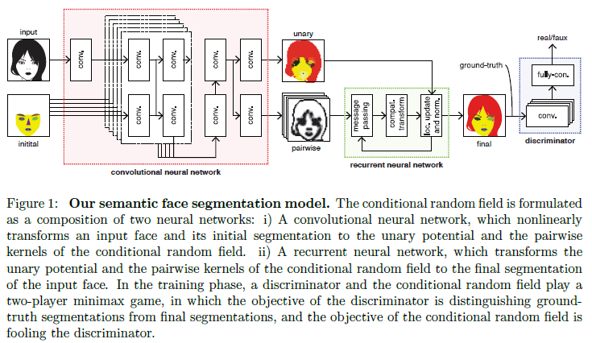
CRF in Deep Learning Image Segmentation 1

Slide 29
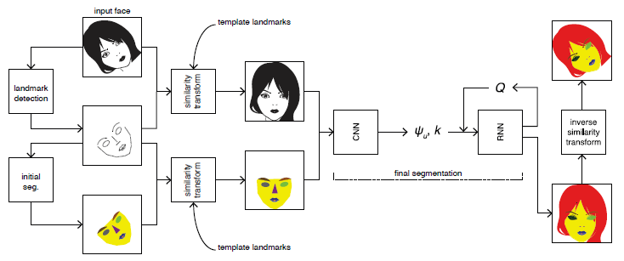
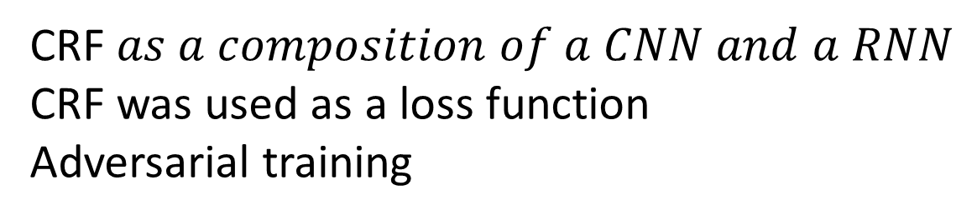
CRF in Deep Learning Image Segmentation 1
CRF $as a composition of a CNN and a RNN$
CRF was used as a loss function
Adversarial training

Slide 30
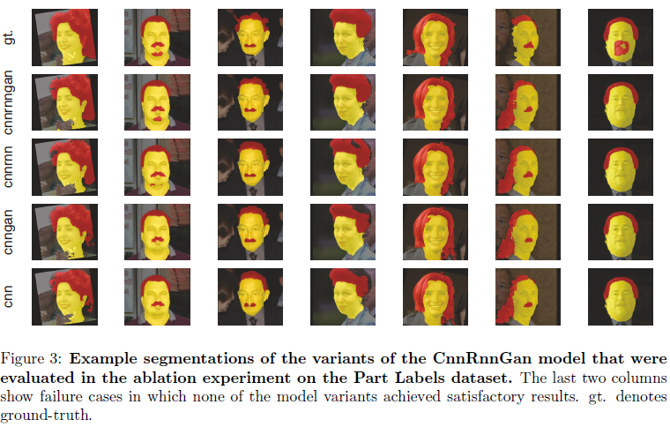
CRF in Deep Learning Image Segmentation 1

Slide 31
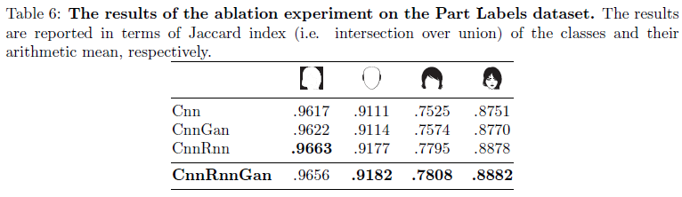
CRF in Deep Learning Image Segmentation 1

Slide 32
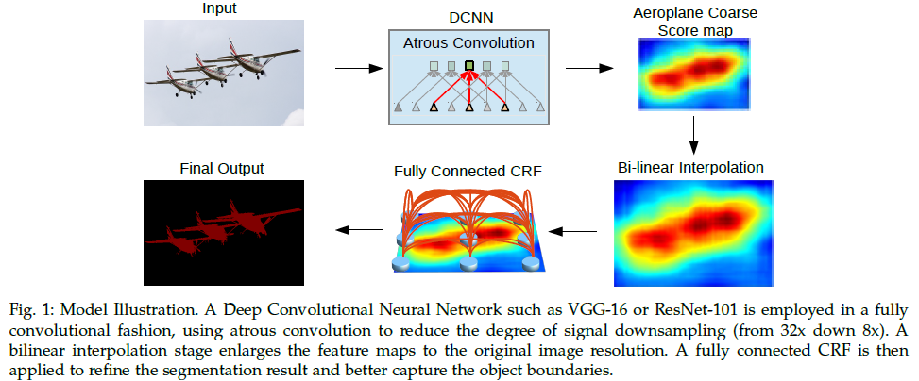
CRF in Deep Learning Image Segmentation 2 post processing

Slide 33
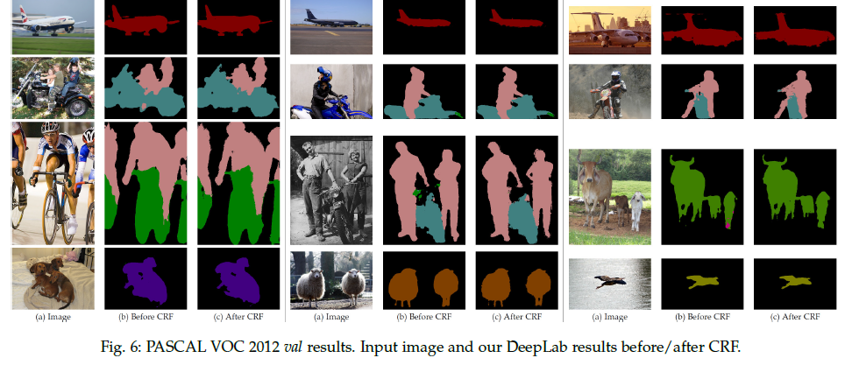
CRF in Deep Learning Image Segmentation 2 post processing

Slide 34
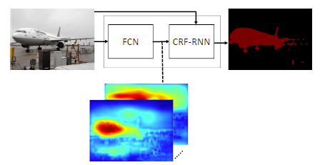
CRF in Deep Learning Image Segmentation 3 post processing

Slide 35
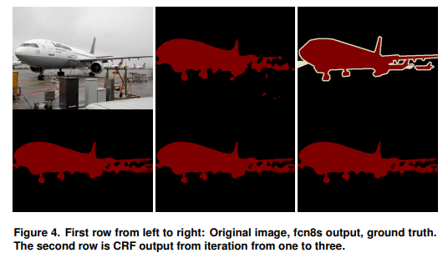
CRF in Deep Learning Image Segmentation 3 post processing

Slide 36
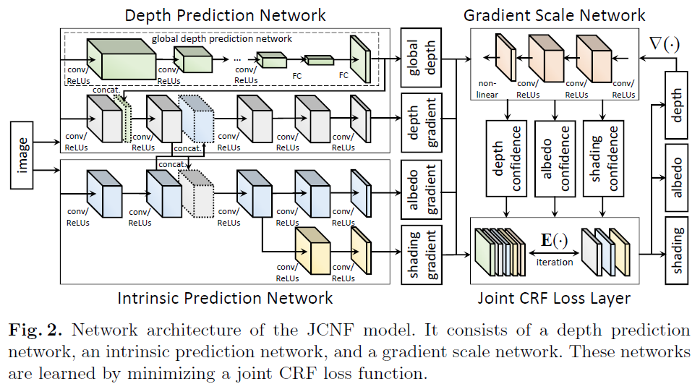
CRF in Deep Learning Intrinsic Image Decomposition & Depth Prediction

Slide 37
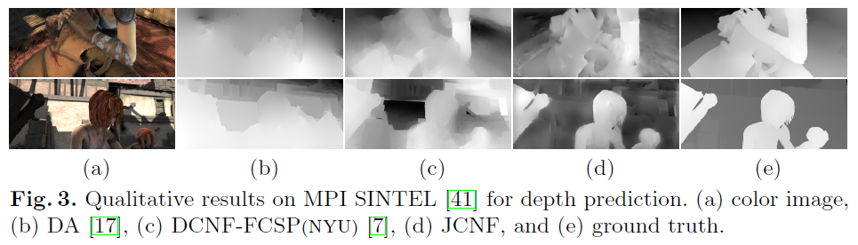
CRF in Deep Learning Intrinsic Image Decomposition & Depth Prediction

Slide 38
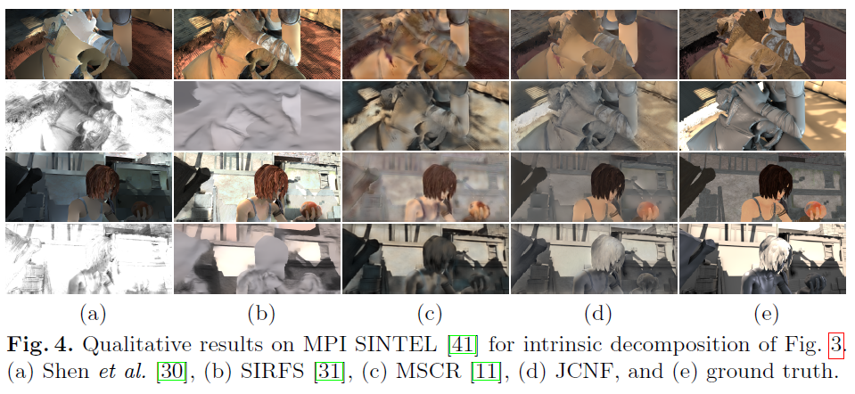
CRF in Deep Learning Intrinsic Image Decomposition & Depth Prediction

Slide 39
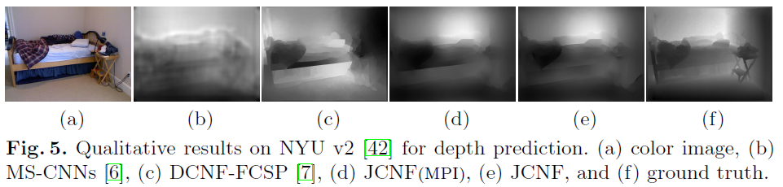
CRF in Deep Learning Intrinsic Image Decomposition & Depth Prediction

Slide 40
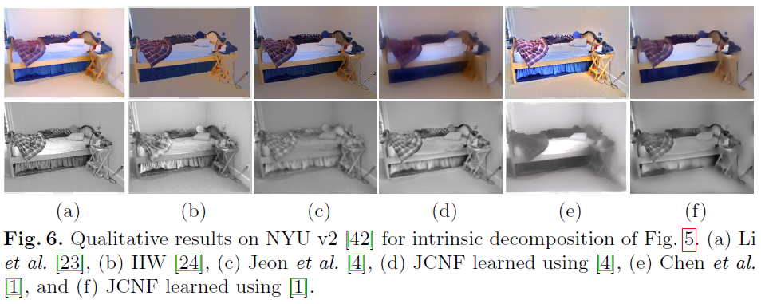
CRF in Deep Learning Intrinsic Image Decomposition & Depth Prediction

Slide 41
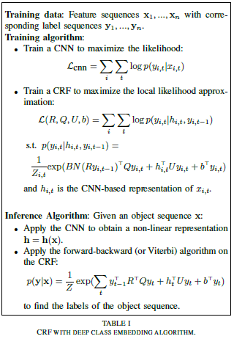
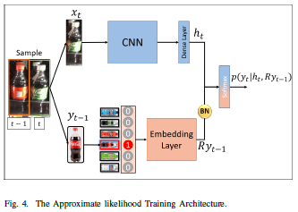
CRF in Deep Learning Classification

Slide 42
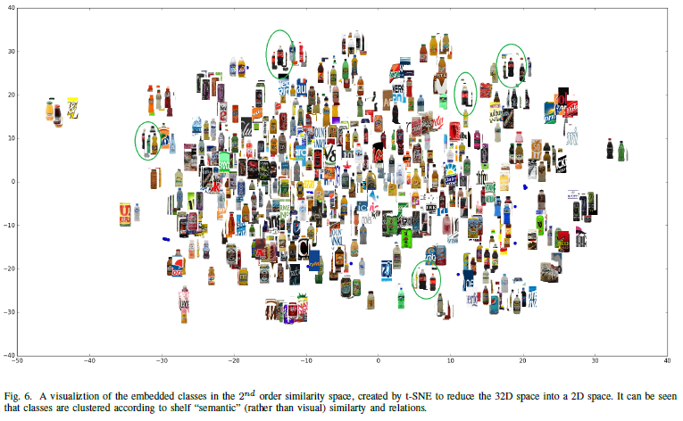
CRF in Deep Learning Classification

Slide 43
생각해보는 시간
CRF 사용해보기

Slide 44
THANK YOU!

