Slide 1

JewelERP
MAJOR PROJECT-II
Digital Jewellery ERP System with Weight-Based Billing and GST Compliance

Slide 2


JewelERP
Digital Jewellery ERP System
Problem Statement Title: Design and Development of a Digital Jewellery ERP System with Weight-Based Billing and GST Compliance
Theme: Digital India
PS Category: Software
Team Name: JewelERP
Objective: To design and develop a Digital Jewellery ERP System that automates weight-based billing, inventory management, customer ledger tracking, and GST-compliant invoicing for wholesale jewellery businesses.

Slide 3
JewelERP
Digital Jewellery ERP System
Proposed Solution
  Web-based Digital Jewellery ERP System for wholesale jewellery businesses
  Weight-based billing with automatic calculation of purity, wastage, and making charges
  GST-compliant invoice generation with automatic 3% tax calculation
  Real-time inventory tracking with automatic stock deduction after billing
  Daily metal rate management with historical rate storage
  Customer ledger & payment tracking with outstanding balance updates
  Comprehensive dashboard for sales, stock, GST summary, and financial reports

Slide 4
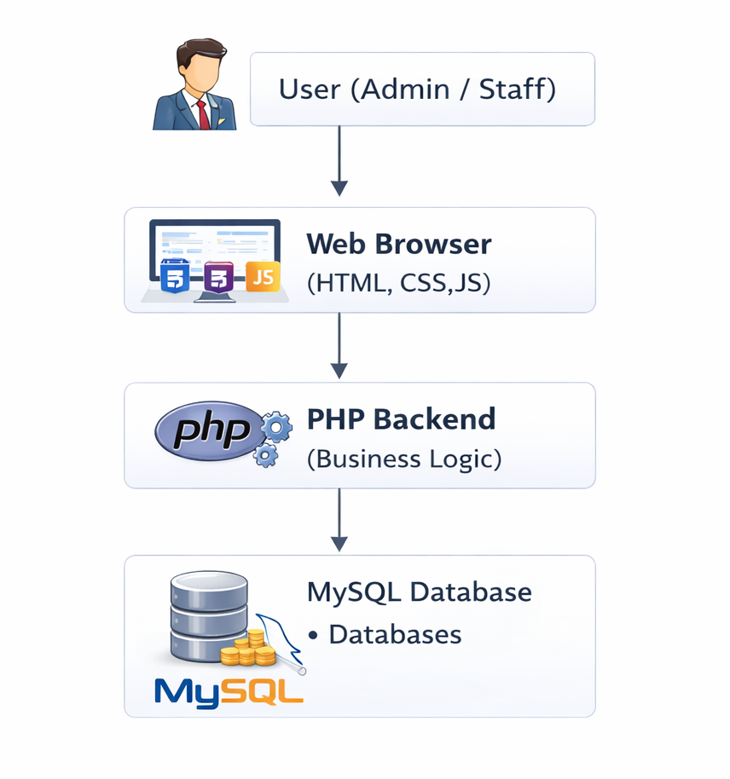
JewelERP
Digital Jewellery ERP System
Technical Approach
  Frontend Development
Technology: HTML, CSS, Bootstrap, JavaScript
  Backend Development
Technology: PHP
  Database
Technology: MySQL
  Architecture
Type: Three-tier architecture

Slide 5
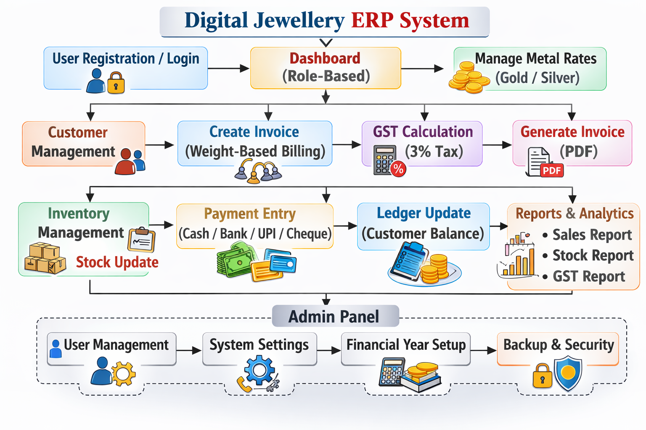
JewelERP
Digital Jewellery ERP System
Project Modules
  User & Security Management
  Company & GST Configuration Module
  Metal Rate Management Module
  Customer Management Module
  Billing & Jewellery Logic Module
  Inventory & Stock Management Module
  Payment & Ledger Module
  Reports Module

Slide 6
JewelERP
Digital Jewellery ERP System
Feasibility & Viability
  Simple dashboard interface
  Minimal training required
  Maintains financial records properly
  Helps businesses reduce manual errors and financial losses
  Ensures data confidentiality and secure login
  Generates GST-compliant invoices
  No advanced hardware requirements
  Improves billing accuracy and stock control

Slide 7
JewelERP
Digital Jewellery ERP System
Impacts & Benefits
  Improves billing speed and reduces manual errors
  Automates weight-based gold and silver calculations
  Ensures accurate GST-compliant invoicing
  Maintains systematic and transparent ledgers
  Enables automatic stock deduction and monitoring
  Prevents stock shortages with low-stock alerts
  Generates detailed sales and GST reports
  Enhances business transparency and accountability
  Offers a cost-effective digital solution for wholesalers

Slide 8
JewelERP
Thank You!

