Slide 1
TMDS Exam Solution
BY: Maverick Wong

Slide 2
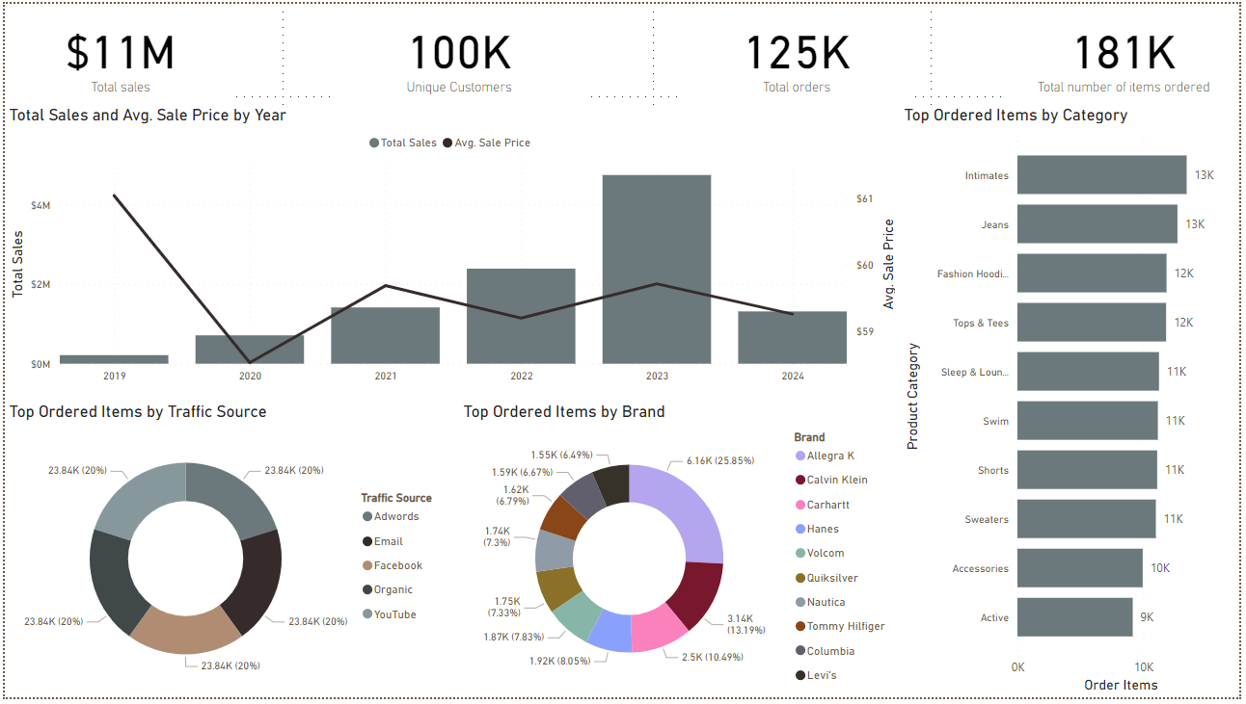

Slide 3
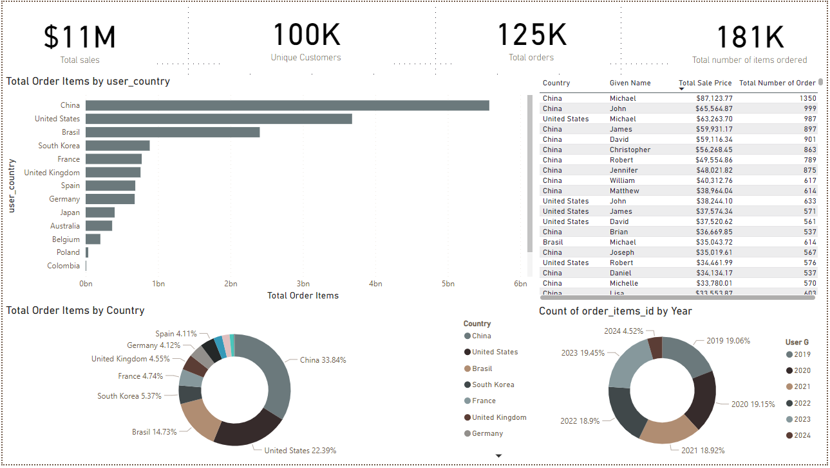

Slide 5
Based on evidence, the company should focus their attention to their biggest markets - China, United States, Brazil and South Korea. Those countries accumulate the biggest order to date. Sales distribution on these areas must be streamlined, lowering down the baseline cost achieving more average order value. As shown, baseline cost can affect retail and sale prices therefore increasing growth and revenue rate in the future.
Second, focus on top categories and top brands with the highest order items. Those brands has performing very well based on the report. With the categories, the recommendation is to expand the product lines and/or services on these key areas. Ideally over 75% percentile of categories should be considered.
Streamline distribution on key location and key brands.
Expand the product line on well-performing categories.

