Slide 1
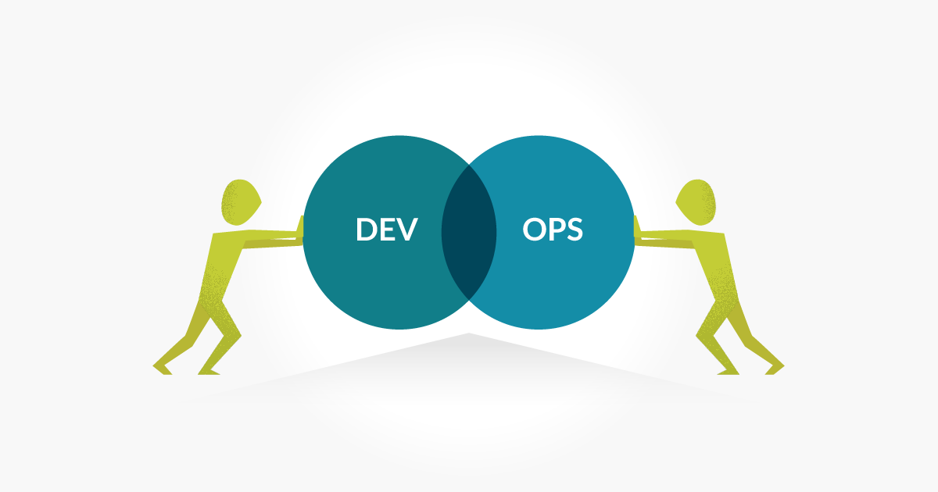
DevOps Fundamentals Introduction to DevOps

Slide 2

Traditional Development and Operations
DEV
OPS

Slide 3

“DevOps is development and operations collaboration”
“DevOps is treating your infrastructure as code”
It’s DevOps!
It’s DevOps!
“DevOps is using automation”
It’s DevOps!
“DevOps is feature switches”
It’s DevOps!
“DevOps is small deployments”
“Kanban for Ops?”

Slide 4
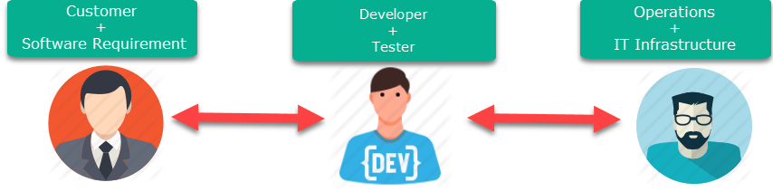
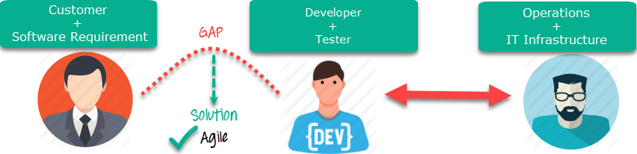
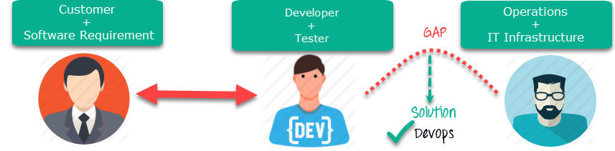
DevOps Vs Agile
Stakeholders and communication chain a typical IT process.
Agile addresses gaps in Customer and Developer communications
DevOps addresses gaps in Developer and IT Operations communications

Slide 5
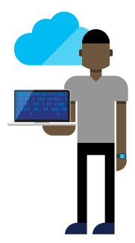




DevOps: the three stage conversation
DEV
OPS
1
People
2
Process
3
Products

Slide 6
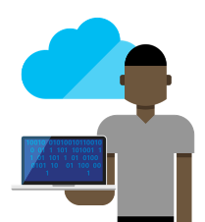






The consequences of inefficiency
40
%
… of implementations end up getting reworked because they don’t meet the users’ original requirements
IT drives business
success!
High IT performance correlates with strong business performance, helps boost productivity, market share and profit.
Outperforming teams are
collaborate
54
%
extensively
more likely to
41
%
… of development budgets for software, IT staff and external professional services will be consumed by poor requirements
with their
Collaboration blockers
counterparts
80
%
failure rate …
26.7% No executive support
56.7% Cultural inhibitors
43.3% Fragmented processes
… for companies that try to adapt their existing tools for DevOps practices
Developers
IT Ops
%
Business
70
o
f
CIOs
Would increase risk
1 in
6
It takes on average 200 minutes to diagnose and repair a production issue
IT decision makers is still unfamiliar with the term DevOps
to reduce IT costs
and accelerate business agility
3/4
of teams
DevOps was being initiated by more development teams than IT Ops teams by about a 40% to 33% margin
The average hourly cost of infrastructure failure is $100,000 per hour
A bug caught in production ends up costing
than if the same bug was found earlier in the development cycle
Responding to ongoing needs for efficiency and growth
100x more
have adopted
Agile methodologies
dual goals
Always keeping all systems safe and secure

Slide 7
List of DevOps Practices
Infrastructure as Code (IaC)
Continuous Integration
Automated Testing
Continuous Deployment
Release Management
App Performance Monitoring
Load Testing & Auto-Scale
Availability Monitoring
Change/Configuration Management
Feature Flags
Automated Environment De-Provisioning
Self Service Environments
Automated Recovery (Rollback & Roll-Forward)
Hypothesis Driven Development
Testing in Production
Fault Injection
Usage Monitoring/User Telemetry

Slide 8
Tools / Products

Slide 9
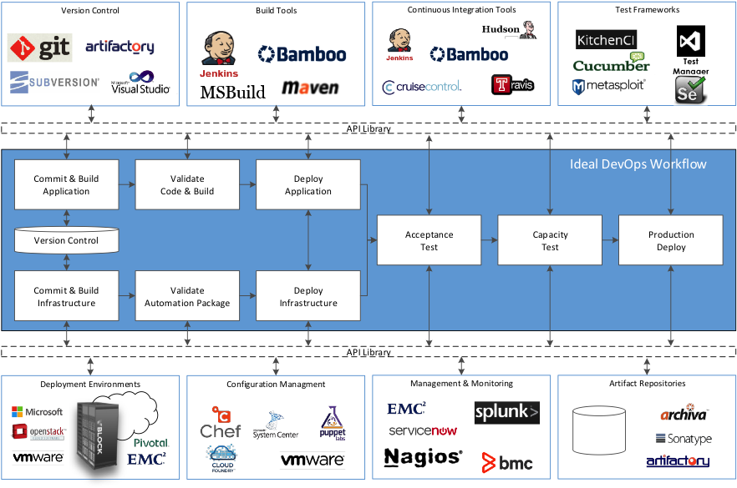

Slide 10
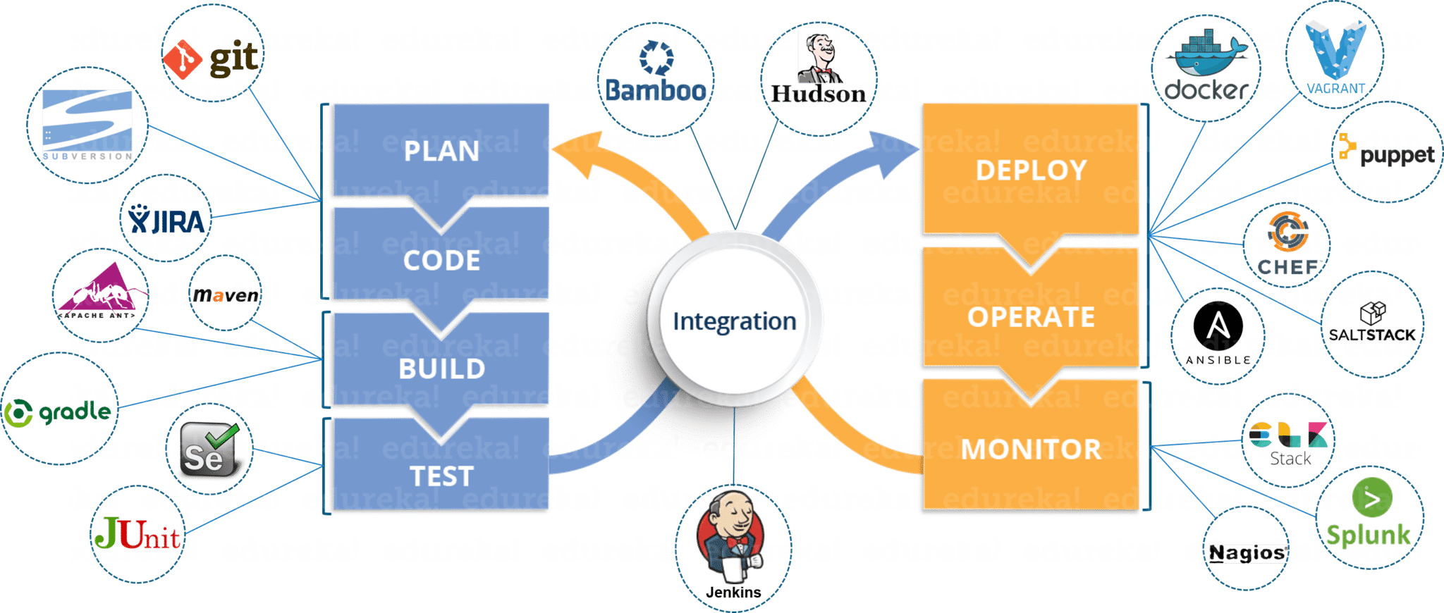

Slide 11



Happy DevOps
DEV
OPS
Production

