Slide 1
Whisper Asset Transfer: Leveraging CCIP and zk Proofs
A New Era of Cross-Chain Interoperability

Slide 2
Introduction
Whisper asset transfer represents a sophisticated method of transferring digital assets across different blockchain networks. This process leverages the Cross-Chain Interoperability Protocol (CCIP) and zero-knowledge (zk) proofs to ensure security, privacy, and efficiency.

Slide 3
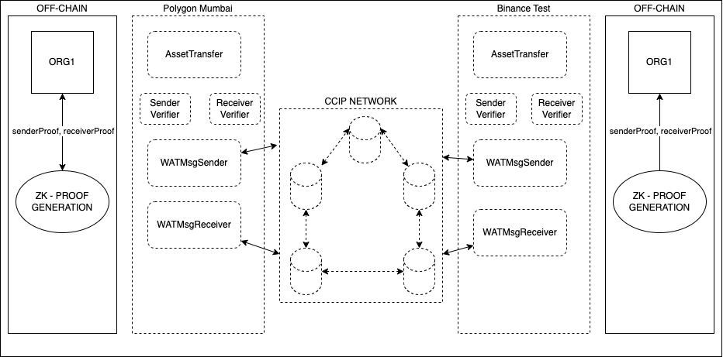
Technology Used and Architecture
Chainlink CCIP – Cross-chain Message broker
Circom & Zksnarks – Zero knowledge proofs
Foundry – Smart contract development
NodeJs – Backend Development

Slide 4
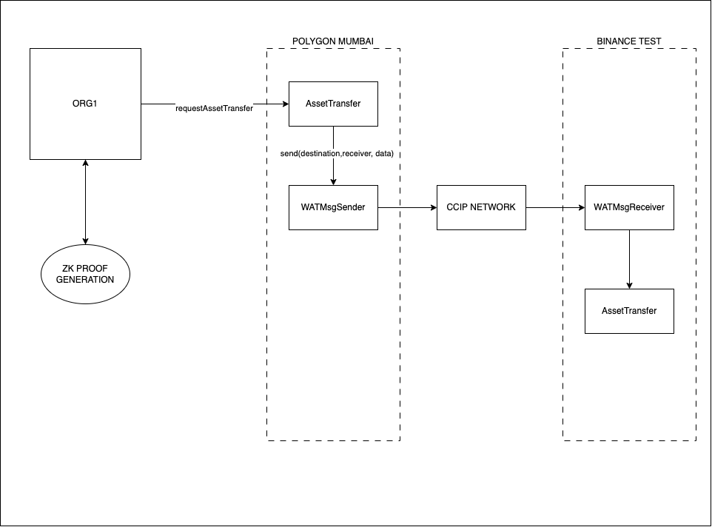
Process: 1. Initiate Transfer

Slide 5
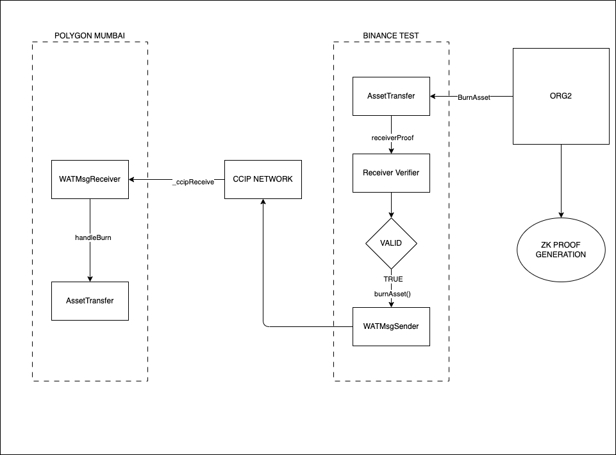
2. Burn Asset

Slide 6
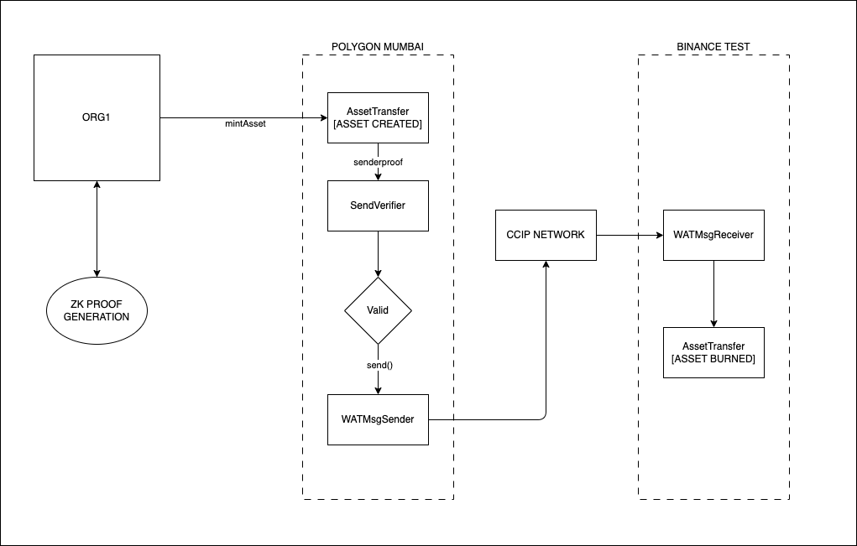
3. Mint Asset

Slide 7
Advantages and Use cases
Advantages
Usecases
Interoperability
Enhanced Security
Privacy Perservation
Efficiency
Decentralised Finance across chains.
Cross chain Exchanges.
Cross Chain NFT Transfer.

Slide 8
Future considerations
Integrate HTLC (Hash Time lock Contracts).
Add additional Stages in transfer to ensure safe asset transfer.

