Slide 1
SecureShare
Secure data-sharing platform built with Flutter Web and Firebase
Žak Drofenik
Martin Vrščaj
Matic Duša
Gašper Jordan Rojko

Slide 2
Problem
Cloud services can access your files
Server-side keys = insider threats
Data breaches can expose sensitive info
Users must trust providers blindly

Slide 3
Solution
Zero-Knowledge, End-to-End Encrypted Storage
Client-side AES-256-GCM encryption
Server stores ciphertext only
Keys never leave the browser
Sharing via email allow-lists

Slide 4
Tech Stack
Flutter Web UI
Firebase Authentication
Firestore Database
AES-256-GCM
SHA-256 key derivation
Firestore security rules
Audit logging

Slide 5
Authentication
Email/password login
AuthGate to protect routes
Identity confirmed by Firebase Auth

Slide 6
Encryption Workflow
User enters passphrase
Key = SHA-256(passphrase)
Random IV generated
File encrypted via AES-GCM
Only ciphertext + IV stored in DB

Slide 7
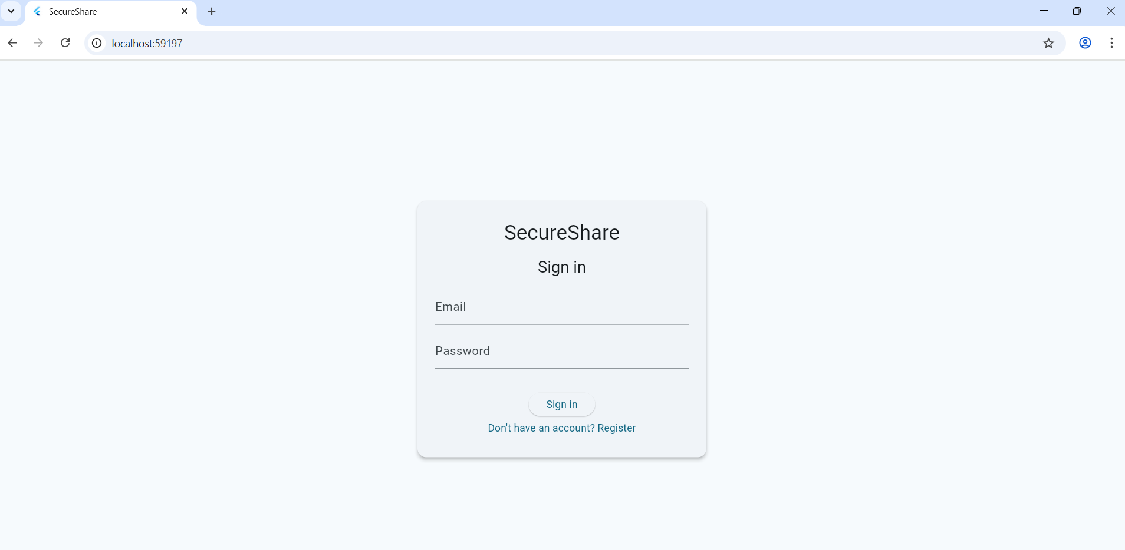
UI Overview

Slide 8
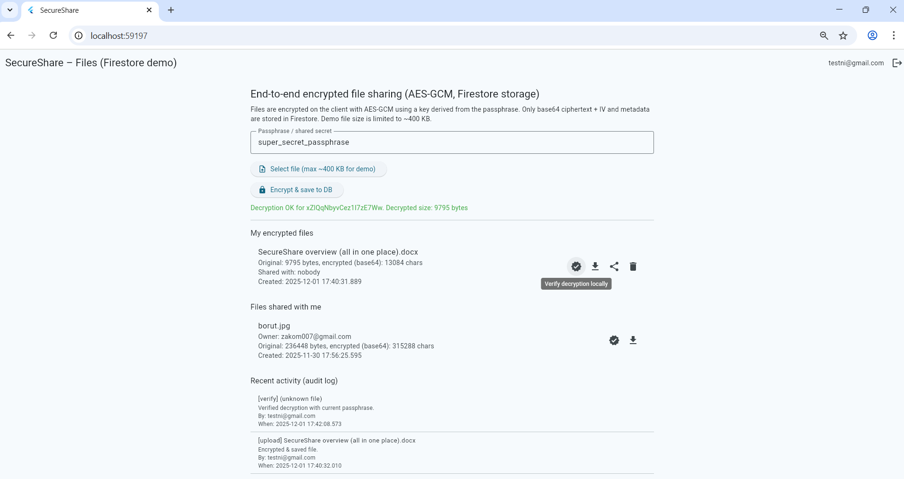
UI Overview

Slide 9
Secure Upload
Client encrypts
Server stores only encrypted content
Metadata remains minimal

Slide 10
Sharing
Share with specific emails
Firestore allow-list determines access
Still encrypted — requires passphrase

Slide 11
Download & Verify
Encrypted file fetched
Client decrypts locally
Integrity failure if modified

Slide 12
Audit Log
Upload
Download
Share
Delete
Verification
Errors / failed attempts

Slide 13
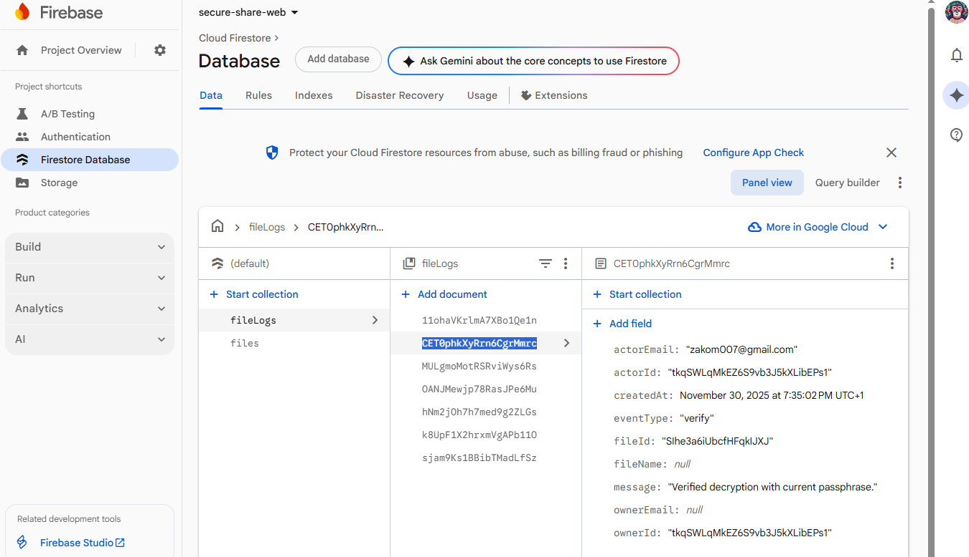

Slide 14
Security Advantages
True E2EE
Data integrity
Zero server knowledge
Fine-grained access control
Transparent logging

Slide 15
Limitations
400 KB file size limit
Simple key derivation (SHA-256)
No mobile/Desktop version
Web-only downloads

Slide 16
Conclusion
A working secure file-sharing system with:
E2EE
Client-side crypto
Access control
Audit logs
Clean & simple UI

