Slide 1
Trainings 11/4
Intro to Java

Slide 2
Wut is that?
Programming Language
Converses with machines
Java is a high-level Object Oriented Programming (OOP) Language
Easily understood by humans then converted to binary for machine
Object Oriented → Define different “objects” in code and their “attributes”
Bird object → attribute: can fly

Slide 3
How do I become a programmer???
You need…
An Integrated Development Environment (IDE)
Eclipse is what we use for robotics
The JVM (Java Virtual Machine)
Download the latest JDK (Java Development Kit) from Oracle
https://wpilib.screenstepslive.com/s/4485/m/13503/l/599679-installing-eclipse-c-java#!prettyPhoto

Slide 4
Ok… How do I make it do stuffs?
Java is a language
Similar to English, Spanish, and French
Has it’s own “rules” known as syntax
Basic Syntax
Sample Program

Slide 5
Data? Wat types?
Primitive Data Types
Integers
byte
short
int
long
Floating Point (Decimals)
float
double
Logic
boolean
Letters
char

Slide 6
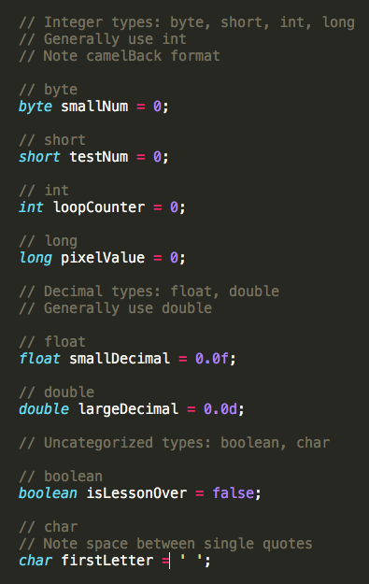
How do I use them in code?

Slide 7
What can I do with variables?
You can do common mathematical operations
Add (+)
Subtract (-)
Multiply (*)
Divide (/)
You can also use some unique operations
Modulus (%)
You can compare to boolean values
Equal to (==)
Not equal to (!=)
! → Not

Slide 8
Constants
Values that do not change
final int MY_CONSTANT = 5;
Naming convention for Constants is all caps

Slide 9
Practice program
Hello World
Make a calculator using Scanner class

Slide 10
Methods
Input
Methods do things
Methods are run when they are called
Creating:
AccessSpecifier returntype methodName(parameters) { Do Something }
Calling:
methodName(parameters)
Do Something
Output

Slide 11
Method Name
Naming convention: Camelback
First letter lowercase, other letters that begin a word are uppercase
Eg:
getName()
printString()

Slide 12
Return type
Value returned by the method (the output)
If no return value, the type is void
Return types can be the data types or objects
int
double
float
String
char

Slide 13
Parameters
Optional: Input for the method
When a method is called, can pass in values
Method can utilize these values
Ex
printString(“Hello”);

Slide 14
Practice Program
Make methods for the calculator program
Return the sum, difference, product, quotient, and modulus from each method

Slide 15
Classes
In real world, there are individual objects of the same kind
For example, there are lots of cars, but they’re all cars
The cars were built from the same general blueprint
A class is a blueprint from which objects can be created
Within a class, there are variables and methods defining the blueprint
For a car
Variables: numOfWheels, maxSpeed
Methods: drive, stop, turn

Slide 16
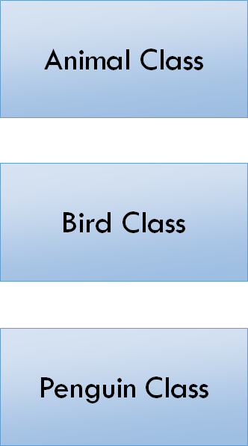
Inheritance
Method: Eat
Super Class/Parent Class
Sub Class
Inherits Information
Polymorphism
Difference between Subclass and Parent Class
Method: Fly
Var: Legs = 2
Wings = 2
Method: Swim

Slide 17
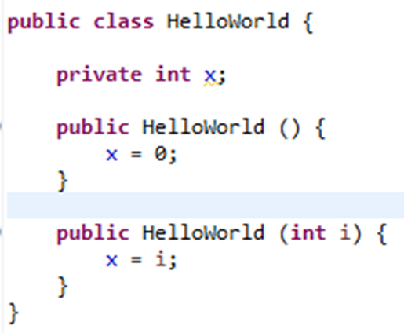
Constructor
Special method used to create an object
Constructor has the same name as the class it is in
Often contains variables to initialize
public Classname( parameters ) { initialize stuff }

Slide 18
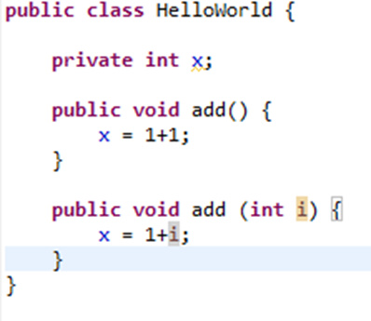
Overloading
Methods with the same name but different parameters

