Slide 1
Trainings 10/28
Woooooo!!

Slide 2
Welcome to Electrical!
Director of Electrical: Ishan Mitra
Subdivision Overview
Wiring
Lead: Sankalp Agrawal
Programming
Robot Code
Lead: Heather Baker
Vision
Lead: TBD
Let’s get started WOOOOOOOOO!!!!

Slide 3
Control Systems

Slide 4
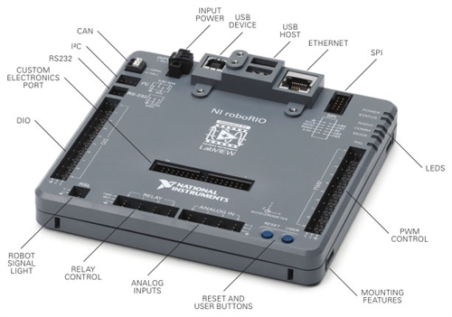
RoboRIO
Brain of the robot
Load code onto it
Sends signals to CAN chain and PWM
Has Digital and Analog In ports for sensors
Has port for signal light
Signals when robot has been enabled
Ethernet port to connect to router so that we can control robot
USB ports for devices (camera, etc.)

Slide 5
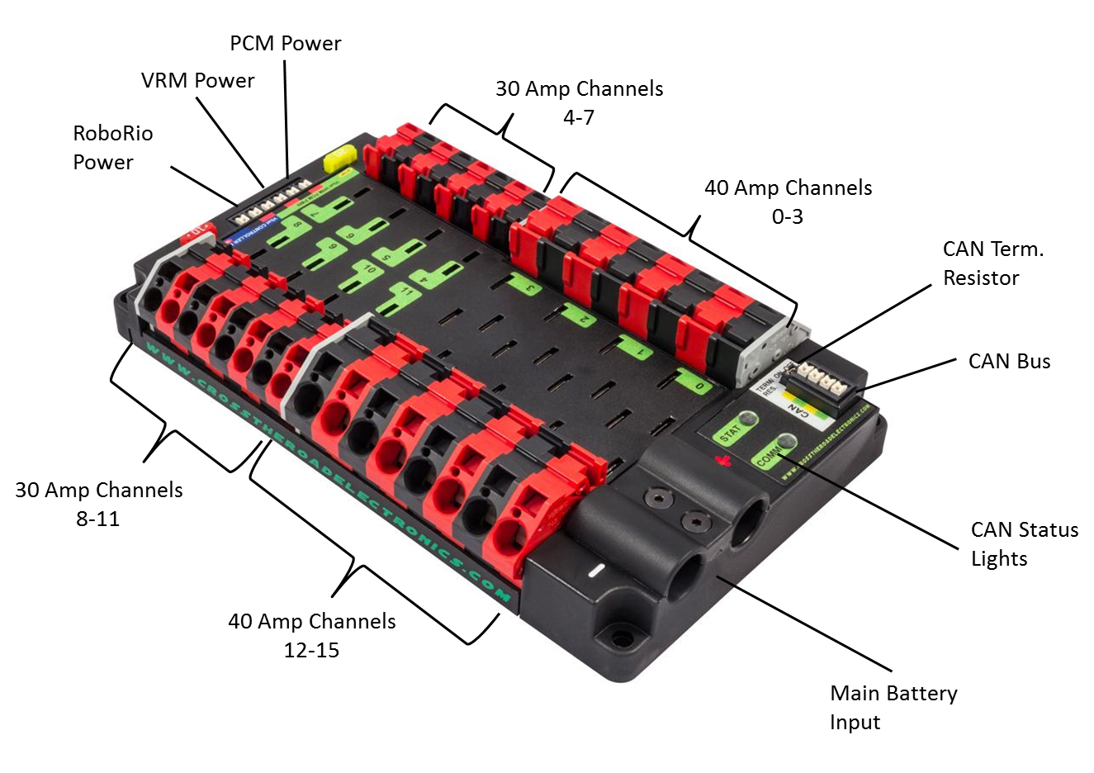
PDP
Power Distribution Panel
Distributes power from battery to rest of robot
Uses breakers to restrict how much power is sent
40 and 30 amp channels
Generally ends the CAN chain

Slide 6
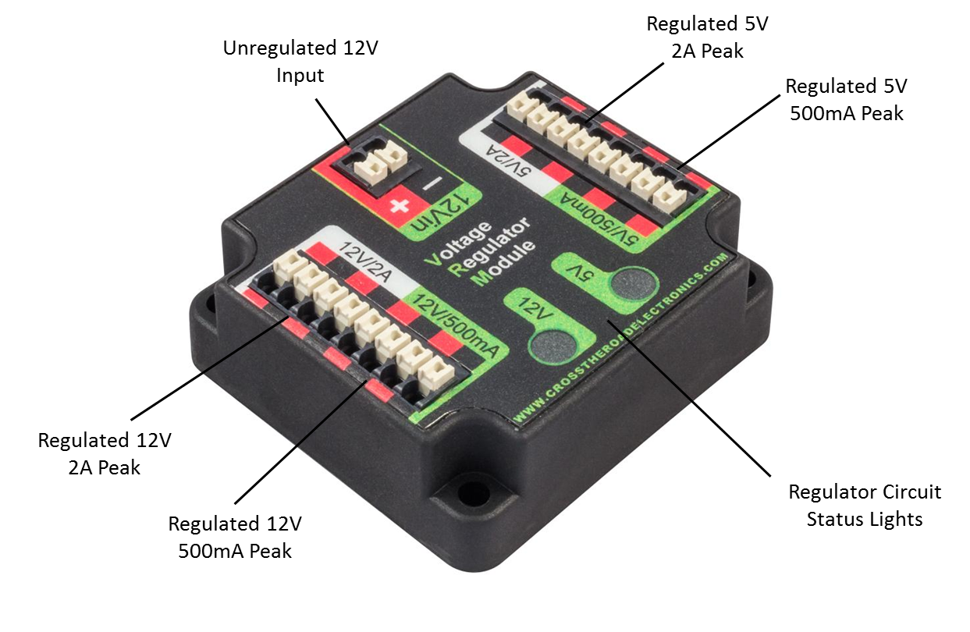
VRM
Voltage Regulator Module
Regulates how many volts travels to certain components
Router
Light Ring
Flashlight

Slide 7
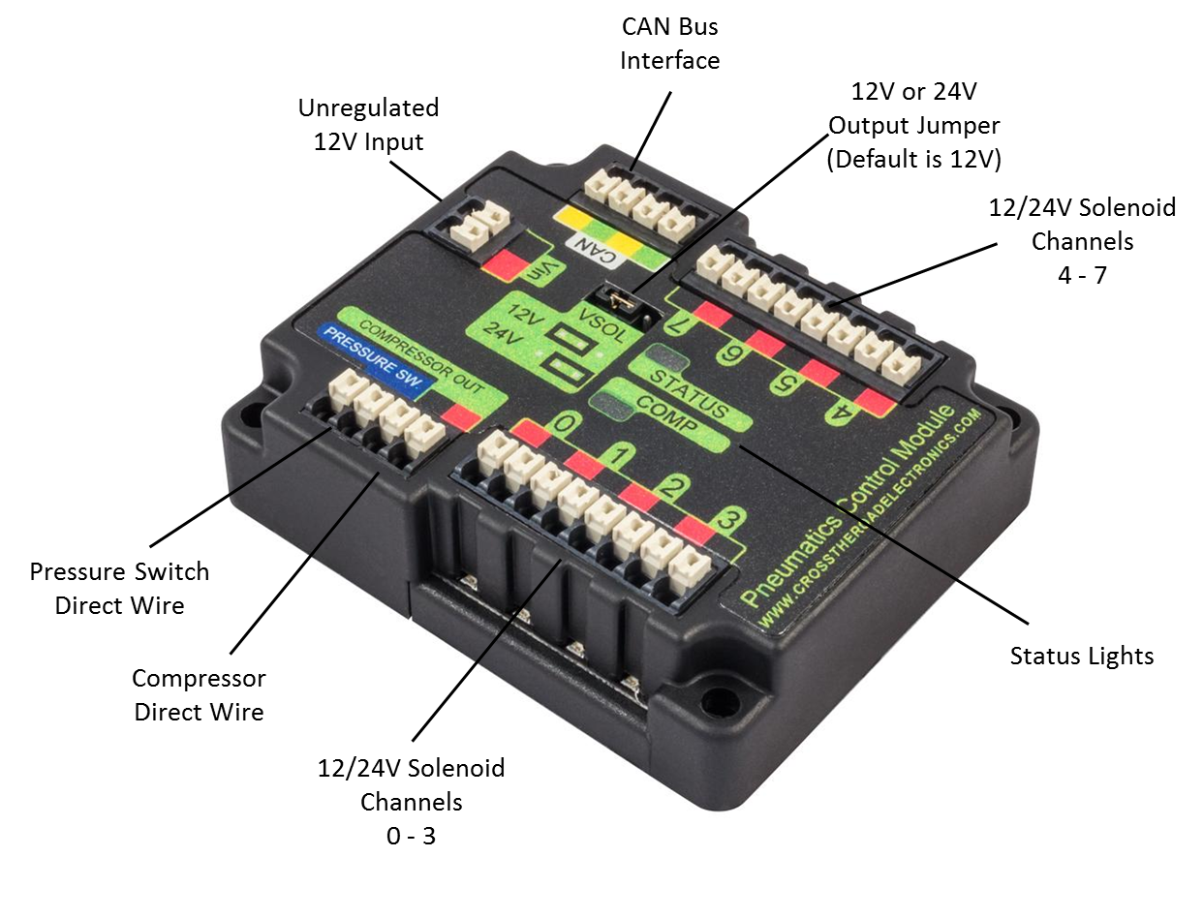
PCM
Pneumatics Control Module
Sends signals to solenoids to actuate pistons
Controls compressor
Contains 7 channels for solenoids
Works through CAN

Slide 8
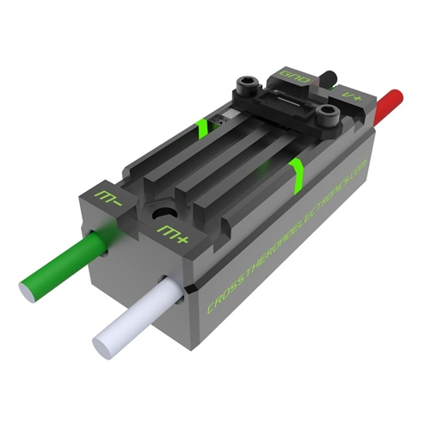
TalonSRXs & Other Motor controllers
Controls the speed of motors
Takes power from PDP and then restricts how much goes to the motors ultimately restricting speed
We use TalonSRX on a CAN Chain
TalonSRXs have special features that make them better than most other motor controllers
Smaller form factor lets them easily fit on the robot
Other motor controllers include
Jaguars
Victor SP
Talon SR (on 2012)

Slide 9
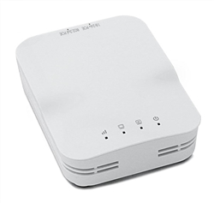
Router
Connects to VRM for power and RoboRIO to pass data
Onboard Wifi lets us connect to the robot and control it from a nearby computer
Must be configured at competitions
To work with the Field Management System (FMS)

Slide 10
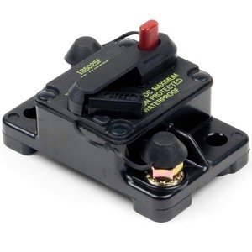
Main Breaker
Turns robot off and on
Push black piece in to turn on
Press big red button to turn off
Connects to PDP and Battery
Wires to positive side of both
Stops the flow of current if there is too much drawn

Slide 11
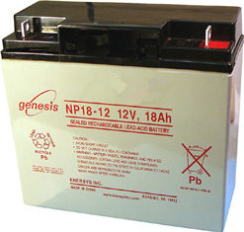
Batteries
12 Volts
Lead Acid (like a Car)
Power source of robot
Connects to main breaker and PDP

Slide 12
Checkup!

Slide 13
Sensors & Wiring I

Slide 14
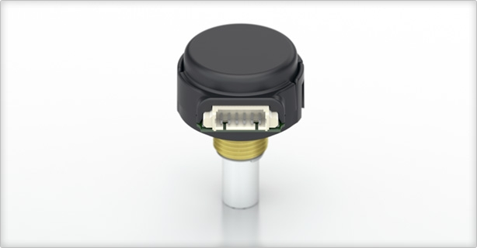
Encoders
Used to measure rotation
Connects to breakout board on Talon SRX
Gives us data in “ticks”, which we divide by ticks per rotation to get total rotations
Uses a black/white disc to determine ticks
Analog (between 0 to 1)
Helps orient the robot in games

Slide 15
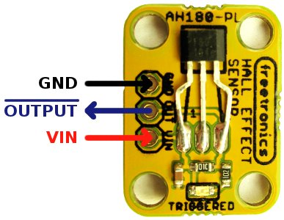
Hall Effect
Digital sensor used to detect the presence of a magnet
Works like a switch (on/off) but some can also have multiple values (analog)
By mounting a magnet on a moving component we can detect its position through multiple hall effect sensors
Plugs into digital pins on Rio

Slide 16
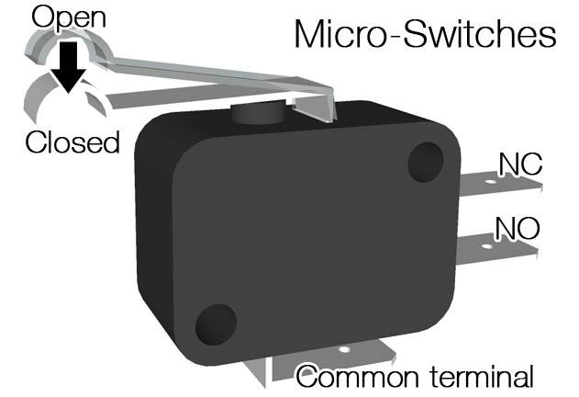
Limit Switches
Used to detect when a manipulator has reached an endpoint
Essentially just a small button
Plugs into digital input/output pin on Rio
Digital output (0 or 1)

Slide 17
Pneumatics

Slide 18
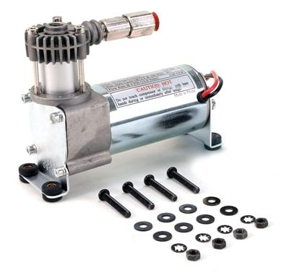
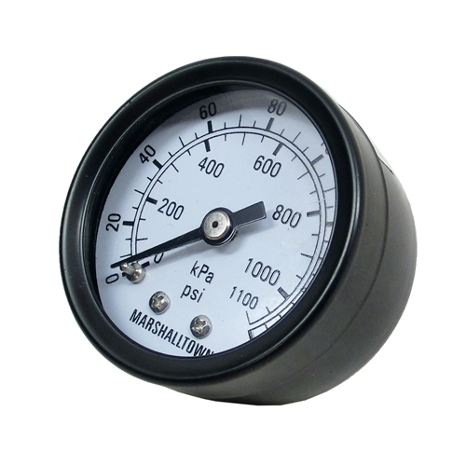
Compressor & Compressor System
Connects to air tank and pressure gauge
Compresses air to be used by pistons
Release valve relieves pressure

Slide 19
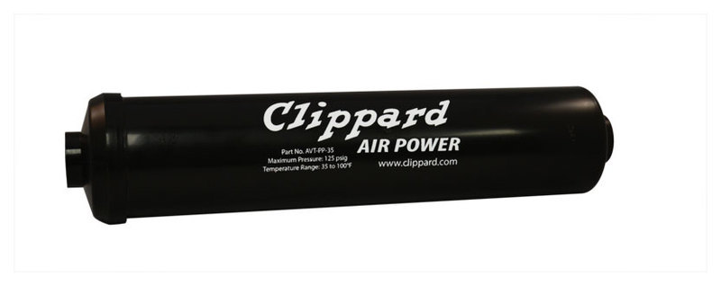
Air Tank
Lightweight tanks that hold compressed air
Can be chained together to hold more air

Slide 20
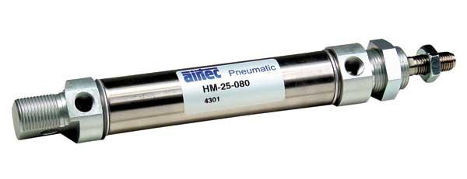
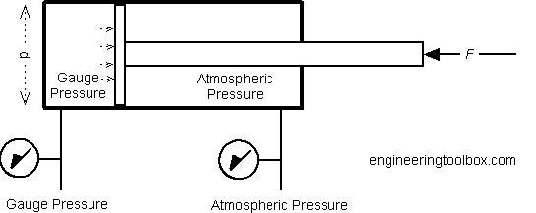
Piston
Fixed length
Can only extend or retract (2 positions)

Slide 21
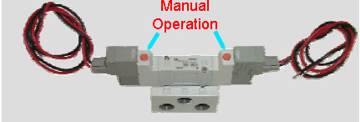
Solenoid
Receive signal from PCM to extend or retract piston
Can manually extend and retract piston

Slide 22
Wiring II

Slide 23
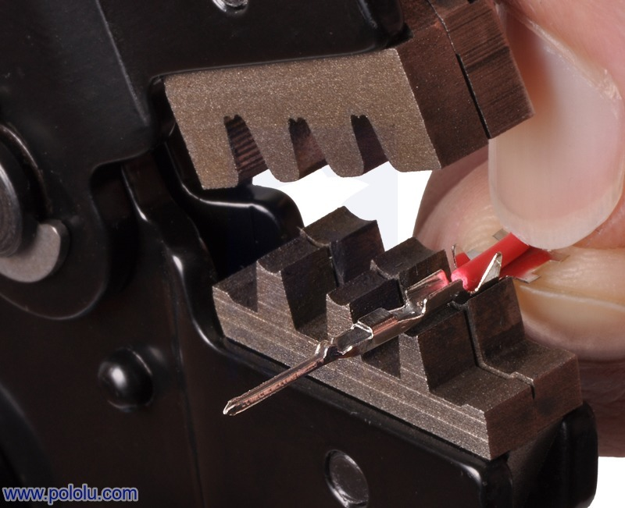
Crimping
Attaching housings to bare wire
Allows us to make reliable and clean connections
Different types for different purposes
PWM for signal
Powerpole for power
Flag for motor connections (don’t use too much)
Ferrules for connections to VRM, PDP, Roborio, etc.

Slide 24
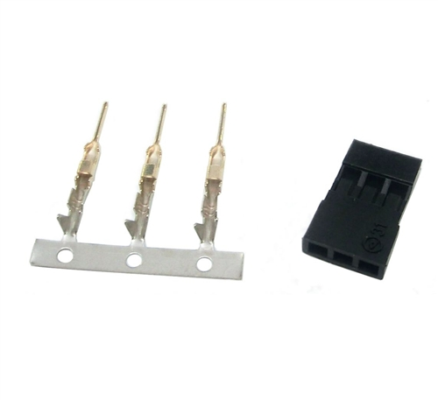
PWM
The smallest and hardest crimps
Used for signal wires
Encoder readings
Break beam readings
Used for CAN chain in talons (also signal wires)

Slide 25
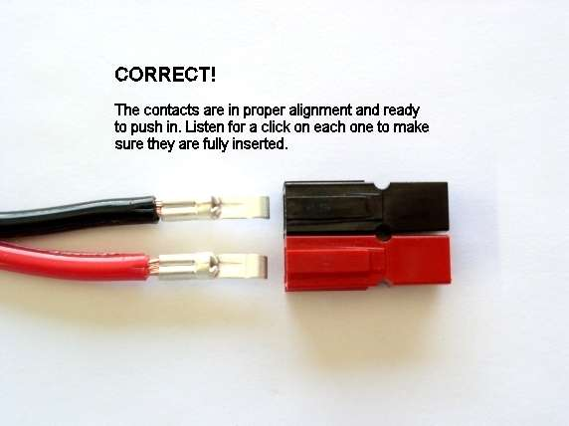
PowerPole
Large and relatively simple crimps
Used for power delivery to Talons, Motors, and some miscellaneous components.

