Slide 1
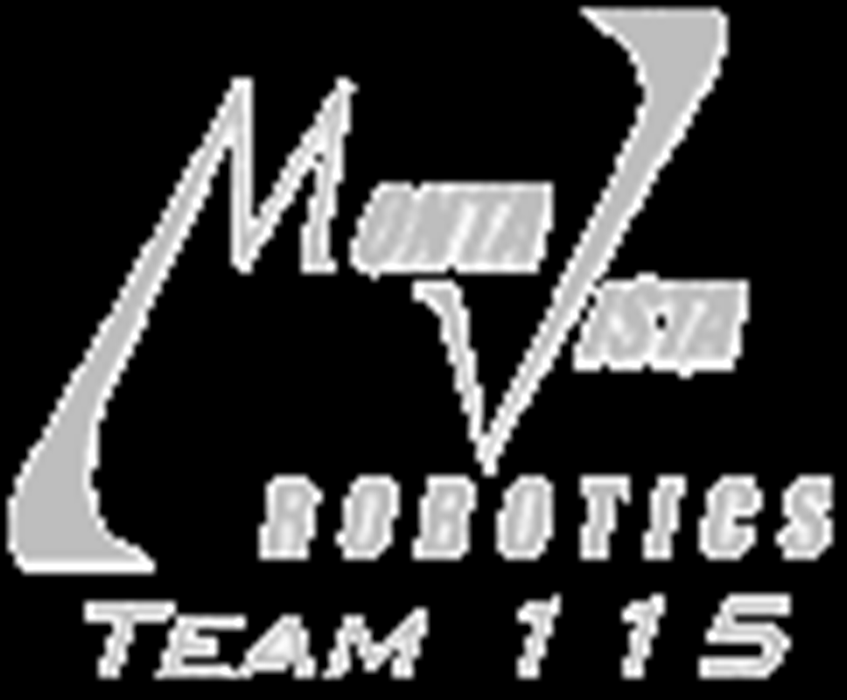

MVRT

Slide 2
FIRST
For Inspiration and Recognition in Science and Technology
  FRC – FIRST Robotic Competition
Gracious Professionalism
FIRST releases a game every January
  6 Weeks
    January 3rd – February 17th
Brainstorm strategy and design, design, fabricate, wire, assemble, program, test, debug, retest.

Slide 3
General Information
We build 1 robot
Alliance of 3 teams
  teamwork and communication
  Game strategy important
Game is ≈ 2 min. long
  Autonomous – Robot drives autonomously
  Telop – Driver(s) control robot and complete task
  End Game – Special task to complete at the end of the game for bonus points with driver control

Slide 4
2012 Game:
Rebound Rumble

Slide 5
Rebound Rumble
Shoot BasketBalls in Hoops
  4 Located on Opponents side of the feild
  Autonomous benefit: +3 Points for each
End Game: Balance robots on bridge
Game pieces:
  Foam Basketballs
http://mvrt.com/?reboundrumble

Slide 6
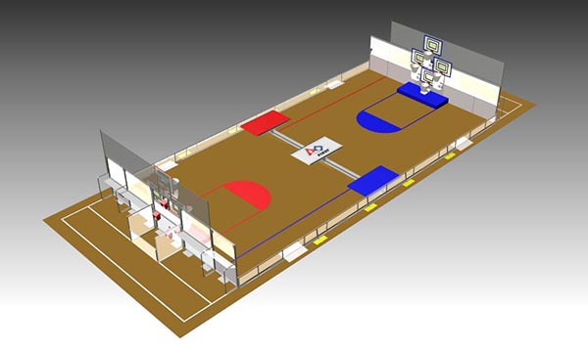
Field

Slide 7
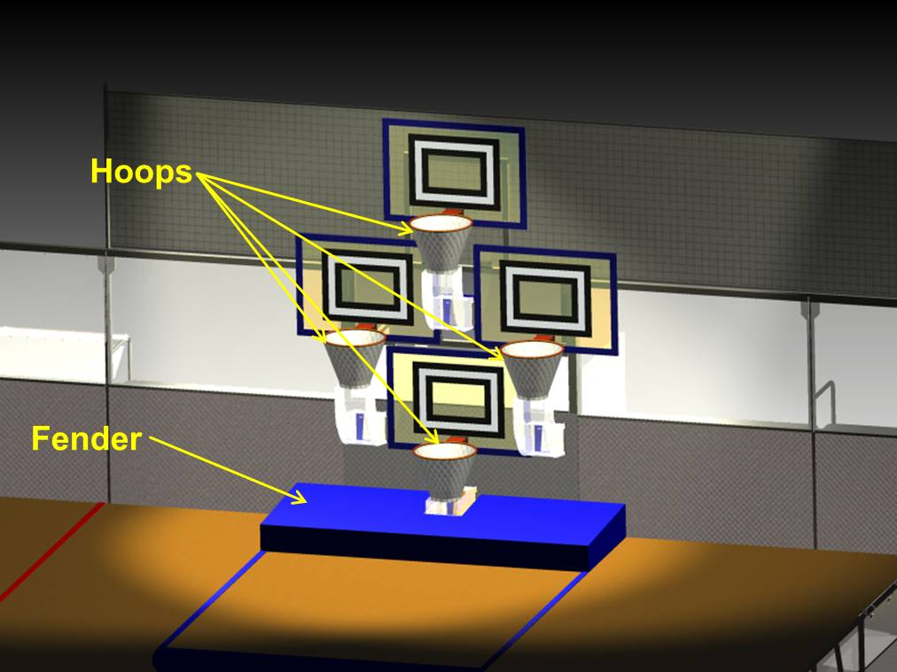
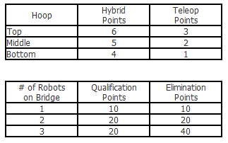
Scoring

Slide 8
Questions?
Discuss what you think.
  Understand? Interested?
  What would you do?
A different game will be released this year

Slide 9
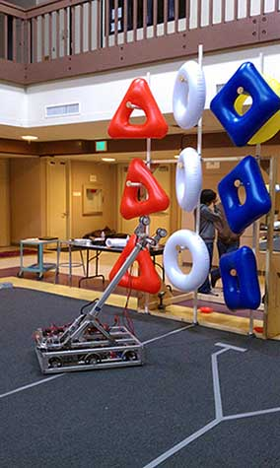
Last Year Strategy
Telescoping arm
Rollers as grabbers
  Used lego tires
Created a minibot
  Tried many different minibot releases

Slide 10
