Slide 1
Additional Programming Concepts
MVRT
2011 – 2012 Season

Slide 2
Table of content
Case structure
Loops
Arrays
Clusters
SubVI

Slide 3
Case Structures

Slide 4
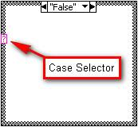
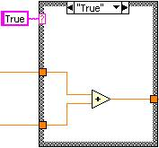
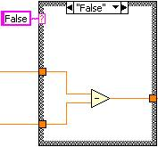
Case Structures
Case structures
If a condition is met then do something
Simile
If _a dog is chasing you_ then _climb a tree_.
If condition met (true)
then goes to true case
If condition isn’t met (false)
Then goes to false case

Slide 5
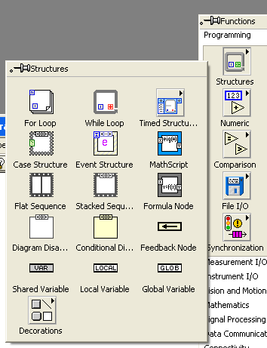
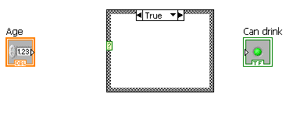


Example If/Else Case Structures

Slide 6
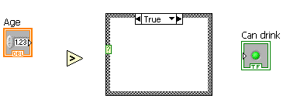
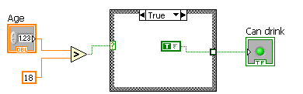
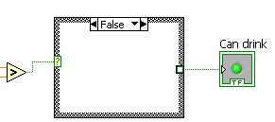
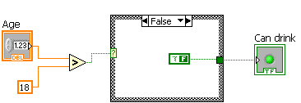
Example If/Else Case Structures
Incomplete as we didn’t add what to return for false value
After adding false case it works

Slide 7
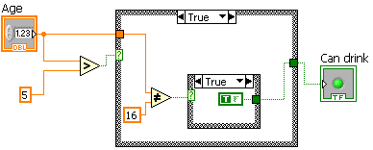
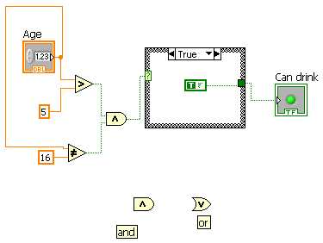
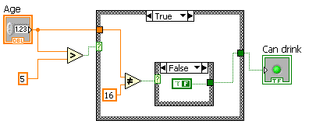
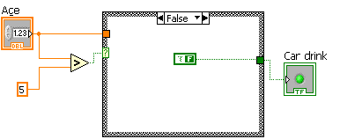
Example If/Else Case Structures
Another way
“And” and “Or” are in Boolean panel

Slide 8
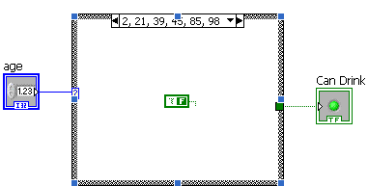
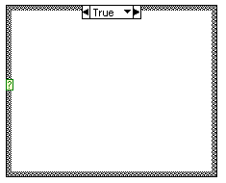
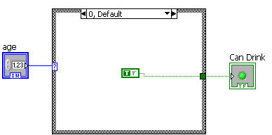
Example Multiple Decision Case Structure
Normal case Structure
Number case Structure
Will work for most simple data types

Slide 9
Loops

Slide 10
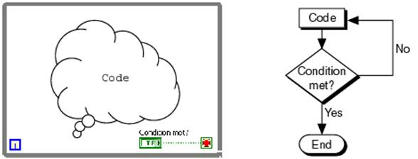
While loop
While
While a condition is not met then do something
Simile
While _dog is chasing you_ then _keep running_. When _dog stops chasing you_ then _stop running_.
action: running
condition: dog stops chasing you
condition needs to be met to stop action

Slide 11


While loop
Condition met?
# of times through loop
Stop if met

Slide 12
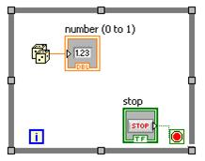
Example of a while loop
While _stop is not pressed_ then _find a random number_.

Slide 13
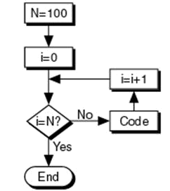
For loop
For loop
For a certain number of times do something
Simile
For _5 laps_ keep _running_. When _5 laps_ are done then stop _running_.
action: running
condition: 5 laps
condition needs to be met to stop action

Slide 14
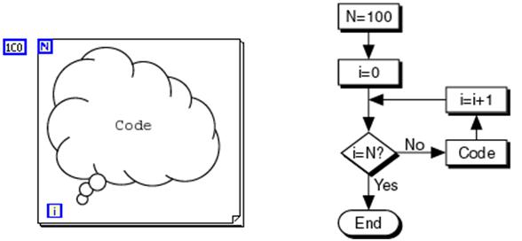

For Loop
# of times gone through loop
condition – total number of times it needs to go through the loop

Slide 15
For vs. While Loops
For Loops
While loops
Good for set number of times
Good for arrays as you can use ArraySize.VI
Obviously for conditions that change
Use for state machines to run the loop till state value is done

Slide 16
Array

Slide 17
Array
Array – a set of elements of the same data type
Useful for doing similar processing on same data
Works well with loops
There are multiple dimension of arrays
  1 d arrays are simple where elements in arrays are simple data types
  2 d arrays are like grids, boards, spreadsheets, etc.
    2 d can be thought of as an array of arrays where the first arrays elements are arrays
Simile: They are lot like filling cabinets

Slide 18
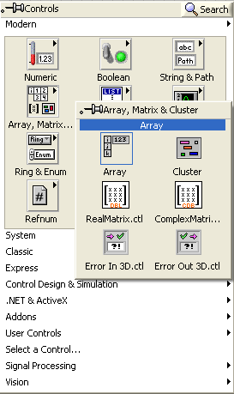
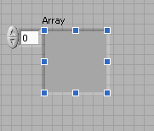

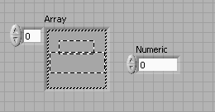


Creating Arrays

Slide 19
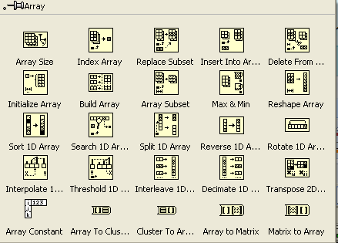
Array Function Nodes/VIs

Slide 20
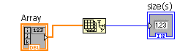


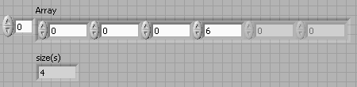
Array: Initialized vs. Non-initialize values

Slide 21
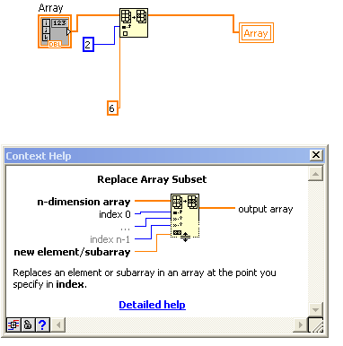
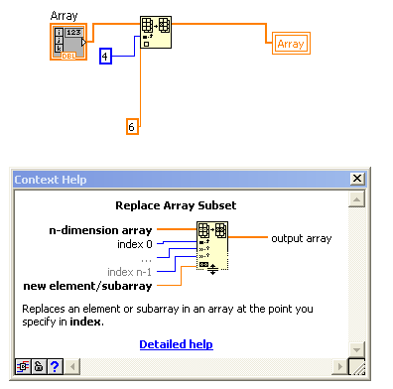


Operations only on initialized values

Slide 22
Similar problems
Index, Replace, Insert, Delete ONLY work only within array values.
If you have a 1 d array size of 3 elements you cannot use insert to add element at index 6 and expect it to initialize other elements

Slide 23
2D Array
2D arrays are like a filling cabinet holding other file cabinets
Similar to a grid or spreadsheet
Index VI gets element at that index
Subset returns a part or chunk of array

Slide 24
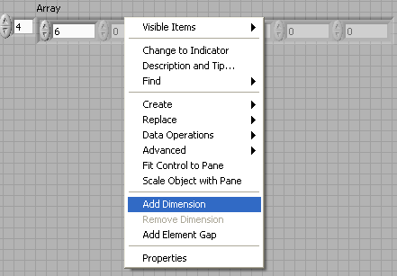
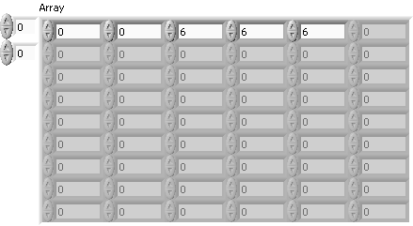
Making 2D Arrays

Slide 25
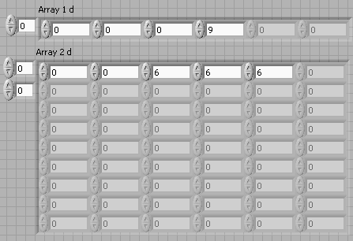
Array Dimensions change Everything

Slide 26
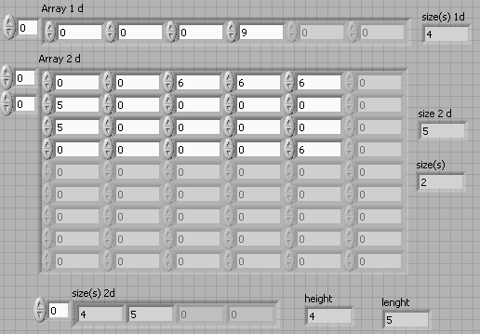
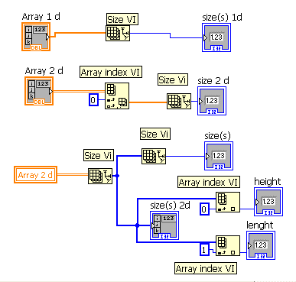
Array Dimensions change Everything

Slide 27
Clusters

Slide 28
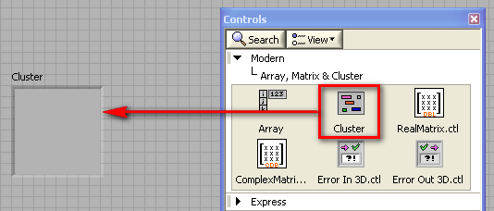
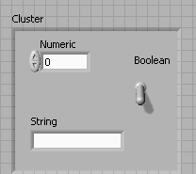
Clusters
Clusters
objects of different data types combined into one data type
  useful when you want to bundle data together
    ex. Used in robot code
Simile
orange juice, apple juice and pineapple juice are mixed into passion fruit juice

Slide 29
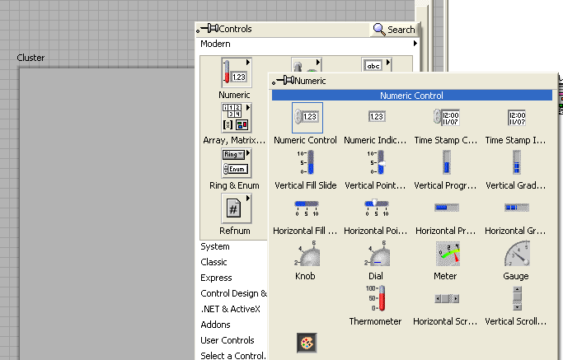
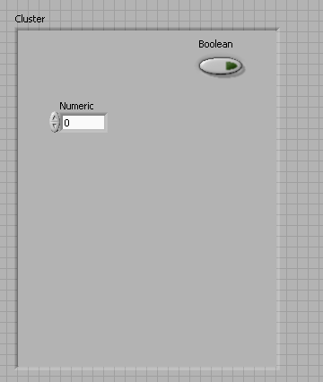
Making Clusters

Slide 30
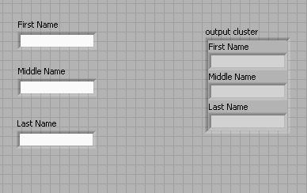
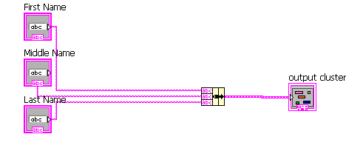
Bundling Clusters

Slide 31
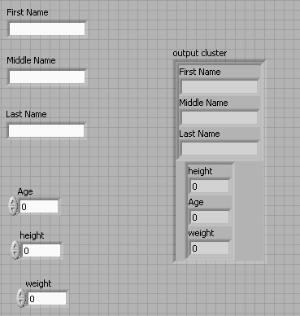
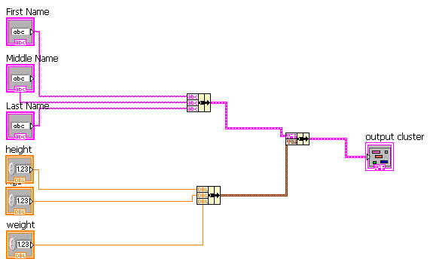
Bundling Clusters of Clusters

Slide 32
SubVI

Slide 33
VI
VI
virtual instruments
  Everything is a vi
  Has inputs and outputs which can be controlled by the front panel or other Vis
Simile
java: a class
an essay

Slide 34
SubVI
SubVI
a VI used in another VI
  Smaller Vis or smaller blocks of code that help complete the overall goal
Simile
java: a method in a class
a paragraph in an essay

Slide 35
Project
Project
Many VIs and SubVIs used together
  Largest VI
Simile
java: multiple classes used together
a portfolio/compilation of essays

Slide 36
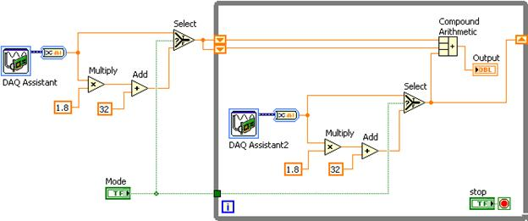
Initial Code
Initial Code
complex code
repetition of the code

Slide 37
SubVI’s Benefit
SubVI Benefits
Shortens & simplifies code by making it a part of another document
  Allows you to fix all applications of code easily
    Note: keep in mind this works in reverse too
Simile
Website – has multiple web pages which help to divide up the content into multiple parts
Example
throughout the robot project – so that all of its code is not in one VI

Slide 38
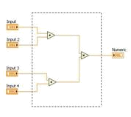
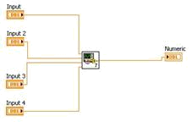
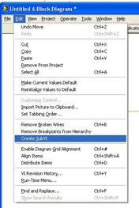
Creating SubVI
Creating SubVI
Select Code
Find: Edit
Create SubVIs

Slide 39
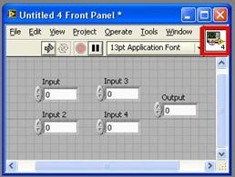
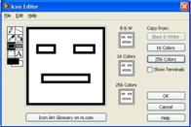
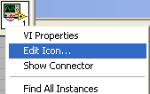
Creating an Icon
Creating an Icon
top right corner of front panel
Why: to be able to identify what a VI does

Slide 40
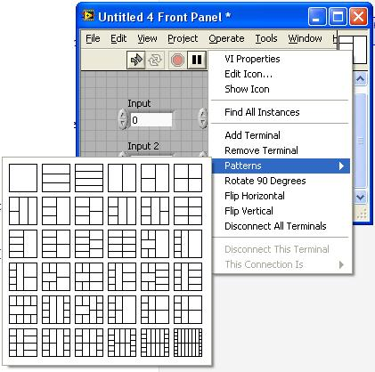
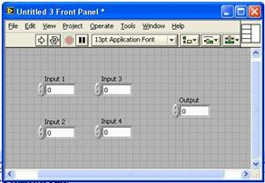
Creating a connector pane
Connector Pane
inputs and outputs
Creating a Connector Pane
top right corner of front panel

Slide 41

Creating a connector pane

Slide 42
Initial code
Initial Code
complex code
repetition of the code

Slide 43

Final Code with SubVI
Final Code
less complex code
no repetition of the code

Slide 44


Using VIs As SubVIs
If you create a separate VI and want to use it as a SubVI you can click “Select a VI” and search through your folders for the VI

