Slide 1
SCALE: 1” = 1”
ROBOT DESIGN CONCEPTS
DRAWING:
THE INCOMPARABLE
Humphrey Hu
MVRT
VINTAGE 2005

Slide 2
SPECIFICATIONS
BASIC CONSTRAINTS:
CHASSIS:
DRIVETRAIN:
MANIPULATOR(S):

Slide 3
BASIC CONSTRAINTS
YOU, AS AN ENGINEER, HAVE MANY CONSTRAINTS TO WORRY ABOUT:

Slide 4
BASIC CONSTRAINTS
WE RUN ON AN EXHAUSTABLE SUPPLY OF FUNDS, WHICH TRANSLATES TO:
CO$T

Slide 5
BASIC CONSTRAINTS
THE ROBOT HAS A LIMIT ON ITS DIMENSIONS, WHICH TRANSLATES TO:
SIZE

Slide 6
BASIC CONSTRAINTS
OUR MACHINISTS HAVE LIVES, WHICH TRANSLATES TO:
MACHINABILITY

Slide 7
BASIC CONSTRAINTS
YOU WILL BE MAINTAINING AND REPAIRING WHATEVER IT IS, WHICH TRANSLATES TO:
MAINTAINABILITY

Slide 8
BASIC CONSTRAINTS
THE DARN THINGS GOT TO WORK, WHICH TRANSLATES TO:
FUNCTIONALITY

Slide 9
COST
SOME MORE THINGS TO CONSIDER:
MATERIALS IN STOCK ARE ESSENTIALLY *FREE*.
SPECIALTY PARTS COST YOU YOUR LUNCH.
OVERNIGHT SHIPPING COSTS YOU YOUR DINNER.
YOU MAY NEED TO MAKE A REPLACEMENT.

Slide 10
SIZE & WEIGHT
SOME MORE THINGS TO CONSIDER:
THE ROBOT HAS SET MAXIMUM DIMENSIONS FOR WIDTH, LENGTH, AND HEIGHT.
IT ALSO HAS SET MAXIMUM DIMENSIONS FOR TOTAL WEIGHT.

Slide 11
MACHINABILITY
SOME MORE THINGS TO CONSIDER:
TIMING AND FEASIBILITY ARE KEY
TIMING INVOLVES NOT OVERWORKING OUR MACHINISTS
FEASIBILITY INVOLVES DESIGNING ACCORDING TO THE CAPABILITIES OF OUR TEAM (MORE ABOUT THIS LATER)
TREAT THE MACHINISTS WITH RESPECT! THEY ARE VOLUNTEERS AFTER ALL AND NOT ALL LIKE COFFEE.

Slide 12
MAINTAINABILITY
SOME MORE THINGS TO CONSIDER:
TIGHTENING LOTS AND LOTS OF BOLTS IS NOT MUCH FUN.
ROBOTS LIKE TO MATCH COORDINATES; PREPARE FOR SUDDEN STOPS AND TRANSFER OF MASSIVE AMOUNTS OF KINETIC ENERGY (COLLISIONS).
IF SOMEONES BATTERY EXPLODES AND RIPS A HOLE IN YOUR COMPONENT, YOU MUST BE ABLE TO HAVE IT REPAIRED OR REPLACED WITHIN 10-15 MINUTES.

Slide 13
FUNCTIONALITY
SOME MORE THINGS TO CONSIDER:
OBVIOUSLY, THE COMPONENT MUST WORK.
MAXIMIZING THE RATIO OF FUNCTIONALITY TO THE OTHER FACTORS IS OUR MAIN CONCERN.
SIMPLE IS ALWAYS BETTER…

Slide 14
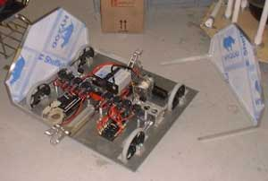
CHASSIS DESIGN
OPERATIONAL BACKBONE, DESIGN FOUNDATION:
THE CHASSIS IS, QUITE TRUTHFULLY, THE MOST IMPORTANT ‘ELEMENT’ OF THE ROBOT.
IMPORTANT FUNCTIONALITY PROPERTIES OF THE CHASSIS SHOULD INCLUDE:
  DURABILITY + EASE OF REPAIR
  EASE OF MOUNTING
  WEIGHT AND MATERIAL EFFICIENCY
  MUST ACCOMMODATE ALL THE OTHER COMPONENTS OF THE ROBOT (MANIPULATORS, DRIVE TRAIN, AND ELECTRICAL COMPONENTS)

Slide 15
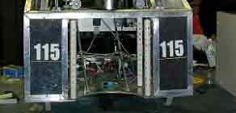
CHASSIS DESIGN
COMMON CHASSIS DESIGN ELEMENTS:
THE FRAME
  “OUTLINE” OF ROBOT.
  SHOULD BE MAXIMUM DIMENSIONS.
  MUST BE DURABLE; WILL DEFINITELY EXPERIENCE COLLISIONS IN PLAY.
  CONSIDER WHERE AND ON WHICH TIER/LEVEL YOUR FRAME WILL HAVE PRESSURE APPLIED

Slide 16
CHASSIS DESIGN
COMMON CHASSIS DESIGN ELEMENTS:
HORIZONTAL BRACING (THE + OR - |)
  GENERALLY USED TO ADD SUPPORT TO THE WEAK MIDDLE POINTS OF THE FRAME
  ADDS MOUNTING OPTIONS FOR MANIPULATORS AND DRIVE TRAINS
  MAKE SURE THE MANIPULATORS DESIGN TEAM KNOWS EXACTLY WHERE YOUR BRACING WILL BE, UNLESS YOU WANT 1/5TH OF ENGINEERING PO’D
  CONSIDER THE FORCES FROM ALL DIRECTIONS

Slide 17
Horizontal Bracing ( and | )
Horizontal and Vertical Bracing is supposed to help spread out the impact of a force exerted throughout the structure of the chassis.
NOTE: Even after impact, the braced areas retain their original dimensions
Areas displaying strength when exerted force upon
Areas displaying weakness when exerted force upon
Potential shape of chassis after force is exerted upon due to weakness

Slide 18

CHASSIS DESIGN
COMMON CHASSIS DESIGN ELEMENTS:
CROSS BRACING (THE X OR \ /)
  GOOD FOR HELPING RECTANGLES KEEP THEIR SHAPE.
  NOT AS FEASIBLE FOR MOUNTING AS HORIZ.
  CONSIDERABLY MORE USEFUL AGAINST FORCE APPLIED ON CORNERS FROM ODD DIRECTIONS.
  THESE AREN’T ALWAYS FROM CORNER TO CORNER
  CAN ALSO BE USED FOR MANIPULATOR SUPPORT.

Slide 19
Cross Bracing (X or / \ )
Cross Bracing is supposed to help spread out the impact of a force exerted throughout the structure of the chassis.
NOTE: Even after impact, the braced areas retain their original dimensions
Areas displaying strength when exerted force upon
Areas displaying weakness when exerted force upon
Potential shape of chassis after force is exerted upon due to weakness

Slide 20
Horizontal + Cross Bracing
The use of both Horizontal and Cross Bracing enables the impact of most forces to spread out throughout the body of the chassis, allowing the chassis to retain its original dimensions.
Areas displaying strength when exerted force upon
Areas displaying weakness when exerted force upon
Potential shape of chassis after force is exerted upon due to weakness

Slide 21
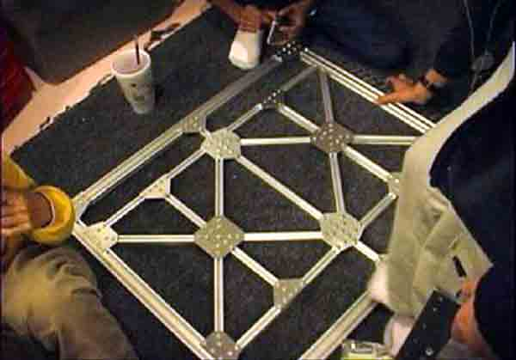
Bracing Cont…
Identify the Strengths and Weaknesses of the design…

Slide 22
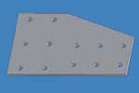
CHASSIS DESIGN
COMMON CHASSIS DESIGN ELEMENTS:
PLATES (THE FLAT ‘UNS WITH HOLES)
  USEFUL FOR KEEPING CORNERS AT A 90 DEGREE ANGLE.
  REMEMBER: 2 POINTS DEFINES A LINE; MORE IS JUST A WASTE OF TIME.
  A ROBOT GETS OBESE FAST WITH TOO MANY PLATES.
  CAN BE USED IN CONJUNCTION WITH CROSS BRACING FOR A STRONG BASE (SPROCKET HELL).

Slide 23
DRIVETRAIN DESIGN
FUNCTIONALLY MOST IMPORTANT COMPONENT
ENABLES THE ROBOT TO PERFORM ITS MOST IMPORTANT FUNCTION: DRIVE
IMPORTANT ASPECTS OF THE DRIVETRAIN:
  TORQUE VS. SPEED RATIO SUITED TO GAME
  TYPE OF DRIVETRAIN SUITED TO GAME
  ABILITY TO DRIVE EVERY ROUND, GUARANTEED
  WEIGHT AND SPACE REQUIREMENTS
  DURABILITY AND EFFICIENCY

Slide 24
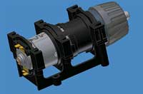
DRIVETRAIN DESIGN
COMMON DRIVETRAIN ELEMENTS:
MOTOR(S)
  PROVIDE ROTATIONAL MOTION.
  SHOULD NOT BE OVERWORKED (MAGIC SMOKE)
  DIFFERENT MOTORS HAVE DIFFERENT CHARACTERISTICS (WE WILL COVER THIS ANOTHER TIME); CHOOSE WISELY.
  CONSUME SPACE AND ELECTRICAL (UH, CONDUITS?) MUST BE ACCESSIBLE.
  ALWAYS FIND A SIMPLER SOLUTION PRIOR TO USING A MOTOR (THEY ARE LIMITED…)

Slide 25

DRIVETRAIN DESIGN
COMMON DRIVETRAIN ELEMENTS:
GEARBOX
  ALTERS SPEED TO TORQUE RATIO OF MOTOR OUTPUT.
  OFFERS OPPURTUNITY TO MATE MOTOR OUTPUTS.
  GENERALLY MOST IMPORTANT FOR MOUNTING THE DRIVETRAIN ONTO THE CHASSIS.
  MUST BE EXTREMELY PRECISELY DESIGNED, FABRICATED, AND ASSSEMBLED (BULLET PROOF)

Slide 26
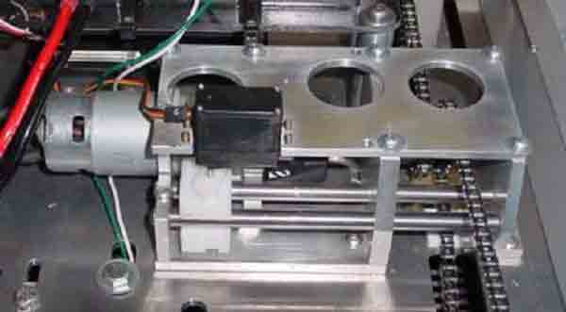
Gear Box
Motor
Gears
Chains
(output to the wheels)
Gear Box
Motor Output
(potentially alter the speed and torque)

Slide 27

DRIVETRAIN DESIGN
COMMON DRIVETRAIN ELEMENTS:
(NOT SURE WHAT TO CALL THIS) “WHEELS”
  ACTUAL INTERACTION POINT WITH FIELD.
  MORE CONTACT POINTS = BETTER GRIP.
  LESS CONTACT POINTS = BETTER TURNING.
  WILL WEAR DOWN, BUT IS GENERALLY NOT AN ISSUE.
  SHOULD BE EASILY EXCHANGEABLE

Slide 28
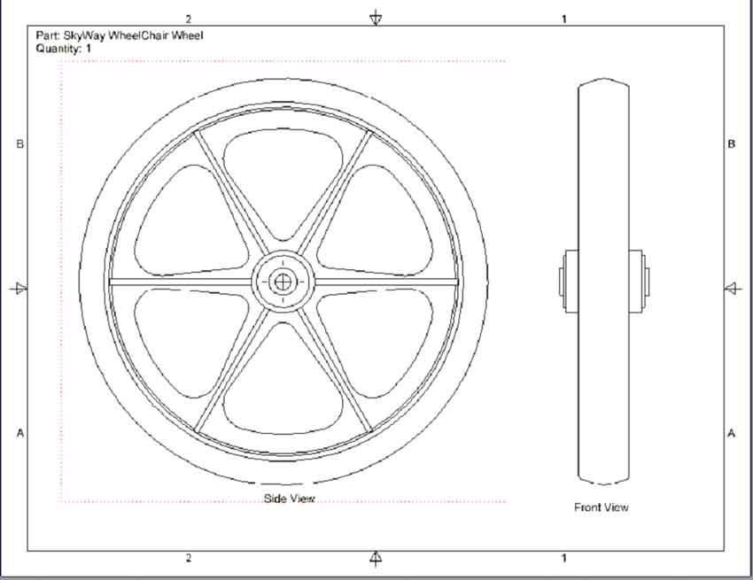

Slide 29
DRIVETRAIN DESIGN
COMMON DRIVETRAIN DESIGNS:
4 WHEEL DRIVE
  MOST BASIC AND COMMON TYPE OF DRIVETRAIN.
  GENERALLY FAST, THOUGH SUFFERS AT TURNING WITH ITS ‘TANK DRIVE’ STYLE.
  OUTDATED BY THE OFFSET 6 WHEEL DRIVE.

Slide 30
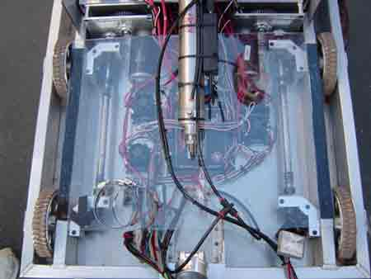
Standard 4-Wheel Drive Train
Gear Boxes (x 2)
Wheels (x 4):
Each pair of wheels has 1 gear box controlling it
Always all 4 on the ground
Turns are made by spinning two pairs of wheels in opposing directions
Courtesy: Chief Delphi Forums

Slide 31
DRIVETRAIN DESIGN
COMMON DRIVETRAIN DESIGNS:
6 WHEEL DRIVE
  MOST EFFECTIVE FORM OF WHEEL DESIGN.
  CENTER PAIR OF WHEELS SLIGHTLY LOWER THAN OTHERS
  THIS ALLOWS THE ROBOT TO ‘ROCK’ FORWARD AND BACKWARDS
  ROCKING ACTION GRANTS THE POWER OF A 4 WHEEL DRIVE WITHOUT THE DIFFICULT TURNING

Slide 32
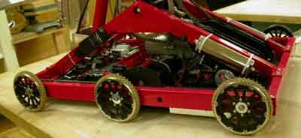
Six-Wheel (Cantilever) Drive
End Wheels (x 4):
Slightly smaller than center wheels
Always 2 on the ground, so 4 total wheels on the ground
Center Wheels (x 2):
Lowest to the ground
Always on the ground
Allow quick, 2-wheel turning
Courtesy: Chief Delphi Forums

Slide 33
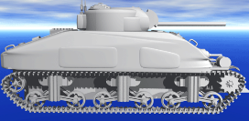
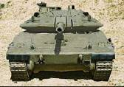
DRIVETRAIN DESIGN
COMMON DRIVETRAIN DESIGNS:
TREAD
  RARELY SEEN AT COMPETITIONS.
  GENERALLY NOT USEFUL AT FIRST COMPETITIONS.
  OFFERS EXTREME TRACTION AND A SMOOTH RIDE.
  COMBINED WITH A TORQUE-GEARED DRIVETRAIN CREATES, WELL, A TANK.
  OFFERS LOTS OF TRACTION, DUE TO HIGH SURFACE AREA (INCREASED CONTACT POINTS)

Slide 34
DRIVETRAIN DESIGN
COMMON DRIVETRAIN DESIGNS:
OMNIWHEELS
  OFFERS SOME CHARACTERISTICS OF SWIVEL
  BASED ON ‘OMNIWHEELS’, WHEELS WITH SMALL WHEELS ON THE SURFACE ROTATING PERPENDICULAR TO THE LARGE WHEEL.
  USES AND CHARACTERISTICS VARY WITH LAYOUT.
  OMNIWHEELS EXPENSIVE AND RATHER EXPERIMENTAL.

Slide 35
DRIVETRAIN DESIGN
COMMON DRIVETRAIN DESIGNS:
SWIVEL OR SWERVE
  DIFFICULT TO DESIGN PROPERLY; DEMANDS A HUGE AMOUNT OF RESOURCES.
  GENERALLY 4 WHEELS ABLE TO ‘SWIVEL’ TOGETHER.
  PROVIDES SPEED AND MANEUVERABILITY.
  ALSO RARELY SEEN; NOT PERFECTED YET.

Slide 36
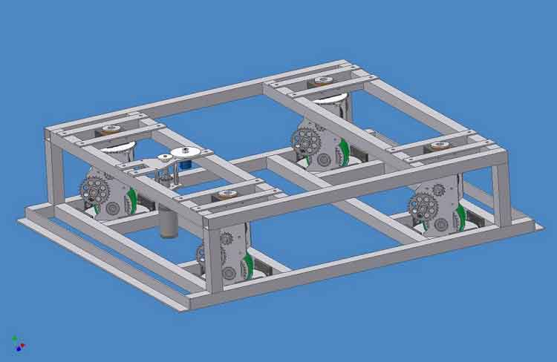
4-Wheel Swivel +Chassis
Chains
Swivel Module x 4
Courtesy: Chief Delphi Forums

