Slide 1
Engineering: Tools
MVRT
Season 2011-2012

Slide 2
Table Of Content
Screw Driver
Bosch
Allen Key
Drill
Drill Press
Wire Stripper
Crimper
Electrical Pliers
Soldering Iron
Zipties
Tape
Measuring Tape

Slide 3
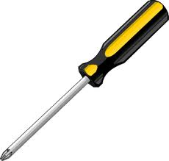
Screw Driver
Used to tighten flathead or “cross” screws

Slide 4
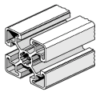
Bosch
Aluminum framing material
Use it to build the robot

Slide 5
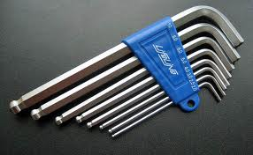
Allen Key
Used for socket cap screws or hex bolts.
5mm is the most common on our robot because it is used for Bosch.
If you hold the longer end with your hand you get more torque.

Slide 6
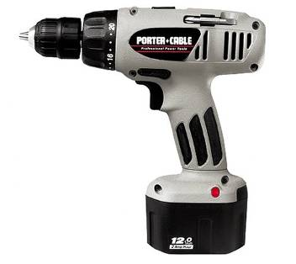
Drill
Useful for drilling holes, removing rivets, and tightening screw.
Use it when you don’t need accuracy as much.
Use mostly for wood avoid for aluminum and never use for steel.

Slide 7
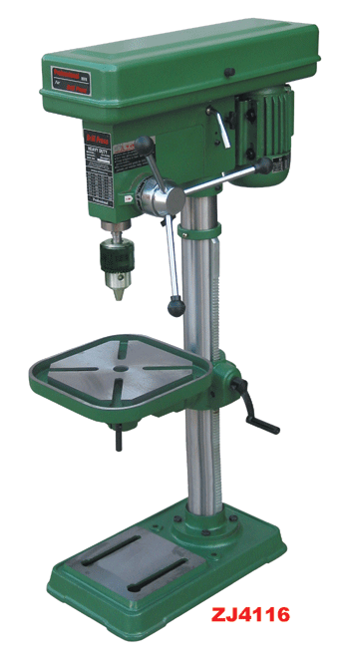
Drill Press
Useful for drilling holes
Use it for accurate holes

Slide 8
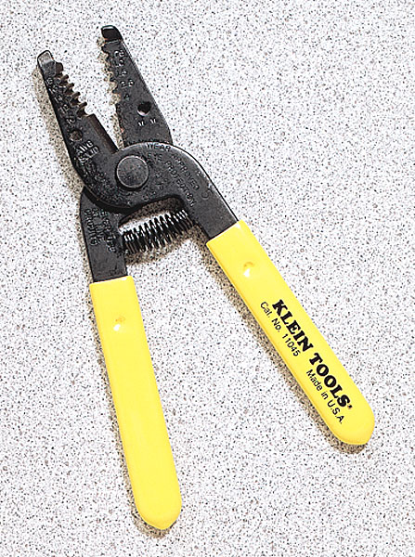
Wire Strippers
Wire Stripper – Strips wires
  Yellow handled wire strippers
  “Automatic” wire strippers with the wire cutter
  Red-handled wire strippers with specific gauge # (usually only for smaller sizes only)

Slide 9
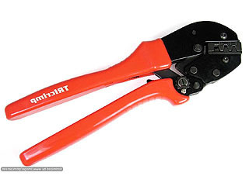
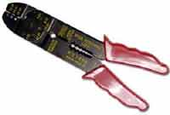
Crimper
Crimping – creating an electrical connection without using solder
  Ex. Connecting speed controller to power distribution board to pass on an electrical current
Crimping tools

Slide 10
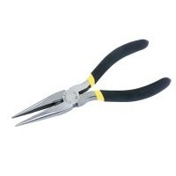
Needle nose Pliers
Used for cutting and gripping wire
Used to manipulate wires in cavities – wires stuck which can’t be reached with your fingers
Two sizes
  Longer
  shorter

Slide 11
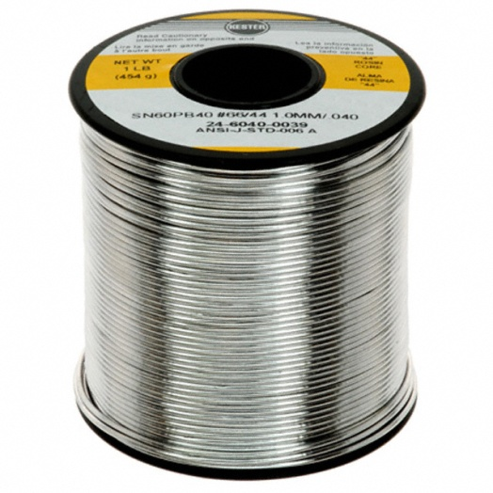
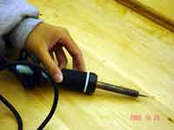
Soldering Iron
Soldering is joining metals by melting a metal with a low melting point (solder) and join metals (wire/terminal)
Creates an electrical and mechanical connection
Soldering Iron melts the solder
Solder
Soldering
Iron

Slide 12
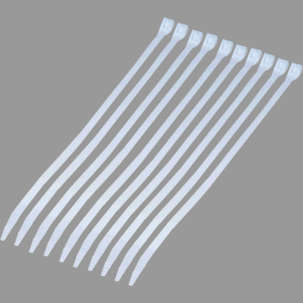
Zipties
Used to mainly keep wires in place.
Use for short term if it is on a mechanical component, but switch it out for the long run.

Slide 13
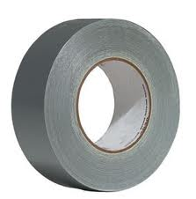
Tape
Use when prototyping
Try not to have any tape on the final robot.

Slide 14
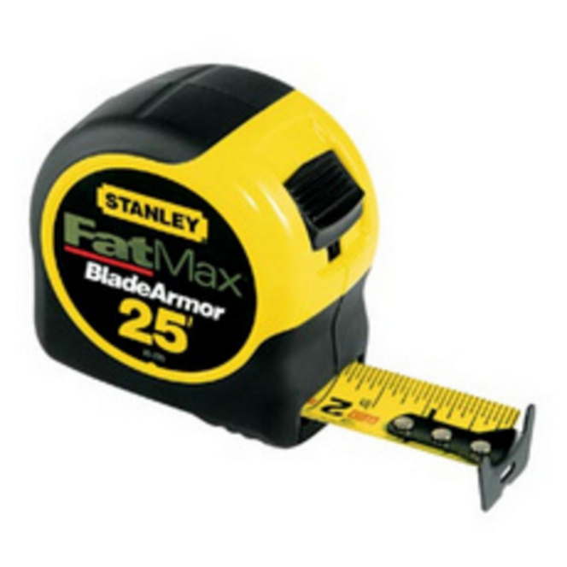
Measuring Tape
Used for inaccurate measuring
Use other forms of measurement for measuring accurate parts
  Calipers
  Smaller rulers

