Slide 1
Autodesk Inventor:
Part 2
Assembly
An assembly puts multiple parts together to show how each part is used in the design
PowerPoint by: Danica Chang

Slide 2
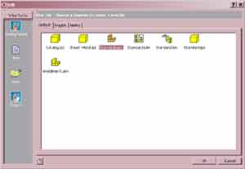

Creating an assembly
Press new
Open a new Standard.iam, then press OK

Slide 3
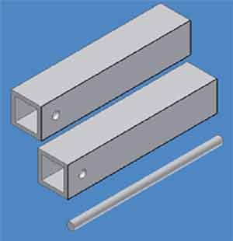
Adding Components
Press the button
located at the top of the left column
Find the part you created earlier and place as many of them as needed.

Slide 4
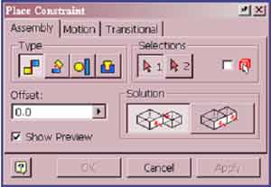
Constraints
The next step is to constraint the parts
  Press located near the top of the left column
  The type of constraint we use is called mate
Mate

Slide 5
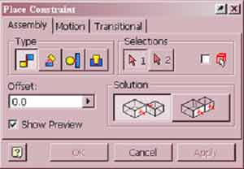
Constraints Continued
  There are two “Solutions”
    Mate: makes the selected planes face each other and coincide (they are become the same plane)
    Flush: makes the selected planes face the same direction and coincide
mate
flush

Slide 6
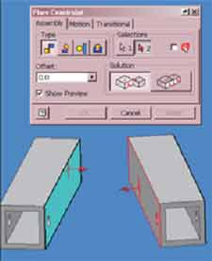
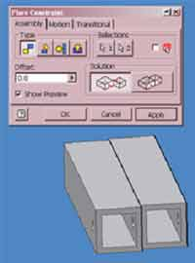
Constraints Continued
This is an example of a Mate
  Chose Mate or Flush from “Solutions”
  Click on the 2 planes you would like to mate (or flush)
  Be sure to press apply, or else your parts will move back to their original positions.

Slide 7
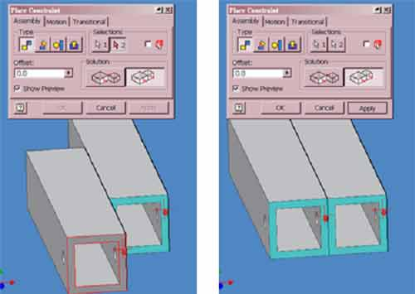
Constraints Continued… Flush
Don’t forget to press apply
Here is an example of a Flush constraint

Slide 8
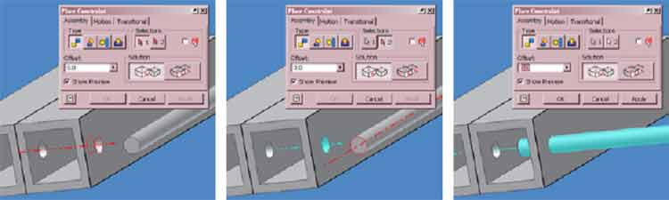
Constraining holes and rods
  To constraint things like holes and rods, use Mate
    Constraint the center axes of the rod and hole

Slide 9
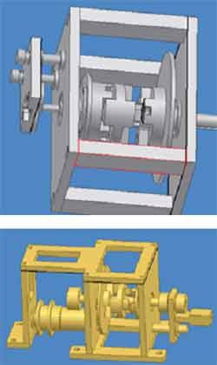
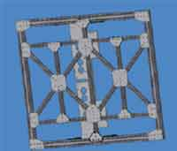
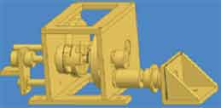
Once you are finished constraining the parts, and are ready to begin machining the parts, you need to create Drawings of the parts.
We will learn about Drawings in our next Inventor lesson

