Slide 1
Autodesk Inventor: Part 3
Creating a Drawing
Once a part has been finalized and fitted into the assembly, a Drawing needs to be made, so a diagram of the part can be printed to show how the part should be made.
PowerPoint by: Danica Chang

Slide 2
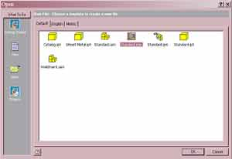

Creating a Drawing
Press new
Open a new Standard.idw, then press OK

Slide 3
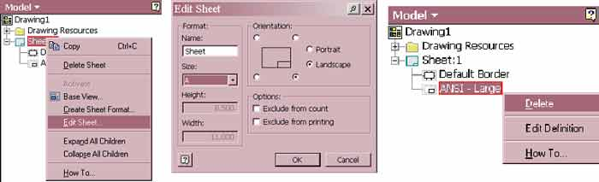
Formatting
Under model, in the lower left part of the screen, right-click “Sheet:1”
Then press “Edit Sheet…”
Change size to A, then press OK
Next, delete by right-clicking and pressing delete

Slide 4
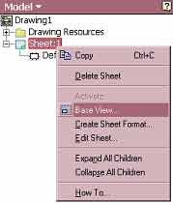
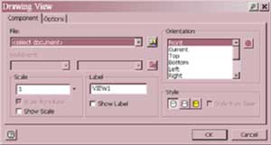
Insert Component
Find component
Pick an appropriate scale
Right-click “Sheet:1” again, and press “Base View…”
Find the component you want to make a drawing of.
Pick a scale that will allow the entire part to fit on the page
Then, press OK

Slide 5
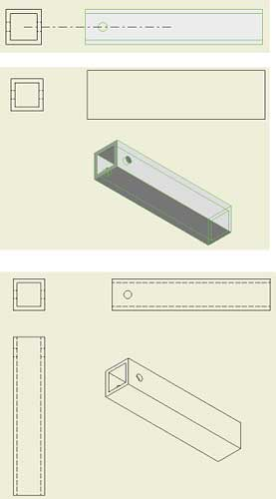
Projected View
Press on the upper left menu, then press your component.
Next move your mouse to where you want a different orientation of the part to be shown, and click.
Repeat for as many sides as necessary.
Then, right-click and press create

Slide 6


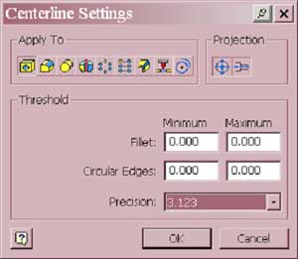
Centerline
Make sure both are pressed
If you have holes in your part, you need to draw centerlines
  Right-click on each view and press “Automated centerlines…”
  After changing the centerline settings, press OK
Precision should be to 3 decimal places

Slide 7
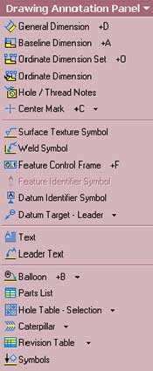

Baseline Dimensions
Press on the top left and switch to
Press
This tool allows you to display the dimensions of the part, measuring from one side.

Slide 8
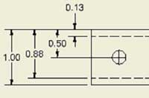
Baseline Dimensions
First click on a side you want to measure everything else from (an outer edge)
Then click on all the features you wish to measure from that edge.
Right-click and press continue
The dimensions should show up and simply left-click to designate where it should be placed

Slide 9

Hole Dimensions
Next use
to label the dimensions of the holes.
Make sure the tolerance is to 3 decimal places

Slide 10
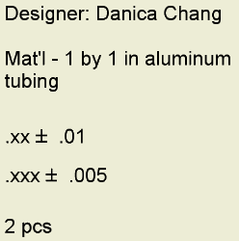
Description
Finally, add a description, which should include:
  The name of the designer
  Description of the part
  Material
  Tolerance
  Quantity
  Any other notes

Slide 11
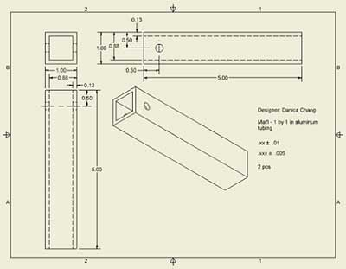
Your final drawing should look like this:

