Slide 1
Autodesk Inventor:
Part 1
Creating a Part
Inventor is used to design 3D models of the parts we design and allows us visualize what the robot will look like once it is build.
PowerPoint by: Danica Chang

Slide 2
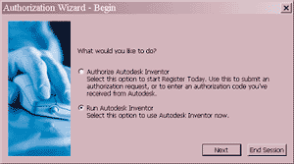
Getting Started
Open Inventor
Press Run Autodesk Inventor, then press Next

Slide 3
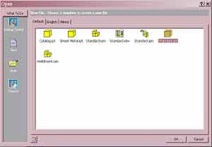

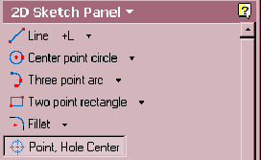
Creating a Part
To create a part, open a new Standard.ipt, then press OK
Create a 2D sketch of the part using the tools on the left hand side of the screen

Slide 4
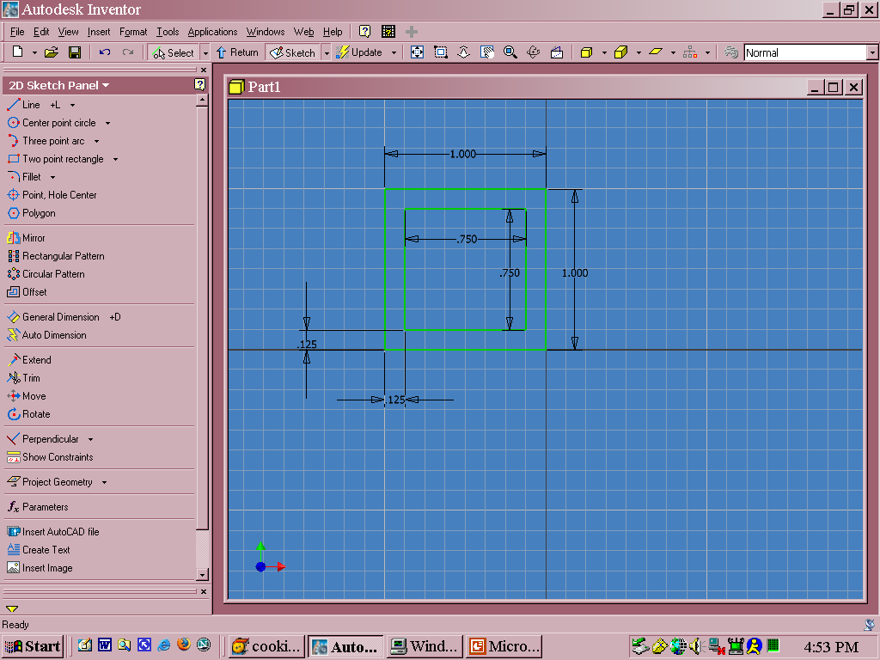
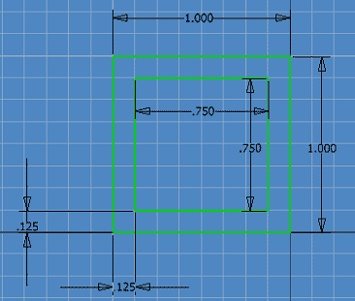
General Dimension
Using General Dimension, specify the length of each each component of the sketch
Once you are done, press the button at the top of the screen

Slide 5

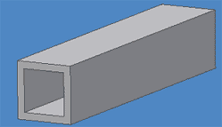
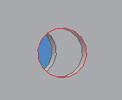
3D Mode
Now you are in 3D mode.
The 2 most useful buttons you will need to use are Extrude and Hole
  Extrude: adds depth to the sketch
  Hole: creates a hole

Slide 6
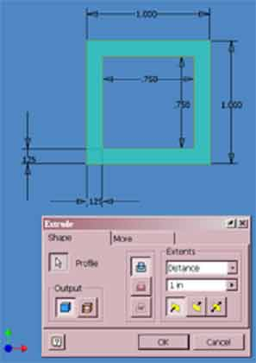
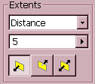
Extrude
To Extrude, press and highlight the portion of the sketch you would like to extrude.
Indicate the length and direction you want your part to extend
Then press OK
To rotate the part, press on the top of the screen

Slide 7
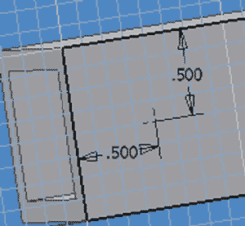
Hole
To make a hole, you must first make another sketch to place this feature on.
  Rotate to face the side you want to put a hole in
  Press and press the face that you want the sketch to be on.
  In the sketch, use to
  indicate where the center of the hole should be. (don’t forget to use )
  Once you are done with the sketch, press

Slide 8
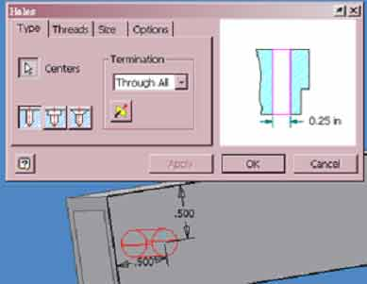
Hole continued…
Now press
Indicate which holes you would like to drill
Then determine length and diameter of the hole.
Press OK

Slide 9
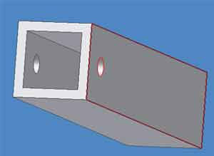
There are many other features that Inventor offers. Feel free to try all of the different tools. We have only covered the most frequently used tools.
In the next Inventor lesson, we will learn to put multiple parts together to create an assembly.

