Slide 1

Part I
Introduction to LabVIEW
MVRT
2011 – 2012 Season

Slide 2
Table Of Content
Programming
Labview
VI
Blank VI
Front Panel
Variables & Data Types
Controls Vs. Indicators
Block Diagram
Wires
Data Flow
Clean Up Wires
Putting It Together
Debugging
Activity

Slide 3
Programming
Programming
writing a computer program using a computer language
Simile
as verbal languages tell people what to do
computer languages tell computers what to do
as verbal languages are spoken ,
computer languages are programmed .

Slide 4
Labview
LabVIEW
“laboratory virtual instrumentation engineering workbench”
graphical programming software
Simile
a software like Word

Slide 5
Opening Labview
Opening labview
Find correct version of labview
Use search bar if needed
Open

Slide 6
VI
VI
virtual instruments
the document in which you program
has a front panel and a block diagram
Simile
a document in word

Slide 7
Blank VI
Blank VI
Open labview
Click “blank vi” in upper left under “new”

Slide 8
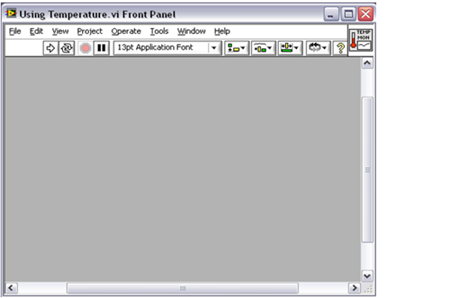
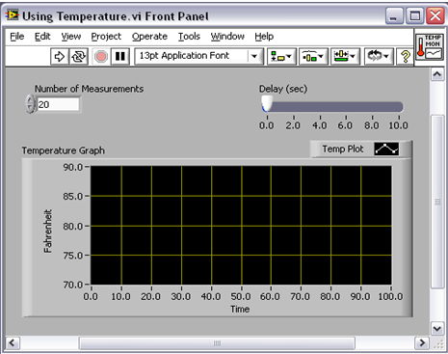
Front Panel
Front panel
user interface (where users interact with the program)
Simile
keys on a keyboard

Slide 9
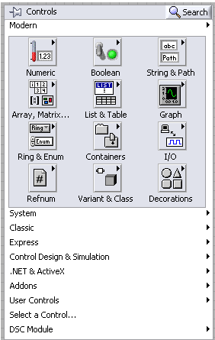
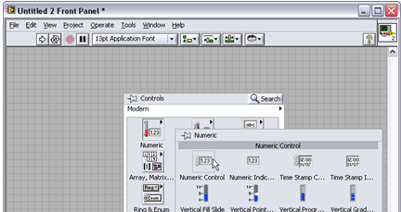
Front panel
Control Palette
contains inputs and outputs
find: right click front panel
Simile
contains possible keys for a keyboard

Slide 10
Variables and Data Types
A variable has an unchanged name [fido] and it always holds a value of the same data type [dog].
However the value [breed] is changeable.
The value [breed] of a dog may be accessed by calling the variable’s name [fido].

Slide 11
Data Types
Int
  Integer
  Blue in LabVIEW
Double/Float
  Decimal number
  Red in labVIEW
Boolean
  True/False
  Dashed in Labview
String
  String of Characters: letters/number/symbols

Slide 12
Controls vs. Indicators
Controls
Indicators
A control allows for data input (changing the value of the variable)
Examples
- Typing into an editable text box
- Turning the knob
- Flipping the switch
An indicator displays the output (accessing the value of the variable)
Examples
- a read-only text box
- a graph
- an on/off light

Slide 13
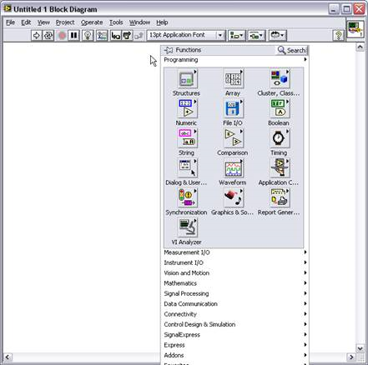
Block Diagram
Block Diagram
programming interface
Simile
contains what happens when a key on a keyboard is pressed
Functions Palette
contains elements for programming
Find: right click
Simile
contains pieces behind the keyboard

Slide 14
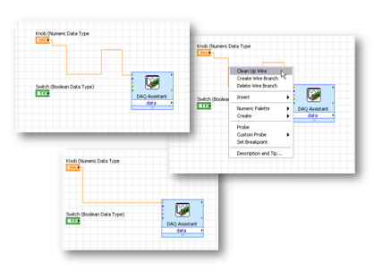

Wires
Wires
connect an input and output
Simile
connect the dots
Broken wire
input and output are not of the same data type
Simile
can’t add 1+a ← broken
can add 1+1 ← connected
Broken wire

Slide 15
Data flow: Left → right
Labview functions (ex. Addition) accept input from the left and output to the right
Right and write labview as you read and write english

Slide 16
Clean up wires
Cleaning up wires
Process: 1. right click
2. “clean up wires”

Slide 17
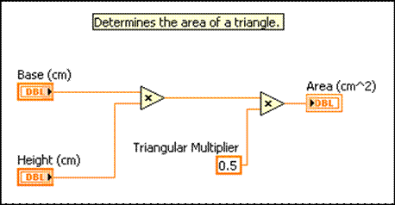
Putting it together
Inputs
variable
Integer
Wire
Output
integer

Slide 18



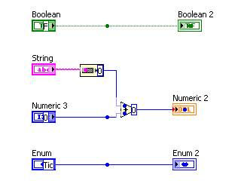
Debugging
Debugging
finding & fixing problems
how: highlight execution & run
tips: keep code neat & organized

