Slide 1
ENGINEERING
Electric Motors
Engineering
MVRT
10-21-2006

Slide 2
WHAT IS A MOTOR?
A motor generates rotational motion.
Conventional motors use chemical or electromagnetic and electric PE.
ie: Car engines (motors) burn gasoline to turn wheels.

Slide 3
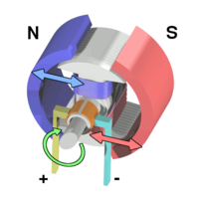
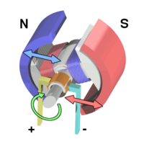
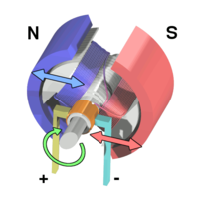
THE ELECTRIC MOTOR
An electric motor uses electric energy.
Electromagnets
Magnet
Magnet
Armature
A simple DC motor. Current flow generates an EMF around the armature.
The armature continues to rotate.
Once it has reached the zero position, the current is reversed and the process repeats.

Slide 4
ROTATIONAL MOTION
Rotational motion has two components.
TORQUE
SPEED
Torque is the force of the rotation.
Speed is the rate of rotation.

Slide 5
POWER
Power describes energy over time in Watts (W).
There are two power equations that deal with electric motors:
ELECTRIC
ROTATIONAL
P=IV
P=TV
Power = Current times Voltage
Power = Torque times Speed

Slide 6
ELECTRIC POWER
Power = Current times Voltage
P=IV
Voltage is difference in charge, or potential.
V
Volts
V
I
Current is the quantity of electrons moving over time.
Amps
A

Slide 7
ROTATIONAL POWER
Power = Torque times Speed
P=TV
Torque is the force of the rotation.
T
Newton-meters
Nm
V
Speed is the rotations per unit of time.
RPM
Rotations per Minute

Slide 8
MOTOR CHARACTERISTICS
Electric motors behave with certain characteristics.
P
T
V
V
P
As the armature of the motor turns, it generates backward current.
With no load and constant voltage, motors output a certain rpm.
With maximum load and constant voltage, the motor outputs a certain torque.
The graph of the relationship between torque and rpm looks like this.
Thus, the faster the motor turns, the greater its resistance to current flow.
Even as you put in a huge amount of power, the graph begins to flatten out.
At these high power inputs, most of the energy is converted to heat.
This is the maximum speed of the motor at this voltage.
Here is the graph of power vs. speed.
At low speed, you either have low power or high power.
At those points, you have either low torque or high torque.
To find the best power output of a motor...
We take our real torque vs. speed graph...
This is always halfway between the two extremes.
The torque at this point is called the max power torque.
The speed at this point is called the max power rpm.
And find when their product is greatest.
This is the maximum torque at this voltage.
Ideally, the graph should look like this.
At any point, the product of T and V is the same.
This is the graph of speed versus power.
However, in reality, the power is not constant.
At this point, the motor is most efficient.
This is called the free load rpm.
This is called the stall torque.

Slide 9
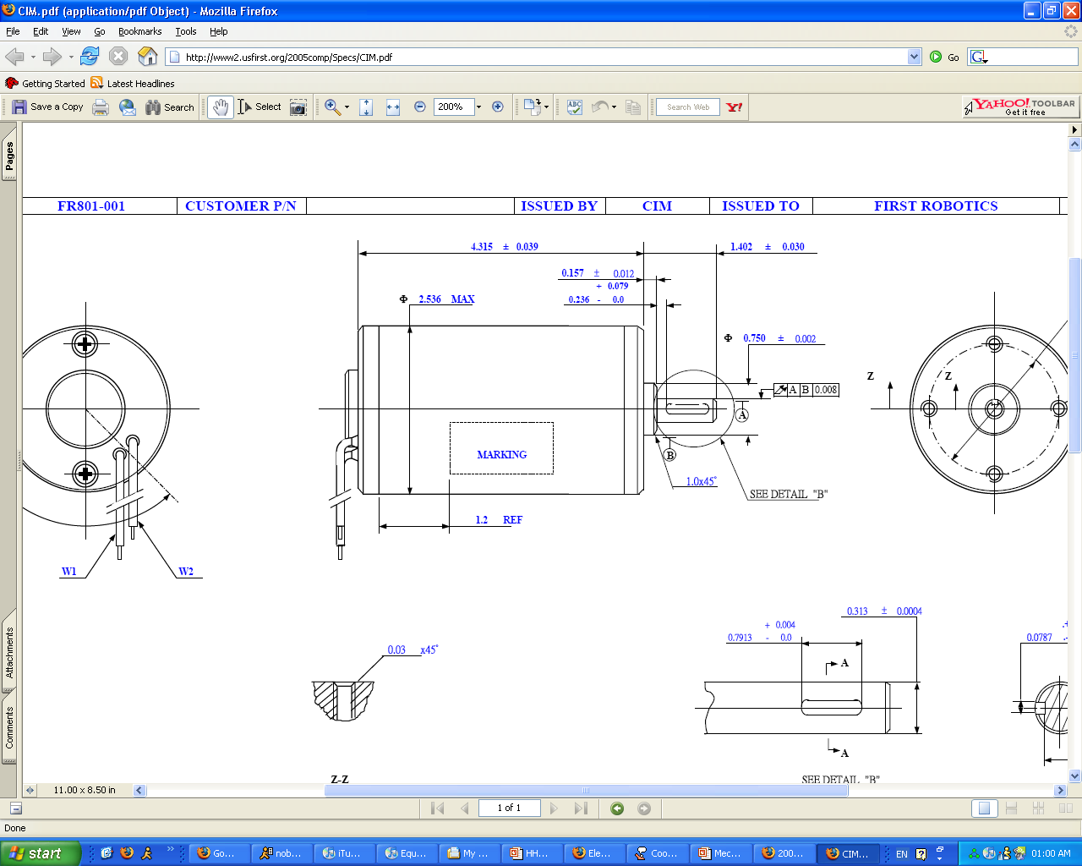
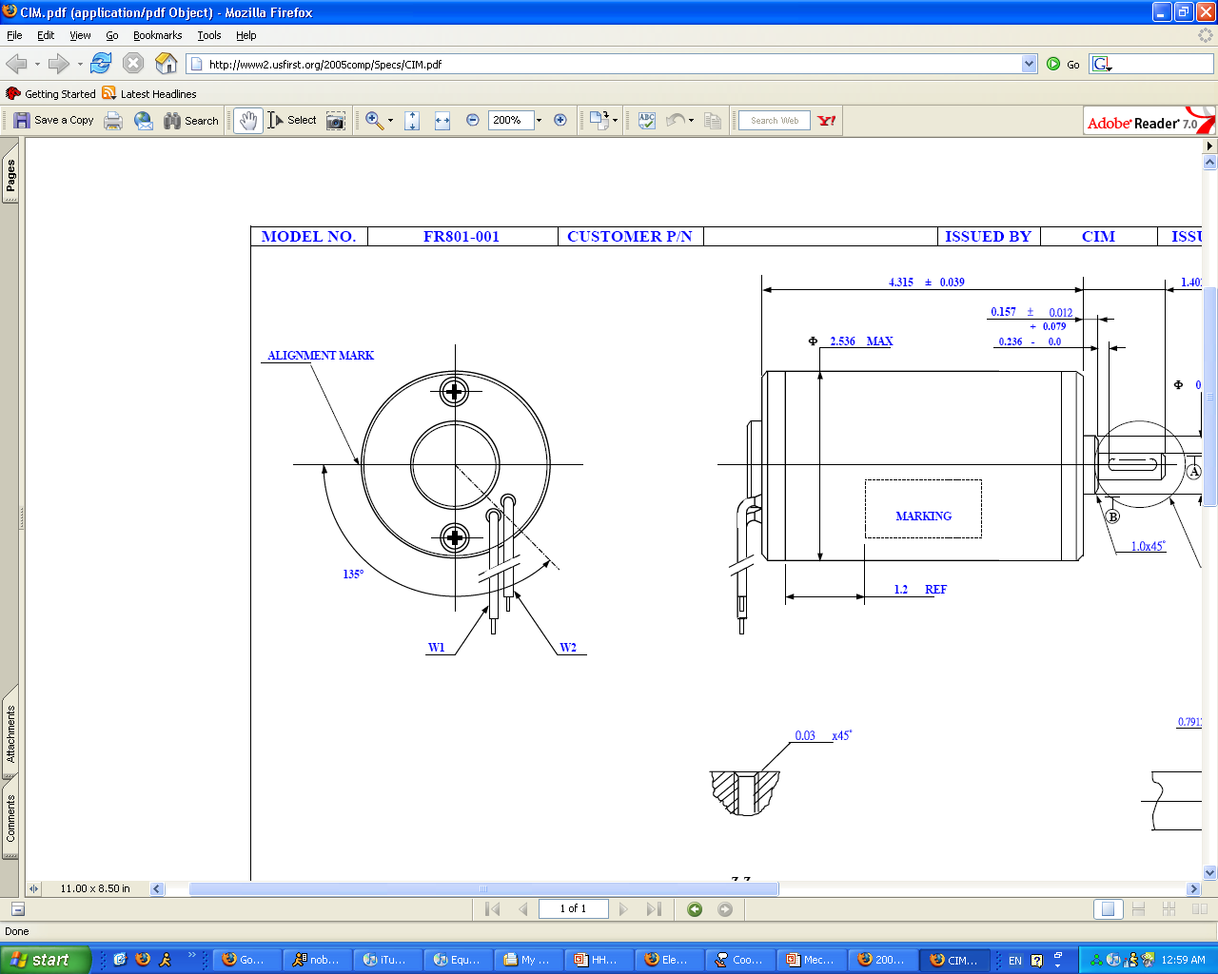
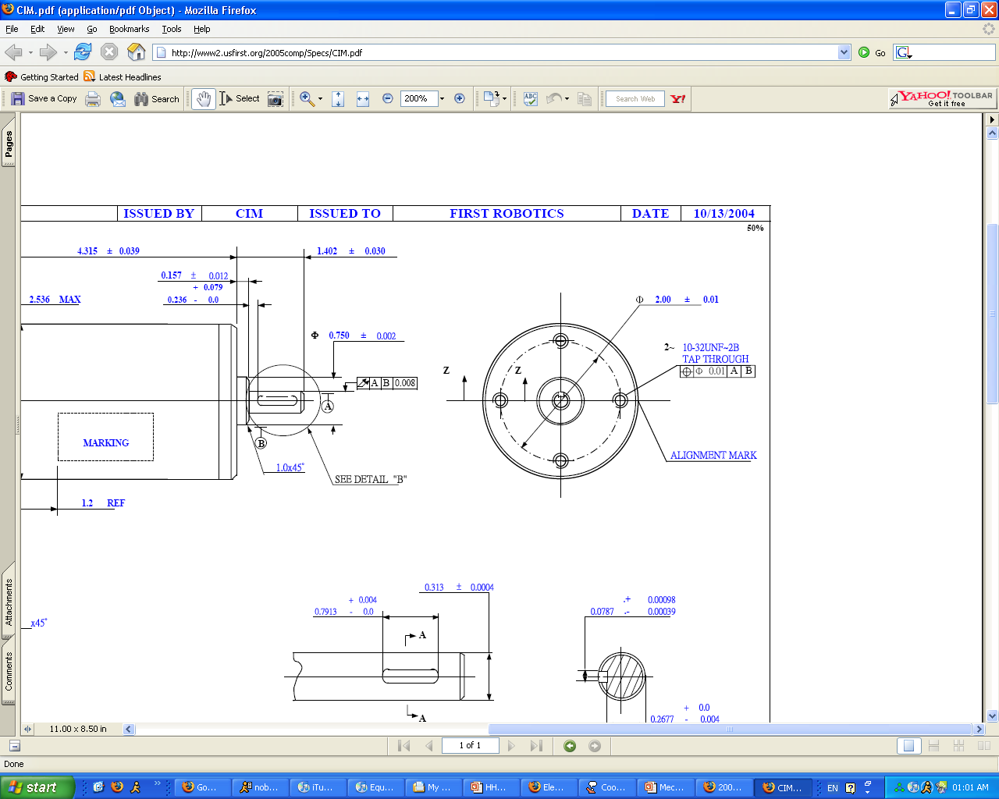
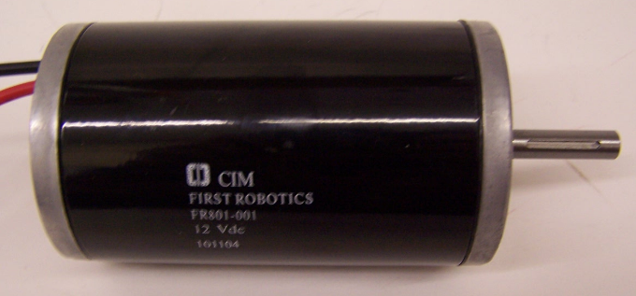
THE CIM
Power Output:
343 Watts
Free RPM:
5310
Stall Torque:
343.4 oz-in
Ideal for long running times.

Slide 10
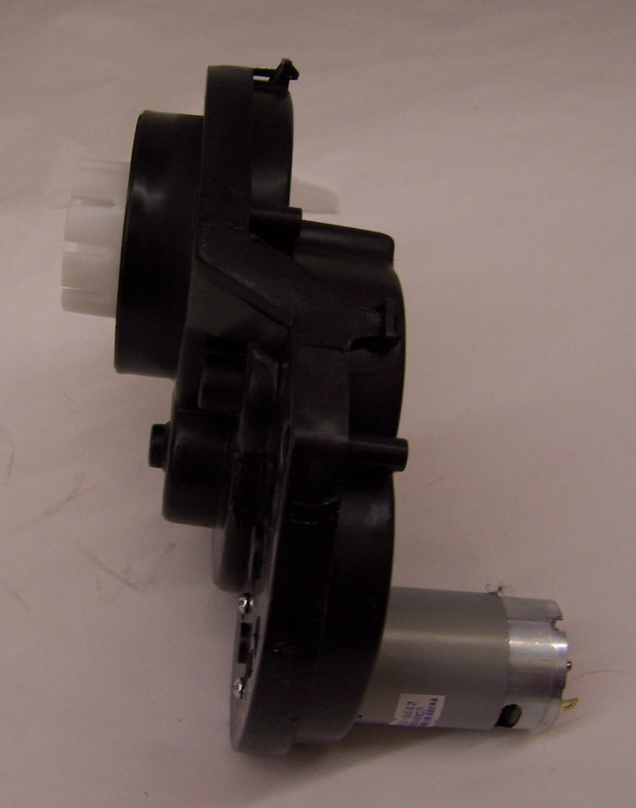
THE FISHER PRICE
Power Output:
387.5 Watts
Free RPM:
126
Stall Torque:
51.79 Nm
Hi power, but suited for medium loads due to plastic gears.

Slide 11
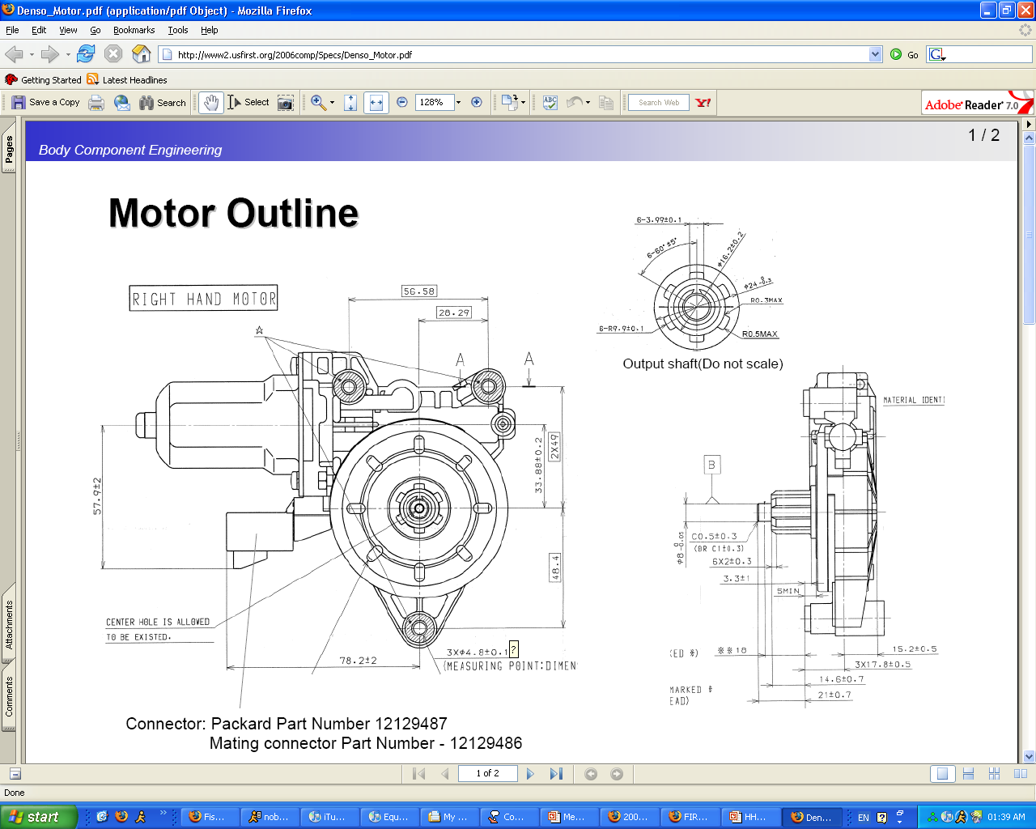
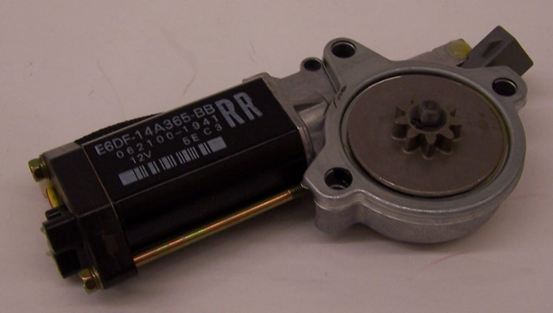
THE WINDOW
Power Output:
22 Watts
Free RPM:
84
Stall Torque:
10.6 Nm
Useful for preventing backdrive.

Slide 12
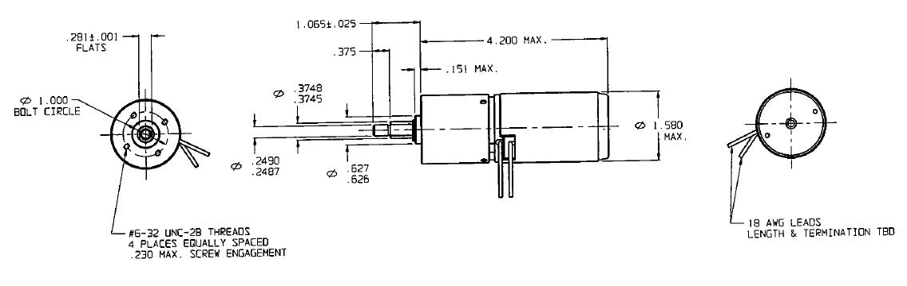
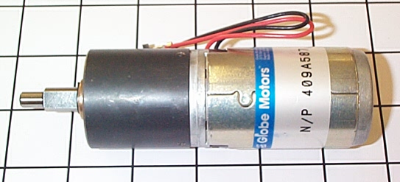
THE GLOBE
Power Output:
55 Watts
Free RPM:
81
Stall Torque:
150 in-lb
Low power motor for low-medium load applications.

Slide 13
THE MABUCHI
Power Output:
16.8 Watts
Free RPM:
4700
Stall Torque:
60.8 mNm
Counterclockwise rotation with additional spur gear.
Sadly, the Mabuchi was not around when motor photos were being taken.
Nobody missed it.

Slide 14
ENGINEERING
Electric Motors
By Humphrey Hu
Photographs from Wikipedia, USFIRST
You may not modify this Powerpoint without permission

