Slide 1
Intro to Pneumatics
Presented by Jon Pannell

Slide 2
Lesson Breakdown:
Part One: Lecture covering:
    What are Pneumatics
    What is a “system” and what is it made of
    Applications
    Advantages and disadvantages
    Calculations with Pneumatics
Part Two: Hands on lab and experimentation

Slide 3
What are Pneumatics?
Pneumatics is a type of power transmission that uses a gas ( in our case, air) and pressure differential to create movement.
Akin to Hydraulics, hydraulics use oil, water, or other fluids instead of gases.

Slide 4
The Pneumatics System:
A “System” is a complete set of parts working together.
Our systems usually contain :
    A compressor
    Storage tanks
    Regulators
    Gauges
    Valves and solenoids
    Actuators
    Fittings and tubing

Slide 5
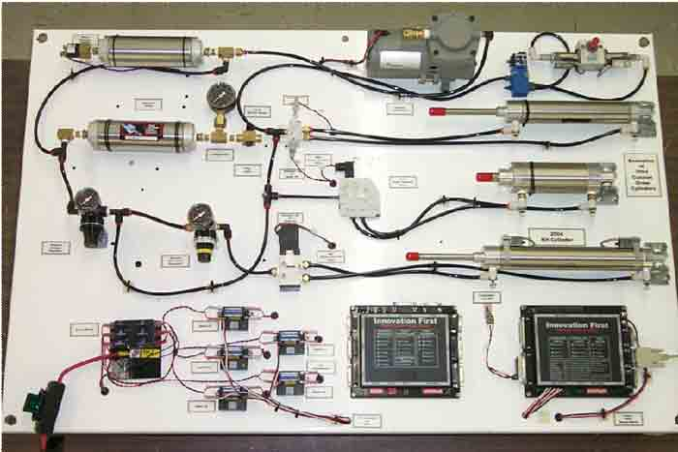
The Pneumatic “System”

Slide 6
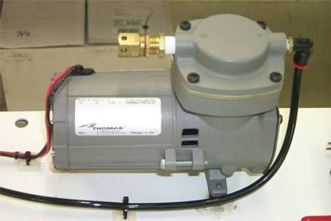

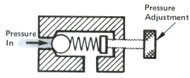
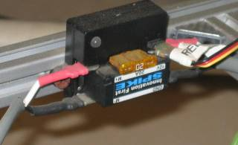
Parts of the “System” Pt.1
The compressor:
  Heart of the system.
  Converts electrical energy to pneumatic potential.
  Contains a relief valve protects compressor and system from overload
  Controlled by a Spike relay

Slide 7
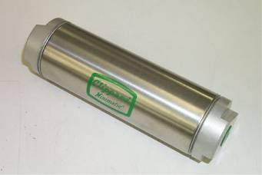
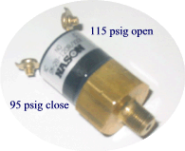
Parts of the “System”: Pt. 2
Air tanks:
Stores pressure to activate actuators
Our robots can have up to 2 (included in the KOP)
Pressure Switch:
Used to signal Robot Controller when to turn on and off compressor

Slide 8
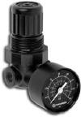
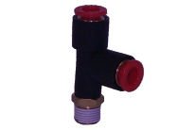


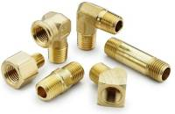

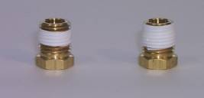
Parts of the “System”: Pt. 3
Regulators:
Adjust pressure output to working levels for actuators
2 types :
  Relieving and Non- Relieving
Fittings:
Quick release and pipe thread.
Pipe thread requires Teflon tape

Slide 9
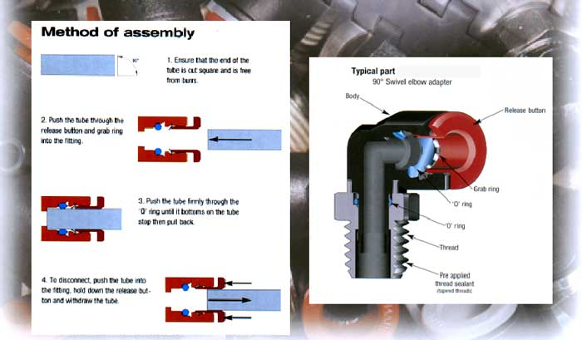
Fittings
Connection and Disconnection

Slide 10
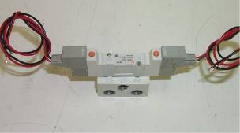
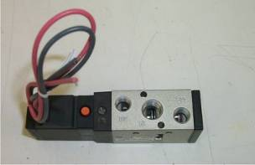
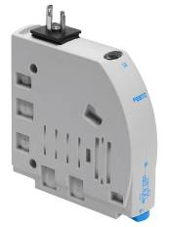
Parts of the “System”: Pt. 4
Valves and Solenoids:
Used to control actuators
Types:
  Double Solenoid (detented)
  Single Solenoid (spring offset)

Slide 11
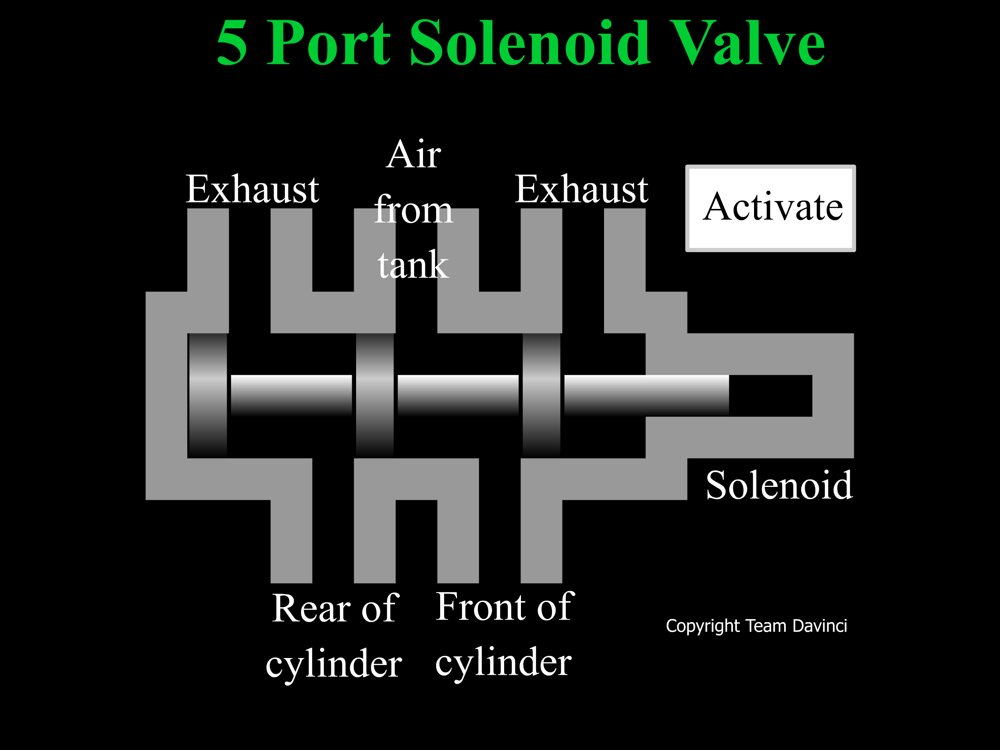

Slide 12

So, how do we hook up a solenoid?

Slide 13
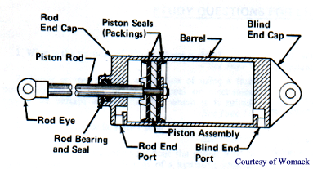
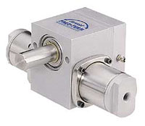
Parts of the “System”: Pt. 5
Actuators
  Linear – Often called cylinders – can be made to perform complex motions by using mechanical components
  Rotary
    Limited Rotation
      Self-contained
      Rack and pinion or lever
    Air Motors or turbines
  Clamps

Slide 14
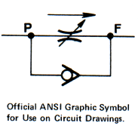
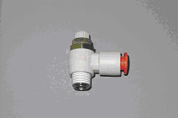
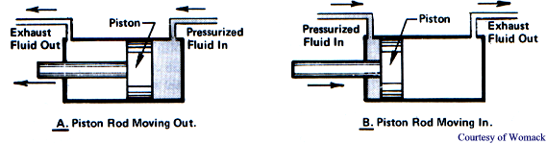
Actuators
Operation with Flow Controls
Typically Flow Controls are mounted between the valve and the cylinder as close to the cylinder as practical.
The check valve permits free flow into the cylinder from the valve and metered flow from the cylinder to exhaust
Operation

Slide 15
Advantages of Pneumatics
Complete kit
Weight
equal or lighter than comparable alternatives
Simple
  Review the manual that
  comes with the pneumatic kit
  and you’re ready to go
Strong
Force from 9 lbs to 180 lbs – easily adjustable
Adjustable Force
  Different bore cylinders change the available force
  and
  By adjusting the applied pressure you can instantly adjust the force
Durable
No burned up motors – stall with no damage
Easy to expand once installed

Slide 16
Disadvantages for Pneumatics
Initial weight cost is high ~15lbs
Requires fine tuning for optimum use
Limited uses with larger actuators

Slide 17
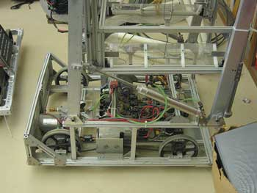
Applications
Pneumatics are good for straight movements, but, with the right linkage can be used for rotation or other movements.

Slide 18
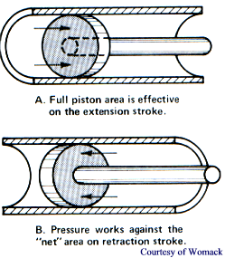
Calculations:
Output force is determined by:
  Bore or diameter
  Pressure over ambient
Cylinder Force
  Push Force = π x cylinder radius² x Pressure (psig)
  Pull Force = Push Force - π x rod radius² x Pressure (psig)

Slide 19
Tips & Tricks
Minimize Leaks (better yet, remove them completely) by careful use of teflon tape and careful assembly of tubing and fittings. Teflon tape should start two threads back and wrap in the direction of the threads.
With no movement taking place the compressor should charge the tanks and then shut off. It should not restart until a valve and cylinder is operated
Use the Compressor Vibration Isolators. The Compressor is a reciprocating device and will cause sympathetic vibrations throughout your assembly unless they are used.
When ordering custom cylinders, use extreme care on the form, both on the address and models ordered

Slide 20
Tips & Tricks
Pressure Switch must be used as inputs to the controller. They cannot handle the amperage of the compressor.
The Norgren Regulator should be first with the Monnier unit used after that if needed.
Make sure you have adequate pilot pressure (30 psi) for the valves.
When using the double solenoid valve, energize only coil one at time.
Fittings are not required in the exhaust ports unless the circuit requires them.
Always stay clear of cylinders in motion. Until compressed air is being metered, flow controls do little to control speed.
Download additional copies of the pneumatic manual from www.PneumaticsFIRST.org

Slide 21
Resources:
First Pneumatic Presentation 2004
http://www.bimba.com/products/prod7.htm
http://www.teamdavinci.com/understanding_pneumatics.htm

