Slide 1
Tools
MVRT
2011-2012 Season

Slide 2
Overview
Design
  Combination Square
  Caliper
Fabrication
  Hacksaw
  File
  Drill
  Sandpaper/Steel Wool
  Shears
Assembly
  Allen Key
  Wrench and Adjustable Wrench
  Screwdriver
  Ratchet
  Riveter
  Tape
  Ziptie

Slide 3
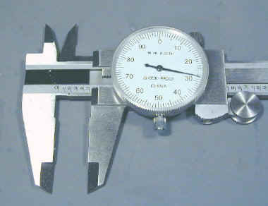
Caliper
Used for precise measurement up to the ten-thousandths place
Useful for measuring shaft and hole diameters
Also use to figure out tolerances more precisely

Slide 4
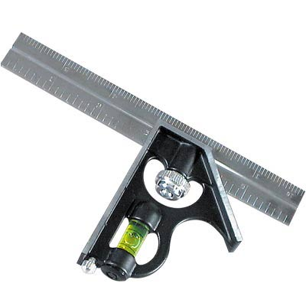
Combination Square
The combination square is used to measure to the the tenths and also used to make sure that surfaces are level
Can be used to see if a surface is level.

Slide 5
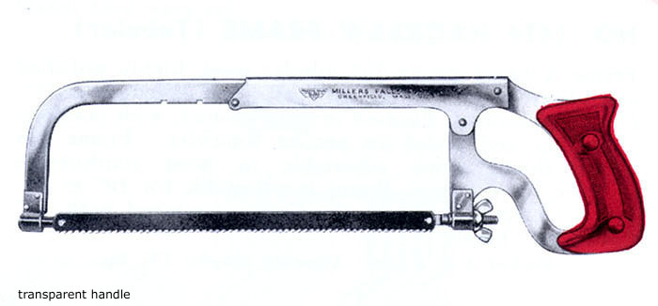
Hacksaw
Use when accuracy is not an issue
Very “crude” cut and not used unless necessary
Always push away from you. Never two directional motion.

Slide 6
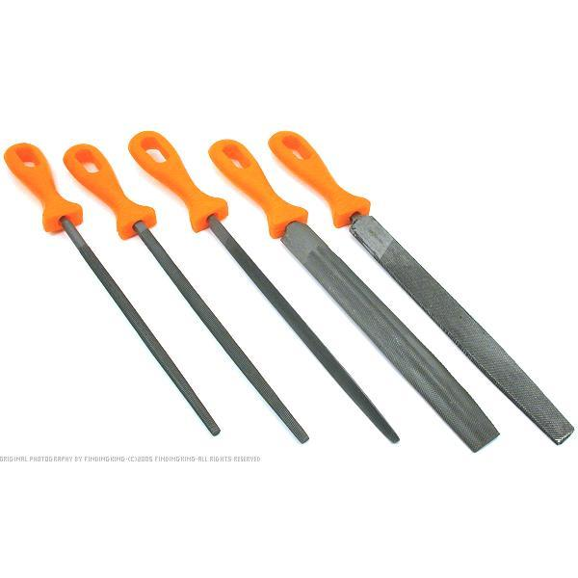
File
Smooth out edges
Use to “make stuff fit”
One directional motion similar to hacksaw

Slide 7
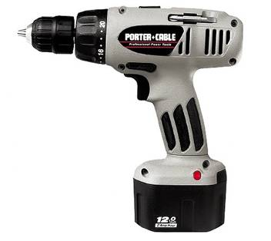
Cordless Drill
Useful for drilling holes, removing rivets, and tightening screw.
Use it when you don’t need accuracy as much.
Use mostly for wood avoid for aluminum and never use for steel.

Slide 8
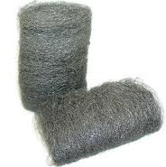
Sandpaper/Steel wool
Used sandpaper on wood to smooth out edges
Use steel wool to polish surfaces
You can use it partially to “make things fit”

Slide 9
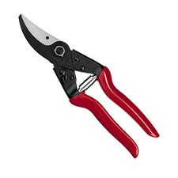
Shears
Use these to cut polycarb
There are three different types one to cut to the right one to cut to the left and one for a straight cut.
Very rough cut
Not for precision

Slide 10
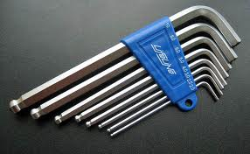
Allen Key
Used for socket cap screws or hex bolts.
5mm is the most common on our robot because it is used for Bosch.
If you hold the longer end with your hand you get more torque.

Slide 11
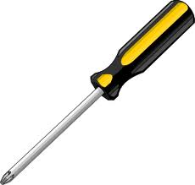
Screwdriver
Used to tighten flathead or “cross” screws.

Slide 12
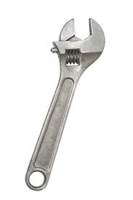
Wrench/Adjustable Wrench
Used to tighten nuts on bolts.
Use the correct size when possible rather than using the adjustable wrench all the time.

Slide 13
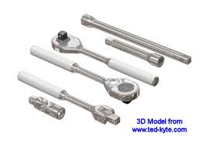
Ratchet
Ratchet has the same function as the wrench but easier in some situations.
Use it when you don’t have too many degrees of freedom because it is easier to tighten.

Slide 14
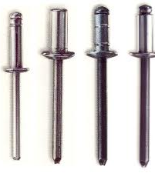
Rivet
A piece used to connect two pieces of metal by clamping them together.
They are useful when they are properly done.
Use aluminum rivets because they are easier to take out.

Slide 15
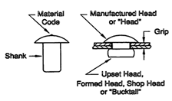
Rivet (cont.)
Consists of several parts: the shank the “Head” and the pin.(seen on the previous slide)

Slide 16
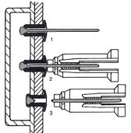
Rivet (cont.)
The metal pin is taken out and with it the other end of the rivet is crushed to clamp the pieces of metal together.

Slide 17
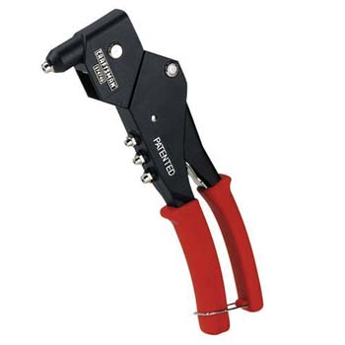
Riveter
The tool used to take the pin out of a rivet and clamp it to an object.
To take out a rivet you have to drill out the shank of the rivet. (see previous diagram)

Slide 18
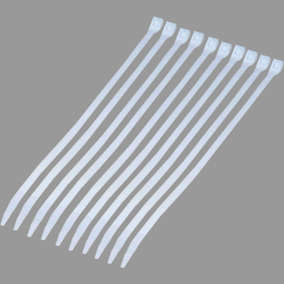
Zipties
Used to mainly keep wires in place.
Use for short term if it is on a mechanical component, but switch it out for the long run.

Slide 19
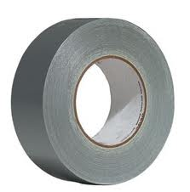
Tape
Use when prototyping
Try not to have any tape on the final robot.

