Slide 1
Wiring
MVRT
2010 – 2011 Season

Slide 2
Table of Contents
Wire stripping
Crimping
Soldering

Slide 3
Basic Wiring Principles
Color convention for insulation (according to rules)
  Power = red, white, brown
  Ground = black, brown
Use right size (gauge/diameter) cables
  Big wire = smaller gauge = more current
  Gauge is inversely proportional to size
Basic types
  Solid – single wire
  Stranded – multiple smaller wires twisted together
  Jacketed – multiple insulated wires with an outer cover

Slide 4
Basic Wire Stripping

Slide 5
tools
Wire Stripper – many kinds
  Yellow handled wire strippers
  “Automatic” wire strippers with the wire cutter
  Red-handled wire strippers with specific gauge # (usually only for smaller sizes only)
Wire
  Black/Red or PWM cable
  Gauge 8, 10, 12, etc. – depends on purpose

Slide 6
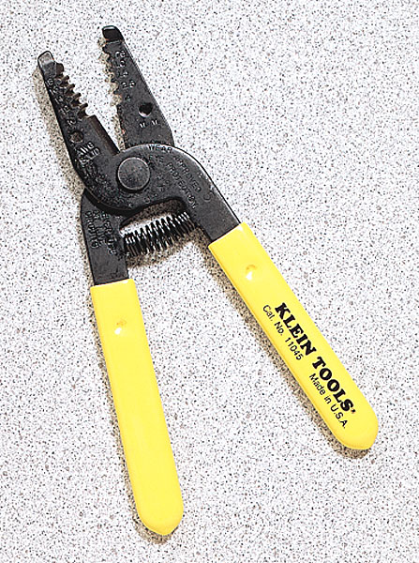
Wire strippers
Yellow handled wire strippers

Slide 7

Wire Strippers
“Automatic” wire strippers with wire cutter

Slide 8
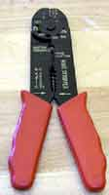
Wire Strippers
red-handled ones
with gauge listings

Slide 9
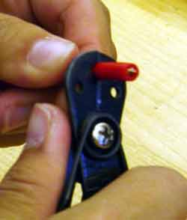
Instructions
yellow handle
usually used for larger gauges (ex. 16-24)
Think about how much you need/want
Squeeze the wire stripper around the wire where you want to start to strip off the insulation
Note: Yellow handled wire stripper not pictured but correct motion

Slide 10

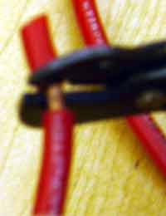
Instructions
yellow handle
Keep rotating wire and squeezing until you can begin to see the wire
Grip the insulation of the part that you want to strip off and pull off carefully
Note: Yellow handled wire stripper not pictured but correct motion

Slide 11
Instructions
Automatic wire strippers
usually for the larger smaller (ex. 12, 16)
Slip the wire into the slot
Squeeze the handle so that the wire stripper blade pulls off the insulation
Note: if the wire is too small, not only will the insulation come off, but some of the wire will break off as well

Slide 12
Instructions
Red handle
for the larger gauges (ex. 20, 24)
Find the gauge number on the wire stripper
Put the wire into the hole
Squeeze and pull away with a horizontal motion
Note: will most likely work better for smaller wires than the “automatic” one

Slide 13
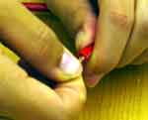

instructions
Be sure to twist the wires
When you finish stripping the wire, it should look like this

Slide 14
Crimping

Slide 15
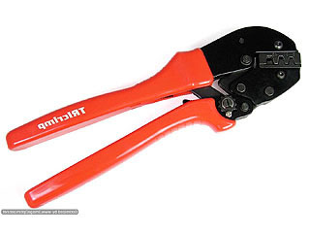
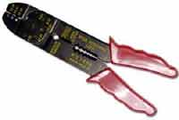
What is crimping
Crimping – creating an electrical connection without using solder
  Ex. Connecting speed controller to power distribution board to pass on an electrical current
Crimping tools

Slide 16
Materials Needed
Crimper
  Type of crimper depends on the crimp being used which depends on purpose
  For motors we use small powerpole connectors
Crimps
Wire – depends on connection

Slide 17

Crimpers
blue-handled ones with insulation colors listed

Slide 18
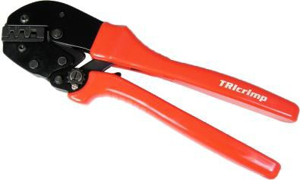
crimpers
Anderson Power pole crimper

Slide 19


Crimps
Male
Female
to connect two wires, crimp a female crimp on the end of one wire and the male crimp on the end of the other wire

Slide 20
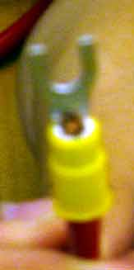
Instructions
Strip the wire according to the type of crimp (generally about 1 cm)
Push the wire into the circular tube of the crimp from the bottom

Slide 21
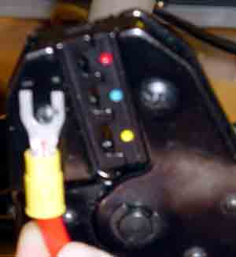
Instructions
Stick the crimp and wire between the two sides of the crimper
Be sure that the crimper is on the front part of the crimp

Slide 22
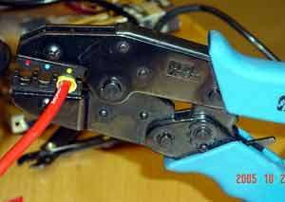
Instructions
Push the handles of the crimper together until the crimp is flattened out
Pull the wire and crimp in opposite directions to check whether or not it is fully crimped

Slide 23

insructions
This is what the wire should look like when after it has been crimped

Slide 24
soldering

Slide 25
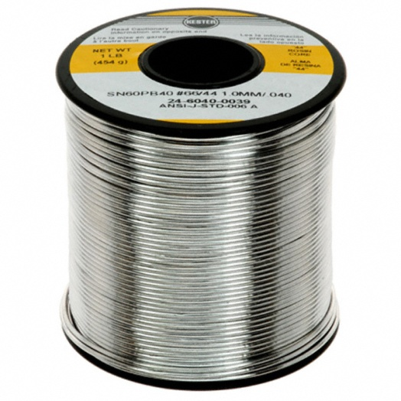
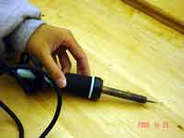
Solder & iron
Soldering is joining metals by melting a metal with a low melting point (solder) and join metals (wire/terminal)
Creates an electrical and mechanical connection
Soldering Iron melts the solder
Solder
Soldering
Iron

Slide 26
soldering
Plug in the soldering iron and heat up
Touch the soldering iron to the wire or terminal and touch the solder in a different place
Wait for solder to melt
  Note: solder and soldering iron should not touch because the heat transfer should melt the solder
Clean soldering iron occasionally if too much solder get on it
Use solder sucker if too much solder is applied to the connection surface

Slide 27
Crimping vs. Soldering
Crimping
Faster/easier
Better for use with larger wire → takes too long too heat wire up to melt solder
Quick fix
Soldering
More reliable when done properly
More rigid
Stronger than a crimp
Preferable
Better connection
Lower resistance
Easier to determine whether connection is good or bad

